Slide 1
BigData project
Event reporting application

Slide 2
Event reporting application
Backend server – Flask, PostgreSQL
Web application – Next.js
Mobile application (Android) – React Native
Event streaming – Apache Kafka
Real-time processing & analytics – Apache Spark
Auxiliary services – Firebase (media storage), Google Maps API

Slide 3
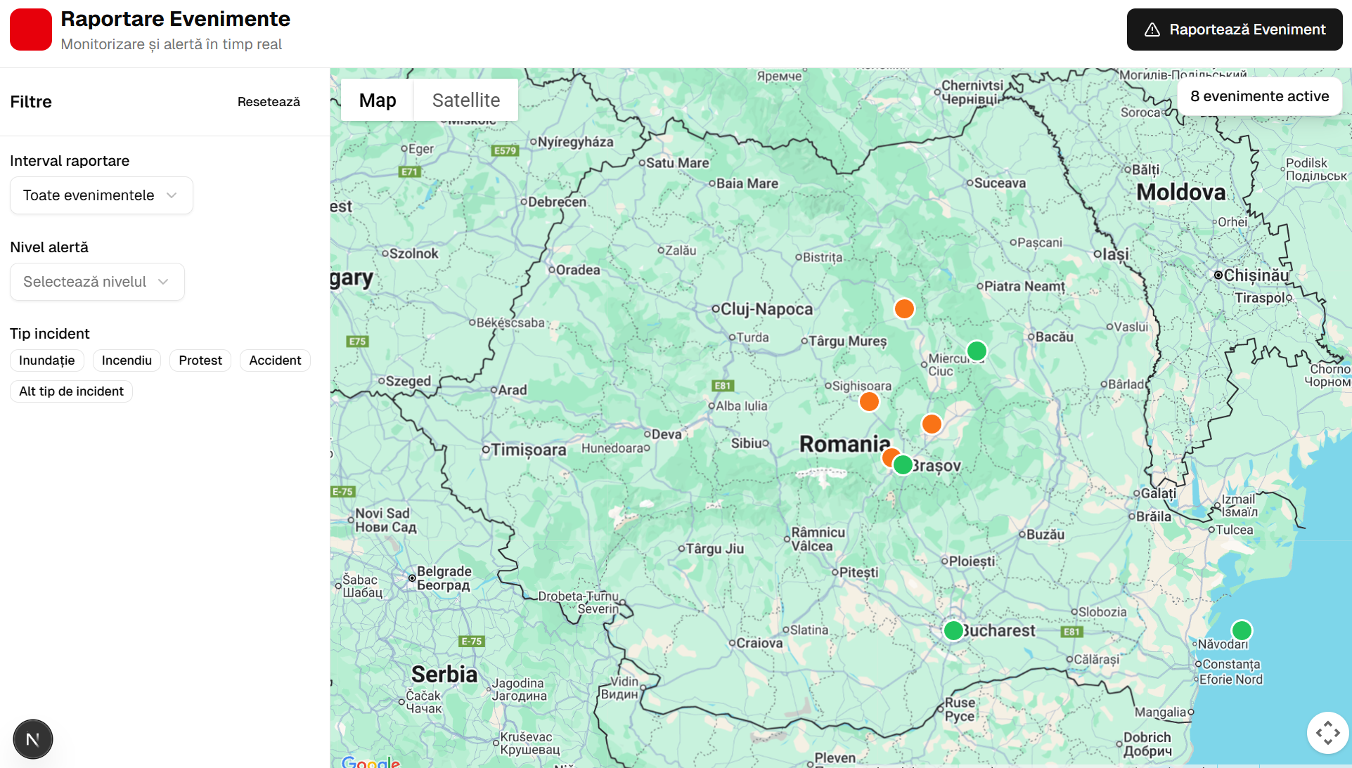
Notes:
Coloane si randuri la schematised
Datele din Orders sunt stocate fizic lângă rândurile din Customers.
Tabele interleaved

Slide 4
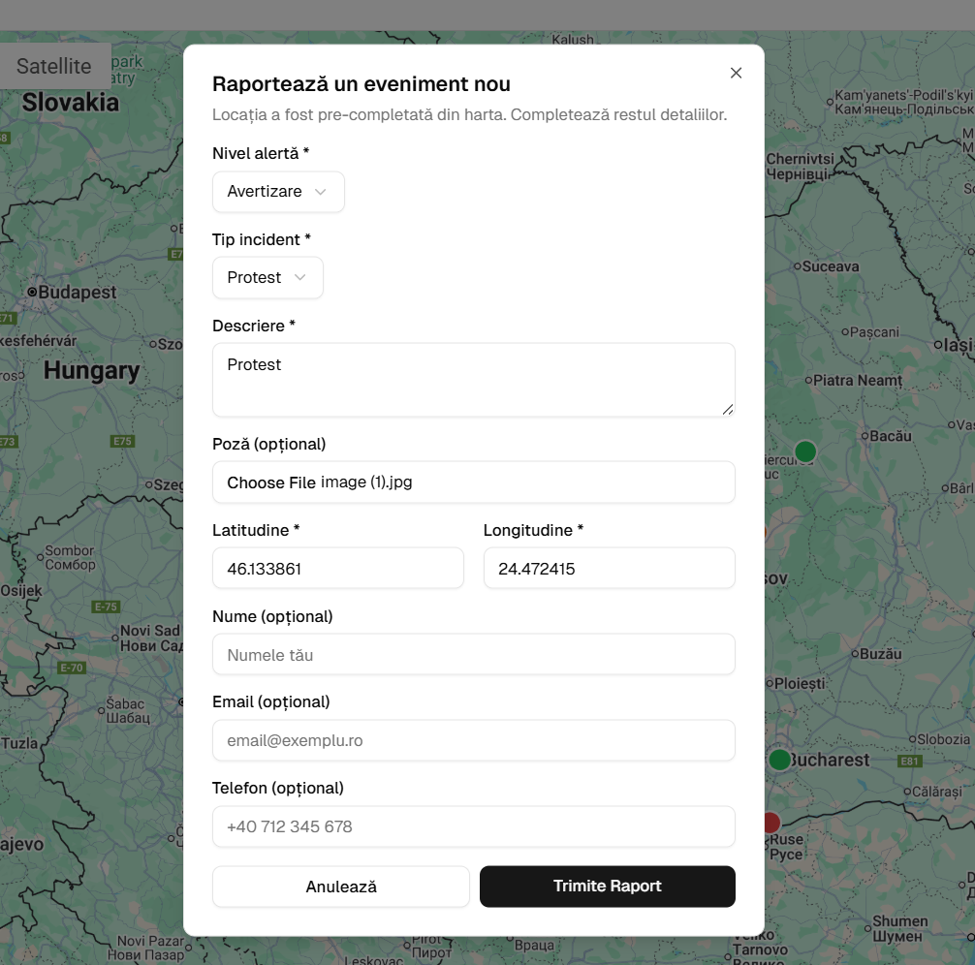
Notes:
Coloane si randuri la schematised
Datele din Orders sunt stocate fizic lângă rândurile din Customers.
Tabele interleaved

Slide 5
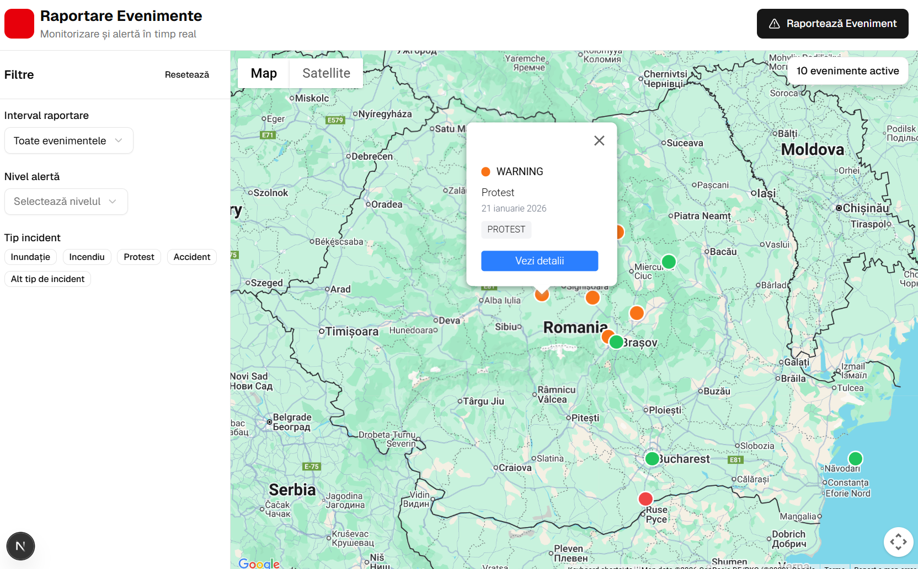
Notes:
Coloane si randuri la schematised
Datele din Orders sunt stocate fizic lângă rândurile din Customers.
Tabele interleaved

Slide 6
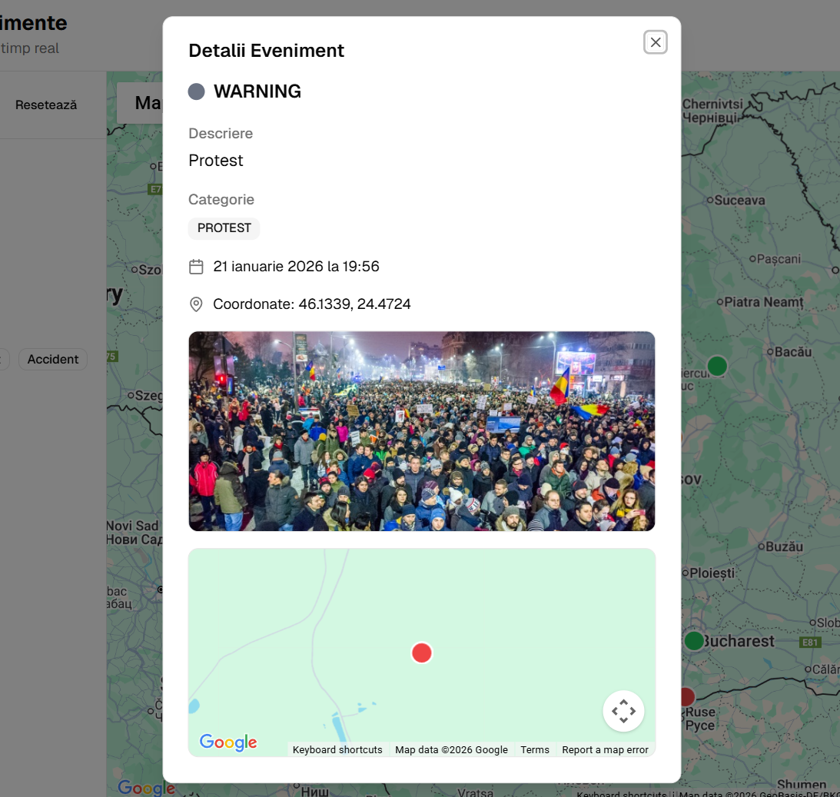
Notes:
Coloane si randuri la schematised
Datele din Orders sunt stocate fizic lângă rândurile din Customers.
Tabele interleaved

Slide 7
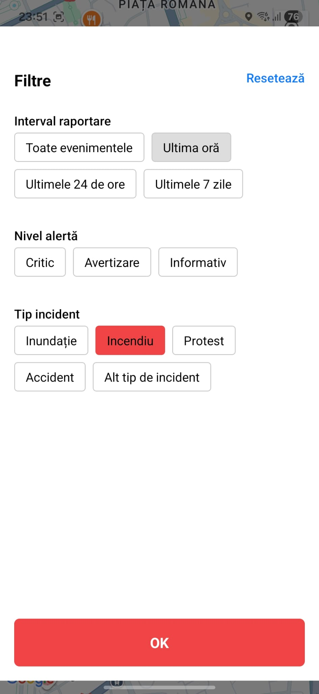
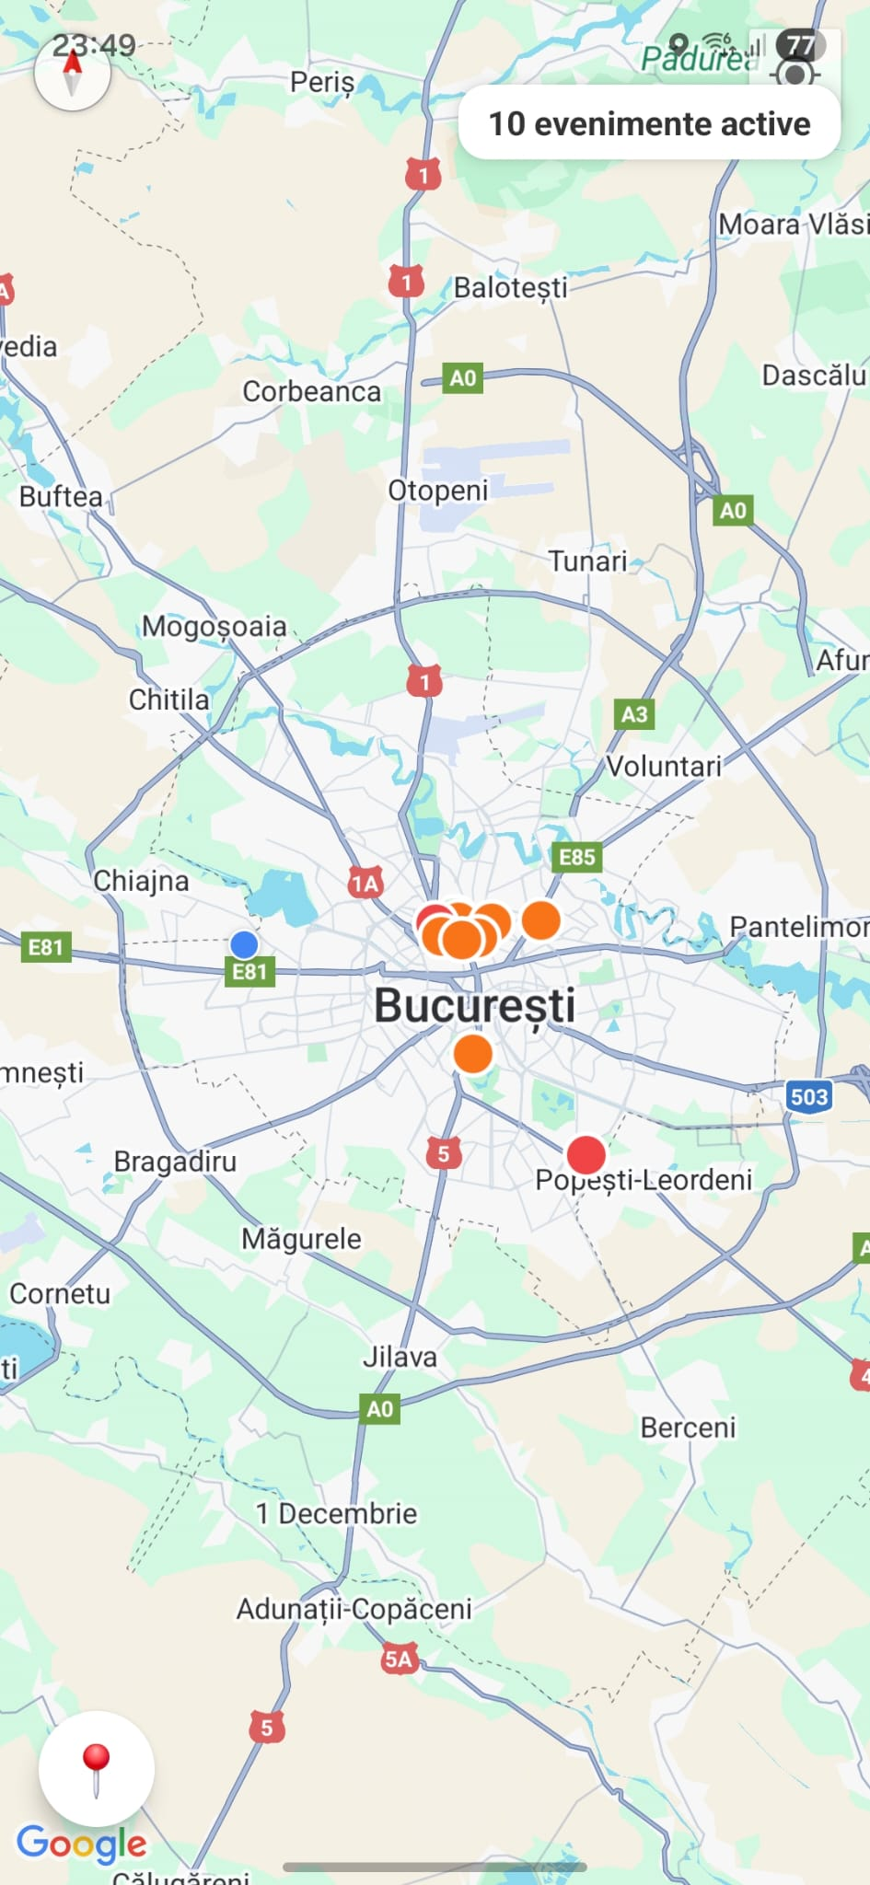
Notes:
Coloane si randuri la schematised
Datele din Orders sunt stocate fizic lângă rândurile din Customers.
Tabele interleaved

Slide 8
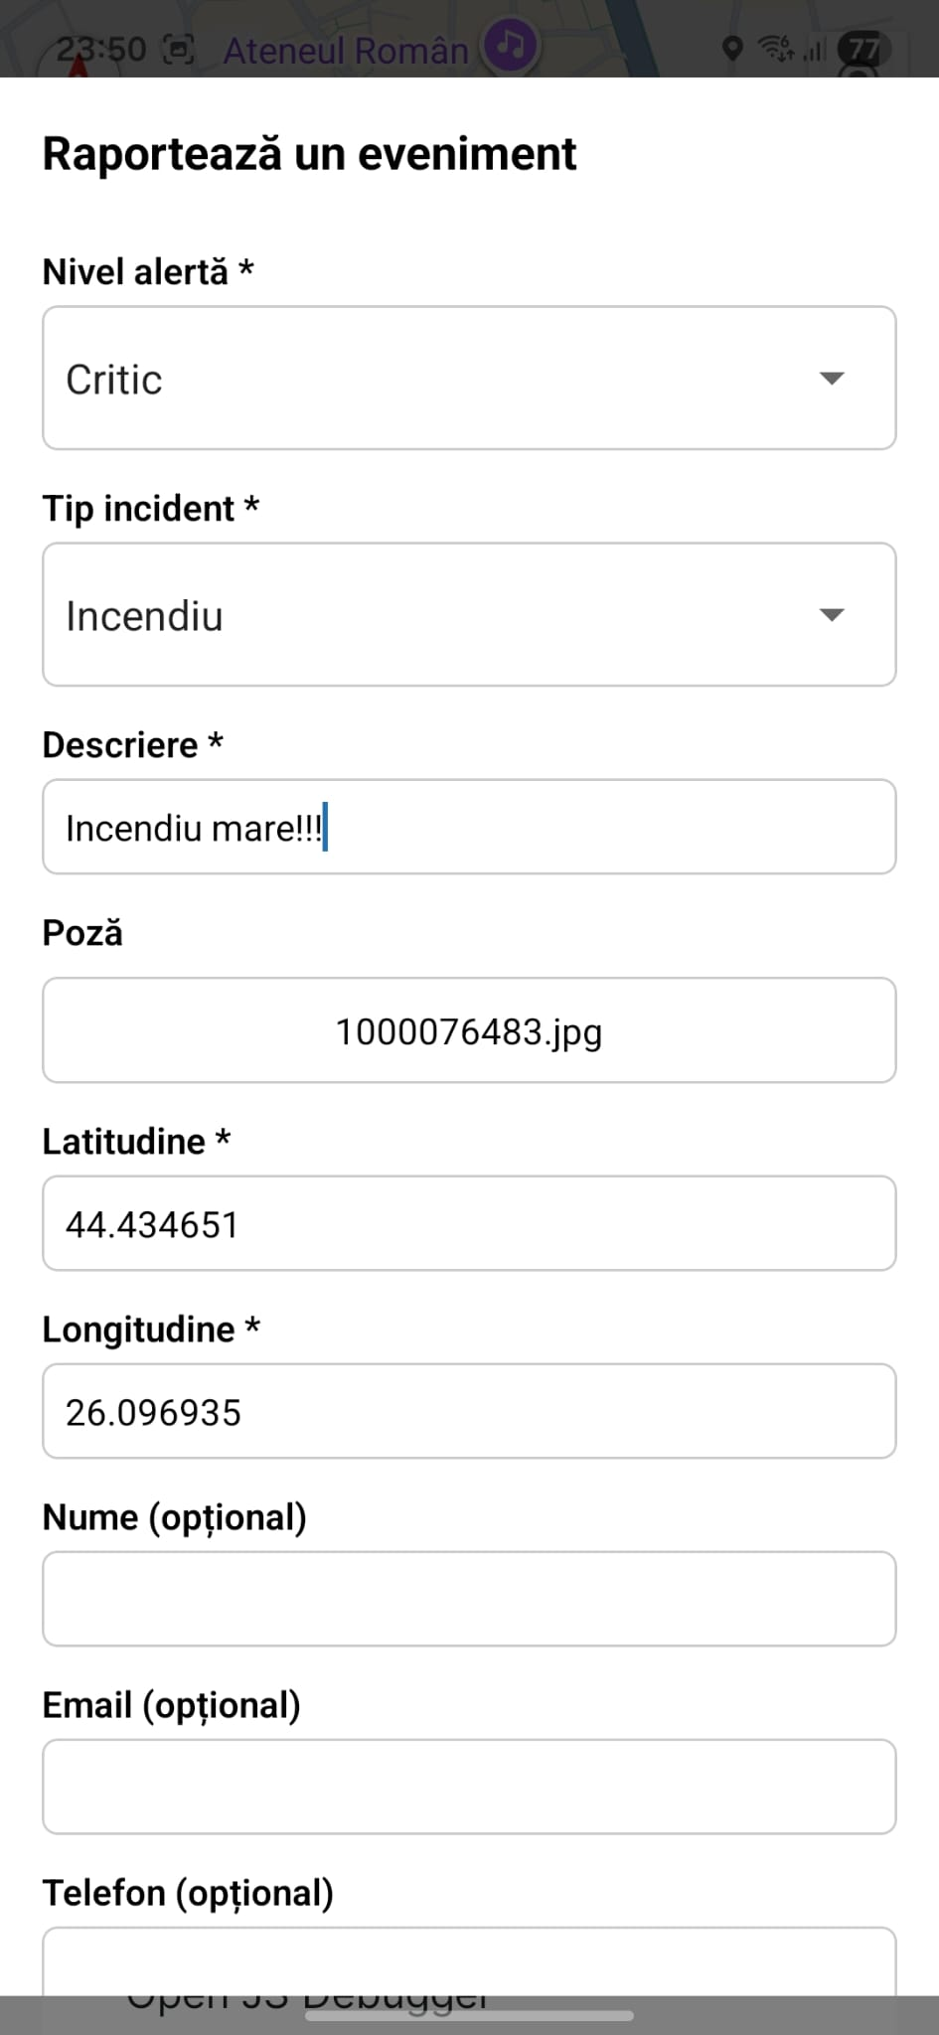
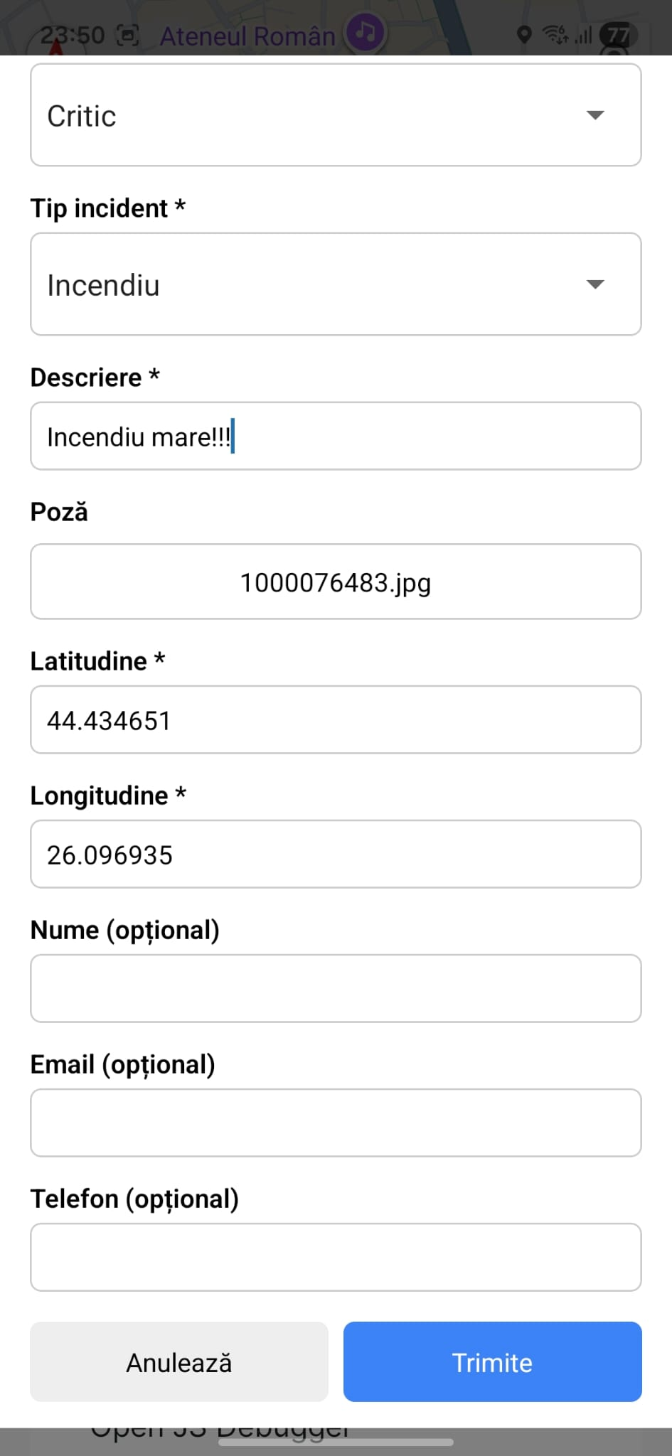
Notes:
Coloane si randuri la schematised
Datele din Orders sunt stocate fizic lângă rândurile din Customers.
Tabele interleaved

Slide 9
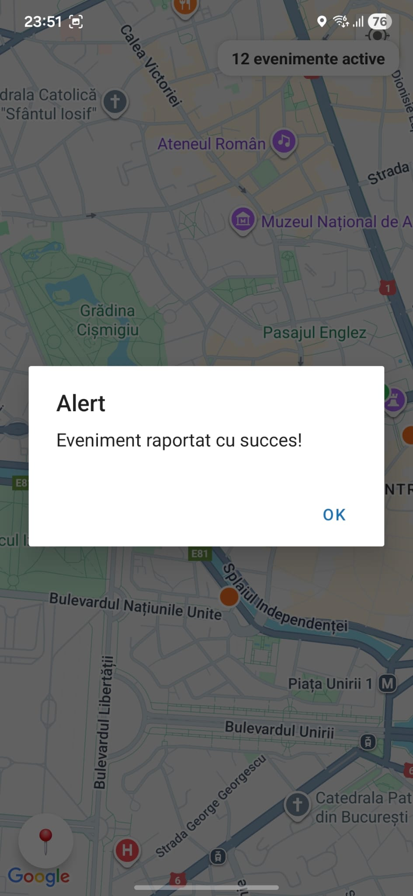
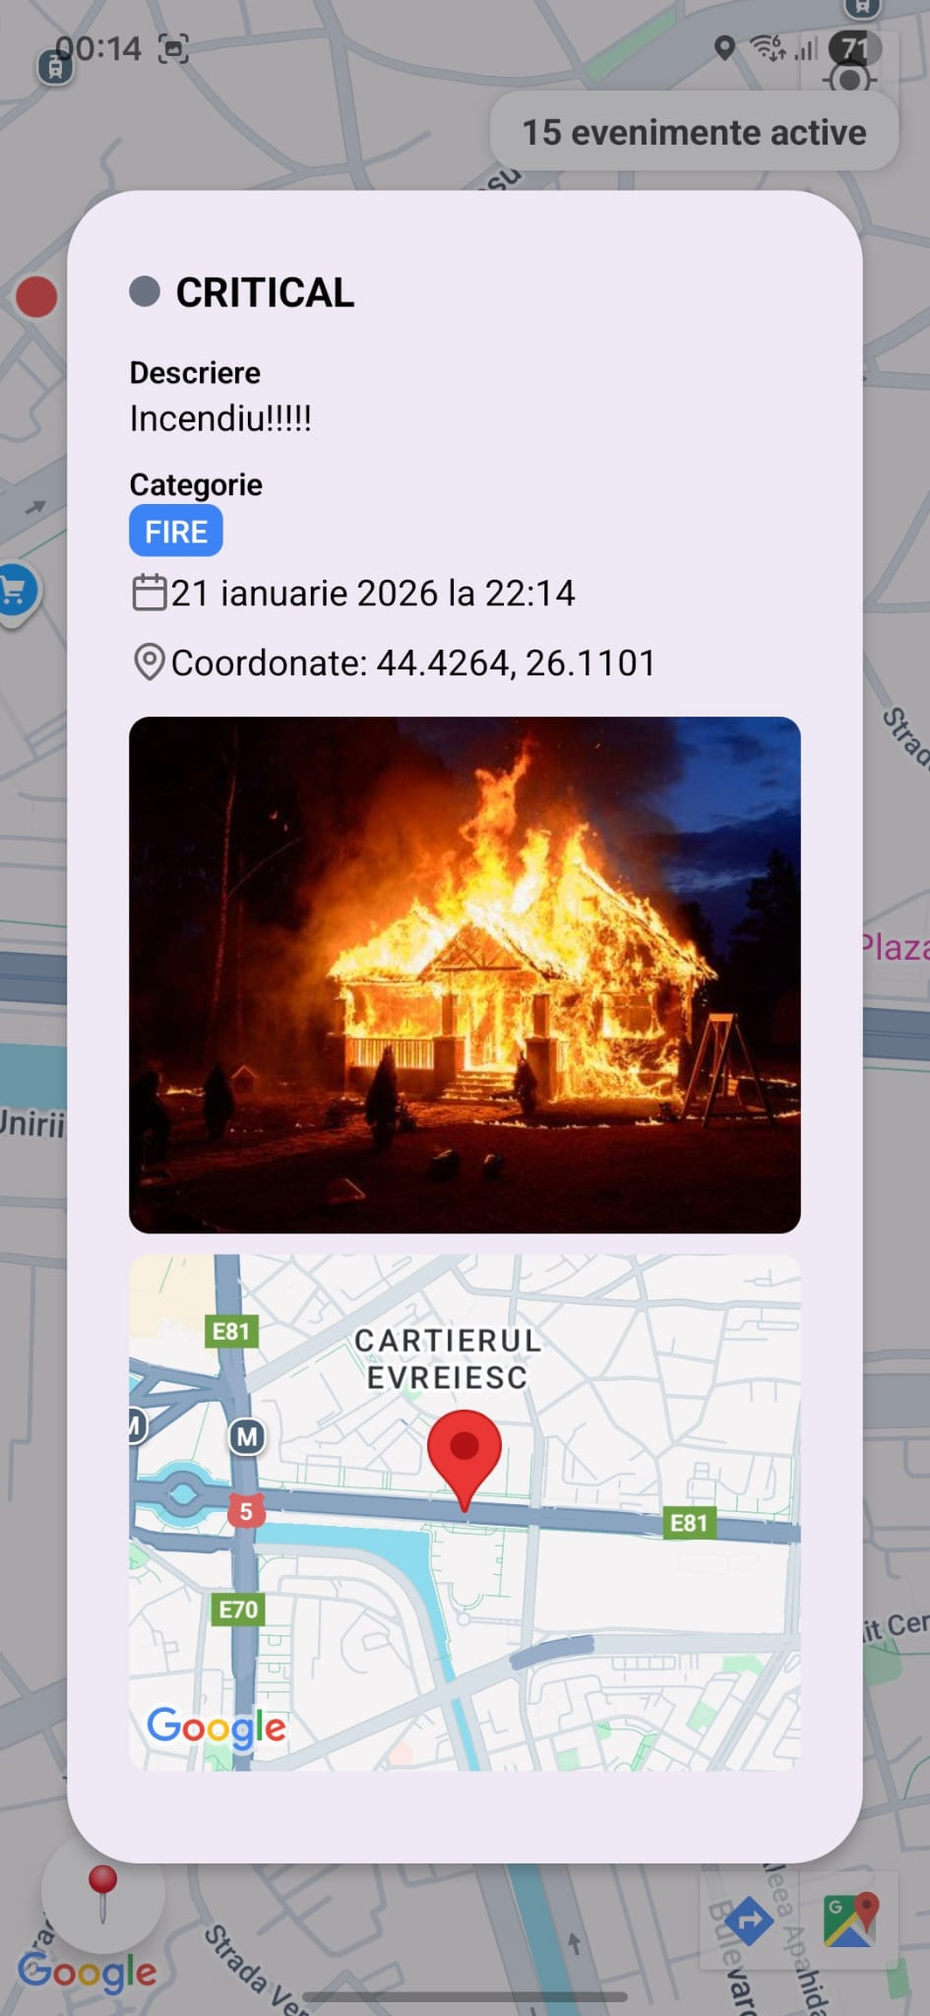
Notes:
Coloane si randuri la schematised
Datele din Orders sunt stocate fizic lângă rândurile din Customers.
Tabele interleaved

Slide 10
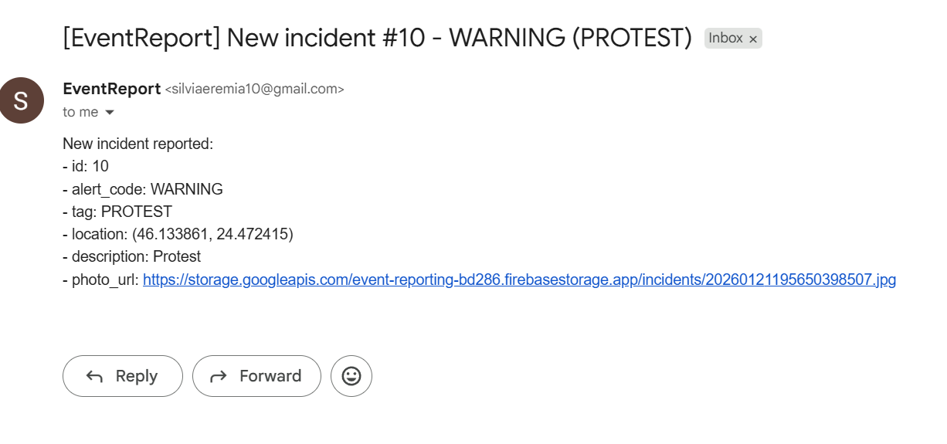
Email notifications
Notes:
Combine the scalability of NoSQL
with the consistency and transactions of SQL databases
Spanner has evolved from a Bigtable-like versioned key-value store into a temporal multi-version database.

Slide 11
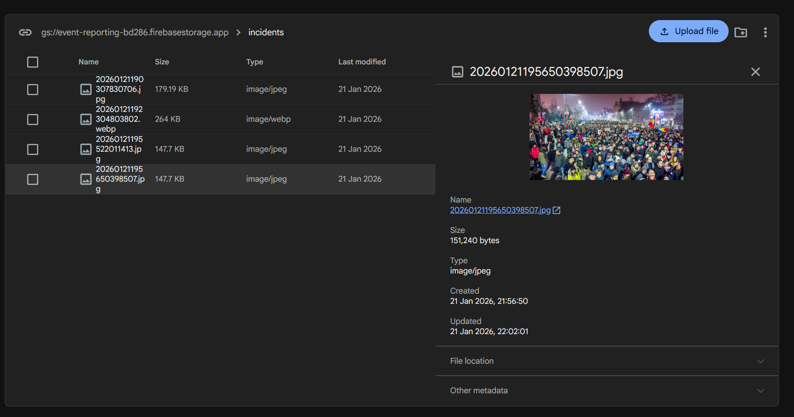
Firebase Storage
Notes:
Combine the scalability of NoSQL
with the consistency and transactions of SQL databases
Spanner has evolved from a Bigtable-like versioned key-value store into a temporal multi-version database.

Slide 12
Backend - Ingestion and Control Layer
Acts as a controlled ingestion gateway for all reported events
Validates and normalizes user-generated data at the entry point
Persists events transactionally in PostgreSQL (ACID guarantees)
Decouples client traffic from downstream Big Data processing
Exposes a stable REST API for web and mobile clients

Slide 13
Backend Implementation Overview
REST API implemented using Flask
Event CRUD operations (POST, GET, PATCH, DELETE)
Input validation and error handling at ingestion time
Image uploads via Firebase Storage (URL stored in DB)
Optional filtering + pagination for /api/incidents (with response headers)
Optional rate limiting to protect ingestion endpoints
Email notifications sent to administrators on new events
JWT-based admin login (token issuance)

Slide 14
Data pipeline
System Setup Overview
A Kafka producer continuously generates and publishes simulated incident events to a Kafka topic in real time.
Apache Spark Structured Streaming consumes the events, processes them in short time windows, and performs aggregations and spatial analysis.
The processed results are visualized through live dashboards, enabling near real-time monitoring and analysis of incident patterns.
Notes:
Combine the scalability of NoSQL
with the consistency and transactions of SQL databases
Spanner has evolved from a Bigtable-like versioned key-value store into a temporal multi-version database.

Slide 15
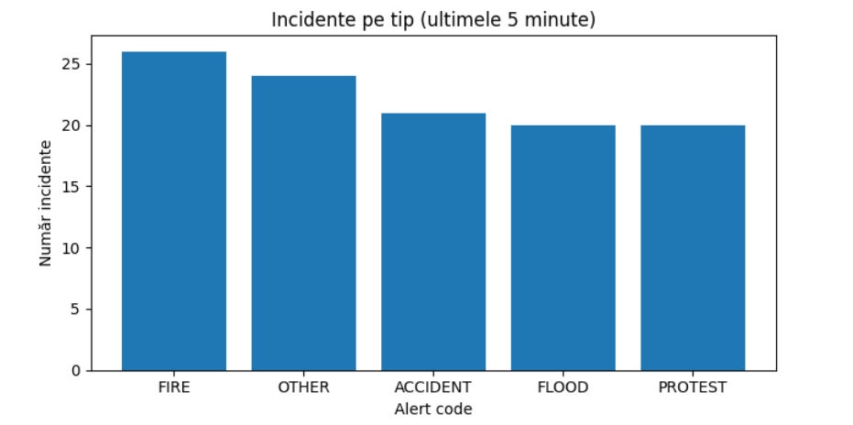
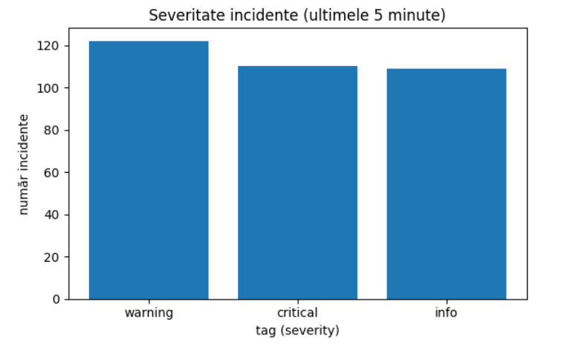
Data pipeline
Notes:
Combine the scalability of NoSQL
with the consistency and transactions of SQL databases
Spanner has evolved from a Bigtable-like versioned key-value store into a temporal multi-version database.

Slide 16
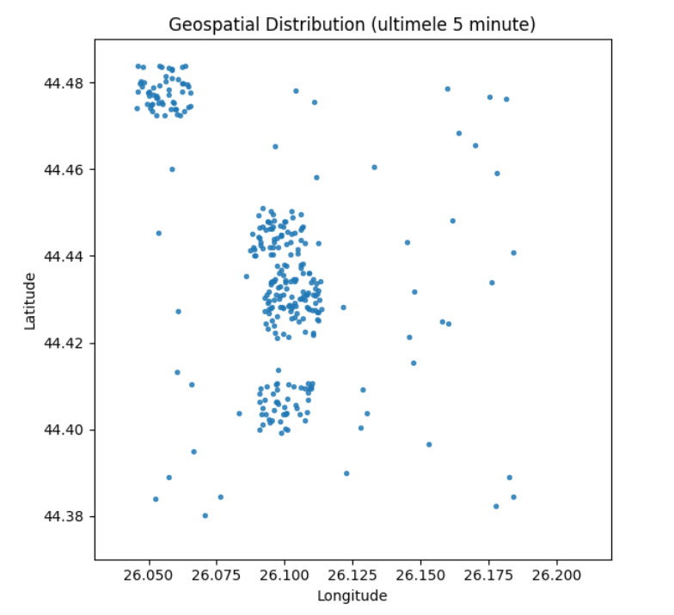
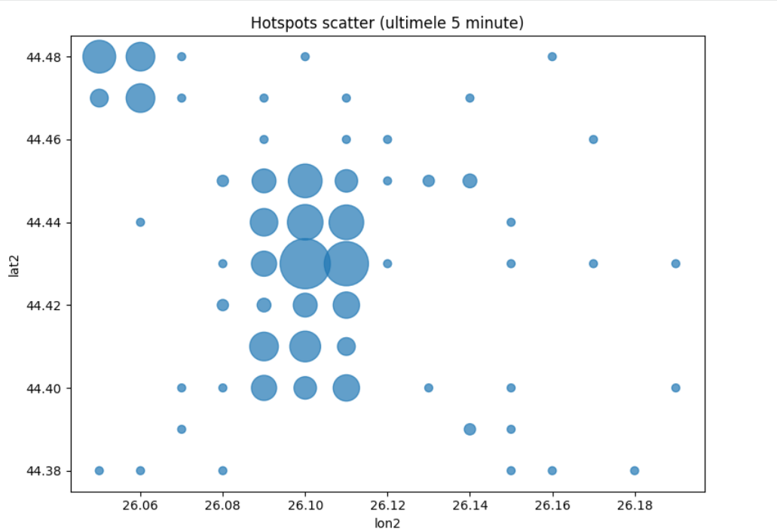
Data pipeline
Notes:
Combine the scalability of NoSQL
with the consistency and transactions of SQL databases
Spanner has evolved from a Bigtable-like versioned key-value store into a temporal multi-version database.

Slide 17
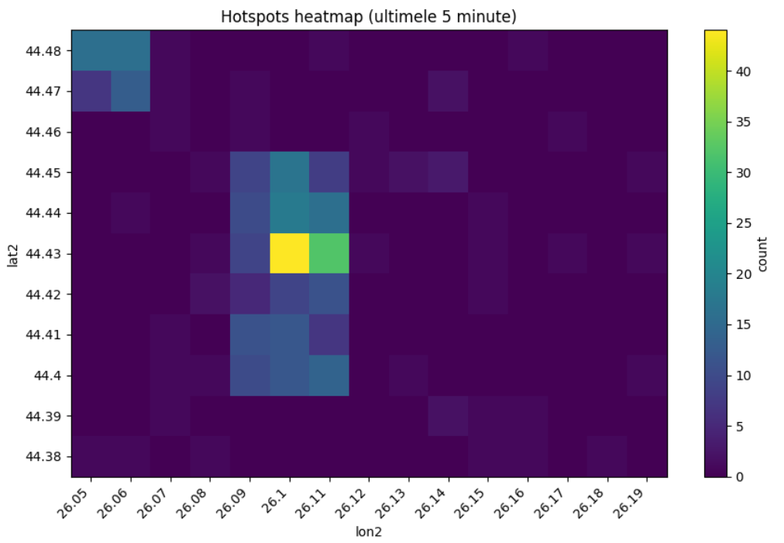
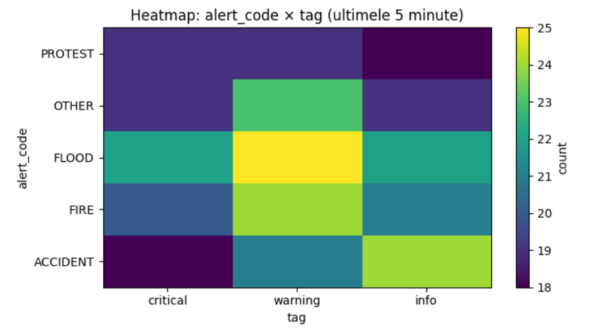
Data pipeline
Notes:
Combine the scalability of NoSQL
with the consistency and transactions of SQL databases
Spanner has evolved from a Bigtable-like versioned key-value store into a temporal multi-version database.

Slide 18
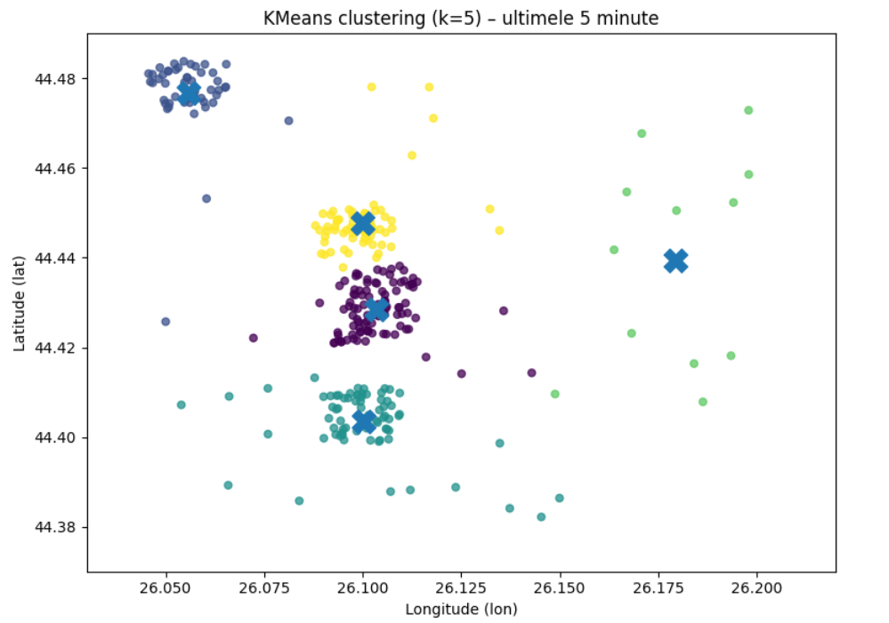
Data pipeline
Notes:
Combine the scalability of NoSQL
with the consistency and transactions of SQL databases
Spanner has evolved from a Bigtable-like versioned key-value store into a temporal multi-version database.

Slide 19

Questions?

