Slide 1
Biotech Analysis
Jason lewris, sharath Pingula, yuanbo Wang, kaustav Shah
Notes:
Jason

Slide 2



Project overview
Looked at large market cap biotechnology firms which included:
Amgen, Gilead Sciences Inc., Pfizer, LLY, Merck, BMS, BIIB
Looked at small market cap biotechnology firms which included:
Aquinox, Bellerophon, Eleven, Inotek, Lexicon, and Loxo
Looked at clinical trial results for various drugs
Correlated clinical trial result dates with stock prices
Notes:
Jason

Slide 3

DATA overview
Historical stock price data was gathered from Google Finance over the periods of Jan 1, 2011 to May 31, 2013 for all biotech companies mentioned
Quality: Data was easy to obtain, download, and ingest into our python program
Source: Reputable source
Quantity: 4242 records and 7 variables
Collected clinical trial results from a study done in 2013 by Thomas J. Hwang titled ‘Stock Market Returns and Clinical Trial Results of Investigational Compounds: An Event Study of Analysis of Large Biopharmaceutical Companies’
Quality: The data was clean and easily digestible
Source: Reputable Source, Harvard graduate, more than 19 published reports
Quantity: 24 observations and 8 variables
Notes:
Jason

Slide 4

Approach
Collected static csv file from Google finance
Created static csv file from biotech report
Used Pandas within Python to sort through historical stock prices csv file
Extract +8 days and -8 days from the actual event date for that particular company
Calculate the percent change in closing price from day to day
Calculate the percent change in volume from day to day
Write new csv file with only dates and data pertaining to event dates
Used various graphical packages with Python to chart each event date over time
Categorized it by event number, and positive and negative results
Notes:
Jason
Big companies, small companies, social impact with respect to trial results and the main focus is on the financial analysis and we wanted to extend our scope to social impact but we faced these limitations.

Slide 5
Python Modules
Notes:
Yuanbo
2 different modules, big cap small cap, and twitter extraction. Create a flow chart with module names that show the flow of the code.
Standaradized, comparing apples to apples, take the max price of gthe range and then create the percent difference from that max value . Standardize other values compared to that max value.

Slide 6
Introduction to analysis
Data Composition
Phase1 – 2 Positive
Phase2 – 9 Positive
Phase3 – 13 5 Positive, 8 Negative
Phase 3 Results – Focus of Analysis, More critical
Events spread across 18 months - 17 days ( -8 to 0 to +8)
Close Price Analysis - Standardization – Uniform Comparison (0 to 1 scale)
Volume Analysis - Average of previous week Vs Results Announcement Day

Slide 7
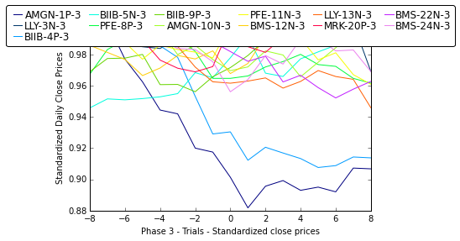
Impact on stock price – big cap
Phase 3 Trials
2 out of 13 - More than 5% variation
Max variations observed in Positive Results
Companies with Negative Results – No Visible Variation
Not much effect from Phase 1 and Phase 2 results
5% Variation
Biogen – 3P
Amgen – 3P
Tries to minimize the impact due to negative results
Less Variation suggests – Not much impact!? Let us look at the volumes

Slide 8
Impact on daily traded volume – big cap
Volume change on Day Zero
Change in volume from previous week to Day zero
Significant variation for Negative results
Change in volume – Signifies activity
Since institutional investors move in or out with speculations – Impact might not be visible immediately
Phase 3 – Negative Results
Big Cap Companies – No Significant immediate impact due to a single trial result
The impact can be perceived in the long term
BIIB (Biogen) - 20% in one month

Slide 9
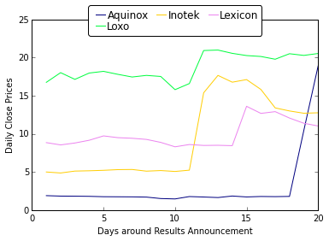
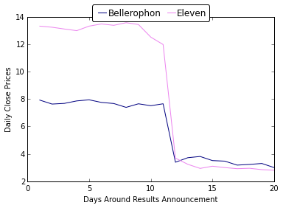
IMPACT of clinical trials – small cap
Positive Results
Negative Results
Company | Result | %Change Close | %Change Volume
Aquinox Pharmaceuticals | Positive | 955% | 48107%
Loxo Oncology | Positive | 33% | 898%
Bellerophon Therapeutics | Negative | -56% | 4257%
Inotek Pharmaceuticals | Positive | 237% | 55317%
Lexicon Pharmaceuticals | Positive | 61% | 5301%
Eleven Biotherapeutics | Negative | -69% | 17485%

Slide 10

Future vision
Adding additional functionality, including social media monitoring, news monitoring, all the while being processed in a live system.
Twitter API does not conveniently allows for historical extraction, only the past 8 days.
Built Twitter functionality to extract current tweets
Notes:
Sharath

Slide 11
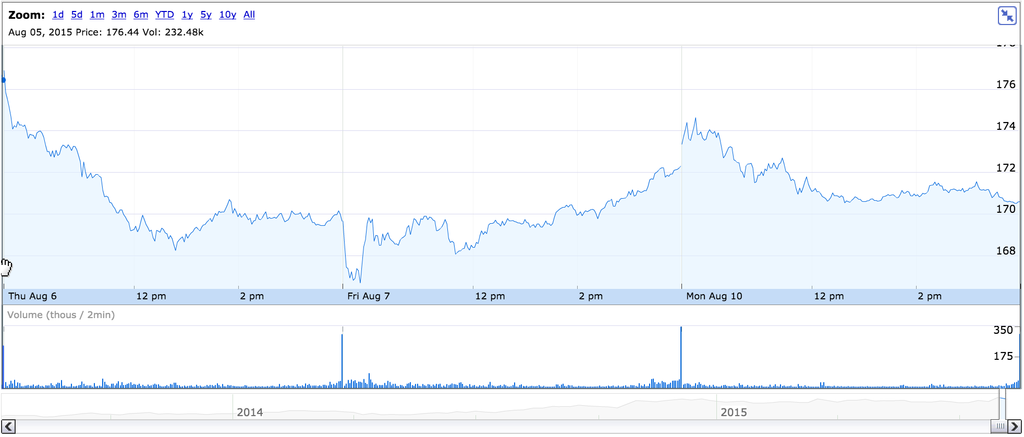
Future vision cont.
Notes:
Kaustav

Slide 12
Coverage analysis
Notes:
Kaustav

Slide 13

Conclusion
Clinical trial results impact large biotech firms volume immediately
Volume swings often indicator of institutional investors
Medium term stock performance changes
Clinical trial results impact small biotech firms stock price immediately
Changes occur within 24 hours of announcement
Short term stock performance changes
Notes:
Jason

Slide 14

Questions

Slide 15
Appendix a
Notes:
Kaustav

