Slide 1
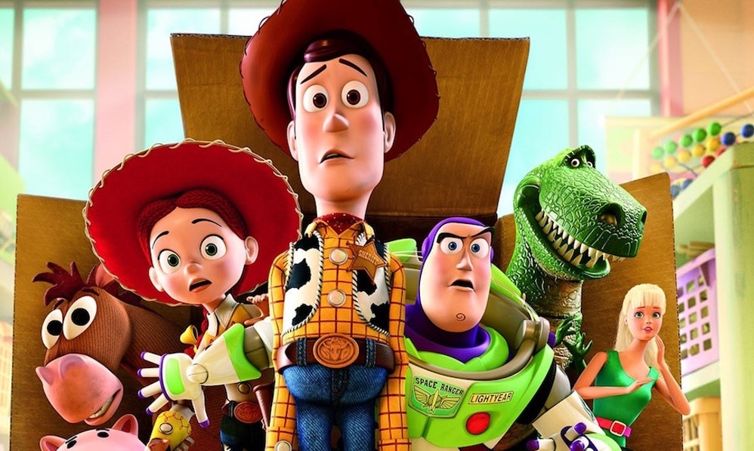

Graphics

Slide 2
Programming takes practice.

Slide 3
Some common issues.

Slide 4

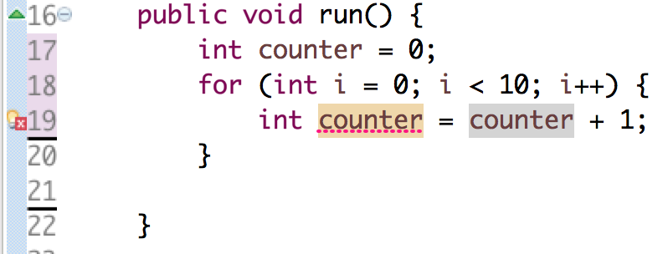

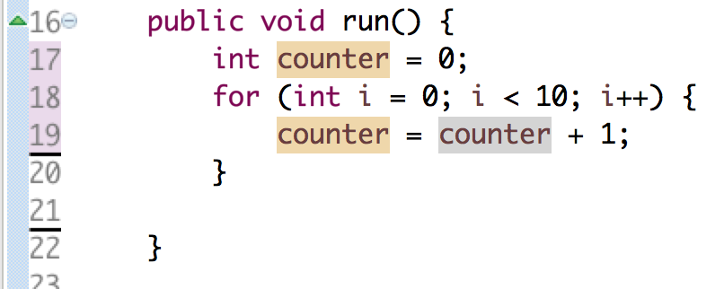
Reusing Variables
You only need to tell Java the type of a variable once.

Slide 5
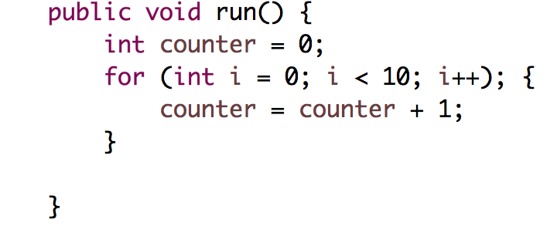
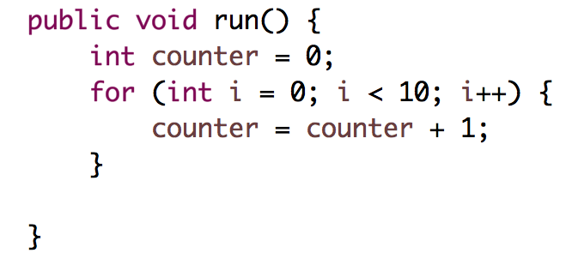
Where semicolons; belong
Semicolons do not go after for, while, if, else. ; and { do NOT go together

Slide 6
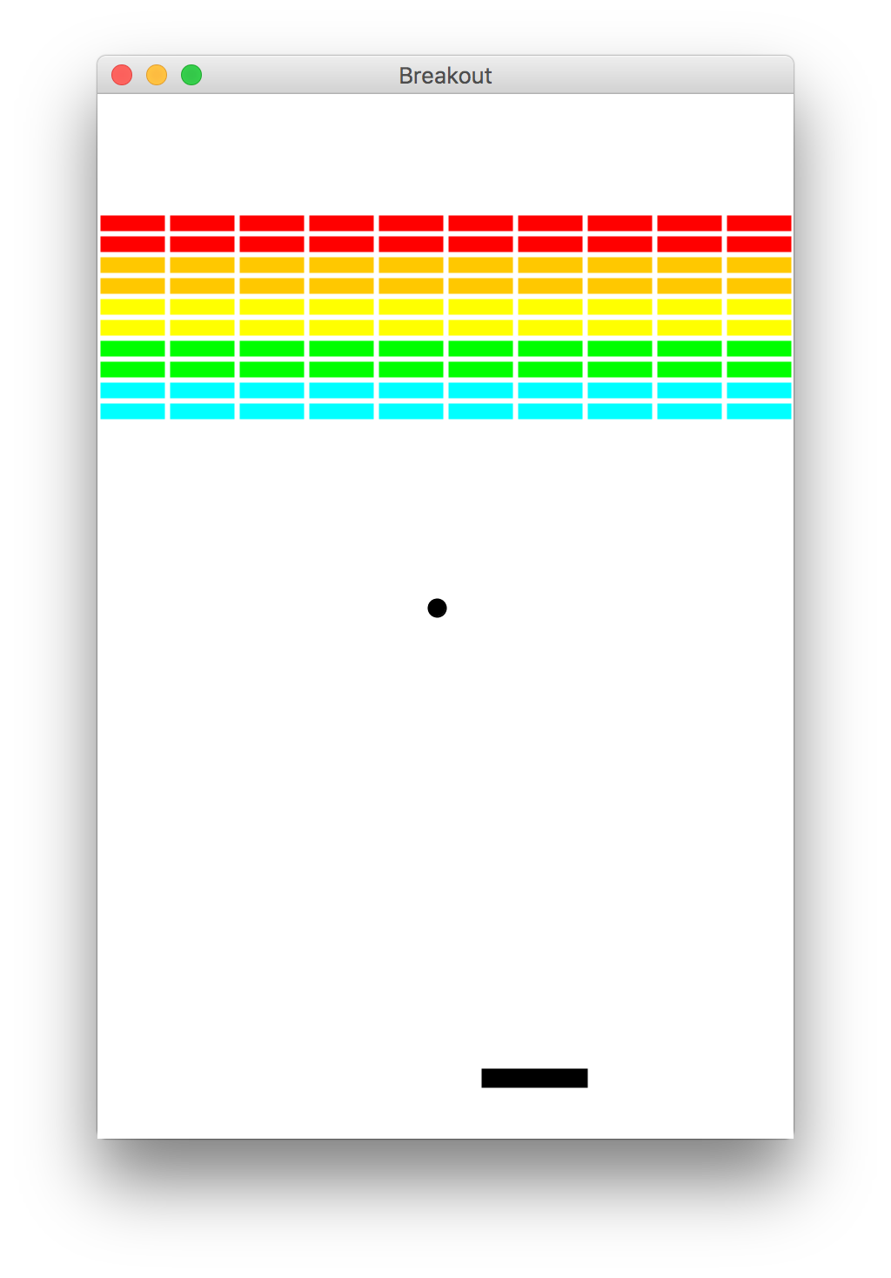
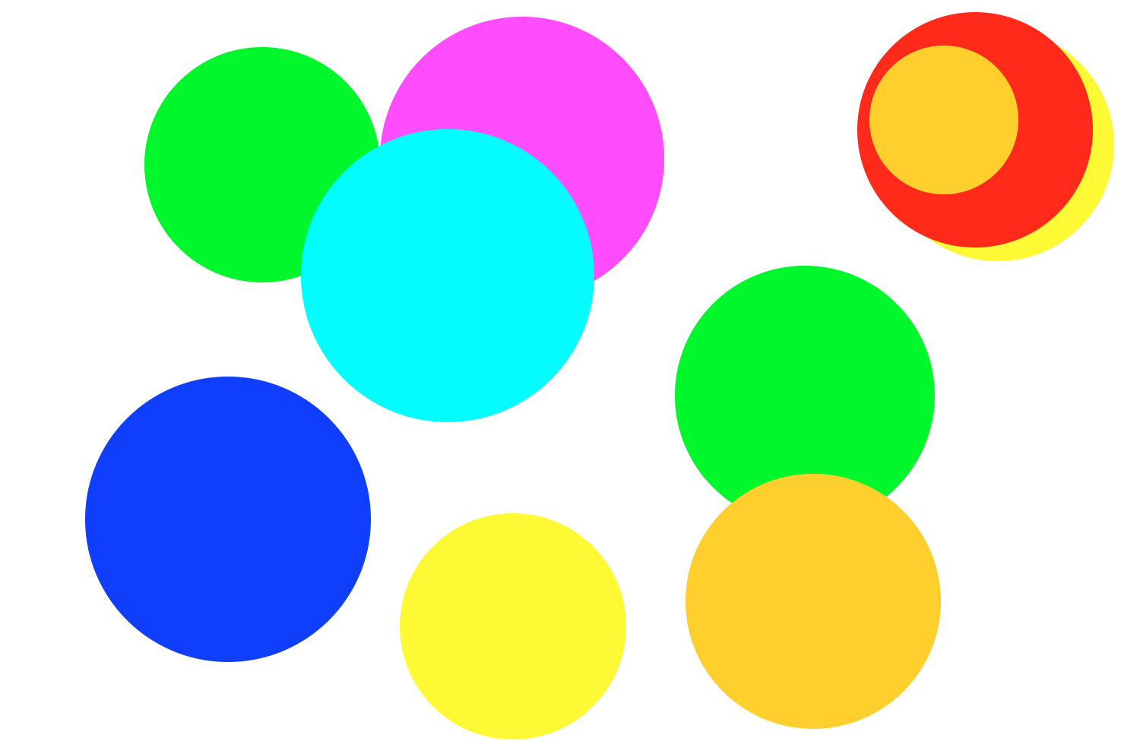
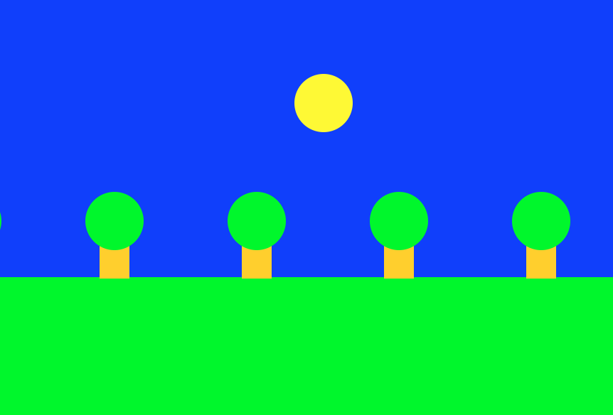
Beyond Console Programs

Slide 7
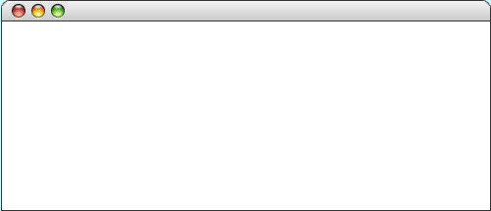
GRect
GRect is a variable that stores a rectangle.
As an example, the following run method displays a rectangle
public void run() {
GRect rect = new GRect(200, 200);
rect.setFilled(true);
rect.setColor(Color.BLUE);
add(rect, 50, 50);
}
LargestOval

Slide 8
GRect
GRect is a variable that stores a rectangle.
As an example, the following run method displays a rectangle
public void run() {
GRect rect = new GRect(200, 200);
rect.setFilled(true);
rect.setColor(Color.BLUE);
add(rect, 50, 50);
}
LargestOval
Coordinates for a rectangle are the top left corner.
50
50

Slide 9
Graphics Coordinates
0,0
40,20
120,40
getHeight();
40,120
getWidth();

Slide 10
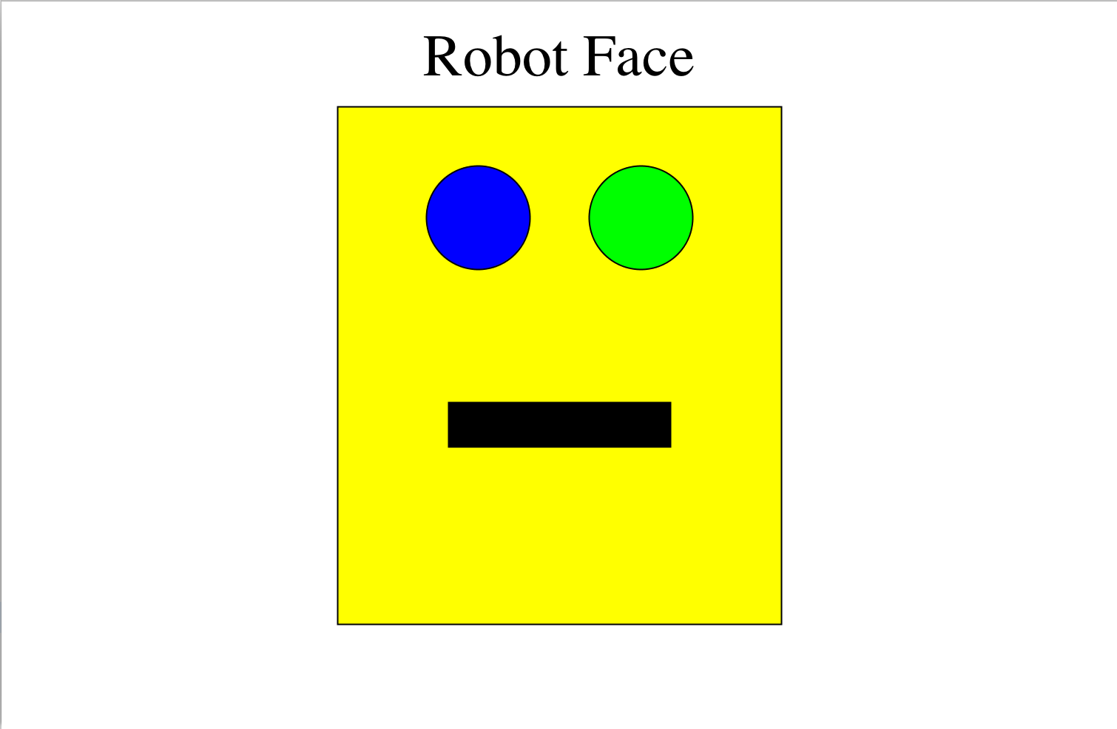
Karel’s Grandpa

Slide 11
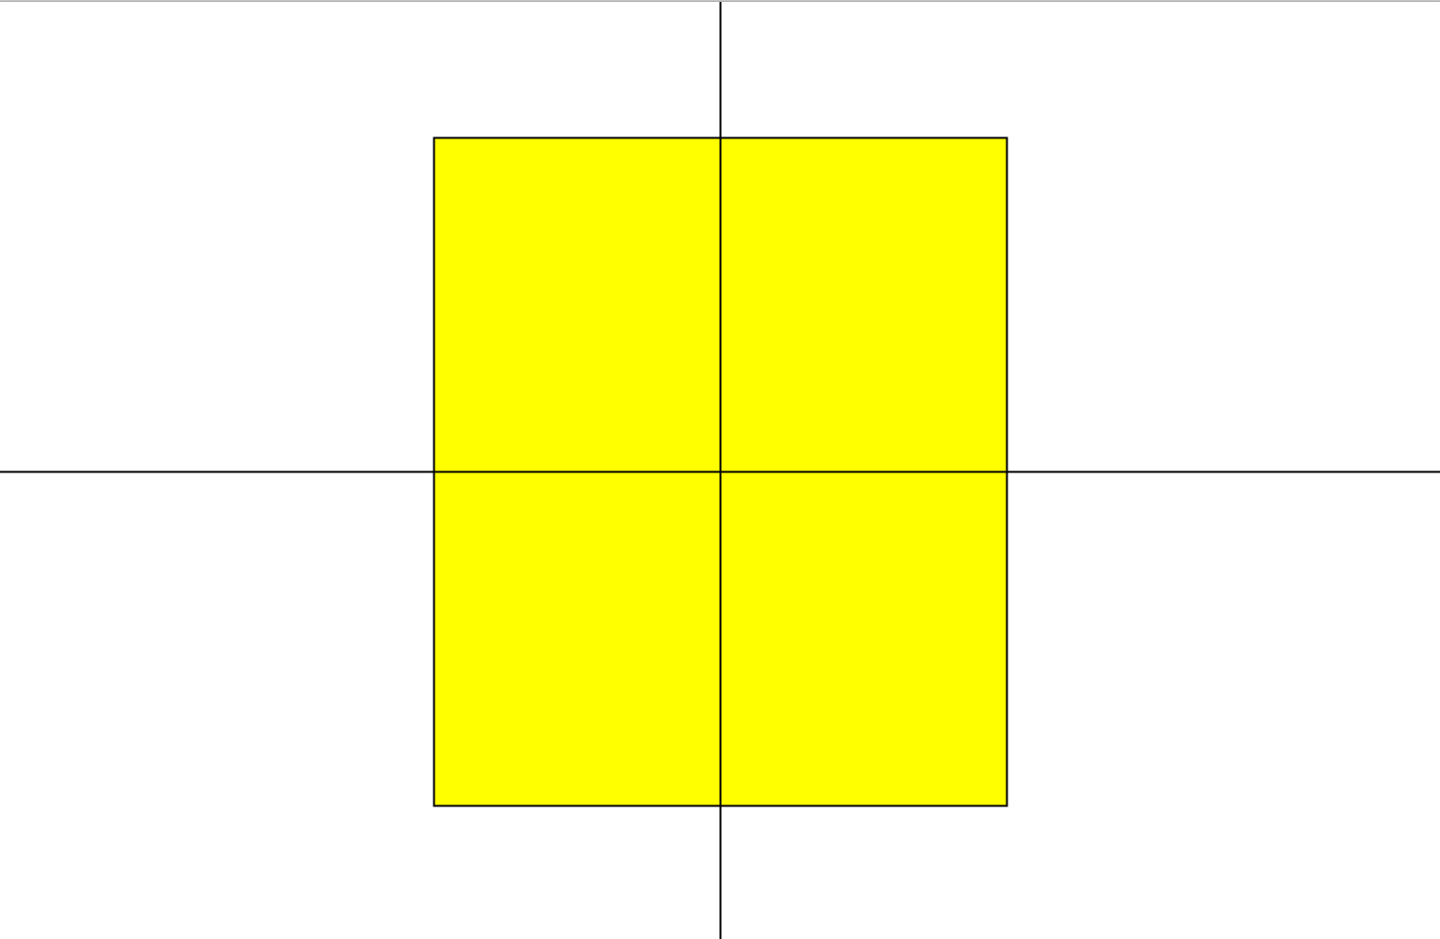
Karel’s Grandpa

Slide 12
Karel’s Grandpa
rect.getWidth() / 2
getWidth() / 2

Slide 13
Karel’s Grandpa
rect.getHeight() / 2
getHeight() / 2

Slide 14
Constants

Slide 15
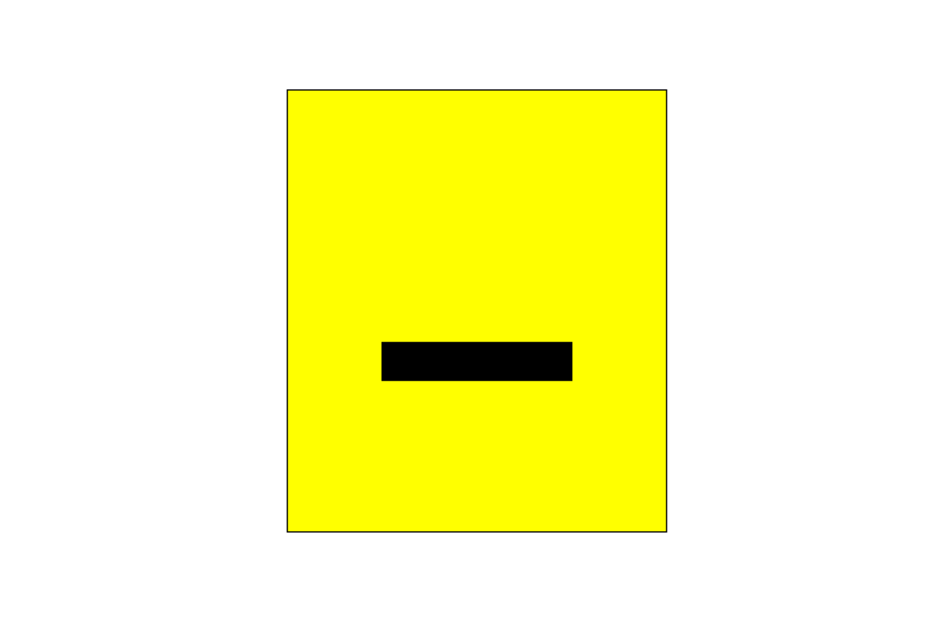
Karel’s Grandpa

Slide 16
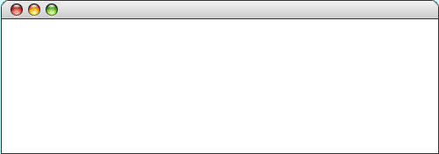
GLabel
A variable that represents text.
public class HelloProgram extends GraphicsProgram {
public void run() {
GLabel label = new GLabel(”hello, world”, 100, 75);
label.setFont(“SansSerif-36”);
label.setColor(Color.RED);
add(label);
}
}
HelloProgram
HelloProgram
hello, world

Slide 17
GLabel
A variable that represents text.
public class HelloProgram extends GraphicsProgram {
public void run() {
GLabel label = new GLabel(”hello, world”, 100, 75);
label.setFont(“SansSerif-36”);
label.setColor(Color.RED);
add(label);
}
}
HelloProgram
HelloProgram
75
hello, world
100

Slide 18
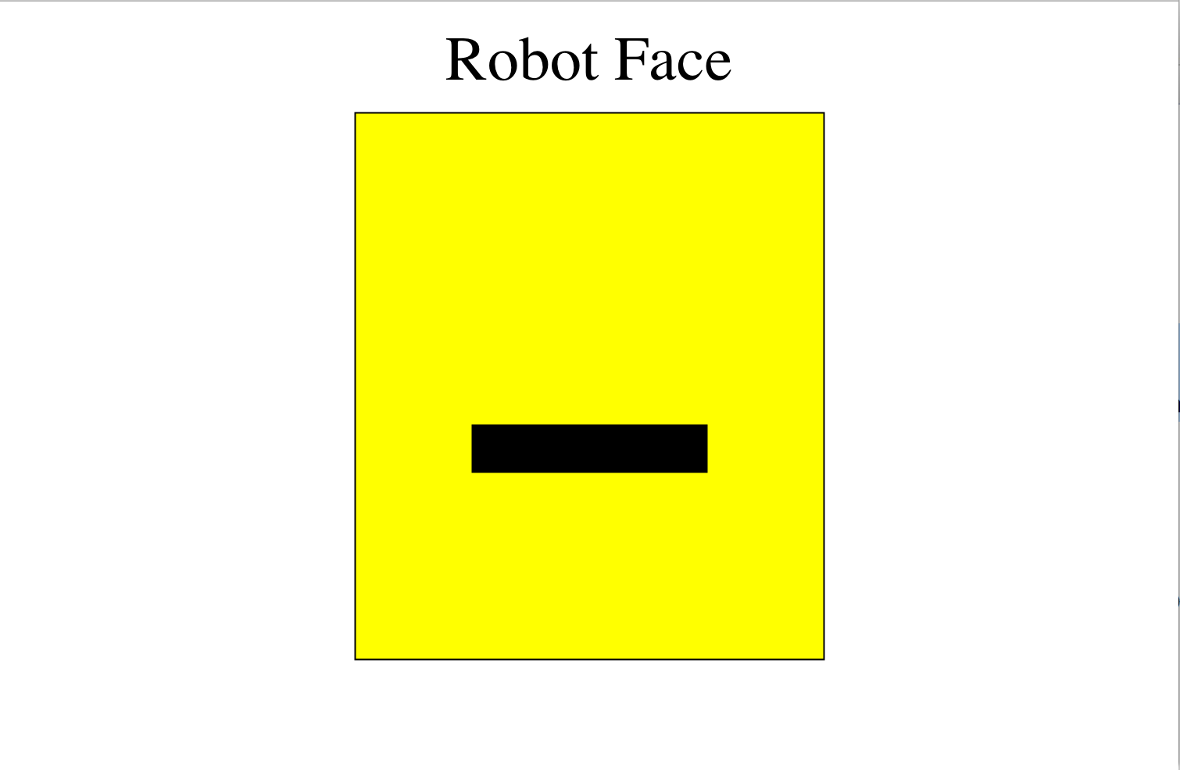
Karel’s Grandpa

Slide 19
GOval
The GOval class represents an elliptical shape defined by the boundaries of its enclosing rectangle.
As an example, the following run method creates the largest oval that fits within the canvas:
public void run() {
GOval oval = new GOval(getWidth(), getHeight());
oval.setFilled(true);
oval.setColor(Color.GREEN);
add(oval, 0, 0);
}
LargestOval

Slide 20

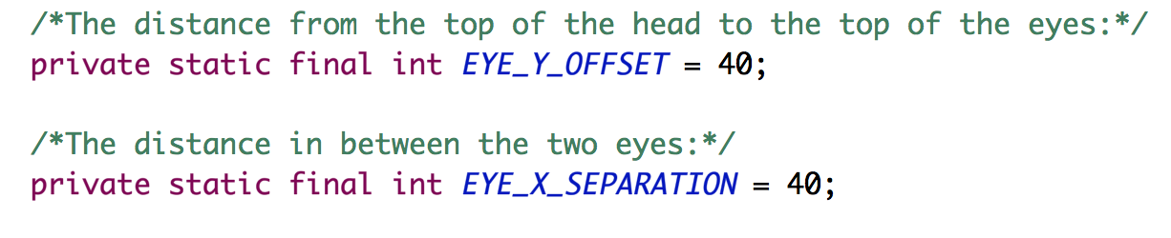
Karel’s Grandpa

Slide 21
Karel’s Grandpa

Slide 22
Graphics Methods
add(object)
Adds the object to the canvas at the front of the stack
add(object, x, y)
Moves the object to (x, y) and then adds it to the canvas
remove(object)
Removes the object from the canvas
removeAll()
Removes all objects from the canvas
getElementAt(x, y)
Returns the frontmost object at (x, y), or null if none
getWidth()
Returns the width in pixels of the entire canvas
getHeight()
Returns the height in pixels of the entire canvas
setBackground(c)
Sets the background color of the canvas to c.
pause(milliseconds)
Pauses the program for the specified time in milliseconds
waitForClick()
Suspends the program until the user clicks the mouse

Slide 23
Graphics Methods
add(object)
Adds the object to the canvas at the front of the stack
add(object, x, y)
Moves the object to (x, y) and then adds it to the canvas
remove(object)
Removes the object from the canvas
removeAll()
Removes all objects from the canvas
getElementAt(x, y)
Returns the frontmost object at (x, y), or null if none
getWidth()
Returns the width in pixels of the entire canvas
getHeight()
Returns the height in pixels of the entire canvas
setBackground(c)
Sets the background color of the canvas to c.
pause(milliseconds)
Pauses the program for the specified time in milliseconds
waitForClick()
Suspends the program until the user clicks the mouse

Slide 24
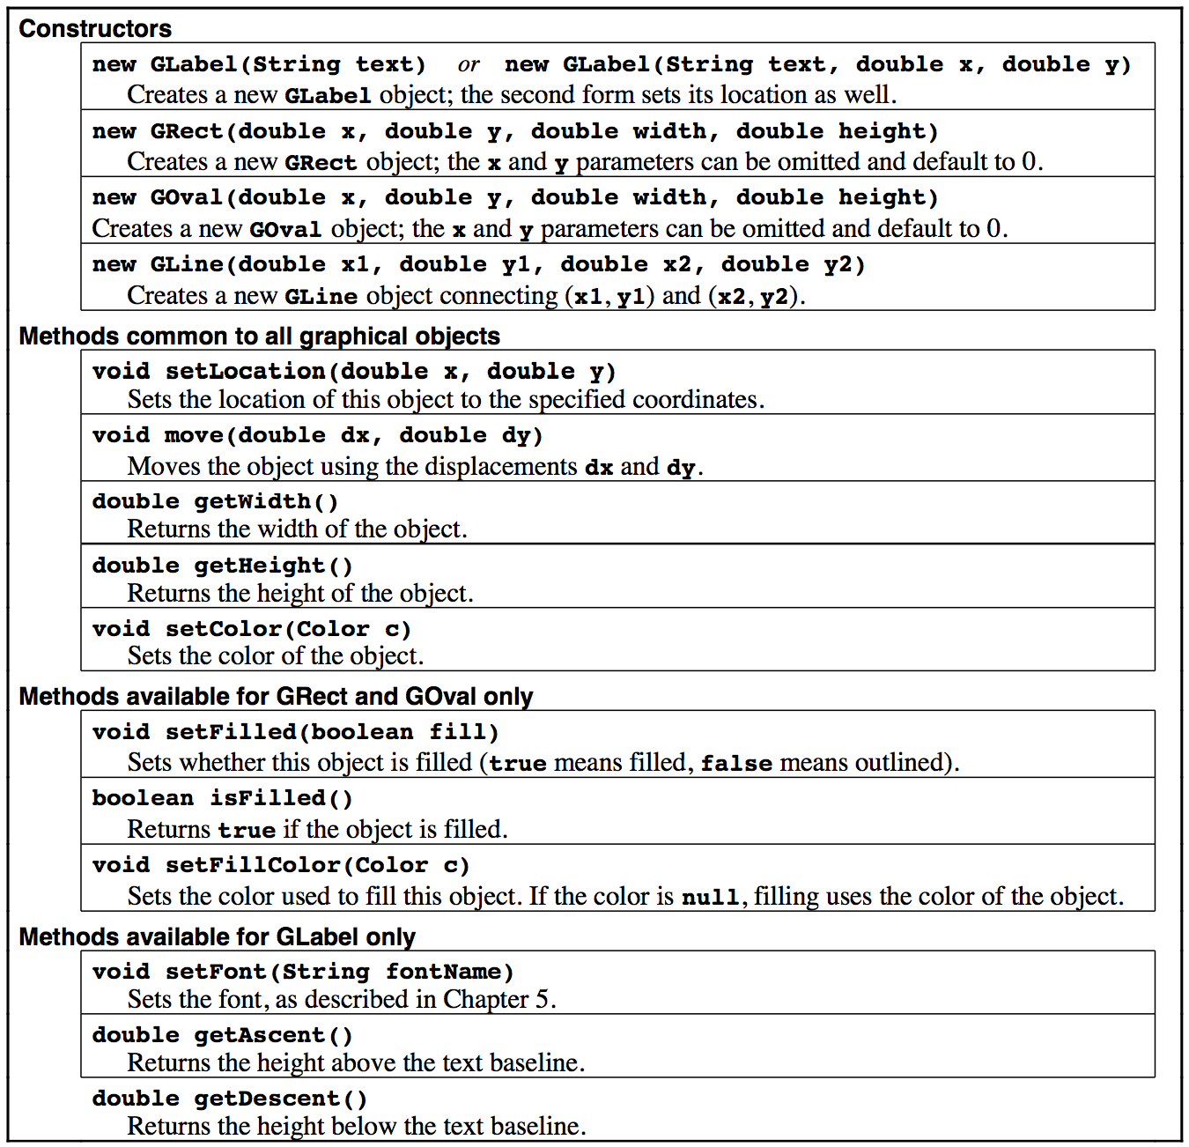
Reference Sheet

Slide 25
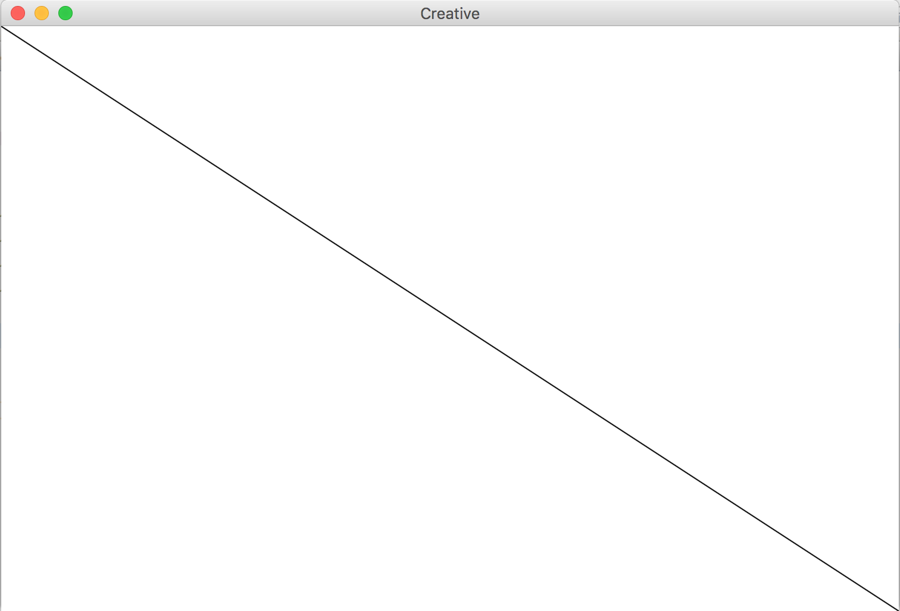
GLine
The GLine class represents a line defined by a start point and an end point.
As an example, the following run method creates a diagonal line across the canvas:
public void run() {
GLine line = new GLine(0,0, getWidth(), getHeight());
add(line);
}

Slide 26
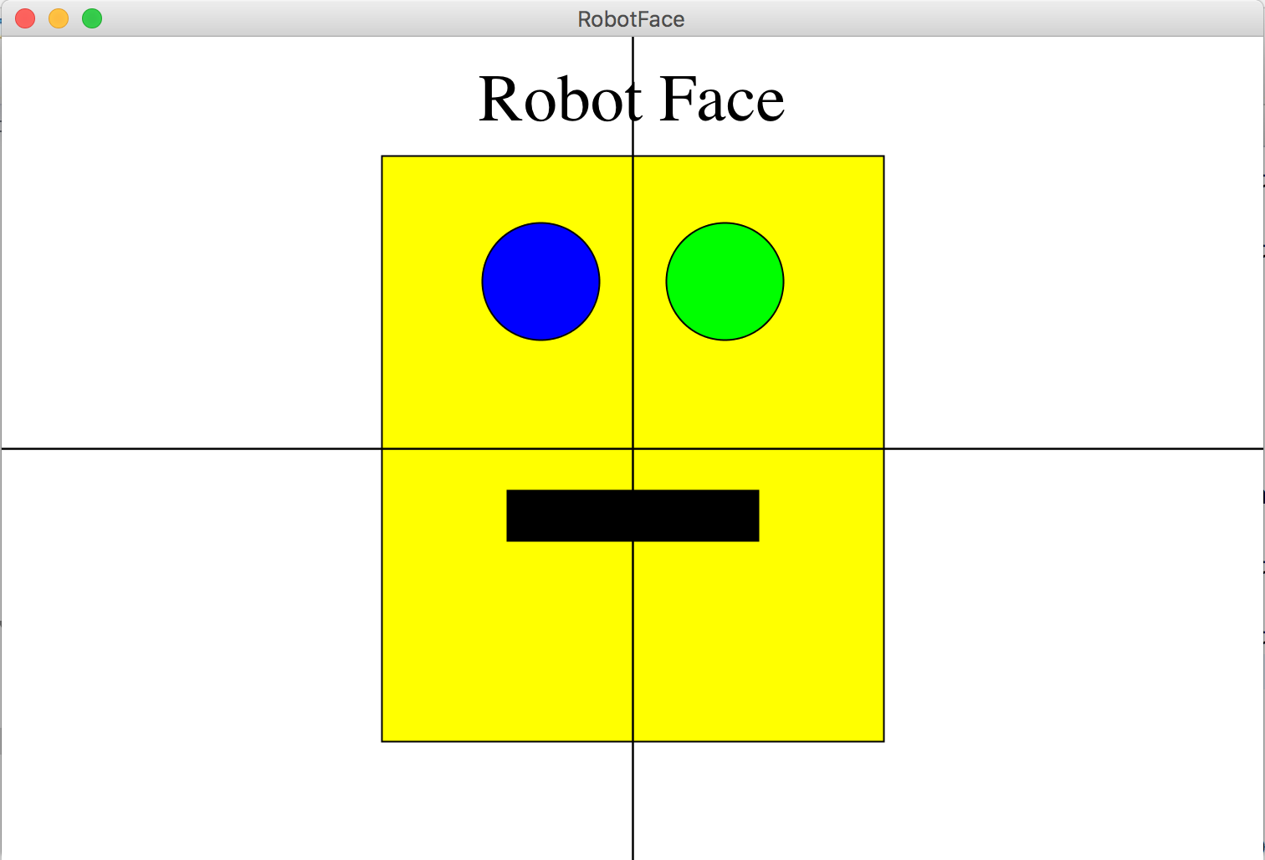
Karel’s Grandpa

