Slide 1

Interactors
CSBridge Summer 2019
By Ayca Tuzmen
Summer 2019 By Ayca Tuzmen

Slide 2
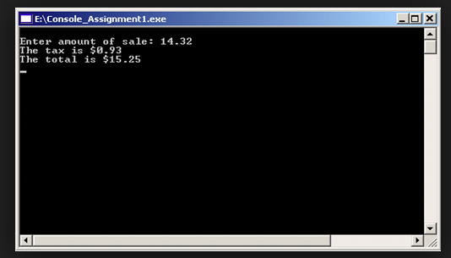
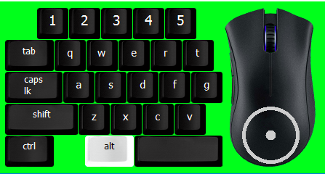
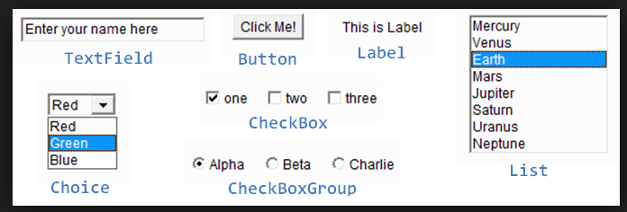
How do programs interact with a user?
Console Program
Mouse and Keyboards
GUI Elements

Slide 3
Different Type of Programs in Java
Console Program
Mouse and Keyboards
GUI Elements

Slide 4
Interactive Program
Most application programs today include a graphical user interface or GUI (pronounced gooey) consisting of buttons and other on-screen controls. Collectively, these controls are called interactors.
Graphical applications usually make it possible for the user to control the action of a program by using an input device such as a mouse. Programs that support this kind of user control are called interactive programs.
In modern interactive programs, user input doesn’t occur at predictable times. A running program doesn’t tell the user when to click the mouse. The user decides when to click the mouse, and the program responds. Because events are not controlled by the program, they are said to be asynchronous.

Slide 5
Event Driven
User actions such as clicking the mouse are called events. Programs that respond to events are said to be event-driven.
When you write a Java program, you indicate the events to which you wish to respond by designating some object as a listener for that event.
When the event occurs, a message is sent to the listener, which triggers the appropriate response.

Slide 6
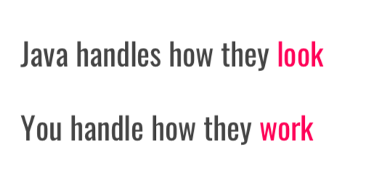
Java Swing Library
Java defines many types of interactors, most of which are part of a collection called the Swing library,
You create a GUI by constructing the Swing interactors you need and then arranging them appropriately in the program window.

Slide 7
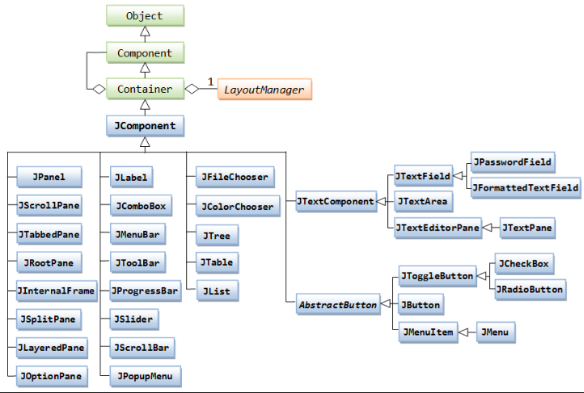
Java Swing Classes

Slide 8
Layout
When you create an instance of any Program subclass, Java divides the window area into five regions as follows:
NORTH
WEST
EAST
CENTER
SOUTH
The CENTER region is typically where the action takes place. A ConsoleProgram adds a console to the CENTER region, and a GraphicsProgram puts a GCanvas there.
The other regions are visible only if you add an interactor to them. The examples in the text use the SOUTH region as a control strip containing a set of interactors, which are laid out from left to right in the order in which they were added.

Slide 9
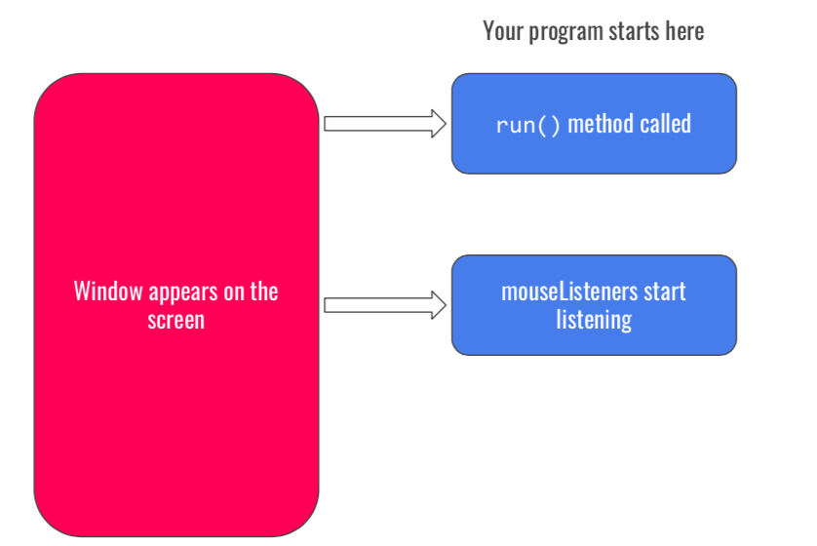
Execution of a Java Program

Slide 10
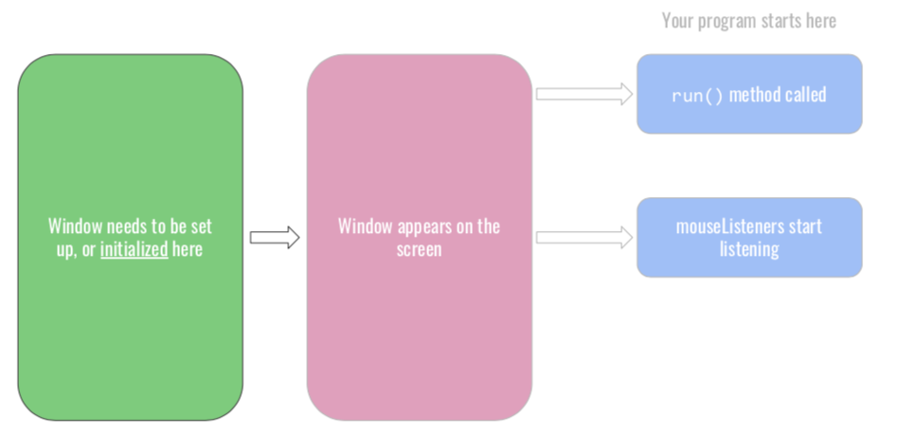
Execution of a Interactive Program

Slide 11
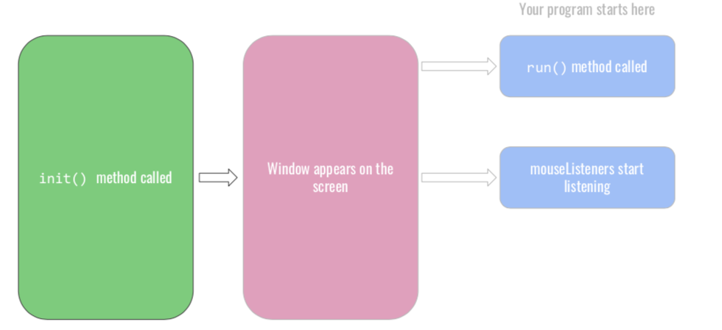
Init()

Slide 12
Responding to Events
On a more practical level, the process of making a program respond to mouse events requires the following steps:
1. Call addMouseListeners.
2. Write new definitions of any listener methods you need.
The most common mouse events are shown in the following table, along with the name of the appropriate listener method:
mouseClicked( e)
Called when the user clicks the mouse
mousePressed( e)
Called when the mouse button is pressed
mouseReleased(e)
Called when the mouse button is released
mouseMoved(e)
Called when the user moves the mouse
mouseDragged(e)
Called when the mouse is dragged with the button down
The parameter e is a MouseEvent object, which gives more data about the event, such as the location of the mouse.

Slide 13
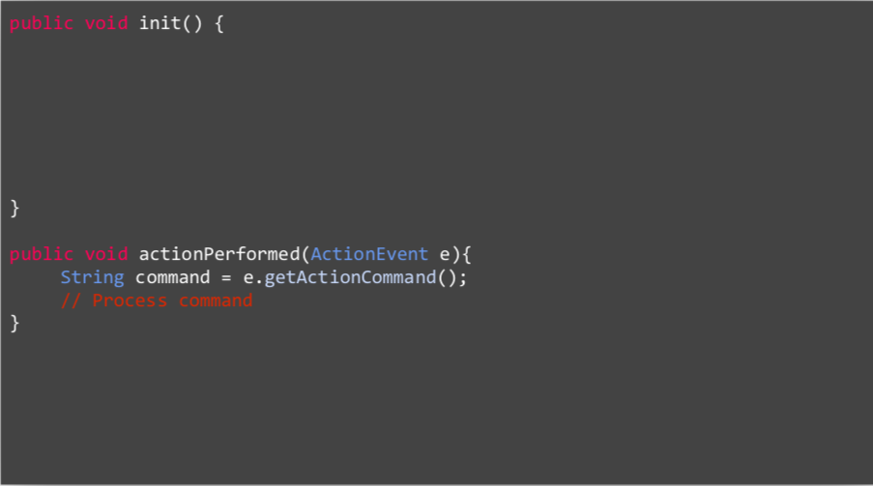
Anatomy of the Program

Slide 14

JButton
The most common interactor in GUI-based applications is an on-screen button, which is implemented in Swing by the class JButton. A JButton object looks something like
Push Me
The constructor for the JButton class is
new JButton(label)
where label is a string telling the user what the button does. The button shown earlier on this slide is therefore created by
JButton pushMeButton = new JButton("Push Me");
When you click on a button, Java generates an action event, which in turn invokes a call to actionPerformed in any listeners that are waiting for action events.

Slide 15
Detecting Event
Before you can detect action events, you need to enable an action listener for the buttons on the screen. The easiest strategy is to call addActionListeners at the end of the init method. This call adds the program as a listener to all the buttons on the display.
You specify the response to a button click by overriding the definition of actionPerformed with a new version that implements the correct actions for each button.
If there is more than one button in the application, you need to be able to tell which one caused the event. There are two strategies for doing so:
1.
Call getSource on the event to obtain the button itself.
2.
Call getActionCommand on the event to get the action command string, which is initially set to the button label.

Slide 16
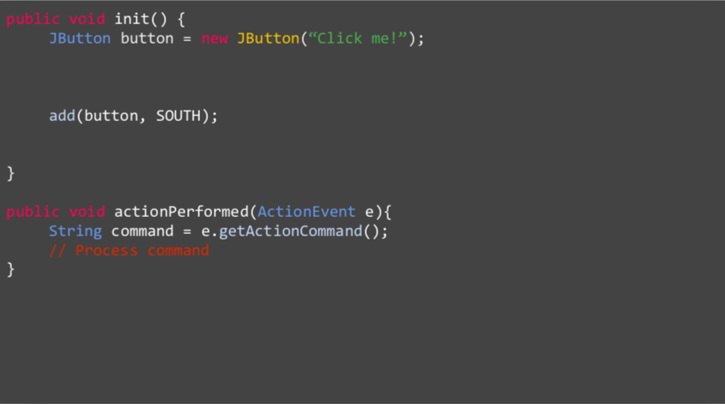
JButton Code

Slide 17
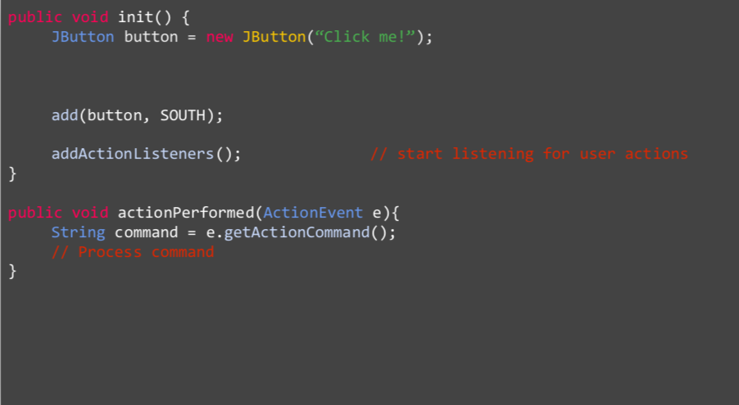
JButton Code

Slide 18
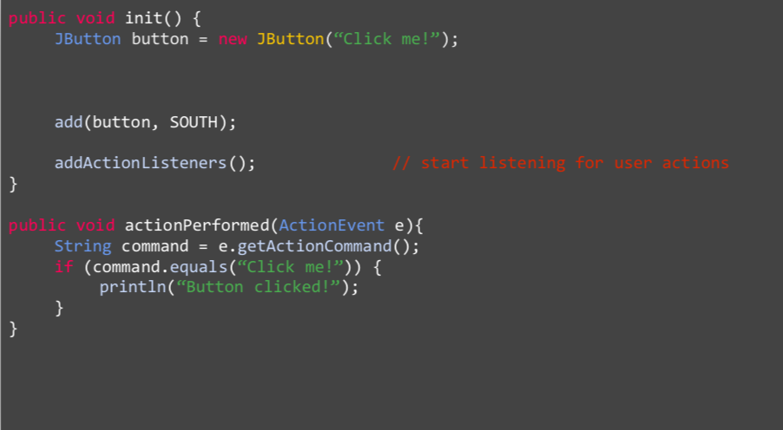
JButton Code

Slide 19
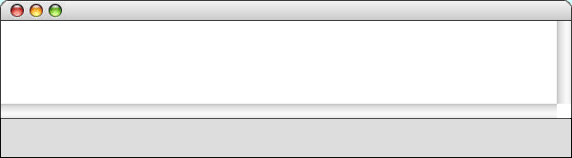


Hitchhiker Button
Arthur listened for a short while, but being unable to understand the vast majority of what Ford was saying he began to let his mind wander, trailing his fingers along the edge of an incomprehensible computer bank, he reached out and pressed an invitingly large red button on a nearby panel. The panel lit up with the words “Please do not press this button again.”
—Douglas Adams, Hitchhiker’s Guide to the Galaxy, 1979
The HitchhikerButton program on the next slide uses this vignette from Hitchhiker’s Guide to the Galaxy to illustrate the process of creating a GUI without focusing on the details. The code creates a single button and adds it to the SOUTH region. It then waits for the user to click the button, at which point the program responds by printing a simple message on the console.
HitchhikerButton
Please do not press this button again.
Please do not press this button again.
Red

Slide 20
Hitchhiker Button
import acm.program.*;
import java.awt.event.*;
import javax.swing.*;
/*
* This program puts up a button on the screen, which triggers a
* message inspired by Douglas Adams's novel.
*/
public class HitchhikerButton extends ConsoleProgram {
/* Initializes the user-interface buttons */
public void init() {
add(new JButton("Red"), SOUTH);
addActionListeners();
}
/* Responds to a button action */
public void actionPerformed(ActionEvent e) {
if (e.getActionCommand().equals("Red")) {
println("Please do not press this button again.");
}
}
}

Slide 21
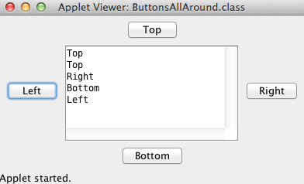
Let's get our hands dirty
Creating a ConsoleProgram including action buttons:
add buttons to the 4 sides and print which one is clicked on the console.
Keywords: JButton, addActionListeners, actionPerformed(ActionEvent e), e.getActionCommand()

Slide 22

JToggle Button
The JToggleButton class is another type of button that is similar to JButton but maintains an on/off state. On the screen, a JToggleButton looks just like a JButton except for the fact that it stays on after you release the mouse button.
As its name suggests, a JToggleButton toggles back and forth between on and off when it is clicked. Clicking the first time turns it from off to on; clicking a second time turns it off.
Toggle
You can determine whether a JToggleButton is on by calling isSelected, which returns true if the button is on.
The JToggleButton class itself is not used as much as two of its subclasses, JCheckBox and JRadioButton, which are described on the next two slides.

Slide 23
JCheckBox
The JCheckBox class is a subclass of JToggleButton and therefore inherits its behavior.
In terms of its operation, a JCheckBox works exactly like an instance of its parent class. The only difference is in what the button looks like on the screen. In a JCheckBox, the button label appears to the right of a small square that either contains or does not contain a check mark, like this:
CheckBox
Because a JCheckBox is a JToggleButton, you can call the isSelected method to determine its state.
Like a JButton, a JCheckBox generates action events when it is clicked. Both of these classes inherit this behavior from AbstractButton, which is their common superclass.

Slide 24
JRadio Button
The JRadioButton class also extends JToggleButton and behaves in much the same way. In this case, the button is displayed as a circle that is tinted and marked with a dot when it is selected, as follows:
Radio button
Radio buttons are ordinarily not used individually but instead as a set. If you create a ButtonGroup object and then add several radio buttons to it, the Swing libraries make sure that only one of those buttons is selected at a time.
Grouped radio buttons are used to allow the user to choose among several mutually exclusive options. As an example, the text extends the DrawStarMap program to allow the user to choose the size of the star by selecting a radio button:
Small
Medium
Large

Slide 25
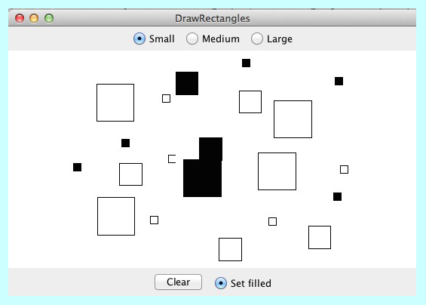
Let's implement an event-driven program from scratch

Slide 26

JSlider Button
In many applications, you want to let the user adjust a value over a wide range instead of selecting among a set of options.
The Swing libraries include several different interactors that allow the user to adjust a parameter. The text uses the JSlider class, which appears on the screen like this:
The user can adjust a JSlider by dragging the slider knob.
The simplest form of the JSlider constructor looks like this:
new JSlider(min, max, value)
where min and max are integers giving the minimum and maximum values of the slider and value is the initial value.
You can retrieve the current value by calling getValue.

Slide 27
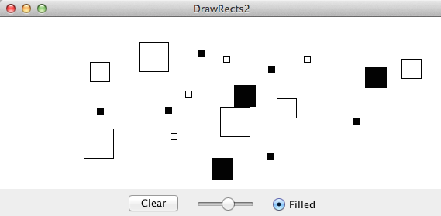
Let's replace our size buttons with a slider

Slide 28
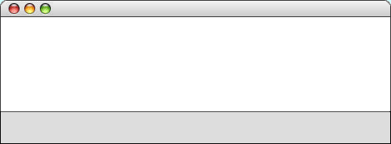

JLabel
The interactors you display on the screen sometimes don’t provide the user with enough information. In such cases, it is useful to include JLabel objects, which appear as text strings in the user interface but do not respond to any events.
As an example, if you wanted to label a slider so that it was clear it controlled size, you could use the following code to produce the control strip shown at the bottom of the screen:
add(new JLabel("Small"), SOUTH);
add(sizeSlider, SOUTH);
add(new JLabel("Large"), SOUTH);
DrawStarMap
Small
Large

Slide 29

JComboBox
In some applications, you may need to allow the user to chose among a set of options that would take up too much space on the screen if you listed them all. In such situations, you can use the JComboBox class, which lists the available options in a popup menu that goes away once the selection is made.
A JComboBox used to select T-shirt sizes might look like this on the screen:
Small
X-Large
X-Large
Medium
Large
From the user’s point of view, a JComboBox works like this:
From the user’s point of view, a JComboBox works like this:
X-Large
Depressing the mouse brings up a popup menu.
Dragging the mouse selects from the different options.
Releasing the mouse sets the state to the current option.
Given that its purpose is to offer the user a choice of options, the JComboBox interactor is sometimes called a chooser.

Slide 30
JComboBox
The standard constructor for a JComboBox creates an empty interactor that contains no options; you then add the desired options by calling the addItem method for each one.
The code to create the T-shirt size chooser looks like this:
JComboBox sizeChooser = new JComboBox();
sizeChooser.addItem("Small");
sizeChooser.addItem("Medium");
sizeChooser.addItem("Large");
sizeChooser.addItem("X-Large");
sizeChooser.setEditable(false);
The last line prevents the user from typing in some other size.
The items in a JComboBox need not be strings but can instead be any object. The label that appears in the popup menu is determined by applying the object’s toString method.
The getSelectedItem and setSelectedItem methods allow you to determine and set which item is selected.

Slide 31
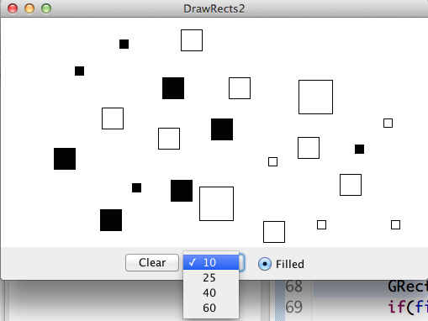
Let's use JComboBox as alternative to selecting radio buttons

Slide 32

JTextField
Although Swing’s set of interactors usually make it possible for the user to control an application using only the mouse, there are nonetheless some situations in which keyboard input is necessary.
You can accept keyboard input in a user interface by using the JTextField class, which provides the user with an area in which it is possible to enter a single line of text.
The HelloGUI program on the next slide illustrates the use of the JTextField class in a ConsoleProgram that prints a greeting each time a name is entered in the text field.
HelloGUI
Hello, world.
Hello, Eric.
world
Name
Eric

Slide 33
JTextField
The constructor for the JTextField class has the form
new JTextField(columns)
where columns is the number of text columns assigned to the field. The space often appears larger than one might expect, because Java reserves space for the widest characters.
You can get and set the string entered in a JTextField by calling the getText and setText methods.
A JTextField generates an action event if the user presses the ENTER key in the field. If you want your program to respond to that action event, you need to register the program as an action listener for the field. In the HelloGUI example, the action listener is enable by the statement
nameField.addActionListener(this);

Slide 34
Hello GUI
import acm.program.*;
import java.awt.event.*;
import javax.swing.*;
/** This class displays a greeting whenever a name is entered */
public class HelloGUI extends ConsoleProgram {
public void init() {
nameField = new JTextField(10);
add(new JLabel("Name"), SOUTH);
add(nameField, SOUTH);
nameField.addActionListener(this);
}
public void actionPerformed(ActionEvent e) {
if (e.getSource() == nameField) {
println("Hello, " + nameField.getText());
}
}
/* Private instance variables */
private JTextField nameField;
}

Slide 35
DoubleField, IntField
The acm.gui package includes two JTextField subclasses that simplify the process of reading numeric input within a graphical user interface. The IntField class interprets its text string as an int; the DoubleField class interprets the text string as a double.
In addition to the usual operations on a JTextField, the IntField and DoubleField classes export getValue and setValue methods that get and set the numeric value of the field.
Although it is beyond the scope of the text, the IntField and DoubleField classes support numeric formatting so that you can control the number of digits in the display. The methods that support this capability are described in the javadoc documentation for these classes.

Slide 36
Managing Layout
So far, the interactors live in control strips on each side of the window. Although using control strips makes sense for simple applications, creating a more sophisticated user interface requires you to be able to place interactors anywhere inside a window.
Arranging interactors to form an elegant, easy-to-use interface is a difficult design challenge. One of the factors that complicates the design is the fact that the size of the program window can change over time. A layout that makes sense for a large window may not be appropriate for a small one.
Java seeks to solve the problem of changing window size by using layout managers, which are responsible for arranging interactors and other components when the windows that contain them change size.

Slide 37

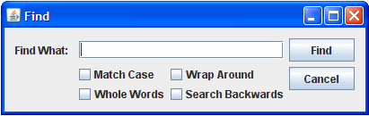
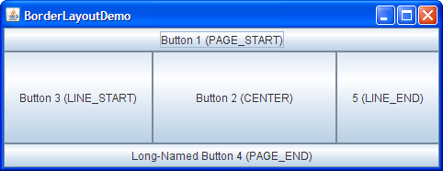
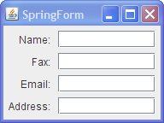
Various Layout Managers exist in Swing
BorderLayout
BoxLayout
CardLayout
FlowLayout
GridBagLayout
GridLayout
GroupLayout
SpringLayout

Slide 38
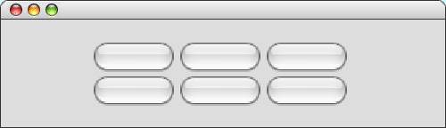
TableLayout
The TableLayout manager arranges components into a two-dimensional grid.
The TableLayout constructor takes the number of rows and columns in the grid:
new TableLayout(rows, columns)
Example:
TableLayoutExample
Button 1
Button 2
Button 3
Button 4
Button 5
Button 6

Slide 39
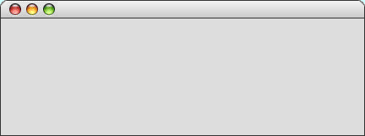
Temperature Convertor
The TemperatureConverter program on the next slide uses the TableLayout manager to create a simple user interface for a program that converts temperatures back and forth from Celsius to Fahrenheit. The steps involved in using the program are:
1.
Enter an integer into either of the numeric fields.
2.
Hit ENTER or click the conversion button.
3.
Read the result from the other numeric field.
TemperatureConverter
Degrees Fahrenheit
32
212
F -> C
Degrees Celsius
0
1
C -> F
10
100

Slide 40
Temperature Convertor Code
/**
* This program allows users to convert temperatures back and forth
* from Fahrenheit to Celsius.
*/
public class TemperatureConverter extends Program {
/* Initializes the graphical user interface */
public void init() {
setLayout(new TableLayout(2, 3));
fahrenheitField = new IntField(32);
fahrenheitField.setActionCommand("F -> C");
fahrenheitField.addActionListener(this);
celsiusField = new IntField(0);
celsiusField.setActionCommand("C -> F");
celsiusField.addActionListener(this);
add(new JLabel("Degrees Fahrenheit"));
add(fahrenheitField);
add(new JButton("F -> C"));
add(new JLabel("Degrees Celsius"));
add(celsiusField);
add(new JButton("C -> F"));
addActionListeners();
}

Slide 41
Temperature Convertor Code
/**
* This program allows users to convert temperatures back and forth
* from Fahrenheit to Celsius.
*/
public class TemperatureConverter extends Program {
/* Initializes the graphical user interface */
public void init() {
setLayout(new TableLayout(2, 3));
fahrenheitField = new IntField(32);
fahrenheitField.setActionCommand("F -> C");
fahrenheitField.addActionListener(this);
celsiusField = new IntField(0);
celsiusField.setActionCommand("C -> F");
celsiusField.addActionListener(this);
add(new JLabel("Degrees Fahrenheit"));
add(fahrenheitField);
add(new JButton("F -> C"));
add(new JLabel("Degrees Celsius"));
add(celsiusField);
add(new JButton("C -> F"));
addActionListeners();
}
/* Listens for a button action */
public void actionPerformed(ActionEvent e) {
String cmd = e.getActionCommand();
if (cmd.equals("F -> C")) {
int f = fahrenheitField.getValue();
int c = GMath.round((5.0 / 9.0) * (f - 32));
celsiusField.setValue(c);
} else if (cmd.equals("C -> F")) {
int c = celsiusField.getValue();
int f = GMath.round((9.0 / 5.0) * c + 32);
fahrenheitField.setValue(f);
}
}
/* Private instance variables */
private IntField fahrenheitField;
private IntField celsiusField;
}

