Slide 1
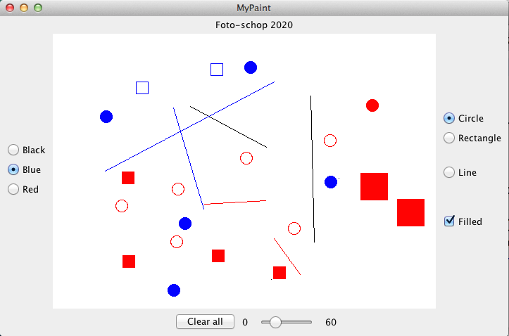
Interactors
For examples, references:
https://sites.google.com/a/ku.edu.tr/comp130/archive/fall2016/8interactors
Notes:
1

Slide 2
Creating a Simple GUI
graphical user interface: GUI consisting of buttons and other on-screen controls. These controls are called interactors.
Interactors of the Swing library will be used.
Two strategies for design: control strip , layout managers.

Slide 3
Creating a Control Strip
When you create an instance of any Program subclass, Java divides the window area into five regions as follows:
NORTH
WEST
EAST
CENTER
SOUTH
The CENTER region is typically where the action takes place. A ConsoleProgram adds a console to the CENTER region, and a GraphicsProgram puts a GCanvas there.
The other regions are visible only if you add an interactors. They appear in the order in which they were added.

Slide 4

The JButton Class
A JButton object looks something like
Push Me
The constructor for the JButton class is
new JButton(label)
where label is a string telling the user what the button does. The button shown earlier on this slide is therefore created by
JButton pushMeButton = new JButton("Push Me");
When you click on a button, Java generates an ActionEvent object, which in turn invokes a call to actionPerformed in any listeners that are waiting for action events.

Slide 5
The HitchhikerButton Program
import acm.program.*;
import java.awt.event.*;
import javax.swing.*;
/*
* This program puts up a button on the screen, which triggers a
* message inspired by Douglas Adams's novel.
*/
public class HitchhikerButton extends ConsoleProgram {
/* Initializes the user-interface buttons */
public void init() {
add(new JButton("Red"), SOUTH);
addActionListeners();
}
/* Responds to a button action */
public void actionPerformed(ActionEvent e) {
if (e.getActionCommand().equals("Red")) {
println("Please do not press this button again.");
}
}
}
We don't have a run method, the program is asynchronous

Slide 6
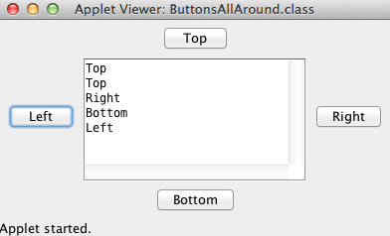
Let's get our hands dirty
Creating a ConsoleProgram including action buttons:
- add buttons to the 4 sides and print which one is clicked on the console.
Keywords: JButton, addActionListeners, actionPerformed(ActionEvent e), e.getActionCommand()

Slide 7
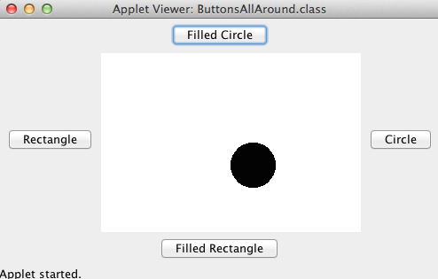
Let's get our hands dirty
Creating a GraphicsProgram including action buttons:
- add buttons to the 4 sides and draw a shape in the middle based on the clicked button.
Keywords: JButton, addActionListeners, actionPerformed(ActionEvent e), e.getActionCommand()

Slide 8
Using check boxes and radio buttons
CheckBox
Radio button
Small
Medium
Large

Slide 9
Remember the Mouse Events
1. Call addMouseListeners.
2. Write new definitions of any listener methods you need.
The most common mouse events are shown in the following table, along with the name of the appropriate listener method:
mouseClicked( e)
Called when the user clicks the mouse
mousePressed( e)
Called when the mouse button is pressed
mouseReleased(e)
Called when the mouse button is released
mouseMoved(e)
Called when the user moves the mouse
mouseDragged(e)
Called when the mouse is dragged with the button down
The parameter e is a MouseEvent object, which gives more data about the event, such as the location of the mouse.
Notes:
9

Slide 10
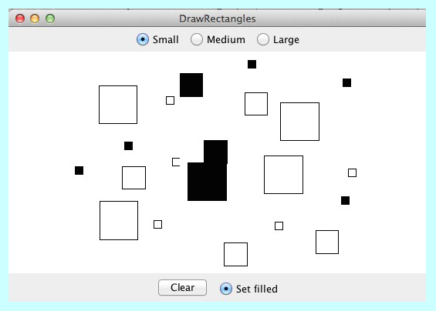
Let's implement the following task which uses radio buttons and mouse events

Slide 11

The JSlider Class
The user can adjust a JSlider by dragging the slider knob.
The simplest form of the JSlider constructor looks like this:
new JSlider(min, max, value)
where min and max are integers giving the minimum and maximum values of the slider and value is the initial value.
You can retrieve the current value by calling getValue.

Slide 12
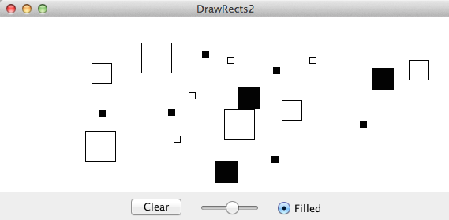
Let's replace our size buttons with a slider

Slide 13
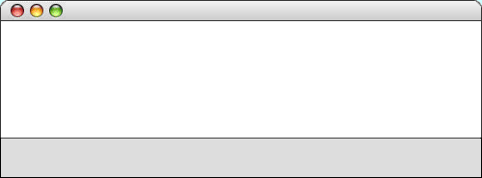

The JLabel Class
add(new JLabel("Small"), SOUTH);
add(sizeSlider, SOUTH);
add(new JLabel("Large"), SOUTH);
DrawStarMap
Small
Large

Slide 14

The JComboBox Class
In some applications, you may need to allow the user to chose among a set of options that would take up too much space on the screen if you listed them all. In such situations, you can use the JComboBox class, which lists the available options in a popup menu that goes away once the selection is made.
A JComboBox used to select T-shirt sizes might look like this on the screen:
Small
X-Large
X-Large
Medium
Large
From the user’s point of view, a JComboBox works like this:
From the user’s point of view, a JComboBox works like this:
X-Large
Depressing the mouse brings up a popup menu.
Dragging the mouse selects from the different options.
Releasing the mouse sets the state to the current option.
Given that its purpose is to offer the user a choice of options, the JComboBox interactor is sometimes called a chooser.

Slide 15
Using the JComboBox Interactor
The standard constructor for a JComboBox creates an empty interactor that contains no options; you then add the desired options by calling the addItem method for each one.
The code to create the T-shirt size chooser looks like this:
JComboBox sizeChooser = new JComboBox();
sizeChooser.addItem("Small");
sizeChooser.addItem("Medium");
sizeChooser.addItem("Large");
sizeChooser.addItem("X-Large");
sizeChooser.setEditable(false);
The last line prevents the user from typing in some other size.
The items in a JComboBox need not be strings but can instead be any object. The label that appears in the popup menu is determined by applying the object’s toString method.
The getSelectedItem and setSelectedItem methods allow you to determine and set which item is selected.

Slide 16
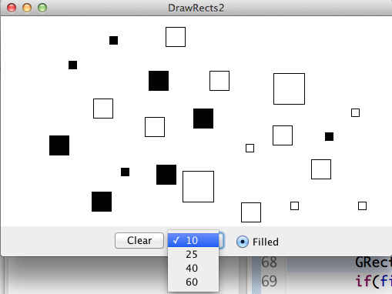
Let's use JComboBox as alternative to selecting radio buttons

Slide 17
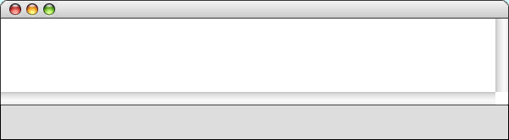

The JTextField Class
You can accept keyboard input in a user interface by using the JTextField class, which provides the user with an area in which it is possible to enter a single line of text.
HelloGUI
Hello, world.
Hello, Eric.
world
Name
Eric

Slide 18
Notes on the JTextField Class
The constructor for the JTextField class has the form
new JTextField(columns)
where columns is the number of text columns assigned to the field (i.e length). The space often appears larger than one might expect, because Java reserves space for the widest characters.
You can get and set the string entered in a JTextField by calling the getText and setText methods.
A JTextField generates an action event if the user presses the ENTER key in the field. If you want your program to respond to that action event, you need to register the program as an action listener for the field. In the HelloGUI example, the action listener is enable by the statement
nameField.addActionListener(this);

Slide 19
The HelloGUI Program
import acm.program.*;
import java.awt.event.*;
import javax.swing.*;
/** This class displays a greeting whenever a name is entered */
public class HelloGUI extends ConsoleProgram {
public void init() {
nameField = new JTextField(10);
add(new JLabel("Name"), SOUTH);
add(nameField, SOUTH);
nameField.addActionListener(this);
}
public void actionPerformed(ActionEvent e) {
if (e.getSource() == nameField) {
println("Hello, " + nameField.getText());
}
}
/* Private instance variables */
private JTextField nameField;
}
We can add one more button for printing

Slide 20
Numeric Fields
JTextField subclasses
IntField class interprets its text string as an int;
DoubleField class interprets the text string as a double.
IntField and DoubleField classes export getValue and setValue methods that get and set the numeric value of the field.

Slide 21
Managing GUI Layout
So far, the interactors live in control strips on each side of the window.
Arranging interactors to form an elegant, easy-to-use interface is a difficult design challenge. One of the factors that complicates the design is the fact that the size of the program window can change over time. A layout that makes sense for a large window may not be appropriate for a small one.
Java seeks to solve the problem of changing window size by using layout managers, which are responsible for arranging interactors and other components when the windows that contain them change size.

Slide 22

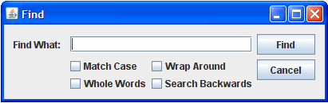
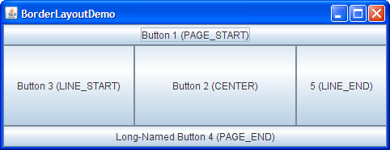
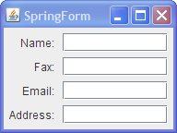
Various Layout Managers exist in Swing
BorderLayout
BoxLayout
CardLayout
FlowLayout
GridBagLayout
GridLayout
GroupLayout
SpringLayout

Slide 23
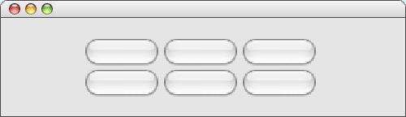
Using the TableLayout Class from ACM
The TableLayout manager arranges components into a two-dimensional grid.
The TableLayout constructor takes the number of rows and columns in the grid:
new TableLayout(rows, columns)
Example:
TableLayoutExample
Button 1
Button 2
Button 3
Button 4
Button 5
Button 6

Slide 24
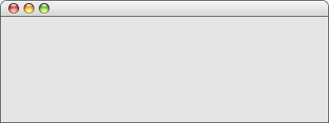


A Temperature Conversion Program
The TemperatureConverter program on the next slide uses the TableLayout manager to create a simple user interface for a program that converts temperatures back and forth from Celsius to Fahrenheit. The steps involved in using the program are:
1.
Enter an integer into either of the numeric fields.
2.
Hit ENTER or click the conversion button.
3.
Read the result from the other numeric field.
TemperatureConverter
Degrees Fahrenheit
32
212
F -> C
Degrees Celsius
0
1
C -> F
10
100
C=(F - 32) x (5/9) F=C x 1.8 + 32
Let's implement it, Lec26

Slide 25
Code for the Temperature Converter
/**
* This program allows users to convert temperatures back and forth
* from Fahrenheit to Celsius.
*/
public class TemperatureConverter extends Program {
/* Initializes the graphical user interface */
public void init() {
setLayout(new TableLayout(2, 3));
fahrenheitField = new DoubleField(32);
celsiusField = new DoubleField(0);
add(new JLabel("Degrees Fahrenheit"));
add(fahrenheitField);
add(new JButton("F -> C"));
add(new JLabel("Degrees Celsius"));
add(celsiusField);
add(new JButton("C -> F"));
addActionListeners();
}
page 1 of 2
skip code

Slide 26
Code for the Temperature Converter
/**
* This program allows users to convert temperatures back and forth
* from Fahrenheit to Celsius.
*/
public class TemperatureConverter extends Program {
/* Initializes the graphical user interface */
public void init() {
setLayout(new TableLayout(2, 3));
fahrenheitField = new IntField(32);
fahrenheitField.setActionCommand("F -> C");
fahrenheitField.addActionListener(this);
celsiusField = new IntField(0);
celsiusField.setActionCommand("C -> F");
celsiusField.addActionListener(this);
add(new JLabel("Degrees Fahrenheit"));
add(fahrenheitField);
add(new JButton("F -> C"));
add(new JLabel("Degrees Celsius"));
add(celsiusField);
add(new JButton("C -> F"));
addActionListeners();
}
/* Listens for a button action */
public void actionPerformed(ActionEvent e) {
String cmd = e.getActionCommand();
if (cmd.equals("F -> C")) {
int f = fahrenheitField.getValue();
int c = GMath.round((5.0 / 9.0) * (f - 32));
celsiusField.setValue(c);
} else if (cmd.equals("C -> F")) {
int c = celsiusField.getValue();
int f = GMath.round((9.0 / 5.0) * c + 32);
fahrenheitField.setValue(f);
}
}
/* Private instance variables */
private IntField fahrenheitField;
private IntField celsiusField;
}
page 2 of 2
skip code

Slide 27
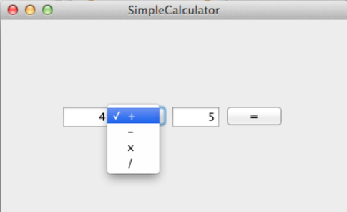
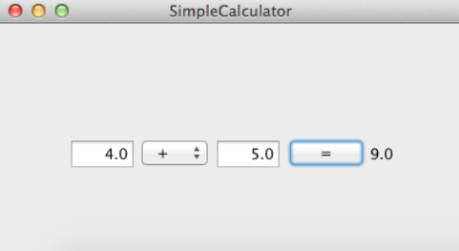
Calculator
Before clicking =
After clicking =
DoubleField
JComboBox
JButton
JLabel
Ensure there will be no divide by zero error

