Slide 1
Calling Methods
turnRight();
move();
readInt(“Int please! ”);
println(“hello world”);
rect.getX();
drawRobotFace();
rect.setLocation(10, 20);

Slide 2

Defining a Method
private void turnRight() {
turnLeft();
turnLeft();
turnLeft();
}

Slide 3
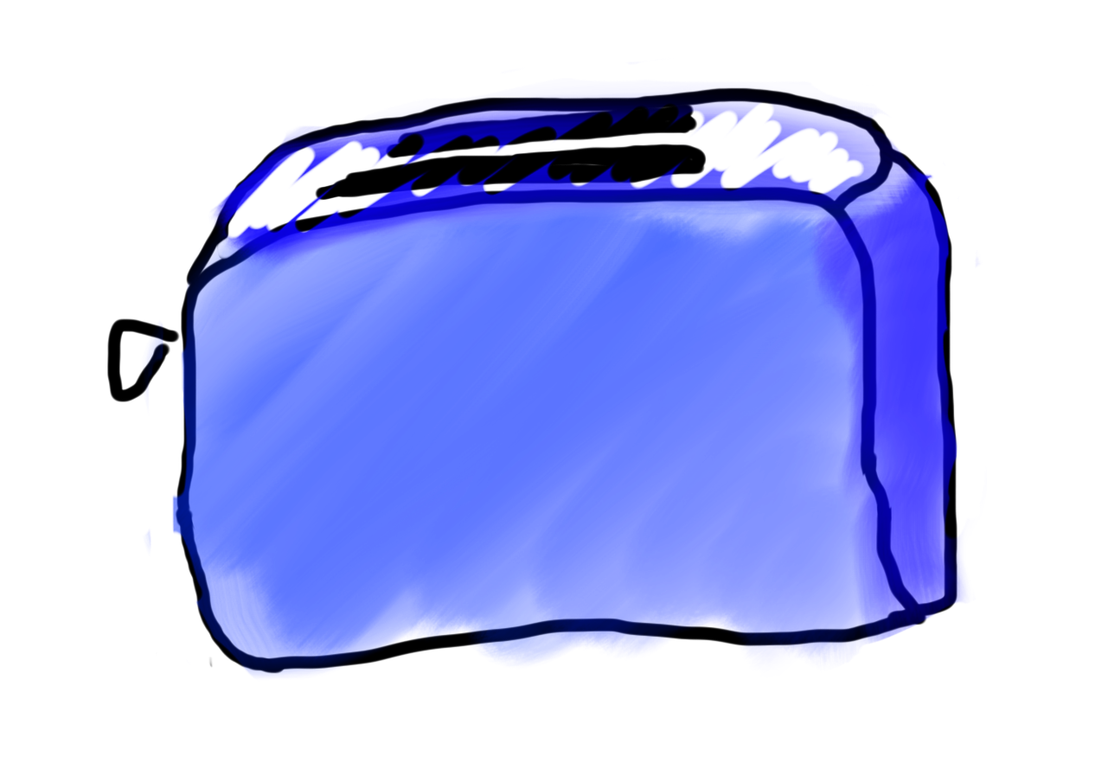
Methods are Like Toasters

Slide 4
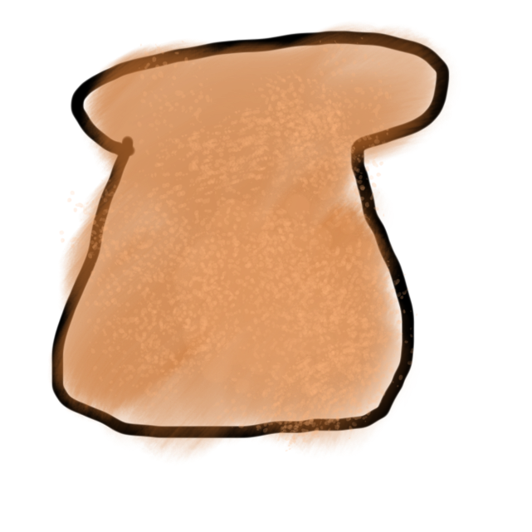
Methods are Like Toasters
parameter

Slide 5
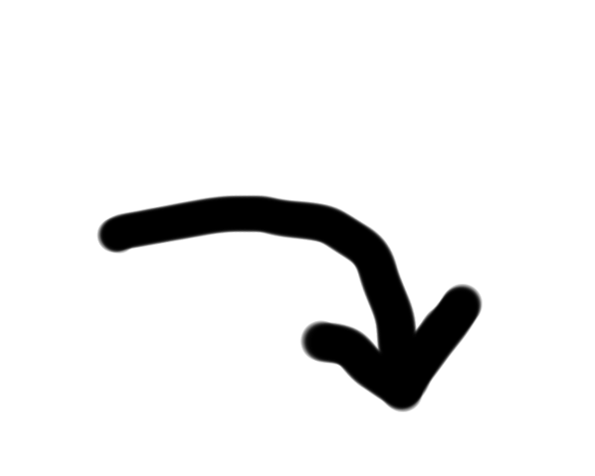
Methods are Like Toasters
parameter

Slide 6
Methods are Like Toasters

Slide 7

Methods are Like Toasters

Slide 8
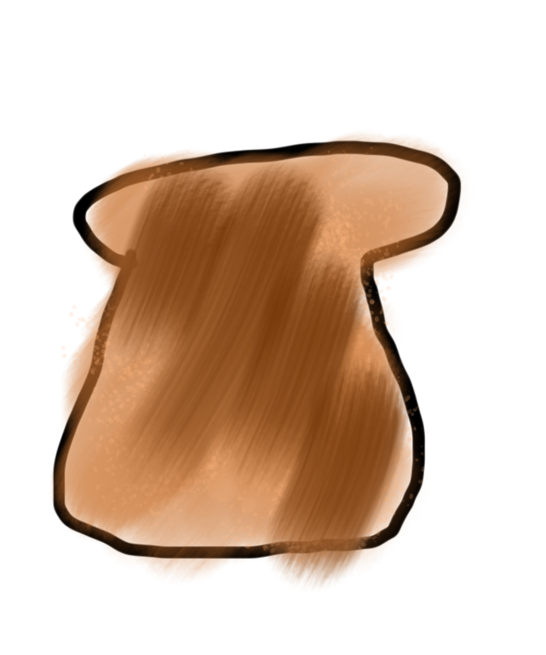
Methods are Like Toasters
return

Slide 9
Methods are Like Toasters

Slide 10
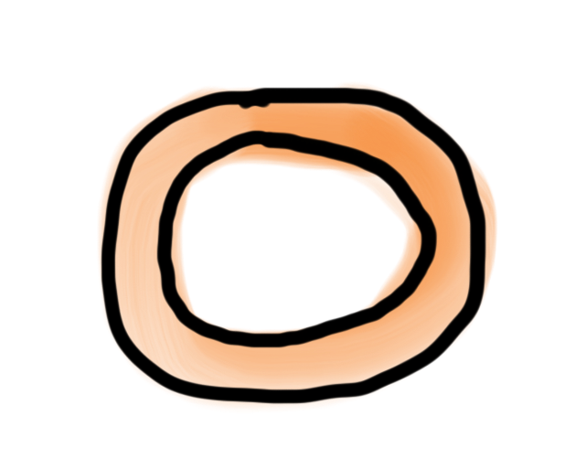
Methods are Like Toasters

Slide 11
Methods are Like Toasters

Slide 12
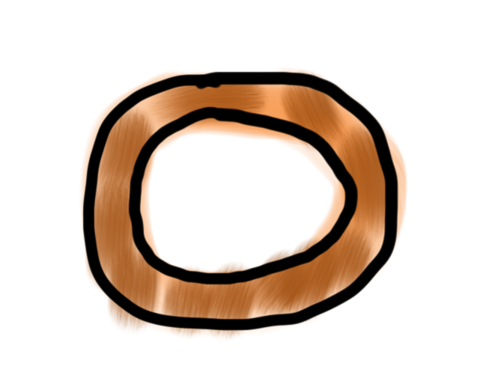
Methods are Like Toasters

Slide 13
Methods are Like Toasters

Slide 14
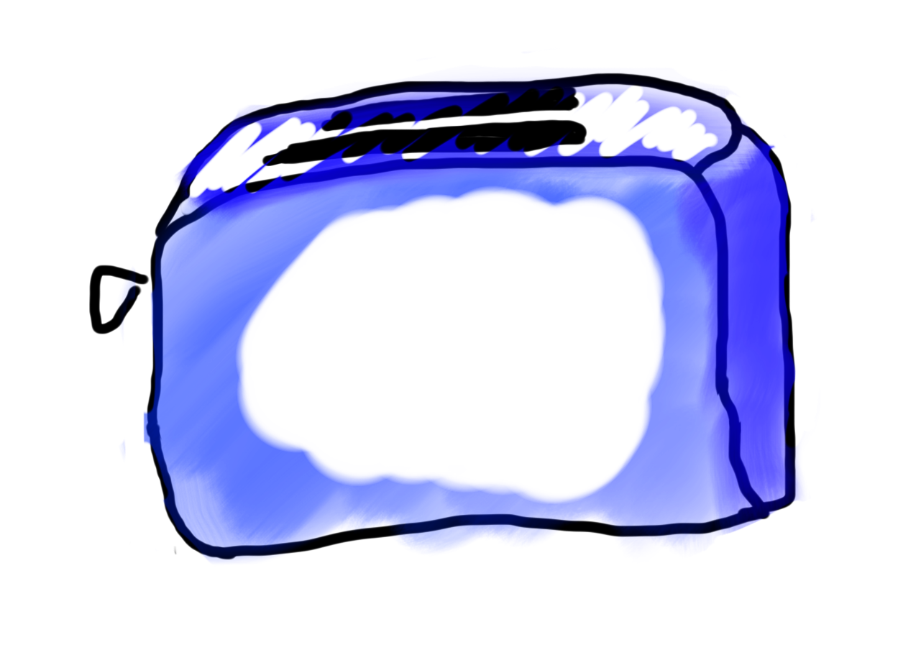
Methods are Like Toasters

Slide 15
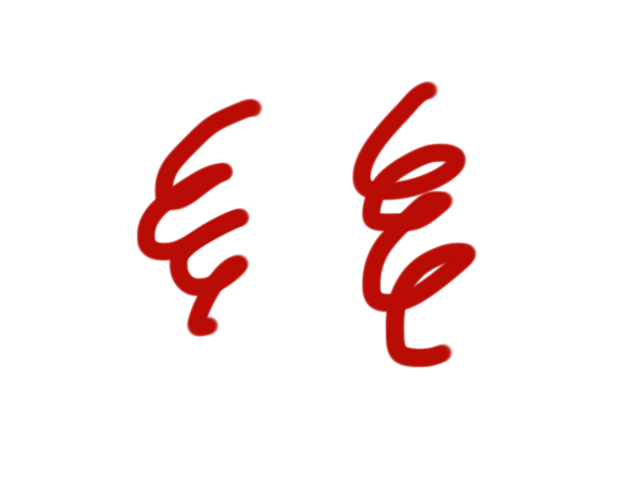
Methods are Like Toasters

Slide 16
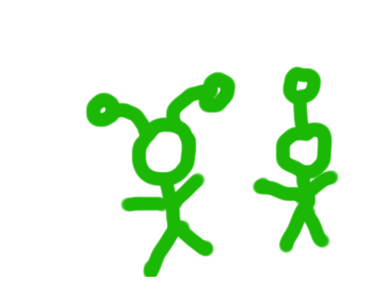
Methods are Like Toasters

Slide 17
Methods are Like Toasters
parameter(s)
return

Slide 18
Anatomy of a method
public void run() {
double mid = average(5.0, 10.2);
println(mid);
}
private double average(double a, double b) {
double sum = a + b;
return sum / 2;
}

Slide 19
Anatomy of a method
public void run() {
double mid = average(5.0, 10.2);
println(mid);
}
private double average(double a, double b) {
double sum = a + b;
return sum / 2;
}
Output expected
Input expected

Slide 20
Anatomy of a method
public void run() {
double mid = average(5.0, 10.2);
println(mid);
}
private double average(double a, double b) {
double sum = a + b;
return sum / 2;
}
name

Slide 21
Anatomy of a method
public void run() {
double mid = average(5.0, 10.2);
println(mid);
}
private double average(double a, double b) {
double sum = a + b;
return sum / 2;
}
body

Slide 22
Anatomy of a method
public void run() {
double mid = average(5.0, 10.2);
println(mid);
}
private double average(double a, double b) {
double sum = a + b;
return sum / 2;
}
return

Slide 23
Anatomy of a method
public void run() {
double mid = average(5.0, 10.2);
println(mid);
}
private double average(double a, double b) {
double sum = a + b;
return sum / 2;
}
method “call”

Slide 24
Void Example
private void printIntro() {
println("Welcome to class");
println("It's the best part of my day.");
}
public void run() {
printIntro();
}

Slide 25
Example
private double metersToCm(double meters) {
return 100 * meters;
}
public void run() {
println(metersToCm(5.2));
}

Slide 26
Parameter Example
private void printOpinion(int num) {
if(num == 5) {
println(“I love 5!”);
} else {
println(“Whattever”);
}
}
public void run() {
printOpinion(5);
}

Slide 27
Multiple Return
private String getMonthName(int i) {
if (i == 0) {
return “January”;
}
if (i == 1) {
return “February”;
}
…
return “Unknown”;
}

Slide 28
Defining a Method
visibility type nameOfMethod(parameters) {
statements
}
visibility: usually private or public
type: type returned by method (e.g., int , double, etc.)
Can be void to indicate that nothing is returned
parameters: information passed into method

Slide 29
private void run() {
double r = readPositive(“Enter radius: “);
double area = getArea(r);
println(area);
}
private double readPositive(String prompt) {
double value = readDouble(prompt);
while(value < 0) {
println(“Invalid”);
value = readDouble(prompt);
}
return value;
}
private double getArea(double radius) {
return PI * radius * radius;
}

Slide 30
private void run() {
double r = readPositive(“Enter radius: “);
double area = getArea(r);
println(area);
}

Slide 31
private void run() {
double r = readPositive(“Enter radius: “);
double area = getArea(r);
println(area);
}

Slide 32
private void run() {
double r = readPositive(“Enter radius: “);
double area = getArea(r);
println(area);
}

Slide 33
private void run() {
double r = readPositive(“Enter radius: “);
double area = getArea(r);
println(area);
}
private double readPositive(String prompt) {
double value = readDouble(prompt);
while(value < 0) {
println(“Invalid”);
value = readDouble(prompt);
}
return value;
}

Slide 34
private void run() {
double r = readPositive(“Enter radius: “);
double area = getArea(r);
println(area);
}
private double readPositive(String prompt) {
double value = readDouble(prompt);
while(value < 0) {
println(“Invalid”);
value = readDouble(prompt);
}
return value;
}
prompt
“Enter radius: “

Slide 35
private void run() {
double r = readPositive(“Enter radius: “);
double area = getArea(r);
println(area);
}
private double readPositive(String prompt) {
double value = readDouble(prompt);
while(value < 0) {
println(“Invalid”);
value = readDouble(prompt);
}
return value;
}
prompt
“Enter radius: “
value
-3

Slide 36
private void run() {
double r = readPositive(“Enter radius: “);
double area = getArea(r);
println(area);
}
private double readPositive(String prompt) {
double value = readDouble(prompt);
while(value < 0) {
println(“Invalid”);
value = readDouble(prompt);
}
return value;
}
prompt
“Enter radius: “
value
-3

Slide 37
private void run() {
double r = readPositive(“Enter radius: “);
double area = getArea(r);
println(area);
}
private double readPositive(String prompt) {
double value = readDouble(prompt);
while(value < 0) {
println(“Invalid”);
value = readDouble(prompt);
}
return value;
}
prompt
“Enter radius: “
value
-3

Slide 38
private void run() {
double r = readPositive(“Enter radius: “);
double area = getArea(r);
println(area);
}
private double readPositive(String prompt) {
double value = readDouble(prompt);
while(value < 0) {
println(“Invalid”);
value = readDouble(prompt);
}
return value;
}
prompt
“Enter radius: “
value
-3

Slide 39
private void run() {
double r = readPositive(“Enter radius: “);
double area = getArea(r);
println(area);
}
private double readPositive(String prompt) {
double value = readDouble(prompt);
while(value < 0) {
println(“Invalid”);
value = readDouble(prompt);
}
return value;
}
prompt
“Enter radius: “
value
42

Slide 40
private void run() {
double r = readPositive(“Enter radius: “);
double area = getArea(r);
println(area);
}
private double readPositive(String prompt) {
double value = readDouble(prompt);
while(value < 0) {
println(“Invalid”);
value = readDouble(prompt);
}
return value;
}
prompt
“Enter radius: “
value
42

Slide 41
private void run() {
double r = readPositive(“Enter radius: “);
double area = getArea(r);
println(area);
}
private double readPositive(String prompt) {
double value = readDouble(prompt);
while(value < 0) {
println(“Invalid”);
value = readDouble(prompt);
}
return value;
}
prompt
“Enter radius: “
value
42

Slide 42
private void run() {
double r = readPositive(“Enter radius: “);
double area = getArea(r);
println(area);
}
private double readPositive(String prompt) {
double value = readDouble(prompt);
while(value < 0) {
println(“Invalid”);
value = readDouble(prompt);
}
return value;
}
prompt
“Enter radius: “
value
42

Slide 43
private void run() {
double r = readPositive(“Enter radius: “);
double area = getArea(r);
println(area);
}
42

Slide 44
private void run() {
double r = readPositive(“Enter radius: “);
double area = getArea(r);
println(area);
}
42
r
42

Slide 45
private void run() {
double r = readPositive(“Enter radius: “);
double area = getArea(r);
println(area);
}
r
42

Slide 46
private void run() {
double r = readPositive(“Enter radius: “);
double area = getArea(r);
println(area);
}
r
42

Slide 47
private void run() {
double r = readPositive(“Enter radius: “);
double area = getArea(r);
println(area);
}
private double getArea(double radius) {
return PI * radius * radius;
}
r
42

Slide 48
private void run() {
double r = readPositive(“Enter radius: “);
double area = getArea(r);
println(area);
}
private double getArea(double radius) {
return PI * radius * radius;
}
r
radius
42
42

Slide 49
private void run() {
double r = readPositive(“Enter radius: “);
double area = getArea(r);
println(area);
}
private double getArea(double radius) {
return PI * radius * radius;
}
r
radius
42
42

Slide 50
private void run() {
double r = readPositive(“Enter radius: “);
double area = getArea(r);
println(area);
}
private double getArea(double radius) {
return PI * radius * radius;
}
5538.96
r
radius
42
42

Slide 51
private void run() {
double r = readPositive(“Enter radius: “);
double area = getArea(r);
println(area);
}
5538.96
r
42

Slide 52
private void run() {
double r = readPositive(“Enter radius: “);
double area = getArea(r);
println(area);
}
5538.96
r
42

Slide 53
private void run() {
double r = readPositive(“Enter radius: “);
double area = getArea(r);
println(area);
}
5538.96
r
42
area
5538.96

Slide 54
private void run() {
double r = readPositive(“Enter radius: “);
double area = getArea(r);
println(area);
}
r
42
area
5538.96

Slide 55
private void run() {
double r = readPositive(“Enter radius: “);
double area = getArea(r);
println(area);
}
r
42
area
5538.96

Slide 56
Bad Times With Methods
// NOTE: This program is buggy!!
private void addFive(int x) {
x += 5;
}
public void run() {
int x = 3;
addFive(x);
println("x = " + x);
}

Slide 57
Good Times With Methods
// NOTE: This program is feeling just fine...
private int addFive(int x) {
x += 5;
return x;
}
public void run() {
int x = 3;
x = addFive(x);
println("x = " + x);
}

Slide 58
More Examples

Slide 59
Changed Name
private void run() {
int num = 5;
cow(num);
}
private void cow(int grass) {
println(grass);
}

Slide 60
Same Variable
private void run() {
int num = 5;
cow();
}
private void cow() {
int num = 10;
println(num);
}

Slide 61
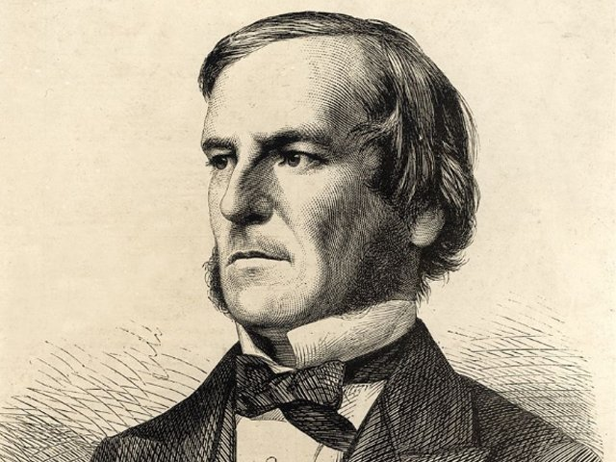
Booleans

Slide 62

Boolean

Slide 63
Boolean Variable
boolean karelIsAwesome = true;
boolean myBool = 1 < 2;

Slide 64
Boolean Operations
boolean a = true;
boolean b = false;
boolean a_and_b = a && b;
boolean a_or_b = a || b;
boolean not_a = !a;

