Slide 1

GUI - Interactors

Slide 2
Interactors
Interactors: graphical element that the user can interact with or view
Presented by a GUI program
Also called widget

Slide 3
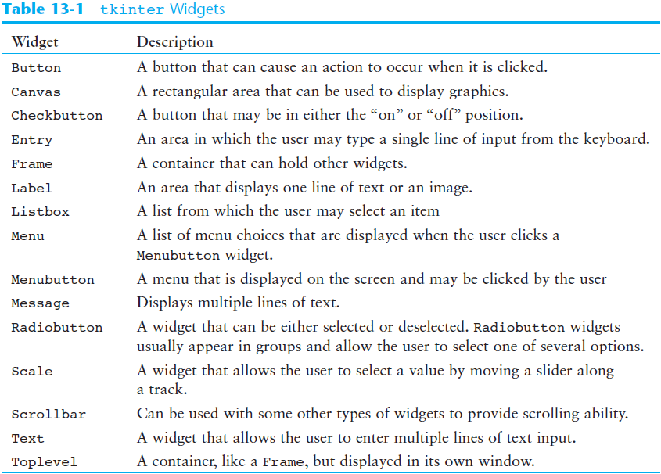

Slide 4
Interactors in graphics.py
Button - widget that the user can click to cause an action to take place
When creating a button can specify:
Text to appear on the face of the button
Location of the button
Text Field - widget that the user can type in
When creating a text field can specify:
Name of the text field
Text appear before the text field
Location of the text field

Slide 5
Interactors in graphics.py
Button
canvas.create_button(“Text and name of the button", location of the button)
e.g canvas.create_button(“Create Rectangle", Canvas.TOP)

Slide 6
Interactors in graphics.py
Text Field
canvas.create_text_field(“name and text of the textfield", location of the textfield)
e.g
canvas.create_text_field("Color", Canvas.TOP)

