Slide 1


Slide 2


Slide 3
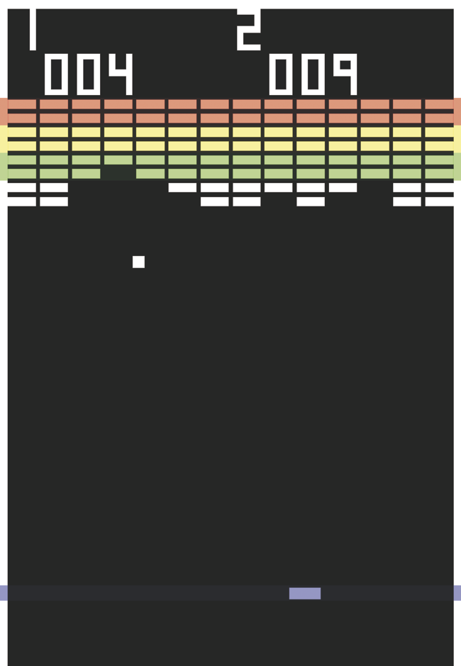
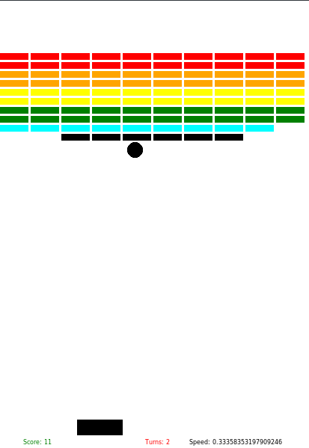
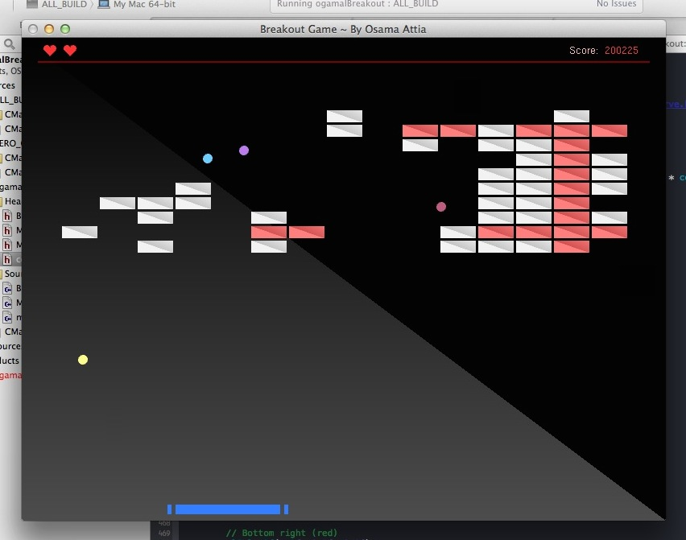
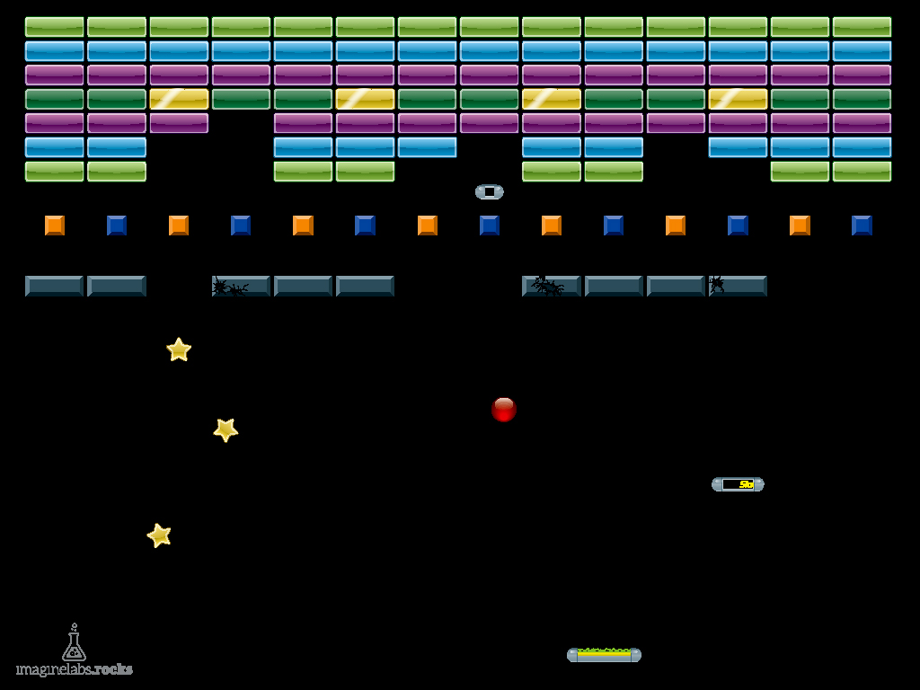
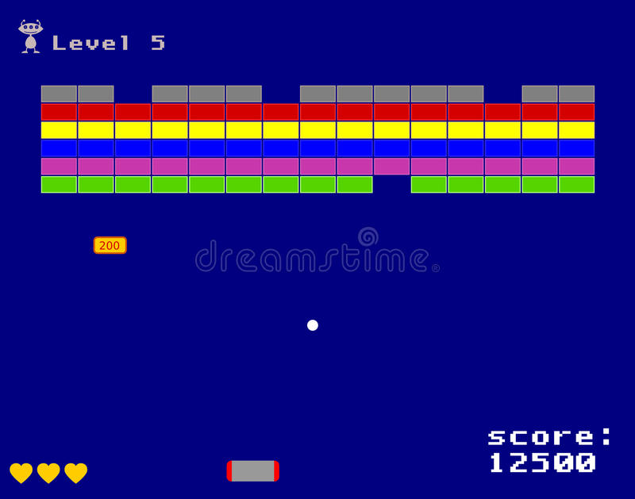

Slide 4
Plan
multiple return values
special bricks
enhanced bouncing
increasing speed
cheats
score
lives
paddle with varying bounce angle

Slide 5
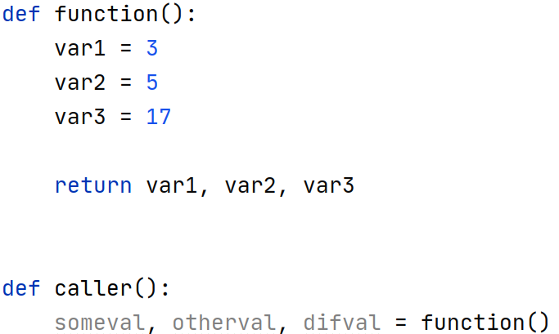

Slide 6
multiple return values
special bricks
enhanced bouncing
increasing speed
cheats
score
lives
paddle with varying bounce angle

Slide 7
Special Bricks
permanent bricks
bricks with a counter
game change (speed, angle, lives)
game-changing “brick” anywhere
How to implement this?

Slide 9
Permanent Bricks
Sticky brick problem

Slide 10
multiple return values
special bricks
enhanced bouncing
increasing speed
cheats
score
lives
paddle with varying bounce angle

Slide 11
The ball is below the bottom so we reverse its change_y
The ball is bellow the bottom so we reverse its change_y

Slide 12
change_y
change_x
over_y
change_x
over_y
change_y

Slide 13
canvas.move(ball, change_x, change_y + 2 * over_y)
change_y
change_x
2 * over_y
change_x
over_y
change_y

Slide 14
multiple return values
special bricks
enhanced bouncing
increasing speed
cheats
score
lives
paddle with varying bounce angle

Slide 16
multiple return values
special bricks
enhanced bouncing
increasing speed
cheats
score
lives
paddle with varying bounce angle

Slide 17
decrease the difficulty (speed)
add turn
infinite turns
sticky paddle
multiple balls or paddles

Slide 18
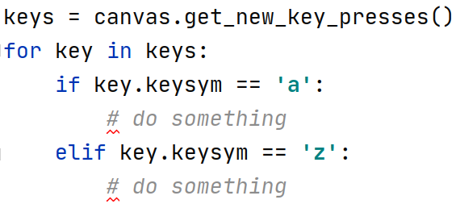

Slide 21
multiple return values
special bricks
enhanced bouncing
increasing speed
cheats
score
lives
paddle with varying bounce angle

Slide 23
multiple return values
special bricks
enhanced bouncing
increasing speed
cheats
score
lives
paddle with varying bounce angle

Slide 26


