Slide 1

CS Bridge, Lecture 3 More Karel Control Flow

Slide 2
Lecture Plan
Review: Karel and Control Flow
If/Else Statements
Practice: Hurdle Jumper
Decomposition and Top-Down Design

Slide 3
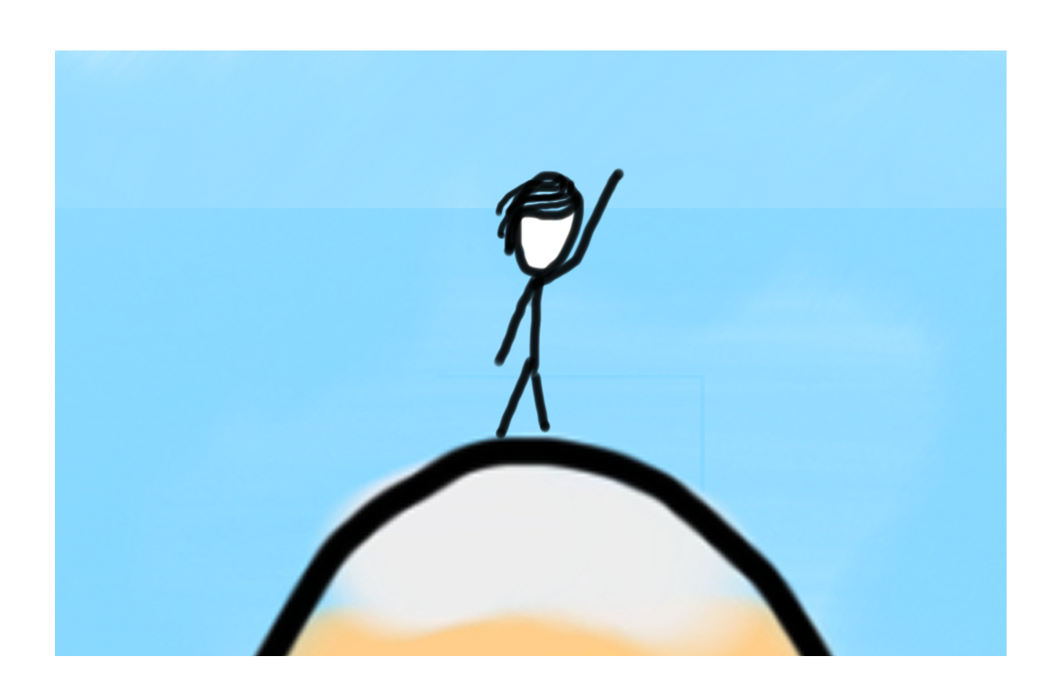

Learning Goals
Code using conditions
Trace programs that use loops and conditions

Slide 4
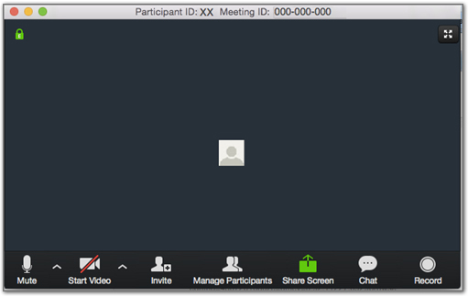

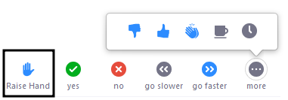
Ask Questions!
Notes:
[3:0; 3-6]
interactions
do interact, ask questions
chat
our assistant, say hello
speak: raise hand
other icons
stay muted

Slide 5
Lecture Plan
Review: Karel and Control Flow
If/Else Statements
Practice: Hurdle Jumper
Decomposition and Top-Down Design

Slide 6
Control Flow
Control Flow lets us control the “flow” of our Karel program.
Example: repeat something 5 times
Example: repeat something until Karel is blocked

Slide 7
Control Flow: For Loops
for i in range(count):
statement
statement
...
Repeats the statements in the body count times.
Notes:
Executes statements in order – NOT repeating each one individually

Slide 8
Control Flow: While Loops
while condition:
statement
statement
...
Repeats the statements in the body until condition is no longer true.
Each time, Karel executes all statements, and then checks the condition.
Notes:
Karel can ask some questions about its world / surroundings

Slide 9
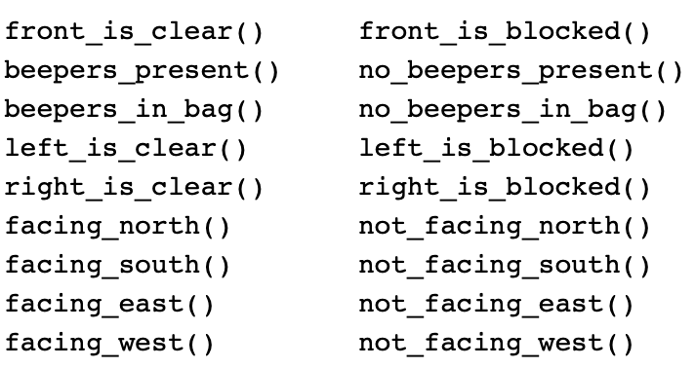
Possible Questions
This is taken from the Karel Reference.

Slide 10
Loops Overview
I want Karel to repeat some commands!
Know how many times
Don’t know how many times
for loop
while loop
Notes:
E.g. “pick up all the beepers on this square”
E.g. “turn until you’re facing west”
E.g. “put down 5 beepers”

Slide 11

Fencepost
I want Karel to put down a row of beepers until it reaches a wall. How do I do this?
Let’s first pretend the program must only work for this world. What commands should Karel execute?

Slide 12
Fencepost
I want Karel to put down a row of beepers until it reaches a wall. How do I do this?
put_beeper()
move()
put_beeper()
move()
put_beeper()
move()
put_beeper()

Slide 13

Fencepost
I want Karel to put down a row of beepers until it reaches a wall. How do I do this?
put_beeper()
move()
put_beeper()
move()
put_beeper()
move()
put_beeper()

Slide 14
Fencepost
I want Karel to put down a row of beepers until it reaches a wall. How do I do this?
put_beeper()
move()
put_beeper()
move()
put_beeper()
move()
put_beeper()

Slide 15
Fencepost
I want Karel to put down a row of beepers until it reaches a wall. How do I do this?
put_beeper()
move()
put_beeper()
move()
put_beeper()
move()
put_beeper()

Slide 16
Fencepost
I want Karel to put down a row of beepers until it reaches a wall. How do I do this?
put_beeper()
move()
put_beeper()
move()
put_beeper()
move()
put_beeper()

Slide 17
Fencepost
I want Karel to put down a row of beepers until it reaches a wall. How do I do this?
put_beeper()
move()
put_beeper()
move()
put_beeper()
move()
put_beeper()

Slide 18
Fencepost
I want Karel to put down a row of beepers until it reaches a wall. How do I do this?
put_beeper()
move()
put_beeper()
move()
put_beeper()
move()
put_beeper()

Slide 19
Fencepost
I want Karel to put down a row of beepers until it reaches a wall. How do I do this?
put_beeper()
move()
put_beeper()
move()
put_beeper()
move()
put_beeper()

Slide 20
Fencepost
I want Karel to put down a row of beepers until it reaches a wall. How do I do this?
put_beeper()
move()
put_beeper()
move()
put_beeper()
move()
put_beeper()

Slide 21
Fencepost
I want Karel to put down a row of beepers until it reaches a wall. How do I do this?
put_beeper()
move()
put_beeper()
move()
put_beeper()
move()
put_beeper()

Slide 22
Fencepost
I want Karel to put down a row of beepers until it reaches a wall. How do I do this?
put_beeper()
move()
put_beeper()
move()
put_beeper()
move()
put_beeper()
We must put 4 beepers but move 3 times!

Slide 23
Fencepost
I want Karel to put down a row of beepers until it reaches a wall. How do I do this?
We must put 4 beepers but move 3 times!
while front_is_clear():
put_beeper()
move()
put_beeper()

Slide 24
Fencepost
I want Karel to put down a row of beepers until it reaches a wall. How do I do this?
while front_is_clear():
put_beeper()
move()
put_beeper()

Slide 25
Fencepost
I want Karel to put down a row of beepers until it reaches a wall. How do I do this?
while front_is_clear():
put_beeper()
move()
put_beeper()

Slide 26
Fencepost
I want Karel to put down a row of beepers until it reaches a wall. How do I do this?
while front_is_clear():
put_beeper()
move()
put_beeper()

Slide 27
Fencepost
I want Karel to put down a row of beepers until it reaches a wall. How do I do this?
while front_is_clear():
put_beeper()
move()
put_beeper()

Slide 28
Fencepost
I want Karel to put down a row of beepers until it reaches a wall. How do I do this?
while front_is_clear():
put_beeper()
move()
put_beeper()

Slide 29
Fencepost
I want Karel to put down a row of beepers until it reaches a wall. How do I do this?
while front_is_clear():
put_beeper()
move()
put_beeper()

Slide 30
Fencepost
I want Karel to put down a row of beepers until it reaches a wall. How do I do this?
while front_is_clear():
put_beeper()
move()
put_beeper()

Slide 31
Fencepost
I want Karel to put down a row of beepers until it reaches a wall. How do I do this?
while front_is_clear():
put_beeper()
move()
put_beeper()

Slide 32
Fencepost
I want Karel to put down a row of beepers until it reaches a wall. How do I do this?
while front_is_clear():
put_beeper()
move()
put_beeper()

Slide 33
Fencepost
I want Karel to put down a row of beepers until it reaches a wall. How do I do this?
while front_is_clear():
put_beeper()
move()
put_beeper()

Slide 34
Fencepost
I want Karel to put down a row of beepers until it reaches a wall. How do I do this?
while front_is_clear():
put_beeper()
move()
put_beeper()

Slide 35
Fencepost
I want Karel to put down a row of beepers until it reaches a wall. How do I do this?
while front_is_clear():
put_beeper()
move()
put_beeper()

Slide 36
Fencepost
I want Karel to put down a row of beepers until it reaches a wall. How do I do this?
while front_is_clear():
put_beeper()
move()
put_beeper()

Slide 37
Fencepost
I want Karel to put down a row of beepers until it reaches a wall. How do I do this?
put_beeper()
move()
put_beeper()
move()
...
put_beeper()
We must put N beepers but move N-1 times!

Slide 38
Fencepost
I want Karel to put down a row of beepers until it reaches a wall. How do I do this?
put_beeper()
move()
put_beeper()
move()
put_beeper()
move()
put_beeper()

Slide 39
Fencepost
I want Karel to put down a row of beepers until it reaches a wall. How do I do this?
put_beeper()
move()
put_beeper()
move()
put_beeper()
move()
put_beeper()

Slide 40
Fencepost
I want Karel to put down a row of beepers until it reaches a wall. How do I do this?
put_beeper()
while front_is_clear():
move()
put_beeper()

Slide 41
Fencepost
I want Karel to put down a row of beepers until it reaches a wall. How do I do this?
put_beeper()
move()
put_beeper()
move()
put_beeper()
...
move()
put_beeper()
We must put N beepers but move N-1 times!

Slide 42
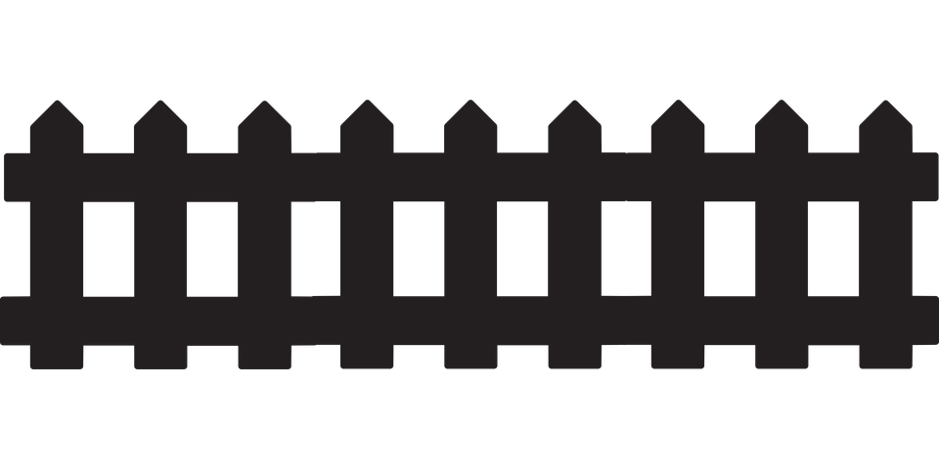
Fencepost Problem
8 fence segments, but 9 posts!

Slide 43
Fencepost Structure
The fencepost structure is useful when you want to loop a set of statements but do one part of that set 1 additional time.
put_beeper() # post
while front_is_clear():
move() # fence
put_beeper() # post
# or...
while front_is_clear():
put_beeper() # post
move() # fence
put_beeper() # post

Slide 44
Indentation
Karel is very picky about indentation.
Make sure to indent a code block 1 level further when you:
Define a new Karel command
Write a for loop
Write a while loop
You may nest these. Make sure you keep track of your indentation!

Slide 45
Indentation
Karel is very picky about indentation.
for i in range(count):
statements # note indenting
def my_command():
for i in range(3):
turn_left()
put_beeper()

Slide 46
Lecture Plan
Review: Karel and Control Flow
If/Else Statements
Practice: Hurdle Jumper
Decomposition and Top-Down Design

Slide 47
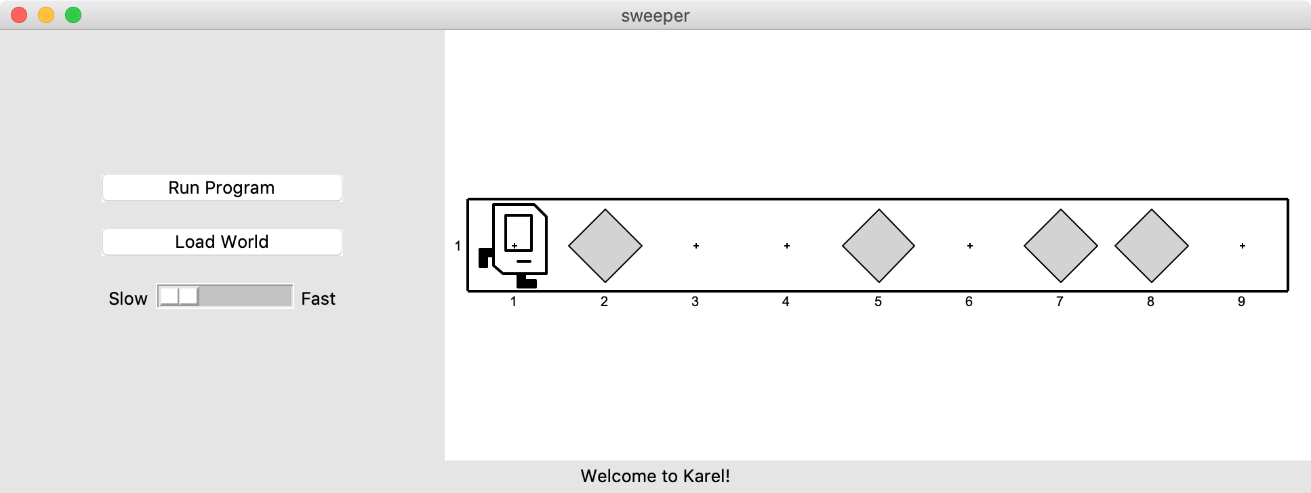
If Statements
I want to make Karel clean up all beepers in front of it until it reaches a wall. How do I do this?

Slide 48
If Statements
Will this work?
while front_is_clear():
move()
pick_beeper()
No. This may crash, because Karel cannot pick up beepers if there aren’t any. We don’t always want Karel to pick up beepers; just when there is a beeper to pick up.

Slide 49
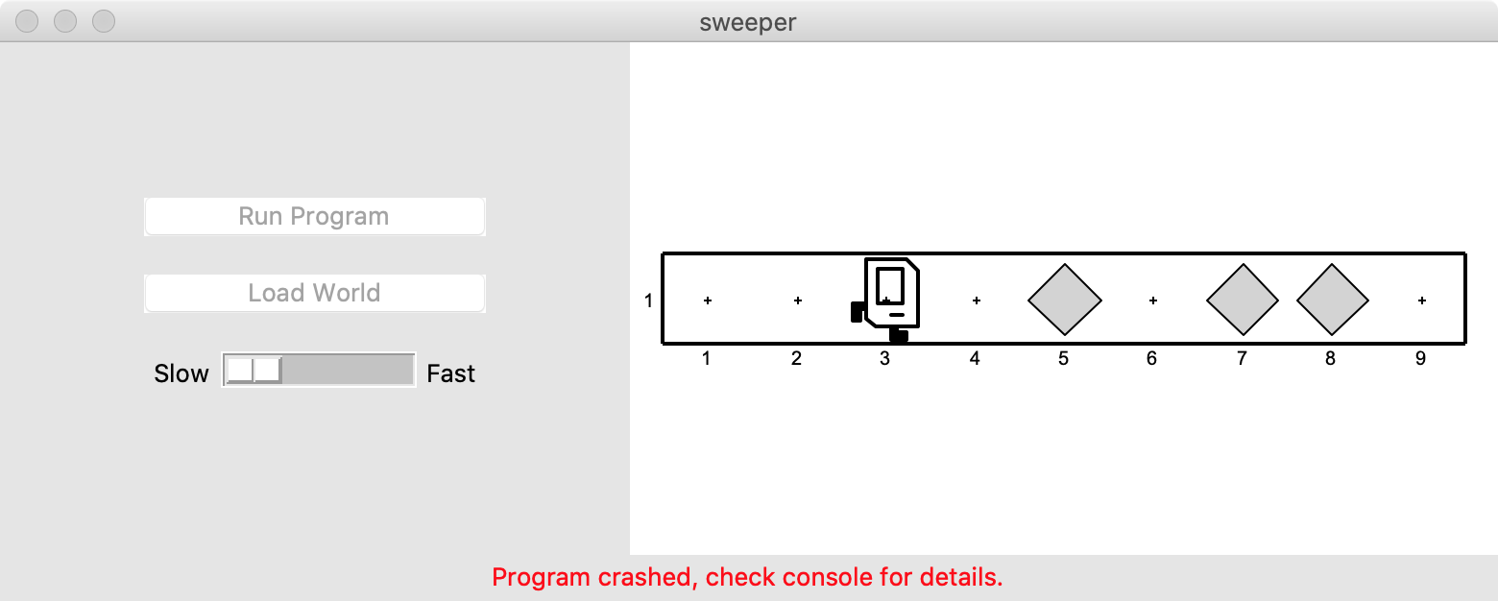
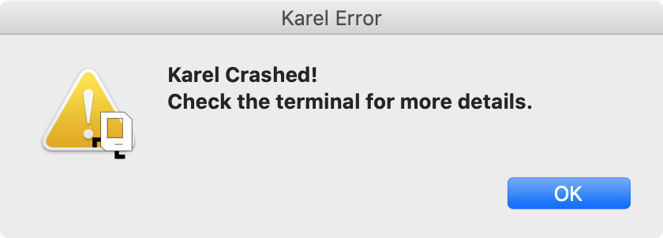
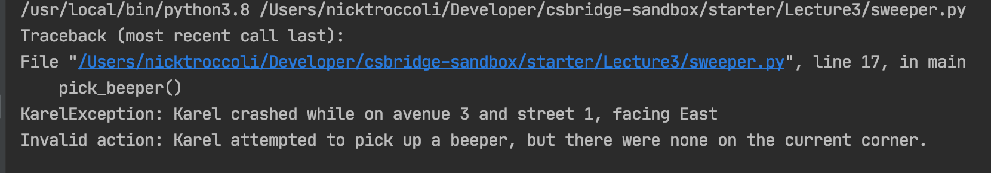
If Statements

Slide 50
If Statements
Instead, use an if statement:
if condition:
statement
statement
...
Runs the statements in the body once if condition is true. These are the same conditions you can use for while loops!
Notes:
Karel can ask some questions about its world / surroundings

Slide 51
If Statements
Now we can say:
while front_is_clear():
move()
if beepers_present():
pick_beeper()
Karel won’t crash because it will only pick up a beeper if there is one.

Slide 52
If Statements and Indentation
if condition:
statements # note indenting
def safe_pick_up():
if beepers_present():
pick_beeper() # note indenting

Slide 53
If/Else Statements
What if we want to do one thing if some condition is true, and another otherwise? We can add an else statement:
if condition:
statement
statement
...
else:
statement
statement
...
This will run the first group of statements if condition is true; otherwise, it runs the second group of statements.

Slide 54
If/Else Statements
What does this code do?
def main():
if beepers_present():
pick_beeper()
else:
put_beeper()

Slide 55
If/Else Statements and Indentation
if condition:
statements # note indenting
else:
statements # note indenting
def invert_beepers():
if beepers_present():
pick_beeper() # note indenting
else:
put_beeper() # note indenting

Slide 56
Karel and Control Flow
Congratulations! You’ve learned all of control flow in Karel.
Control Flow lets us control the “flow” of our Karel program. For example, repeat something more than once, or only do something in certain cases.
Want to repeat something? Use a for or while loop.
- for if we know how many times
- while if we don’t know how many times
Want to conditionally do something? Use if (with an optional else)

Slide 57
Lecture Plan
Review: Karel and Control Flow
If/Else Statements
Practice: Hurdle Jumper
Decomposition and Top-Down Design

Slide 58
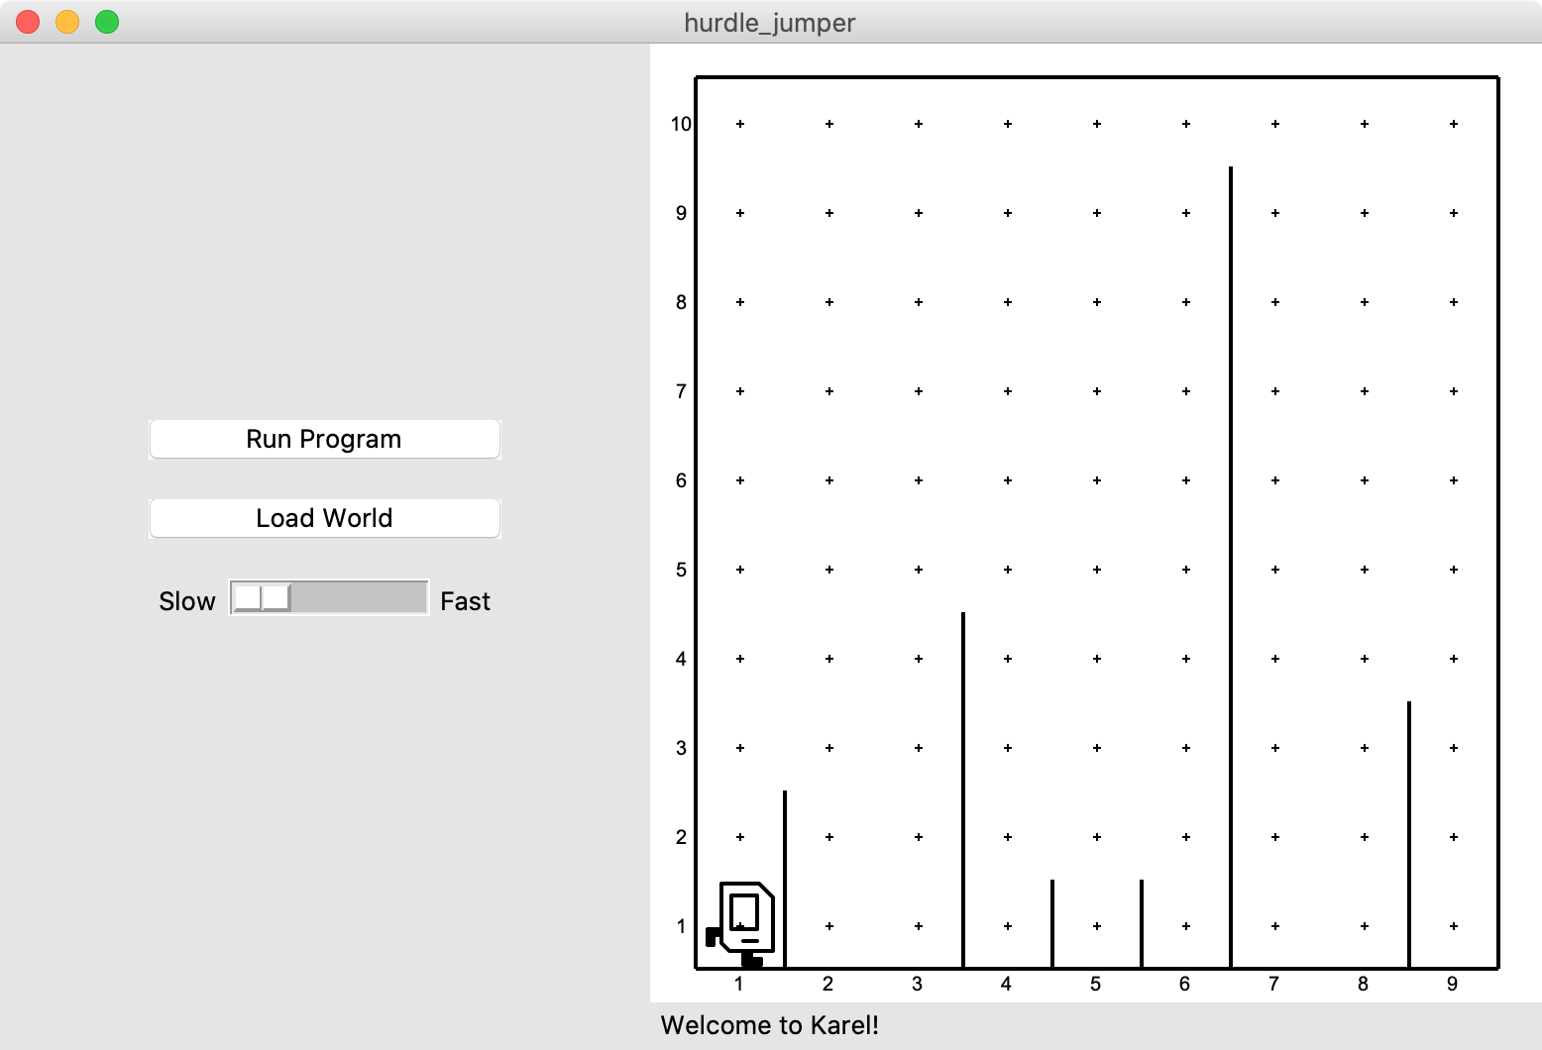
Hurdle Jumper
Karel is in the Olympics! We want to write a Karel program that hops hurdles.
Karel starts at (1,1) facing East and should end up at the end of row 1 facing east.
The world has 9 columns.
There are an unknown number of ”hurdles” (walls) of varying heights that Karel must ascend and descend to get to the other side.

Slide 59
Hurdle Jumper
Demo

Slide 60
Hurdle Jumper
Precondition: something you assume is true at the start of a function or code block
Postcondition: something you promise is true at the end of a function or code block
Pre/post-conditions should be documented using comments.
def jump_hurdle(): """ Karel jumps over one hurdle of arbitrary height. Pre-condition: Karel is facing east next to a hurdle. Post-condition: Karel is facing east at the bottom of the other side of the hurdle. """ ascend_hurdle() move() descend_hurdle()

Slide 61
Hurdle Jumper
Precondition: something you assume is true at the start of a function or code block
Postcondition: something you promise is true at the end of a function or code block
Pre/post-conditions should be documented using comments.
def main(): for i in range(8):
# What do we assume is true here?
if front_is_clear():
move()
else:
jump_hurdle()
# Does the postcondition match?

Slide 62
Lecture Plan
Review: Karel and Control Flow
If/Else Statements
Practice: Hurdle Jumper
Decomposition and Top-Down Design

Slide 63
Decomposition
Breaking down problems into smaller, more approachable sub-problems (e.g. our own Karel commands)
Each piece should solve one problem/task (< ~ 20 lines of code)
Descriptively-named
Well-commented!
E.g. getting up in the morning:
Wake up
Brush teeth
Put toothpaste on toothbrush
Insert toothbrush into mouth
Move toothbrush against teeth
…
…

Slide 64
Top-Down Design
Start from a large task and break it up into smaller pieces
Ok to write your program in terms of commands that don’t exist yet
Goal: make our programs easily readable by humans
Commenting
Decomposition
E.g. Hurdle Jumper

Slide 65
Lecture Recap
Review: Karel and Control Flow
If/Else Statements
Practice: Hurdle Jumper
Decomposition and Top-Down Design

Slide 66

Karel Resources

Slide 67
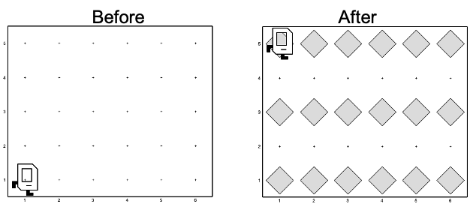
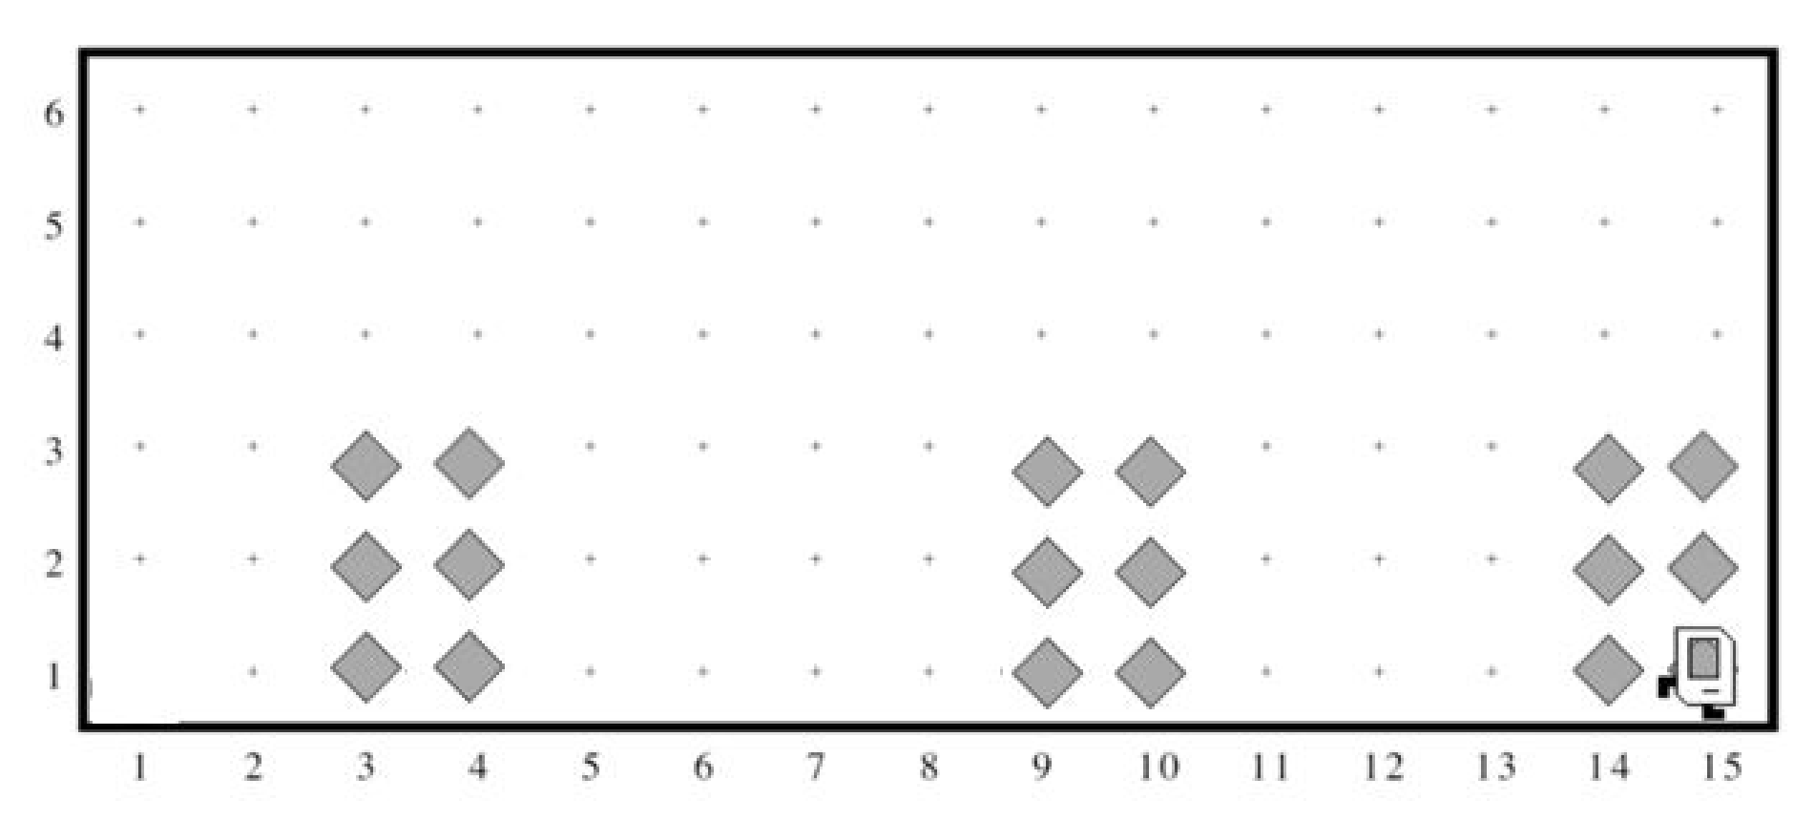
Rest Of Today
Quickstart: Implement a program where Karel draws stripes with Beepers.
Section: Implement a program where Karel builds Hospitals
Project: Write a program where Karel paints any world randomly with green and blue squares.

Slide 68
What’s Next?
Time for your section’s quickstart time!
Check your section’s Ed group for more information

