Slide 1
To Preserve or Not to Preserve Invalid Solutions in Search-Based Software Engineering: A Case Study in Cloud Cost Optimization
Jianmei Guo
Alibaba Group
2018.11.17 @CSBSE
[Guo and Shi, ICSE’18]

Slide 2
Search-based software engineering (SBSE)

Slide 3
Search-based software engineering (SBSE)
Should we preserve invalid solutions
during the search?

Slide 4
Outline
A case study in software produce lines (SPLs)
SPL optimization problem
Five algorithm variants based on the state-of-the-art
Seven real-world subjects (a particular one in cloud cost optimization)
Three potential limitations of preserving invalid solutions
Empirical guidance on how to preserve valid solutions
How to choose the population for performance evaluation?
Should we keep valid solutions in the initial population?
Should we fix invalid solutions after mutation?
Should we preserve valid solutions all along the way?
Should we preserve invalid solutions during the search?

Slide 5
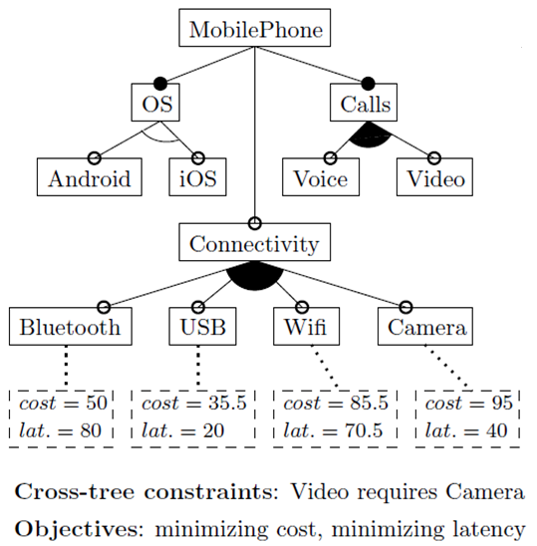
SPL Optimization Problem

Slide 6
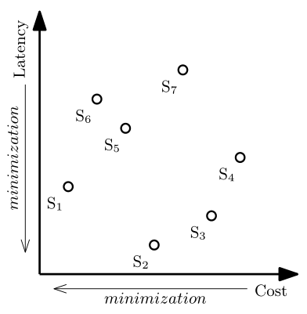
SPL Optimization Problem
A multi-objective combinatorial optimization problem

Slide 7
Five Algorithm Variants
Multi-objective evolutionary algorithms (MOEAs)
IBEA [Sayyad et al., ICSE’13, ASE’13]
SATIBEA [Henard et al., ICSE’15]

Slide 8
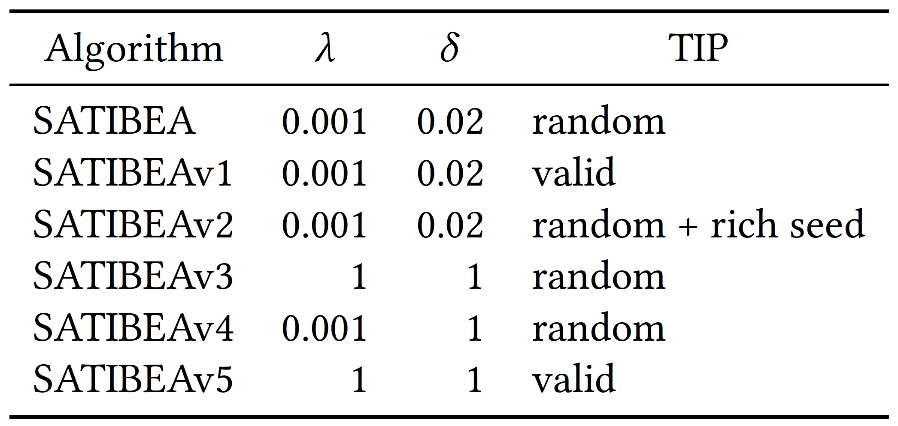
Five Algorithm Variants
Multi-objective evolutionary algorithms (MOEAs)
IBEA [Sayyad et al., ICSE’13, ASE’13]
SATIBEA [Henard et al., ICSE’15]
Mutation rate
Probability of using SAT solving for mutation
Type of initial population

Slide 9
Five Algorithm Variants
Multi-objective evolutionary algorithms (MOEAs)
Preserving validity “all along the way” by incorporating a subroutine that resolves non-Boolean constraints over integer or real-number variables together with arithmetic or relational operators

Slide 10
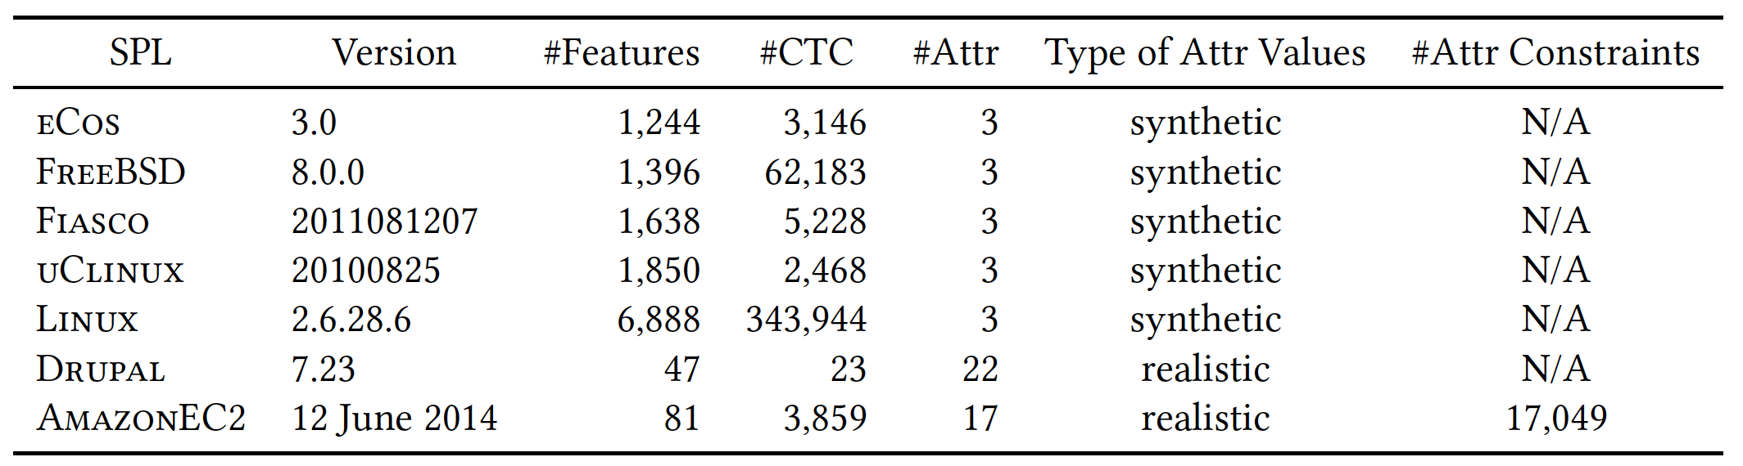
Seven Subjects
Five largest SPLs hitherto reported in the literature
Two SPLs with realistic values and constraints of attributes
[Henard et al., ICSE'15]
[Sánchez et al., Software & Systems Modeling, 2017]
[García-Galán et al., Future Generation Comp. Syst., 2016]

Slide 11
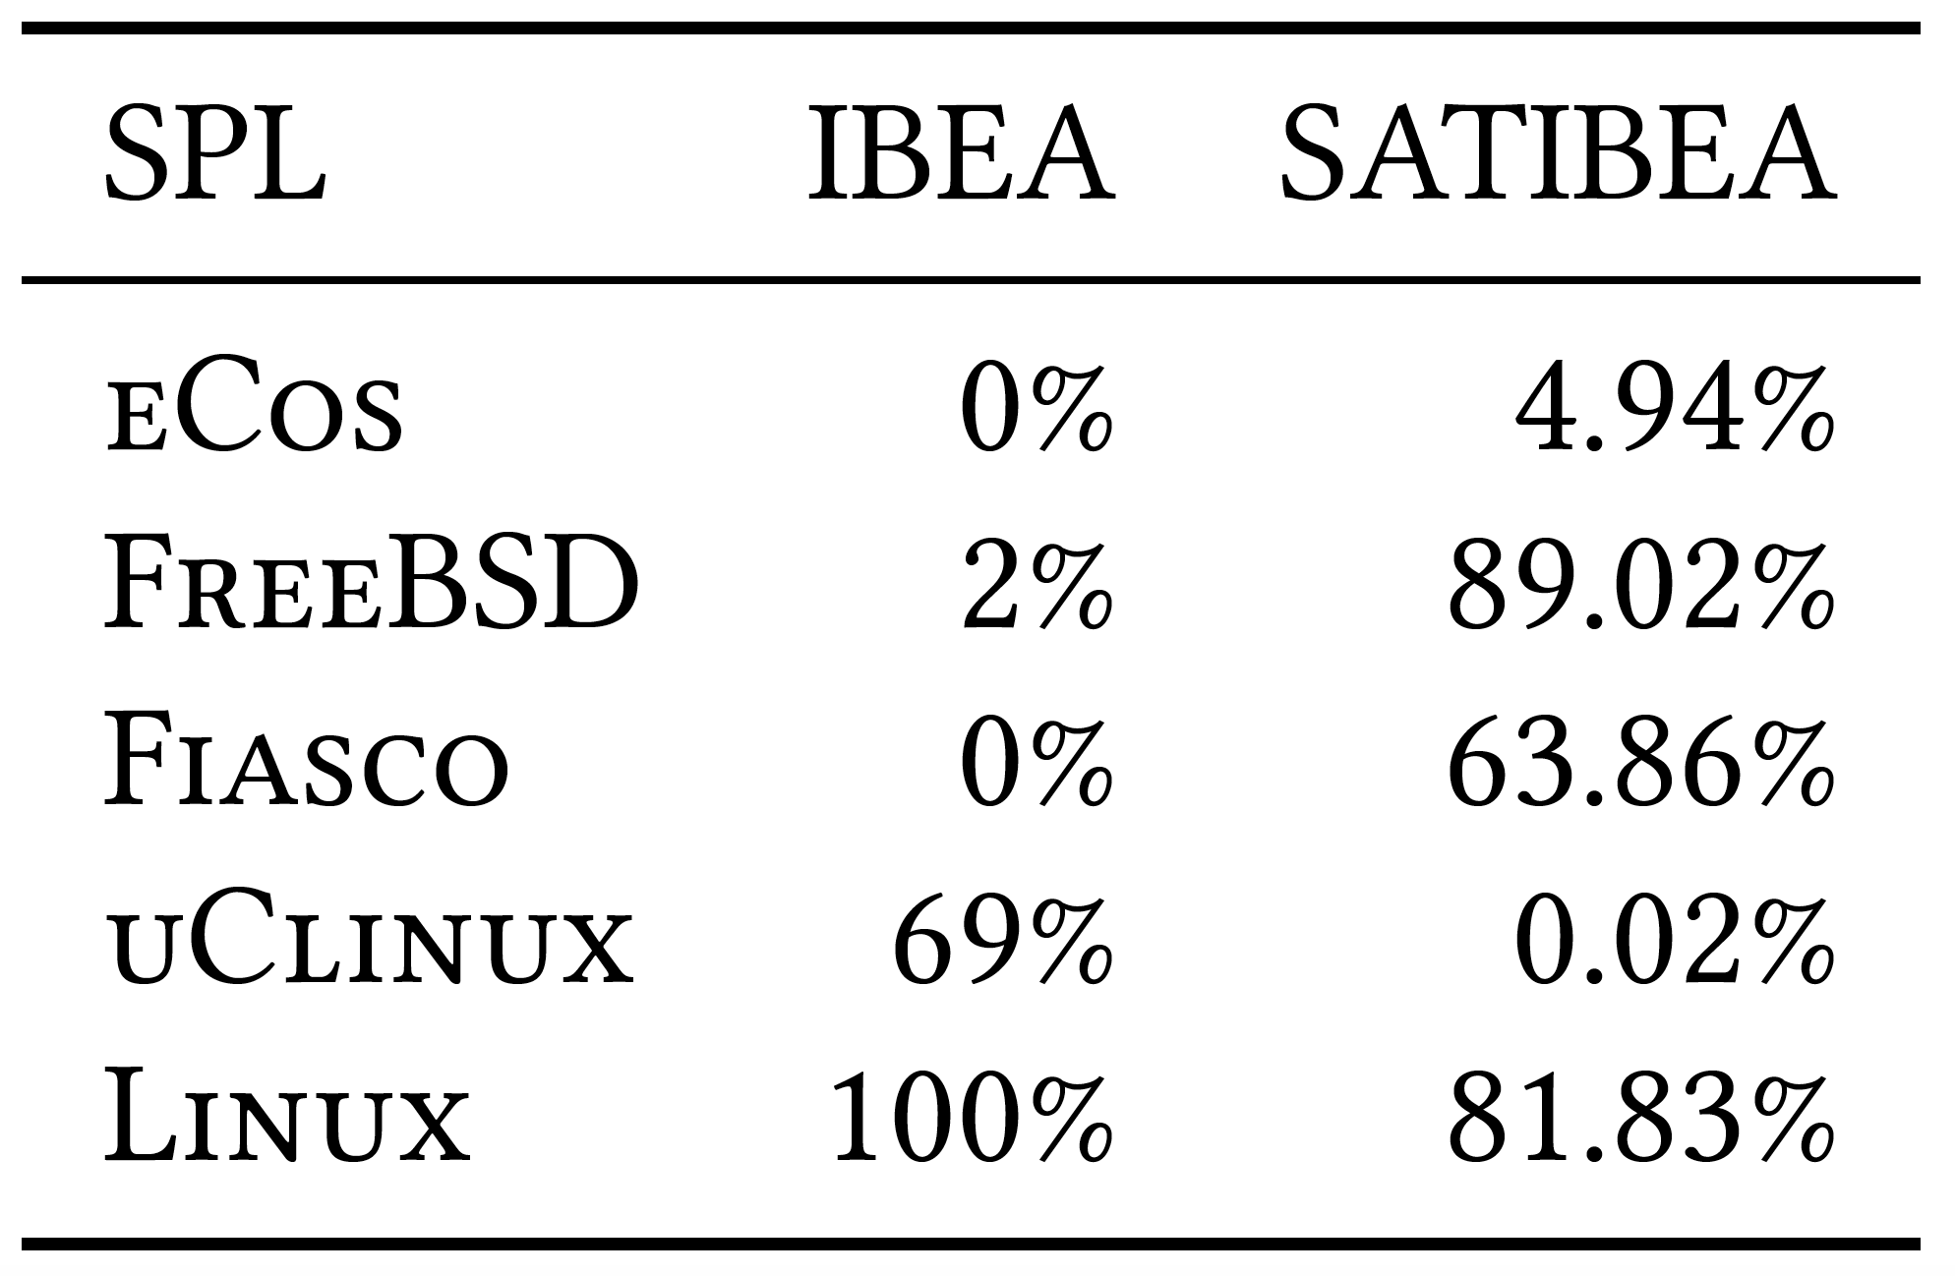
Potential Limitations – 1/3
Ratios of invalid solutions in the final populations produced by state-of-the-art approaches
IBEA [Sayyad et al., ICSE’13, ASE’13]
SATIBEA [Henard et al., ICSE’15]

Slide 12
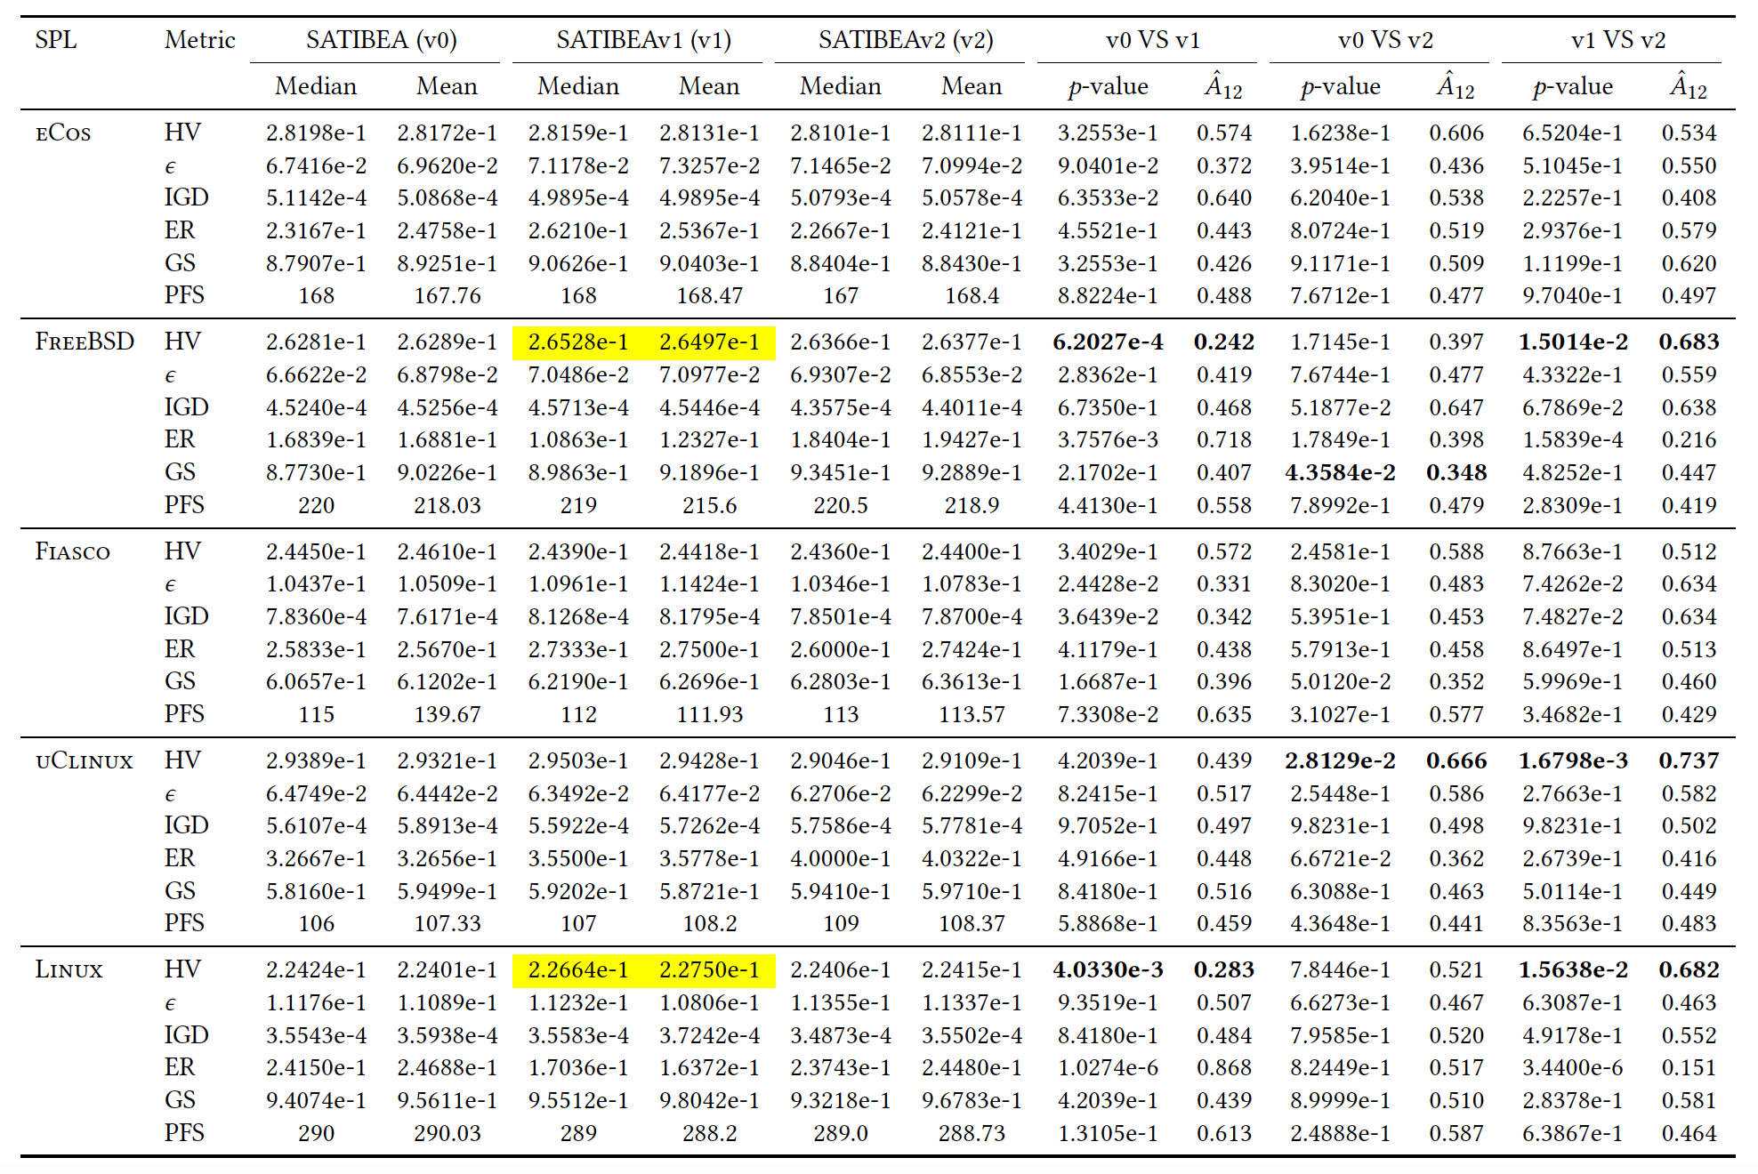
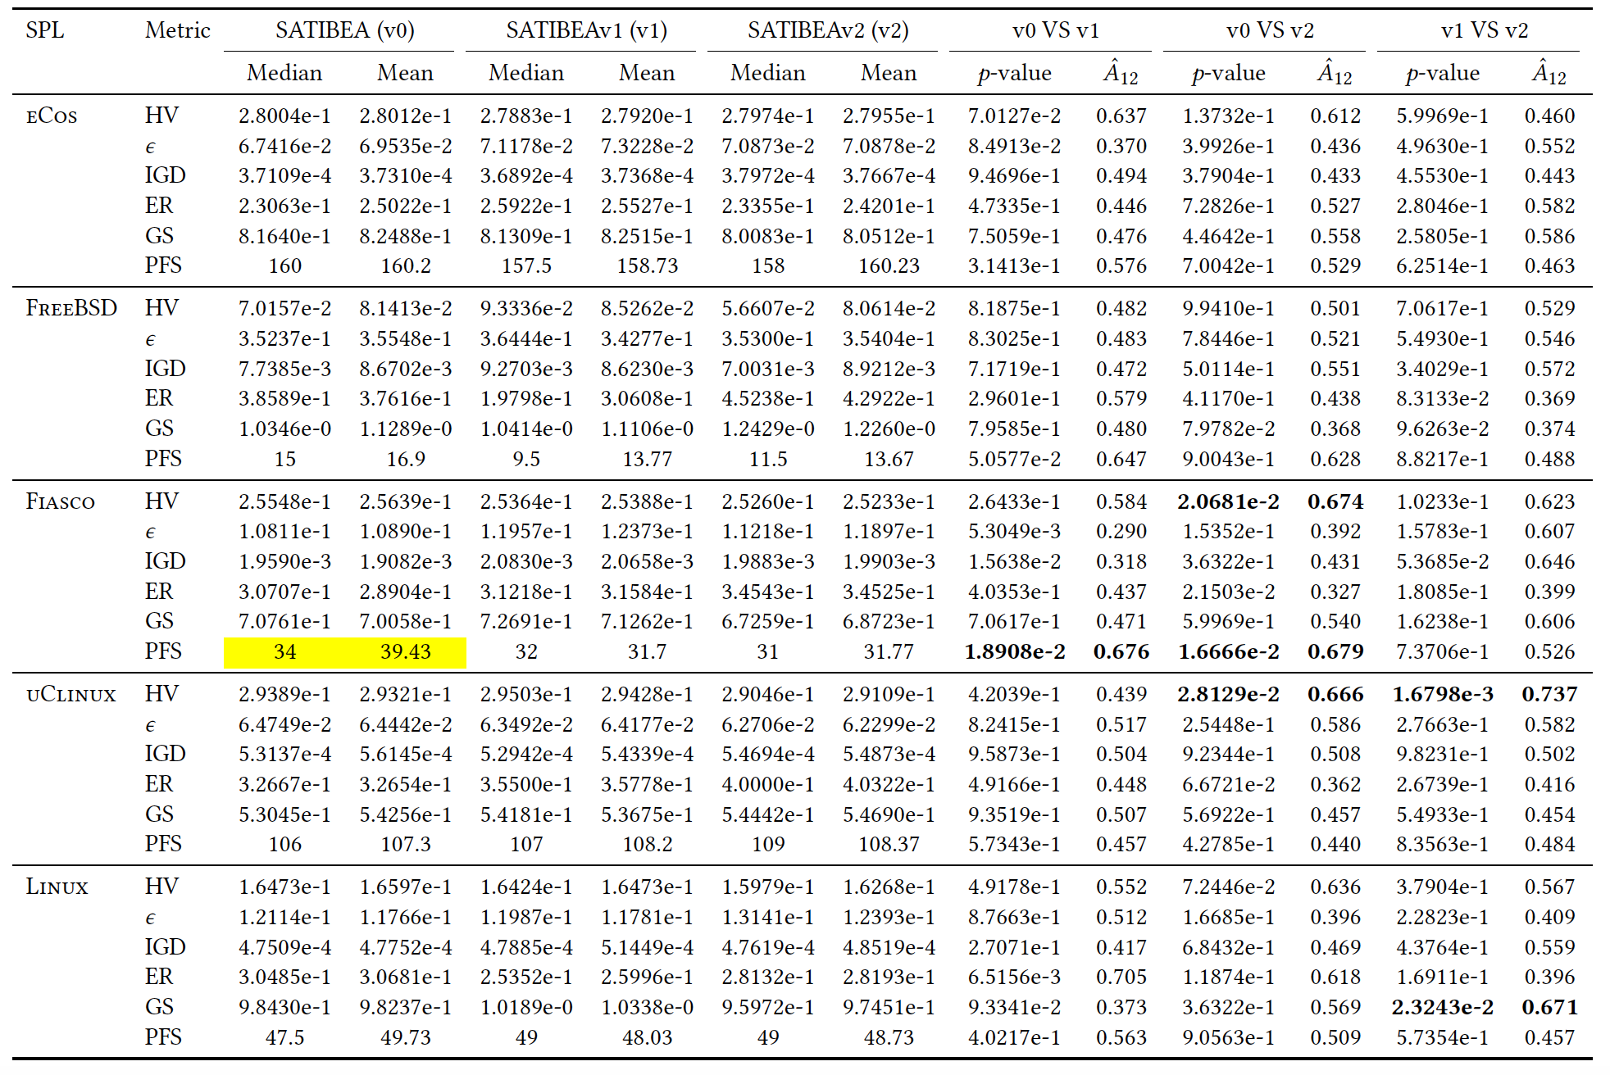
Potential Limitations – 2/3
Performance evaluation depends mainly on the metrics calculated on the population produced
Including invalid solutions
Excluding invalid solutions
SATIBEAv1
SATIBEA

Slide 13
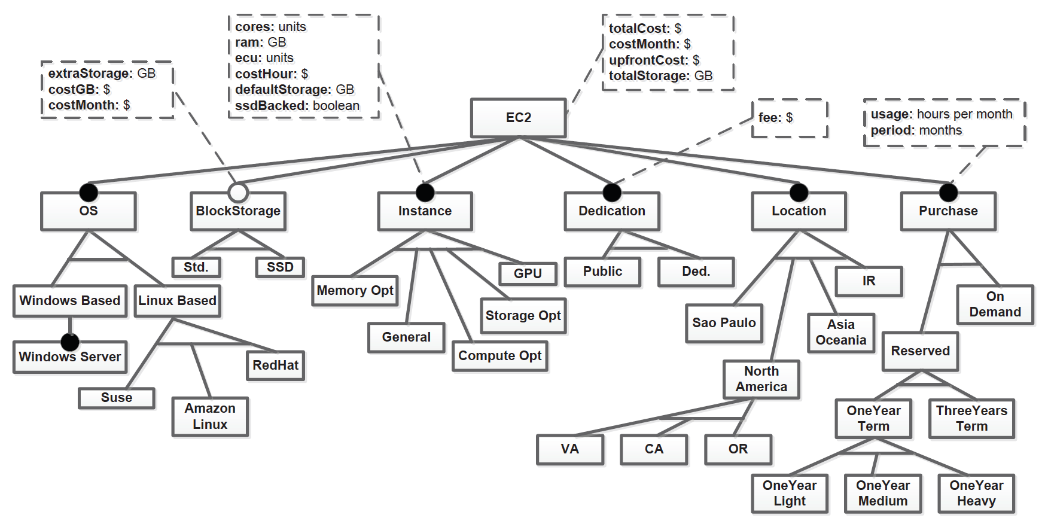
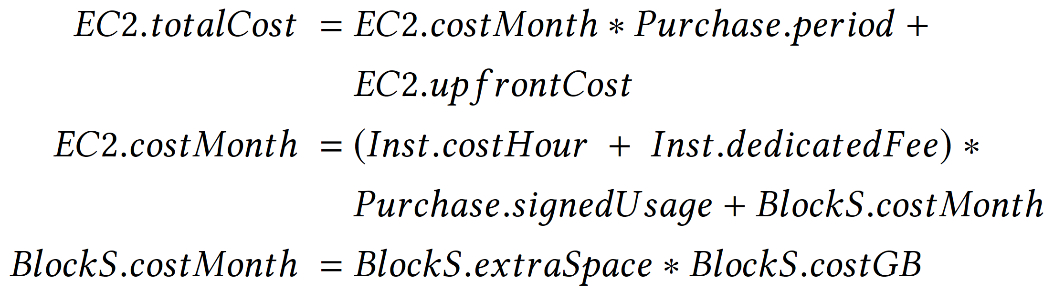
Potential Limitations – 3/3
Amazon Elastic Compute Cloud (EC2)
Excerpted from [García-Galán et al., 2016]

Slide 14
Empirical Guidance – 1/5
How to choose the population for performance evaluation?
Inconsistent results when including and excluding invalid solutions in the population
Invalid solutions are unbuildable and thus useless in practice
Considering only valid solutions, at least, in the final population

Slide 15
Empirical Guidance – 2/5
Should we keep valid solutions in the initial population?
Empirical results cannot statistically distinguish three algorithms adopting different initial populations in terms of any quality metric
SATIBEA is the least and the easiest to build
Using random strategy to generate the initial population

Slide 16
Empirical Guidance – 3/5
Should we fix invalid solutions after mutation?
Experimental results on six subjects demonstrate the superiority of SATIBEA among three algorithms adopting different mutation operators.
Adopting a lower mutation rate (0.001) and a lower probability (0.02) to fix a solution to be valid after mutation

Slide 17
Empirical Guidance – 4/5
Should we preserve valid solutions all along the way?
Valid solutions must be preserved all along the way for AmazonEC2
For the other subjects without attribute constraints, SATIBEA works better for 4 out of 6 subjects.
Preserving valid solutions all along the way might not always be necessary.

Slide 18
Empirical Guidance – 5/5
Should we preserve invalid solutions during the search?
Whether or not to preserve invalid solutions deserves more attention in SBSE,
and in some cases, we have to preserve valid solutions all along the way during the search.

Slide 19
Conclusion
Open question: Should we preserve invalid solutions during the search?
Three potential limitations of preserving invalid solutions
No guarantee to produce valid solutions
Evaluation results might be misleading
Complex attribute constraints break the fitness calculation based on simple aggregation
Empirical guidance on how to preserve valid solutions
Considering only valid solutions, at least, in the final population for evaluation
Using random strategy to generate the initial population
Adopting a lower mutation rate and a lower probability to fix a solution to be valid
Preserving valid solutions all along the way might not always be necessary
Take-home message: Whether or not to preserve invalid solutions deserves more attention in SBSE, and in some cases, we have to preserve valid solutions all along the way during the search.
See paper for:
Detailed experimental setup and results
Threats to validity & Future work

Slide 20
Thanks for your attention!
https://github.com/jmguo/balanceValidity/

