Slide 1

Search-Based Compiler Testing and Debugging
Lu Zhang
November 17, 2018

Slide 2
Agenda
A Search-Based Technique for Compiler Test Generation
A Search-Based Technique for Compiler Debugging

Slide 3




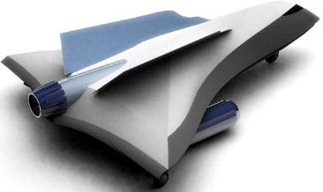
Compiler Testing
Ensure Correctness
Compilers
Compiler Testing
Automated test program generation
……
Operating
Systems
Apps
Safe-critical Systems
Notes:
Compiler is one of the most fundamental software tools and almost all software systems rely on it.
Therefore, it is very important to guarantee the reliability of compilers.
Compiler testing is an effective and widely-recognized way of ensuring the correctness of compilers.

Slide 4

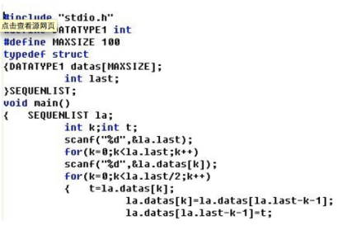
Test Program Generation
A test configuration
(consisting of many options)
Each option directly reflects the probability of a specific program feature to be included.
Find bugs as many as possible
Challenge 1: It is more important to generate test programs that are more likely to trigger bugs
what configuration would lead to such test programs
Challenge 2: It is important to improve the diversity of the generated test programs to cover a wide range of compiler bugs
swarm testing, randomizing the configuration options could lead to more bugs being discovered
Ideal goal
Our solution: to find a set of bug-revealing and diverse test configurations

Slide 5
Approach
Bug space: the space of test programs that trigger bugs
The whole input space
Criteria 1: Each test configuration in the desired set should be able to generate test programs exploring a (large) portion of bug space
Criteria 2: The set of test configurations should have diversity for bug detection

Slide 6
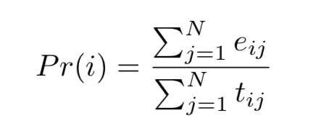
History-based Range Inferring
Control generation
Program feature
option
Infer range
PF = {pf1,pf2,...,pfm}
PP = {pp1,pp2,...,ppn}
p = {e1,e2,...,er}
c = {o1,o2,...,or}

Slide 7
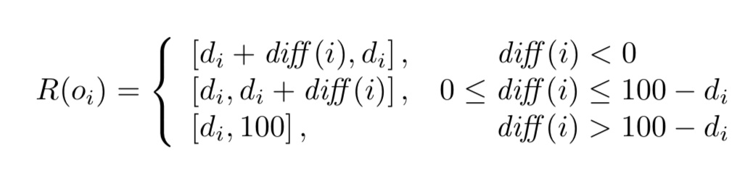
History-based Range Inferring
Emerging patterns: item sets whose supports change significantly between the two datasets
Big support difference: using the support of an item set on one dataset to subtract the support of the item set on another dataset
The differences reflect the range where failing test programs are easier to generate while passing test programs are more difficult to generate to some degree

Slide 8
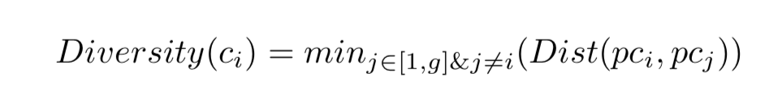
Diversity Measuring
Using the distance between these feature vectors to measure the diversity of test programs
C = {c1, c2, . . . , cg}
ci = {oi1, oi2, . . . , oir}
Pi = {pi1,pi2,...,pis}
Intuitively, the generated test programs under a test configuration tend to concentrate on an area of input space.
HDTest first sets a group center for these generated test programs, and then computes the distance between different group centers.
Manhattan distance

Slide 9
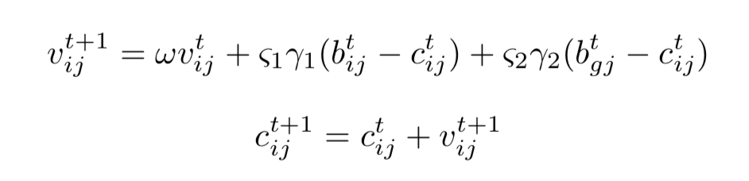
PSO-based Searching
Expected output: a set of diverse test configurations exploring the whole bug space
Search space: inferred range for each option
Fitness function: diversity
After producing a set of bug-revealing and diverse test configurations, HDTest randomly selects a test configuration from the set to generate a test program.

Slide 10
Evaluation
RQ1: How does HDTest perform compared with existing compiler test-program generation approaches?
RQ2: Does HDTest perform well in different scenarios (including cross-version and cross-compiler scenarios)?
RQ3: Does HDTest perform well for the latest release compiler version?
GCC-4.4.0
GCC-4.5.0
GCC-4.6.0
LLVM-2.6
LLVM-6.0.1
GCC-4.3.0
Compared approaches: DefaultTest & SwarmTest

Slide 11
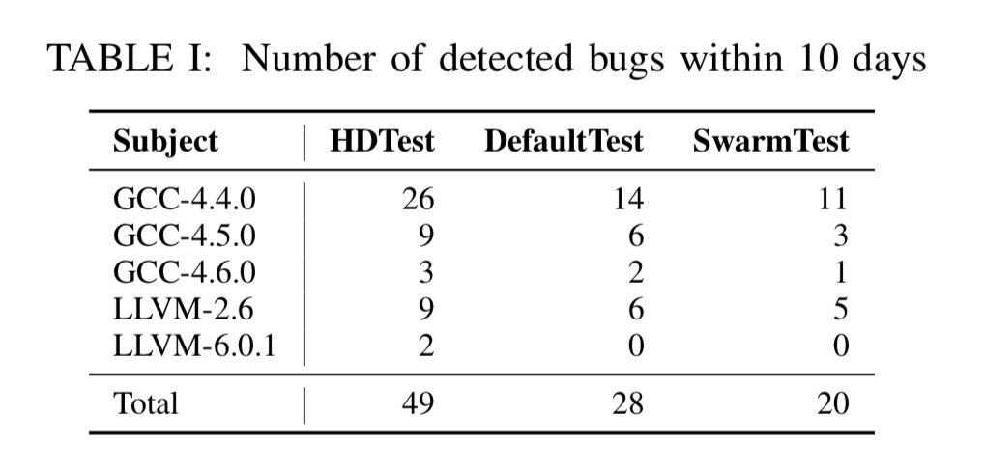
Number of detected bugs
Achieving 75.00% and 145.00% improvements compared with DefaultTest and SwarmTest

Slide 12
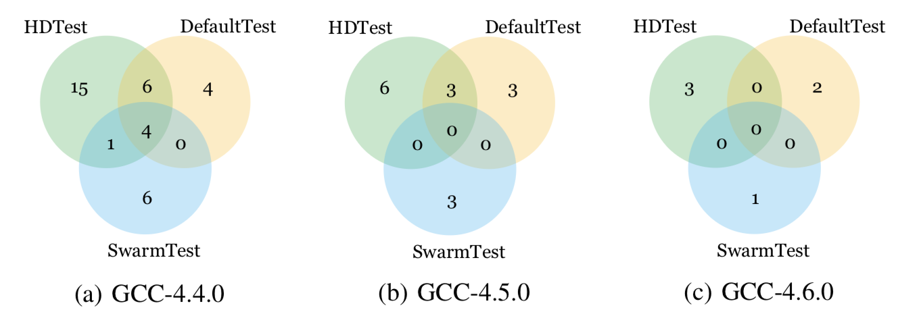
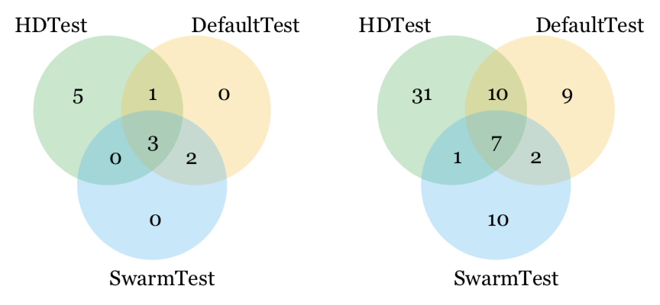
Number of unique bugs
HDTest: 63.26% (31 out of 49) DefaultTest: 32.14% (9 out of 28)
SwarmTest: 50.00% (10 out of 20)

Slide 13
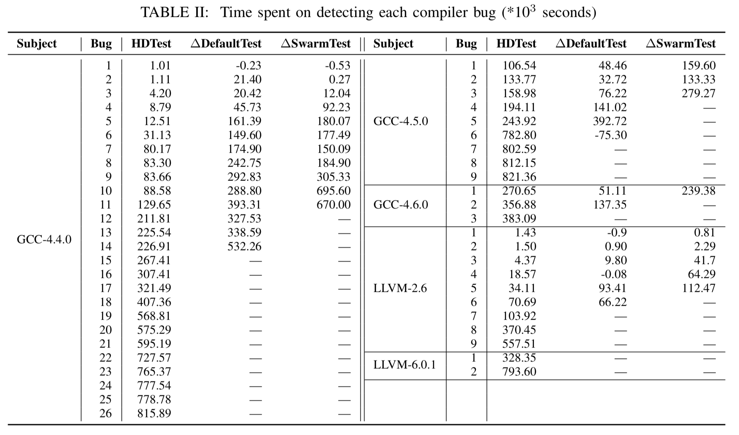
Time spent on detecting each bug

Slide 14
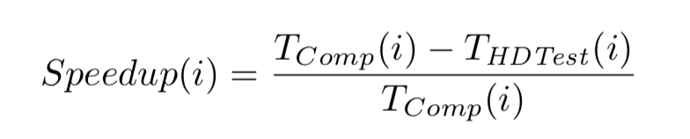
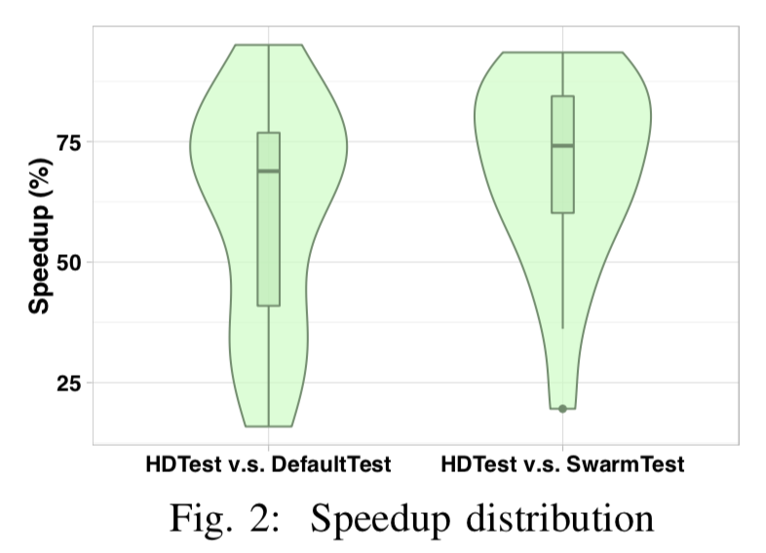
Speedup
Median speedups of HDTest compared with DefaultTest and SwarmTest are 68.86% and 74.14%

Slide 15
Debugging Compilers
Compiler bugs are very difficult to debug
Most compiler bugs are deep bugs
E.g., optimization bugs
Compilers are large
Compiling a program involves a lot of compiler files
Compilation is time-consuming
Manual debugging tools are rarely useful

Slide 16
Basic Idea
Spectrum-based fault localization
Using a set of passing tests (i.e., witness tests) to remove suspicion of various parts in the compiler
Not affordable to have a large set of witness tests
Using only high-quality witness tests

Slide 17
Criteria for Good Witness Tests
Each witness test should share a similar compiler execution trace with the failing test
Witness tests should differ much from each other in their compiler execution traces

Slide 18
Marple (Our Approach)
Mutating the failing test program to obtain the witness test programs
Skeletal Program Mutation
Using an adaptive process to control the quality of the witness test programs

Slide 19
Skeletal Program Mutation

Slide 20
Seed Program Selection
From first order mutations to high order mutations
The higher order, the more different from the failing test program
Lower order mutations having priority
Aiming to have similar compiler execution traces with the failing test

Slide 21
How to obtain passing test programs with low cost?
Relying more on mutation rules with better performance
Markov Chain Monte Carlo Methods
Recording the previous performance
Rules with better performance having better chance of being selected

Slide 22
Aggregation-Based Suspicion Calculation
Calculating suspicion values at a finer level
Summing up the suspicion values at the finer level to form the suspicion values at a coarser level

Slide 23
Evaluation
45 GCC bugs and 45 LLVM bugs
Corresponding to 45 buggy GCC versions and 45 buggy LLVM versions
On Average
A GCC buggy version has 1,588 files with 1,414K LOC
An LLVM buggy version has 3,507 files with 1,431K LOC

Slide 24
Results

Slide 25
Practicability
A small survey with 7 compiler developers
Sending out 10 requests
6 developers confirming that compiler debugging starts with identifying the faulty file
6 developers considering our tool of practical value

Slide 26

Thank You!

