Slide 1

浅谈软件仓库挖掘在软件维护中的简单应用
张 涛
哈尔滨工程大学

Slide 2


科研菜鸟成长记录
科研是一个很有趣的思考过程。
香港理工大学 博士后
首尔市立大学 计算机科学
东北大学 软件工程
东北大学 自动化

Slide 3
Introduction
What is mining software repositories?

Slide 4

软件仓库挖掘是一个新兴的软件工程领域，通过数据挖掘技术分析软件仓库中海量的数据，来提高软件的质量和生产效率。
《软件仓库挖掘领域：贡献者和研究热点》
The Mining Software Repositories (MSR) field analyzes the rich data available in software repositories to uncover interesting and actionable information about software systems and projects.
《MSR web site》
Support/Improve/Help
Archived Communications
Software Maintenance
Source Control Systems
Software Design/Reuse
Defect Tracking Systems
Empirical Analysis

Slide 5
Introduction
How can we do by mining software repositories?

Slide 6
Bug triage
Given a new bug report, how to find a developer to fix this new bug?
Reopened bug prediction
How to predict which closed bug reports will be opened again in the future ?
Severity identification
Given a new bug report, how to rank its severity ?
Bug summarization
How to find duplicate bug reports in bug repositories?
How to extract an abstract for a given bug report?
Bug localization
Given a bug report, how to localize its corresponding source code?
Duplicate bug detection

Slide 7
过 去

Slide 8
Overview
Bug Resolution using Mining Software Repositories
Tao Zhang, He Jiang, Xiapu Luo, Alvin T.S. Chan, “A Literature Review of Research in Bug Resolution: Tasks, Challenges and Future Directions,” The Computer Journal, 59(5), pp.741-773, 2016.

Slide 9
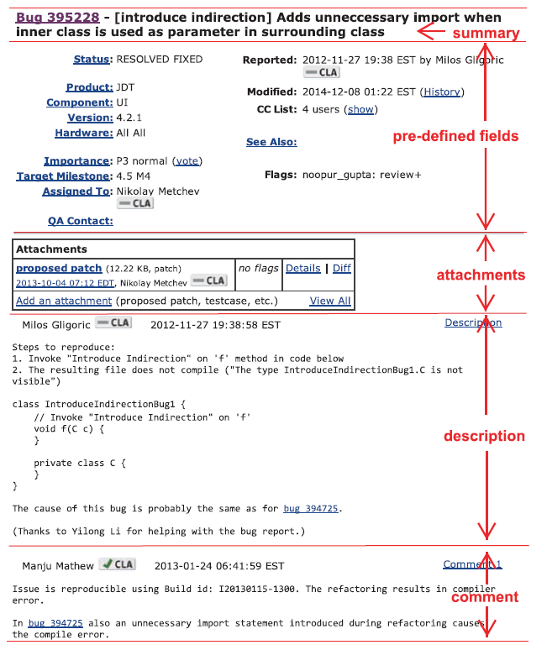
Bug reports

Slide 10
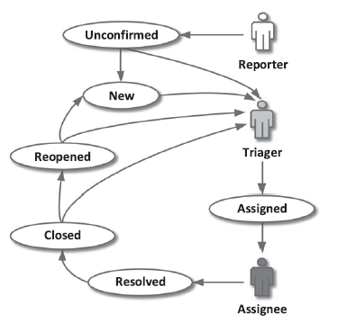
Life cycle

Slide 11
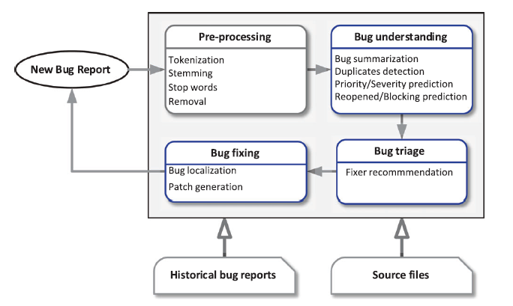
Bug resolution

Slide 12
Implementation
Severity prediction and fixer recommendation
Tao Zhang, Jiachi Chen, Geunseok Yang, Byungjeong Lee, Xiapu Luo, “Towards more accurate severity prediction and fixer recommendation,” Journal of Systems and Software, Vol.117, pp.166-184.

Slide 13
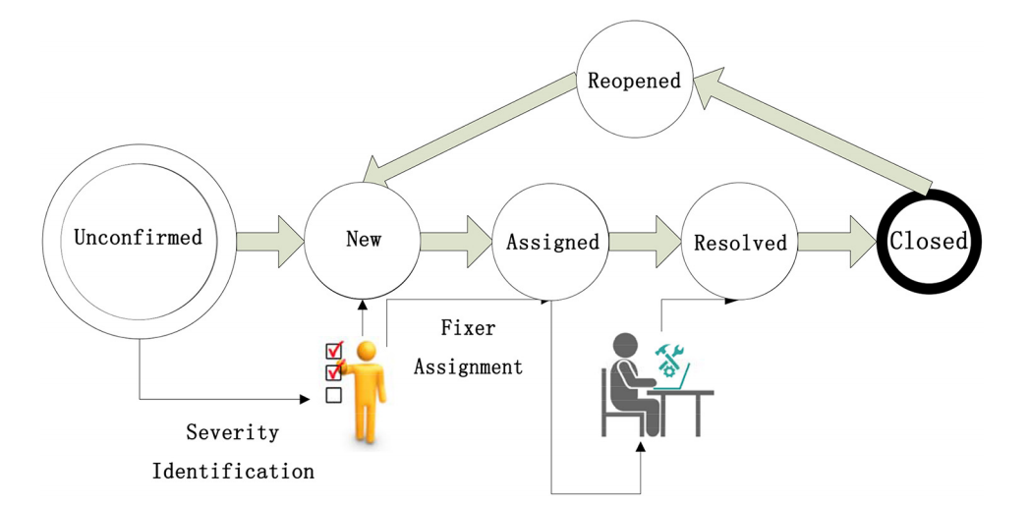
What is severity prediction and fixer recommendation
Block
Critical
Major
Minor
Trivial

Slide 14
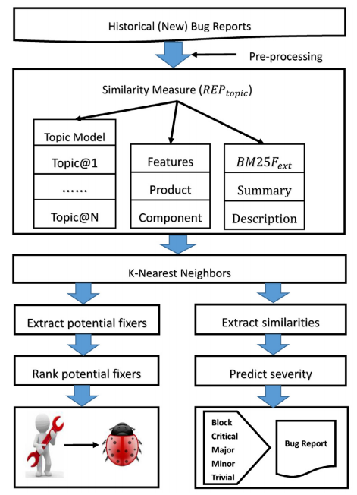
Method: Framework

Slide 15
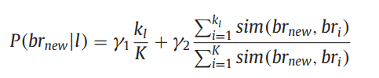
Method: Severity prediction
Number of the neighbors whose severity level is l.
Probability of severity level being l
Similarity between bug report and its neighbor.
Total number of the neighbors.

Slide 16


Method: Fixer recommendation
Number of comments that the developer d posts
Number of bugs fixed by the developer d successfully
Number of comments that the other developers post to the bug reports assigned to d
Number of bugs which have the reopened records among all historical bugs assigned to d

Slide 17
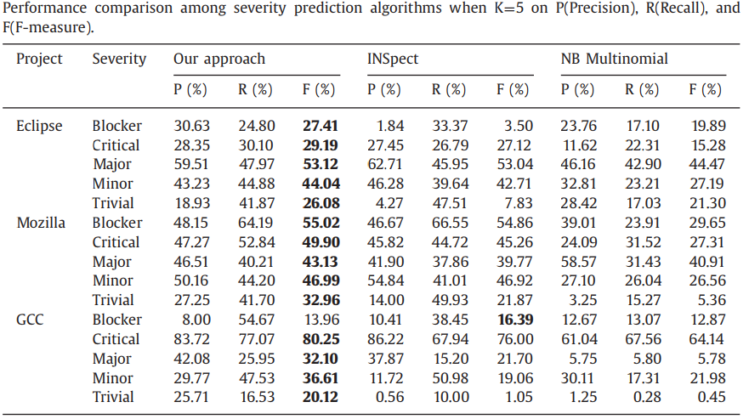
Results: severity prediction

Slide 18
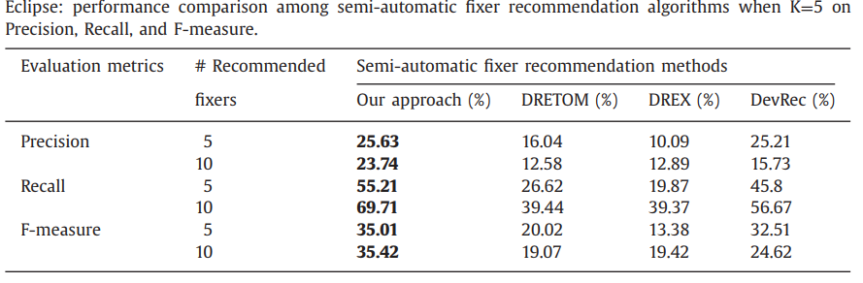
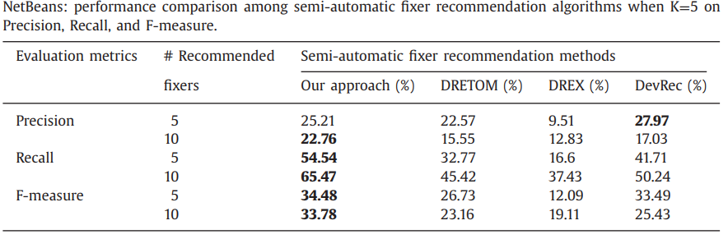
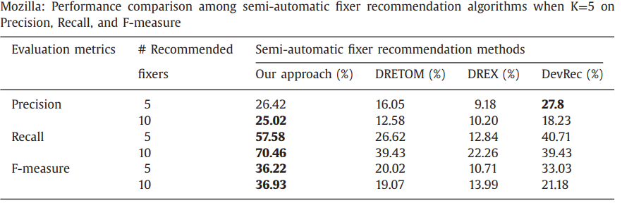
Results: fixer recommendation

Slide 19
Implementation
Bug report enrichment
Tao Zhang, Jiachi Chen, He Jiang, Xiapu Luo, Xin Xia, “Bug Report Enrichment with Application of Automated Fixer Recommendation,” IEEE 25th International Conference on Program Comprehension (ICPC), pp.230-240, 2017.

Slide 20
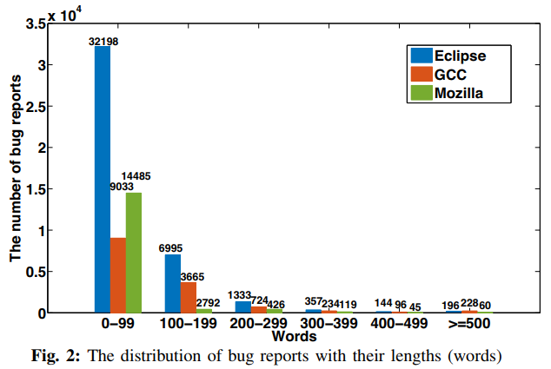
Motivation
Most of bug reports are short.

Slide 21
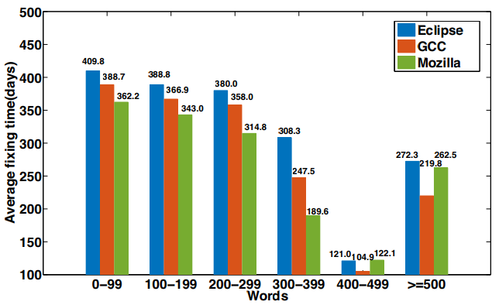
Motivation
Short bug reports delay the average fixing time.

Slide 22
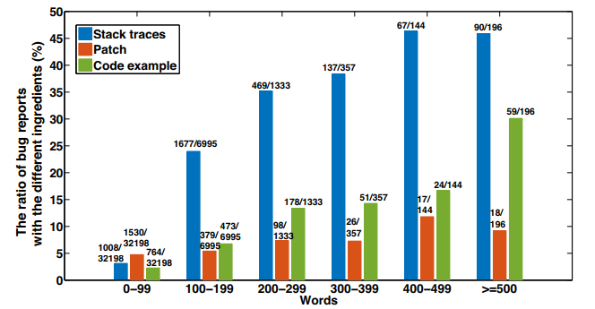
Motivation
Short bug reports include lower proportion of ingredients.

Slide 23
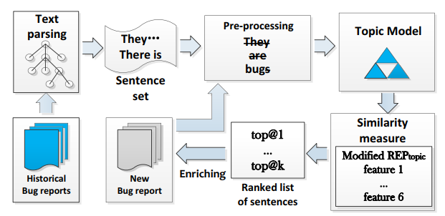
Method: overview

Slide 24
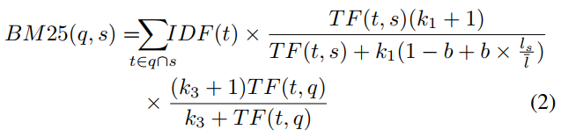

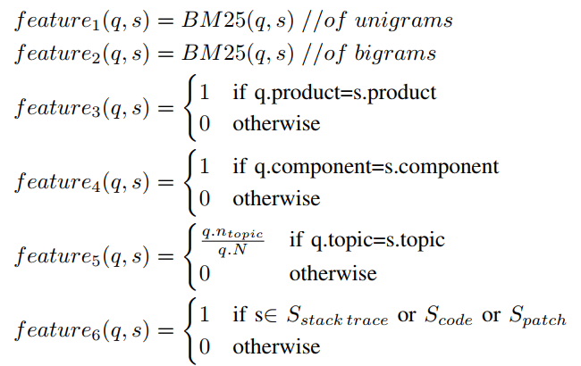

Method: similarity measure

Slide 25
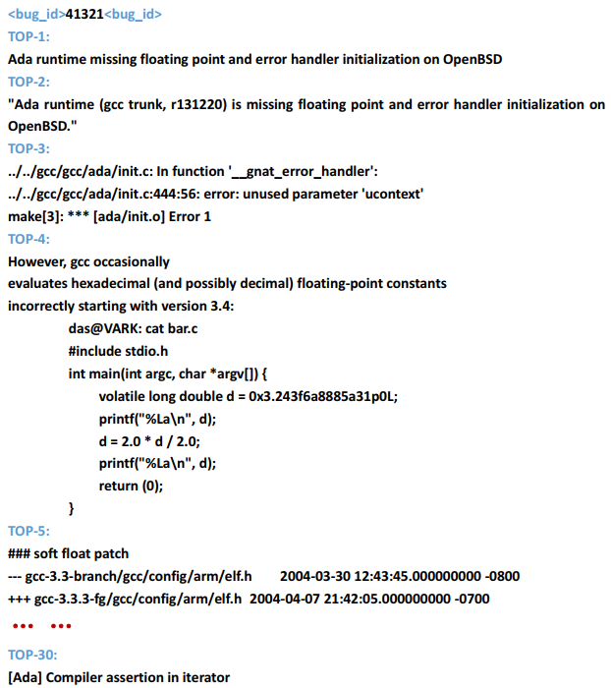
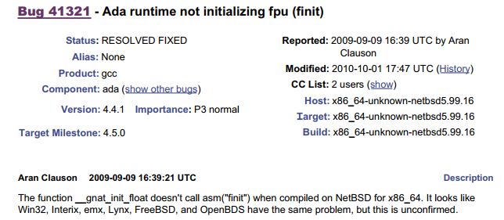
Case

Slide 26
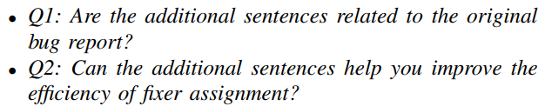
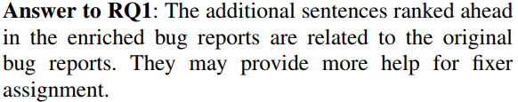
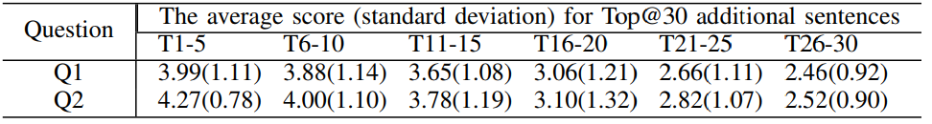
Results RQ1-Human evaluation: Can the enriched bug reports provide further help to fixer assignment?
Evaluation objects: randomly selected 300 pairs of bug reports from Eclipse, Mozilla, and GCC. Each pair includes a bug report and its enriched version with the Top@30 additional sentences.
Sent each pair of bug reports to the corresponding real triager by the emails.
Each triager should answer the following questions and give 1-5 scores.
Results:

Slide 27
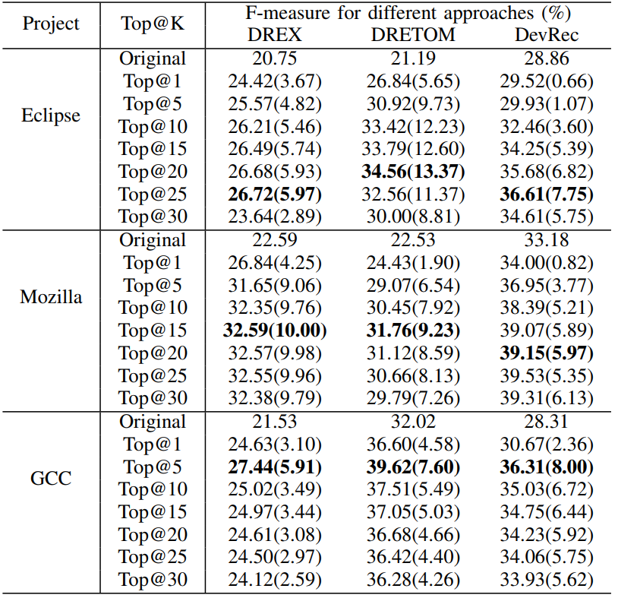
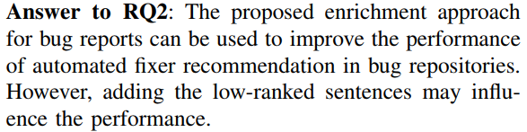
Results RQ2-Effectiveness evaluation: Can the enriched bug reports improve the performance of the automated fixer recommendation in bug repositories?

Slide 28
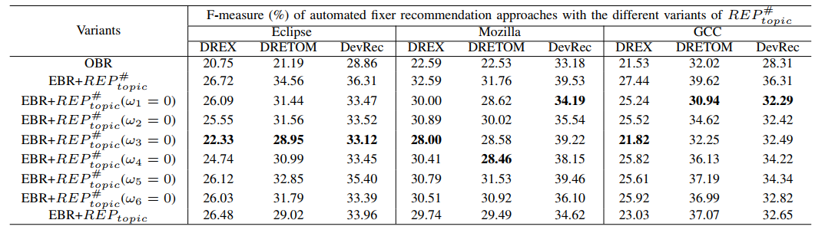
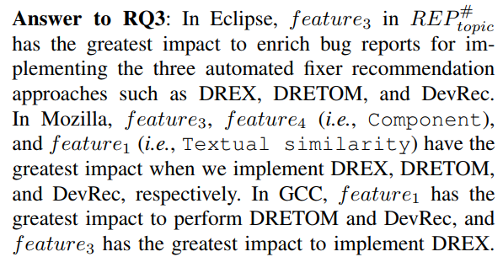
Results RQ3-Feature influence: Which features in the similarity measure have the greatest impact on bug report enrichment for improving automated fixer recommendation?

Slide 29

Results RQ3-Feature influence: Which features in the similarity measure have the greatest impact on bug report enrichment for improving automated fixer recommendation?

Slide 30
Future
Mining repositories of mobile apps
Tao Zhang, Jiachi Chen, Xiapu Luo, Tao Li, “Bug Reports for Desktop Software and Mobile Apps in GitHub: What is the difference?” IEEE Software, online, 2017. (Invited to Journal First Session of ICSME 2017)

Slide 31
Motivation
Selection of bug tracking systems: GitHub
Desktop software VS. Mobile apps

Slide 32
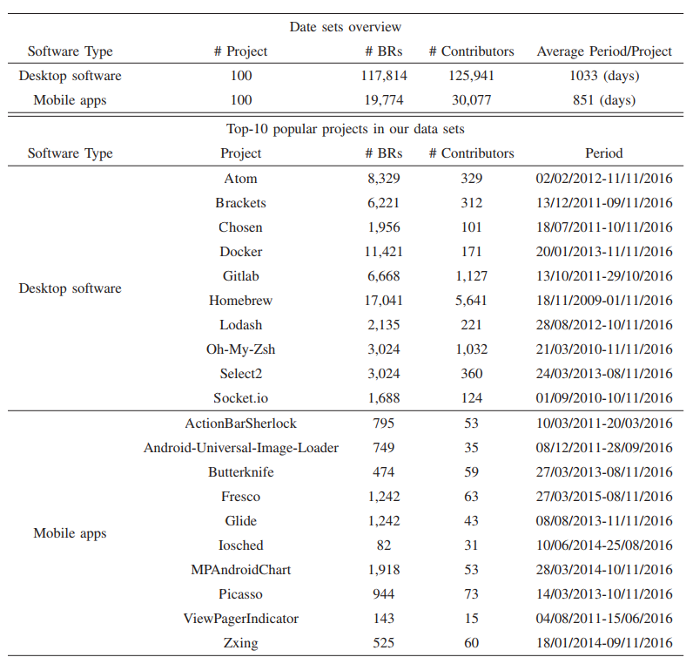
Data Scale
https: //github.com/PolyUCJC317/IEEE-Software

Slide 33
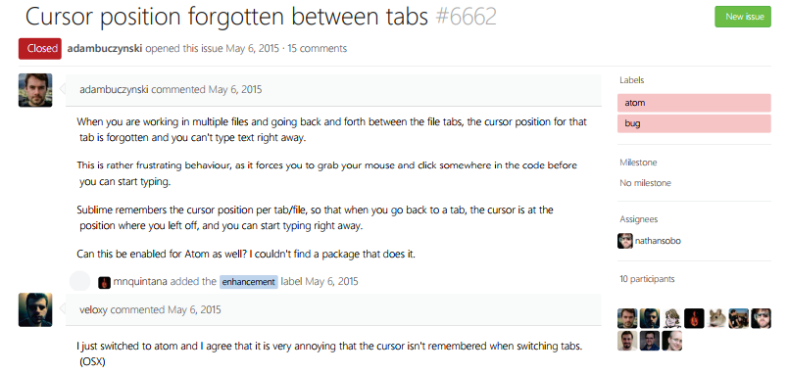
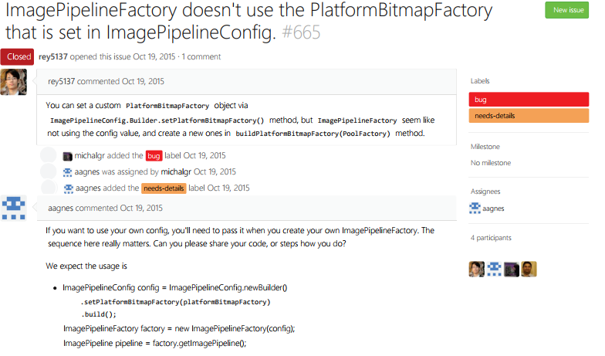
Textual feature
Atom (desktop software)
Fresco (mobile apps)

Slide 34
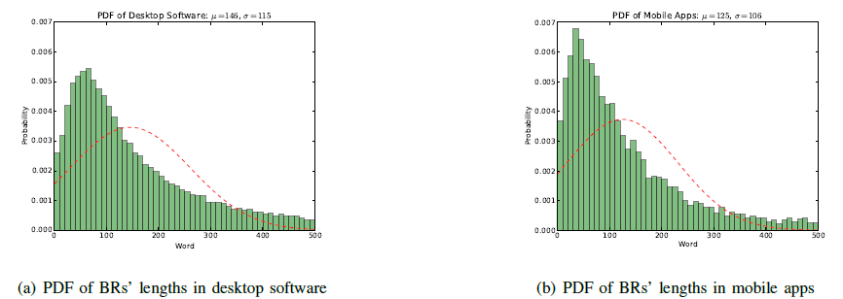
Textual feature
Length comparison: Desktop 251.2 words/BR VS Mobile 181.3 words/BR
Median value: Desktop 129 VS Mobile 101
Probability density function:

Slide 35
Content feature
The quality of a bug report is decided by its Main Elements (MEs).
N. Bettenburg et al.,“What makes a good bug report?”FSE 2008.
MEs: Stack trace, Code example, Patch
Stack trace: a stack trace is a part of the active stack frames at a certain point when a program throws the exception.
Code example: a code example can indicate the reason why the bug appears.
Patch: a patch is a piece of software designed to update a program, it is used to fix (or improve) it.

Slide 36
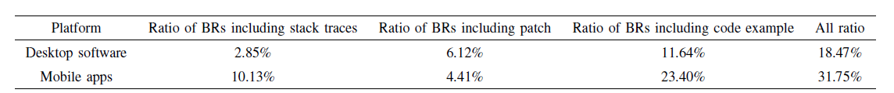
Content feature
How to recognize MEs?
Stack traces: regular expressions (i.e., at + path +：numbers)
Code examples: island parsing
Patches: regular expressions (i.e., **.**.**.py and **/**/**.py)

Slide 37
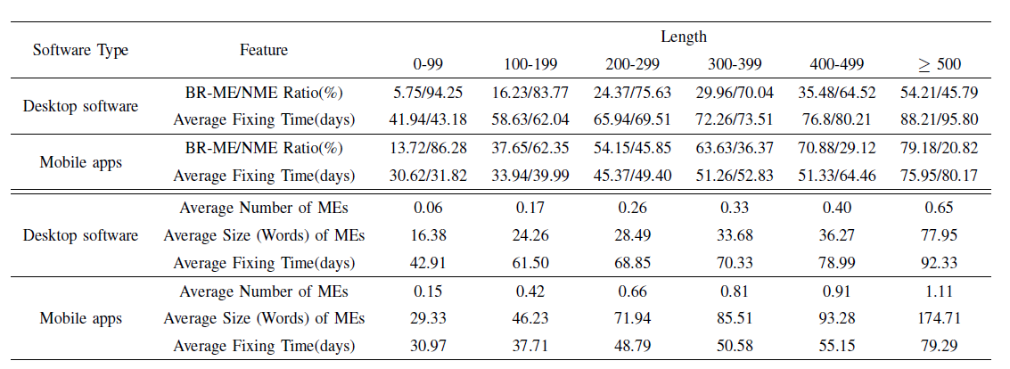
Relationship between BRs’ features and fixing time

Slide 38
Some interesting findings
The ME ratio in mobile apps is higher than that in desktop software at all length fields: p=0.00153<0.05 via t-test
The average fixing time for BRs that include at least one ME is shorter than that for BRs without any ME: p=0.01547<0.05 for desktop software; p=0.03671<0.05 for mobile apps;
The average fixing time in mobile apps is shorter than that in desktop software. P=0.0005744<0.05
With the increase of BR’s lengths, the average time increases.
The small number and size of MEs per BR.
ME ratio and BR’s length: t-test for the values of ME Ratio/Average BR length: p=0.002071
Conclusion: the high ratio of MEs in BRs of mobile apps may be a major reason why the average fixing time is shorter.

Slide 39
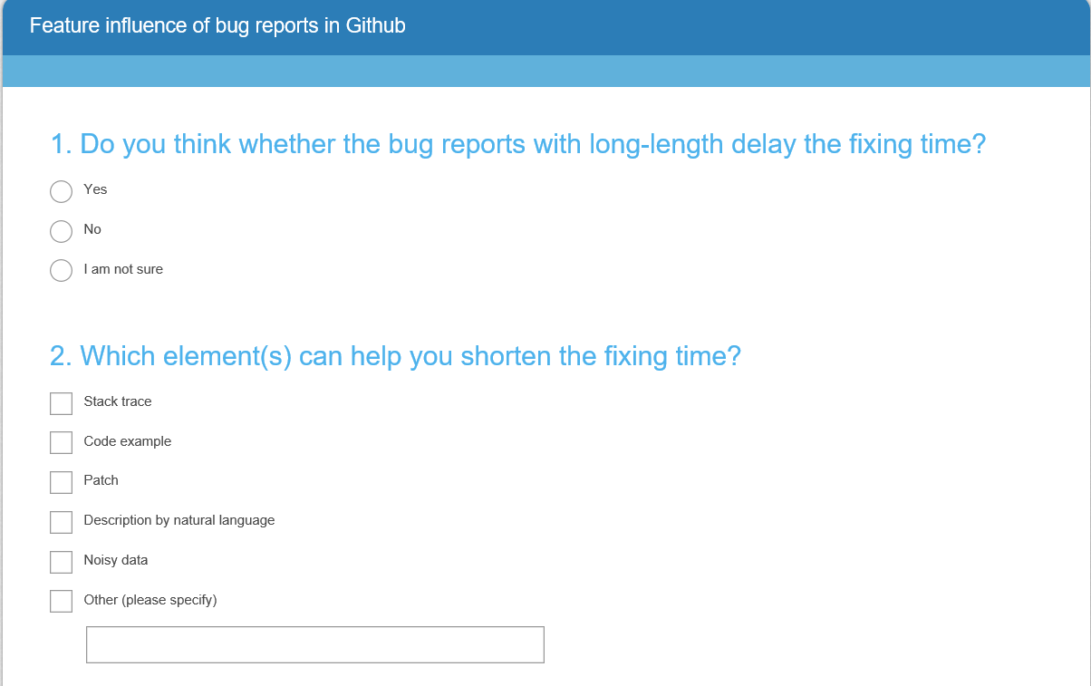
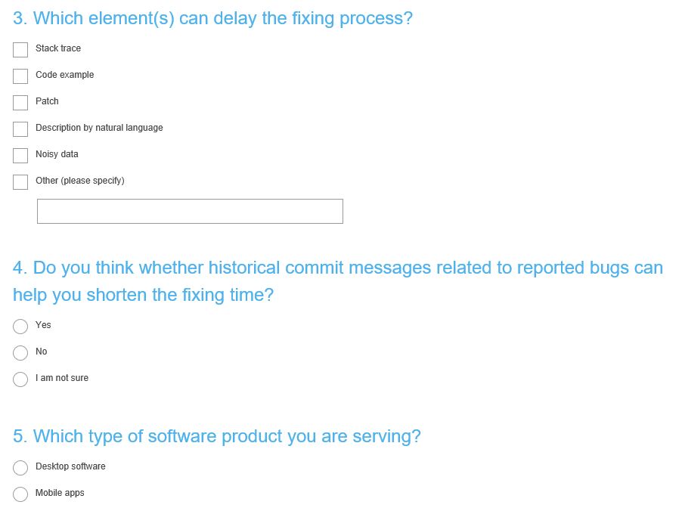
Online survey: start
https://www.surveymonkey.com/r/CFZN9FN

Slide 40
Online survey: process
Send to 100 active contributors who posted the largest number of comments to BRs in desktop software and mobile apps.
60 responses (60%) in desktop software, and 38 responses (38%) in mobile apps.

Slide 41
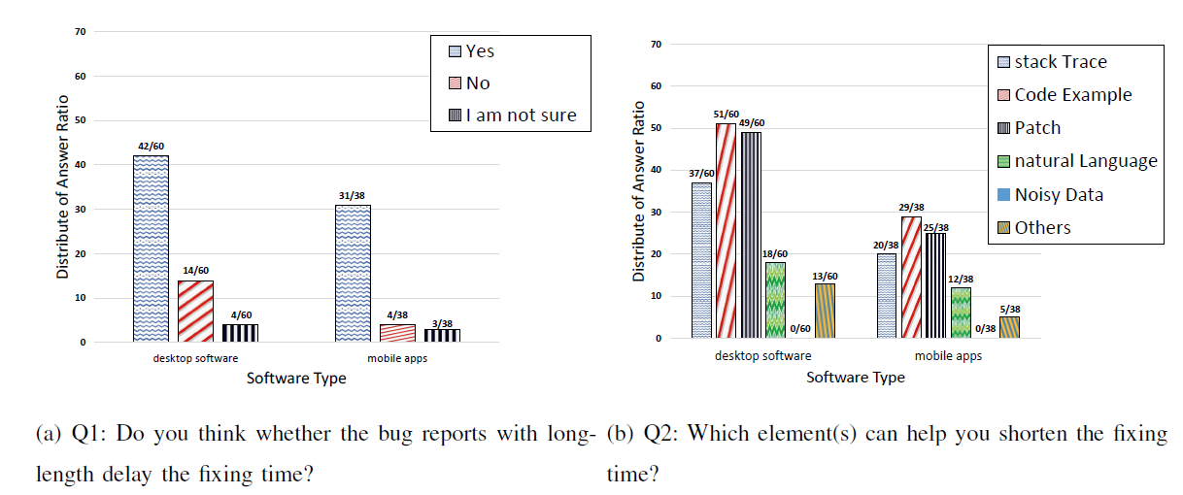
Online survey: result(Q1-Q2)

Slide 42
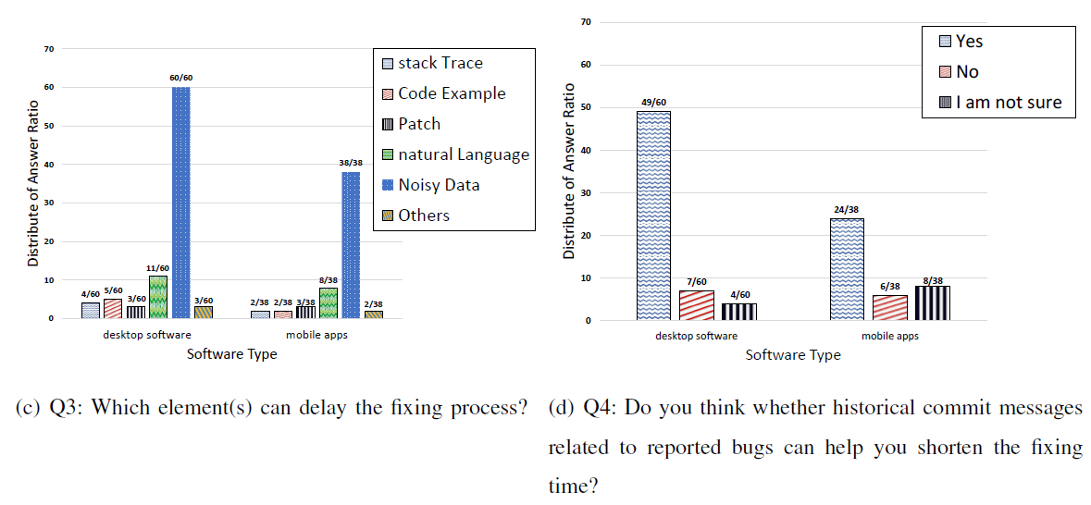
Online survey: result(Q3-Q4)

Slide 43
Limitation
We did not consider natural language in BRs.
But it is necessary to deeply analyze NL in BRs.
NL： OB (observed behavior)，S2R (steps to reproduce)，and EB (the software’s expected behavior)
How can we know the knowledge?
Chaparro et al., “Detecting Missing Information in Bug Descriptions”, FSE 2017.

Slide 44
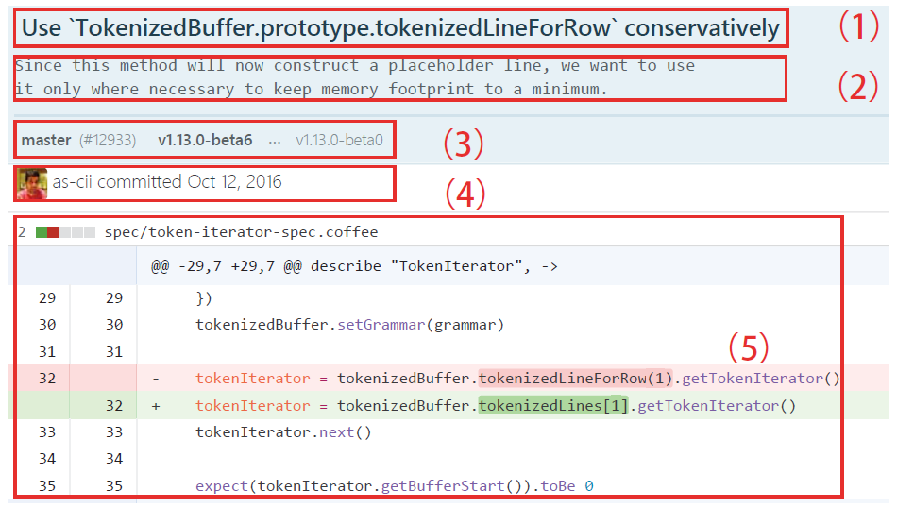
New resource: commit message
Enrichment and relevancy
Enrichment: high ratio of MEs
Relevancy: related to the reported bugs in BRs
Commit messages 1) title
2) description
3) feature
4) committer
5) changed code

Slide 45
Conclusion
Show the difference of bug reports in desktop software and mobile apps
Commit messages can help to enrich bug reports, especially for desktop software
But this is just a start…

Slide 46
现 在

Slide 47
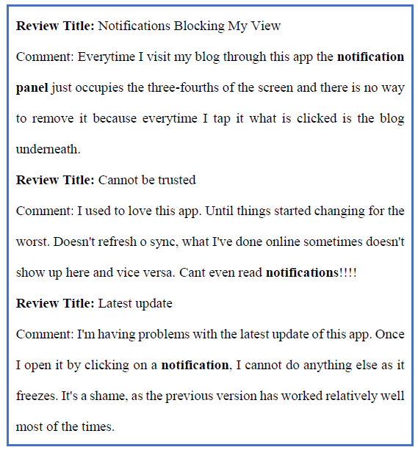
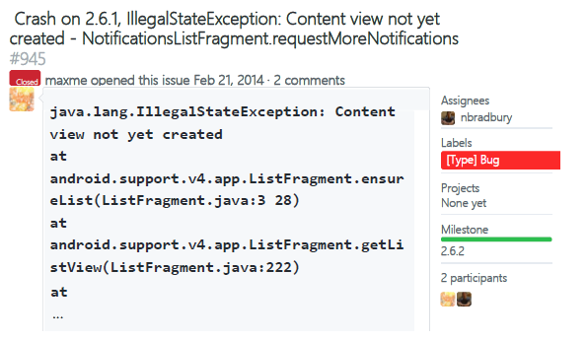
CLARE: Change Locator for App REviews
在移动应用中，真实的定位过程是怎样？

Slide 48
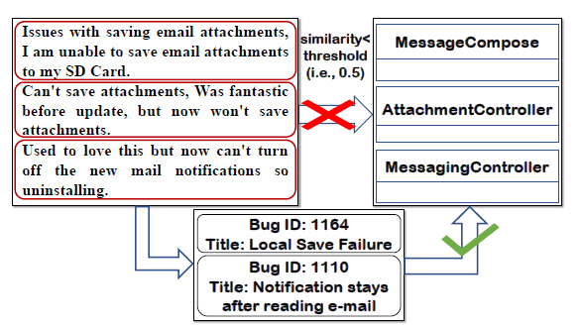

CLARE: Change Locator for App REviews
如果我们只是考虑用户评论信息，结果会是？
Dice similarity coefficient

Slide 49
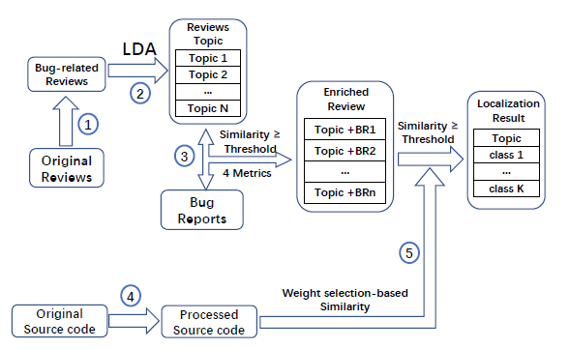
CLARE: Change Locator for App REviews
我们的做法

Slide 50
很多有趣的工作即将展示
To be continue

Slide 51
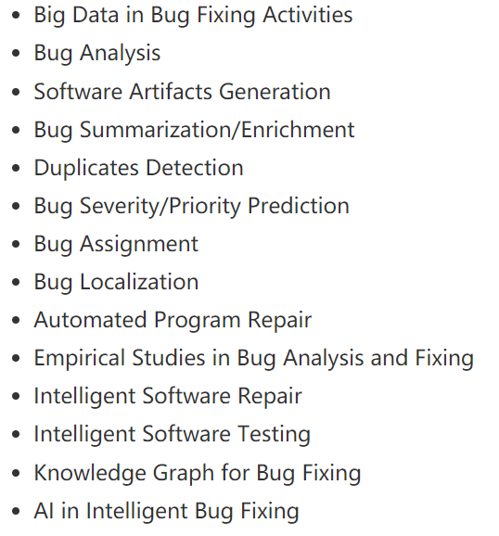
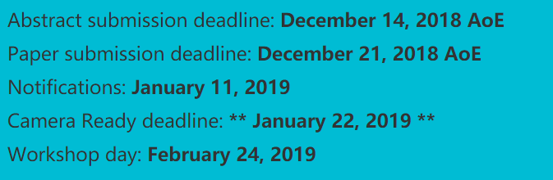
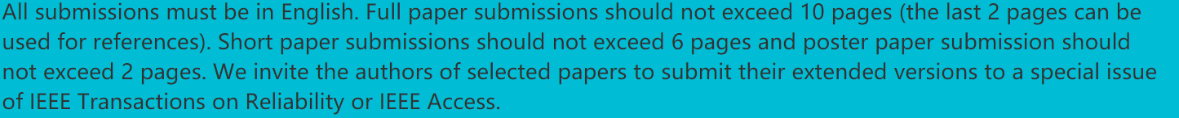
First Workshop on Intelligent Bug Fixing (IBF 2019) co-located with SANER 2019 (Feb. 24-27, 2019, Hangzhou, China)

Slide 52

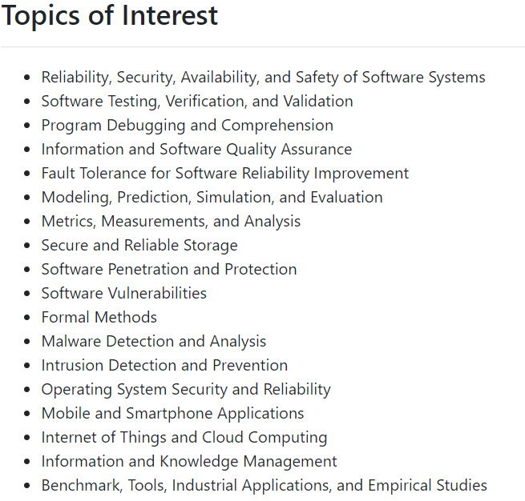
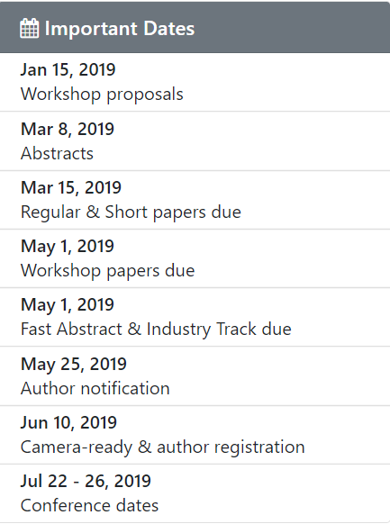
Authors of selected papers from QRS 2019 will be invited to submit an extended version to a special issue of Journal of Systems and Software (JSS).

