Slide 1
Term Project Overview
UNO
John Paul Apolinar, Kevin Barbour, Christian Mcglothen, Zhenyu Lin

Slide 2
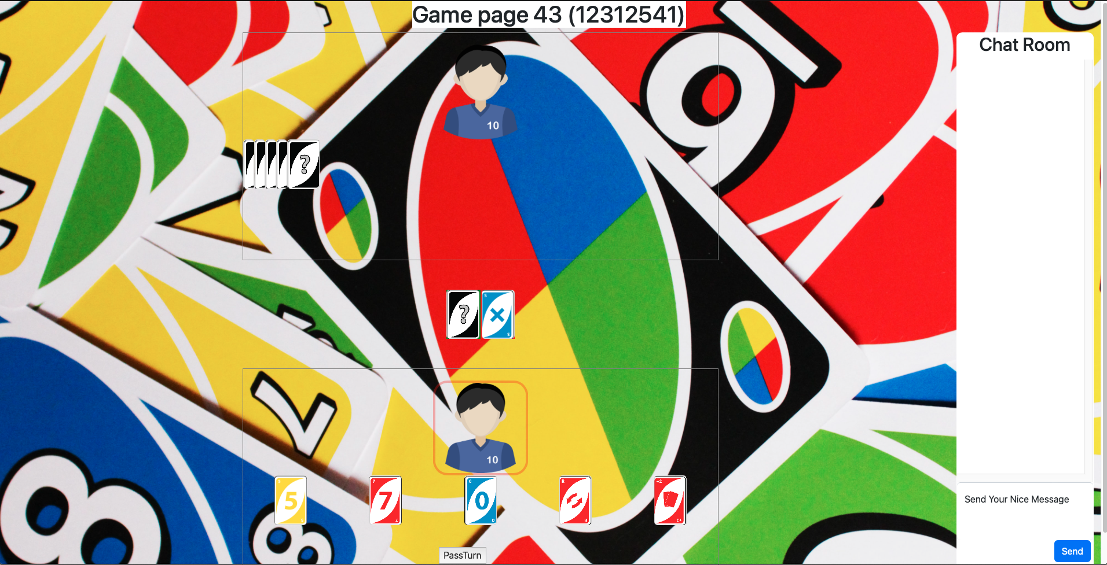
About
Our team implemented the card game ‘UNO’.
Maximum of 4 Players
Chat integration in and out of lobby
Custom Lobby Names

Slide 3
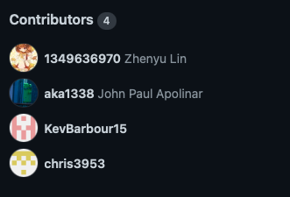
Roles
Zhenyu Lin - Front End, Bug Testing
John Paul Apolinar - Back End (Gameplay)
Kevin Barbour - Back End (Lobby and Gameplay)
Christian Mcglothen - Back End (User Login and Authentication)

Slide 4
Development Stack
Frontend: Javascript, HTML/PUG
Backend: Node JS
Database: PostGres
Deployment: Render

Slide 5
Takeaways
The use of websockets and http requests
The use of threading and multiple connections
Using Render for deployment
Using Postgres/Javascript/Sequelize/HTML to store information obtained from web-browser
Creating a chat that updates all user simultaneously
Loopback IP-Addresses/Ports to run code locally

Slide 6
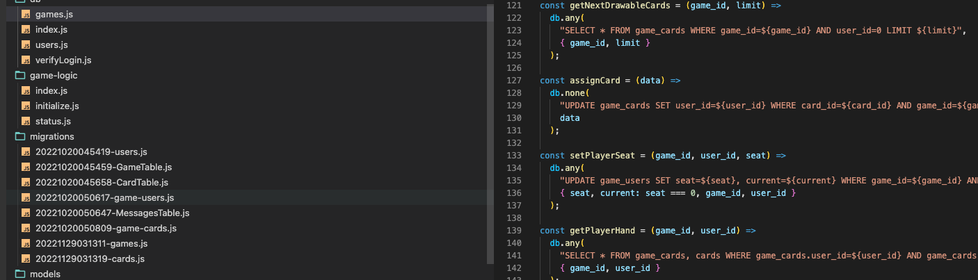
Project Organization and Workflow
Notes:
Show project in VSC, walk through major folders, how things are protected in app.js., migrations, routes, and views. Compare game-logic to a manager in Unity, where it’s objects call the manager to update the status and what’s going on.

Slide 7
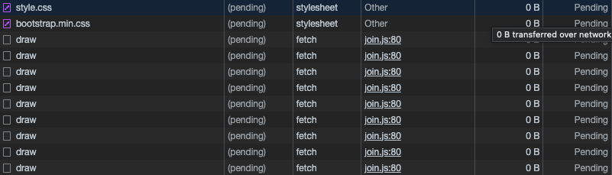
Issues
Single largest issue was this (pending) status.
Only occurred in local environment, and not Render.
Occurs for many different reasons
Online research points to browser extensions, browser type, headers, etc.

Slide 8
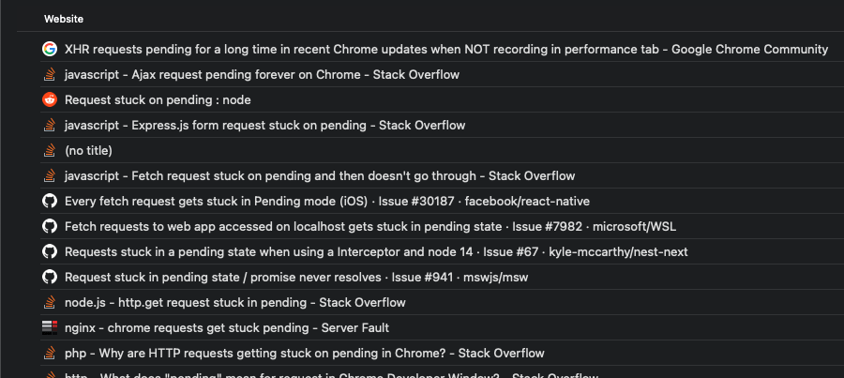

Slide 9
Gameplay Issues
Styling of certain cards
Implementation for special cards
Required a shift in direction to meet deployment requirements.
Player-honesty version of the game where moves are still automated to a degree
Drawing a card and manually skipping if they have no matching card in hand.
Drawing punishment cards e.g., +2 or Skip
The player can press a button to skip their turn on cancel/reverse, and/or draw X amount of cards.

Slide 10
Live Demonstration

