Slide 1
Satisfiability problem : using Grover’s algorithm

Slide 2
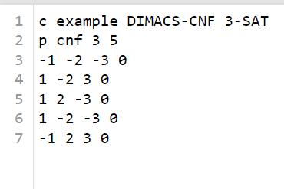
Defining formulas
¬x1 v ¬x2 v ¬x3
x1 v ¬x2 v x3
x1 v x2 v ¬x3
x1 v ¬x2 v ¬x3
¬x1 v x2 v x3
(¬x1 v ¬x2 v ¬x3)^(x1 v ¬x2 v x3)^(x1 v x2 v ¬x3)^ (x1 v ¬x2 v ¬x3)^(¬x1 v x2 v x3)

Slide 3
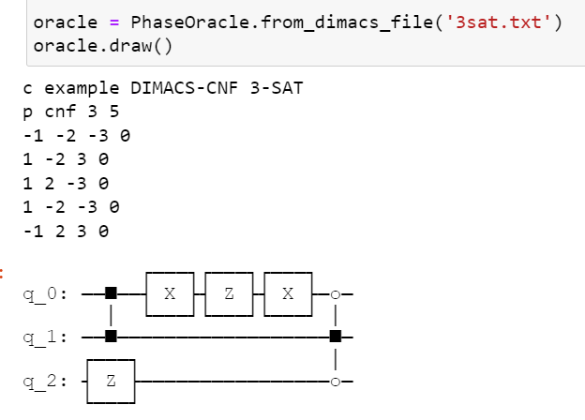
Oracle
Phase-flip oracle:
flips the phase of the computational basis states corresponding to satisfying assignments of the formula

Slide 4
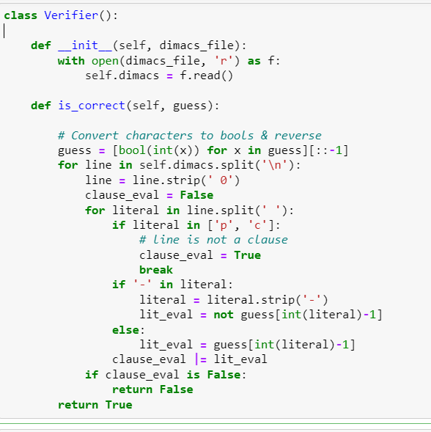
Verifying clauses
Init : reads the file
Is_correct : takes an input and checks whether it is True

Slide 5
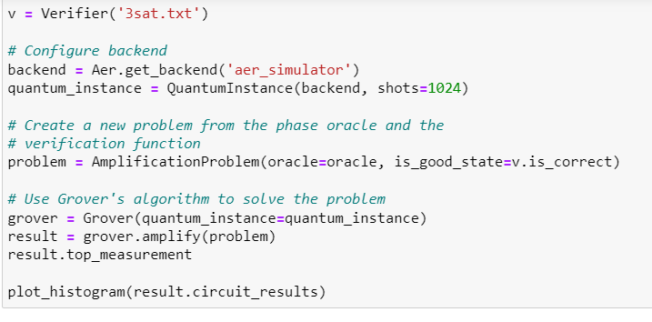
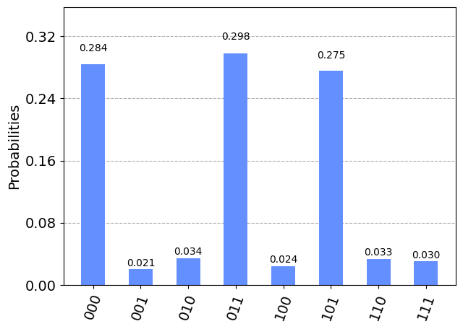
A first histogram

Slide 6
A first histogram
(¬x1 v ¬x2 v ¬x3)^(x1 v ¬x2 v x3)^(x1 v x2 v ¬x3)^ (x1 v ¬x2 v ¬x3)^(¬x1 v x2 v x3)
X1 | X2 | X3 | Formula
0 | 0 | 0 | True
0 | 0 | 1 | False
0 | 1 | 0 | False
0 | 1 | 1 | False
1 | 0 | 0 | False
1 | 0 | 1 | True
1 | 1 | 0 | True
1 | 1 | 1 | False

Slide 7
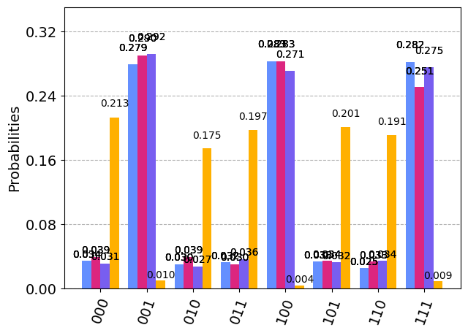
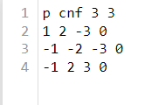
Trying out a different formula
(x1 v x2 v ¬x3) ^ (¬x1 v ¬x2 v ¬x3) ^ (¬x1 v x2 v 3)

Slide 8
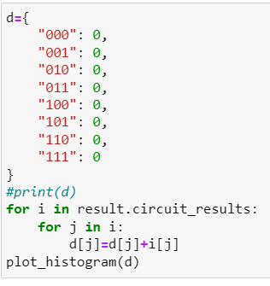
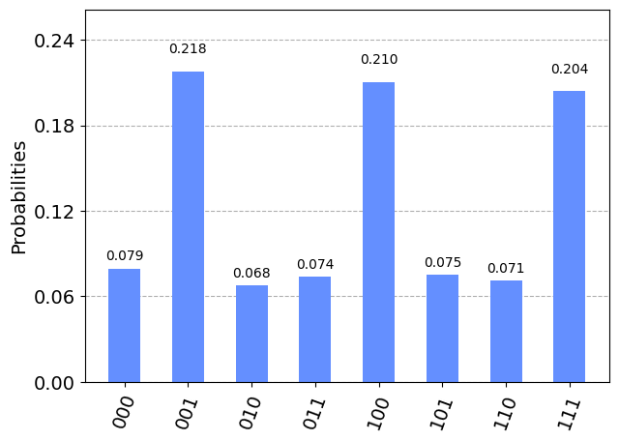
Histogram issues
(x1 v x2 v ¬x3) ^ (¬x1 v ¬x2 v ¬x3) ^ (¬x1 v x2 v 3)
X1 | X2 | X3 | Formula
0 | 0 | 0 | True
0 | 0 | 1 | False
0 | 1 | 0 | True
0 | 1 | 1 | True
1 | 0 | 0 | False
1 | 0 | 1 | True
1 | 1 | 0 | True
1 | 1 | 1 | False

Slide 9
Histograms
(x1 v x2 v ¬x3) ^ (¬x1 v ¬x2 v ¬x3) ^ (¬x1 v x2 v 3)
X1 | X2 | X3 | Formula
0 | 0 | 0 | True
0 | 0 | 1 | False
0 | 1 | 0 | True
0 | 1 | 1 | True
1 | 0 | 0 | False
1 | 0 | 1 | True
1 | 1 | 0 | True
1 | 1 | 1 | False

Slide 10
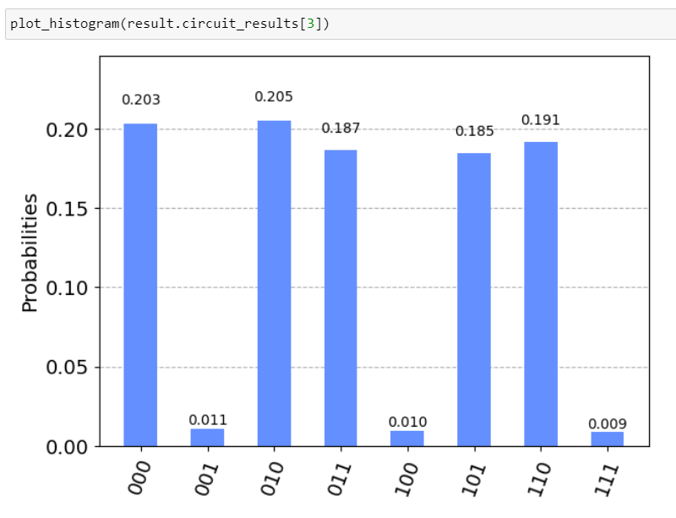
Histograms
(x1 v x2 v ¬x3) ^ (¬x1 v ¬x2 v ¬x3) ^ (¬x1 v x2 v 3)
X1 | X2 | X3 | Formula
0 | 0 | 0 | True
0 | 0 | 1 | False
0 | 1 | 0 | True
0 | 1 | 1 | True
1 | 0 | 0 | False
1 | 0 | 1 | True
1 | 1 | 0 | True
1 | 1 | 1 | False

Slide 11
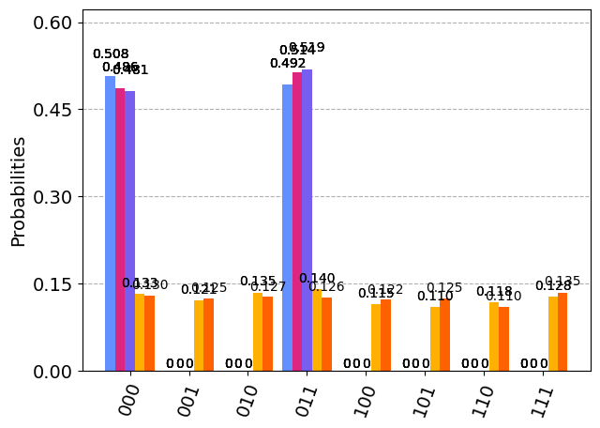
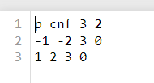
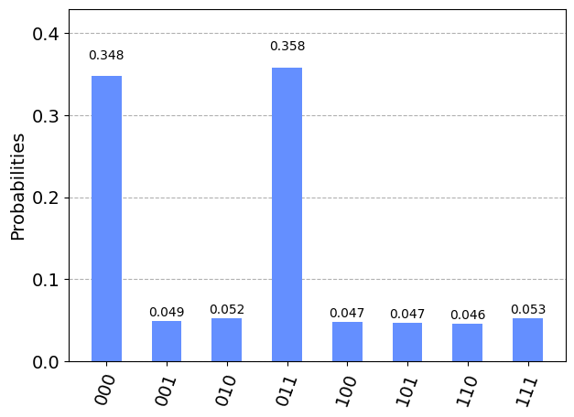
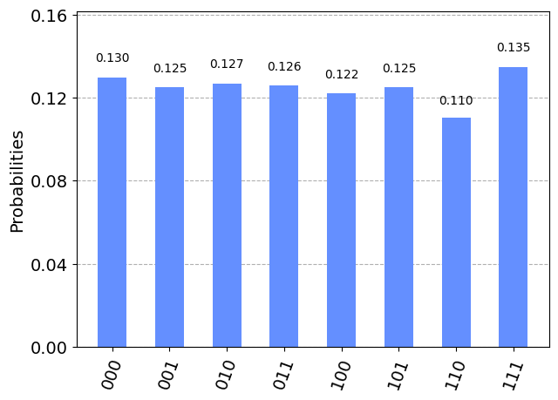
Another try
(¬x1 v ¬x2 v x3) ^ (x1 v x2 v x3)

