Slide 1
R: Fundamental Concepts with RStudio

Slide 2
Tool | Cost | Flexibility | Extensible | Visulation
SPSS | License | Menu-driven | New methods depend on SPSS | Charts
R | Free, open-source | Scriptable | Community-built packages (>22k) on CRAN | Advanced, customizable graphics with `ggplot`
Notes:
tbl <- tibble::tibble( Tool = c(“SPSS”, “R”), Cost = c(“License”, “Free, open-source”), Flexibility = c(“Menu-driven”, “Scriptable”), Extensible = c(“New methods depend on SPSS”, “Community-built packages (>22k) on CRAN”), Visulation = c(“Charts”, “Advanced, customizable graphics with ggplot”) )

Slide 3
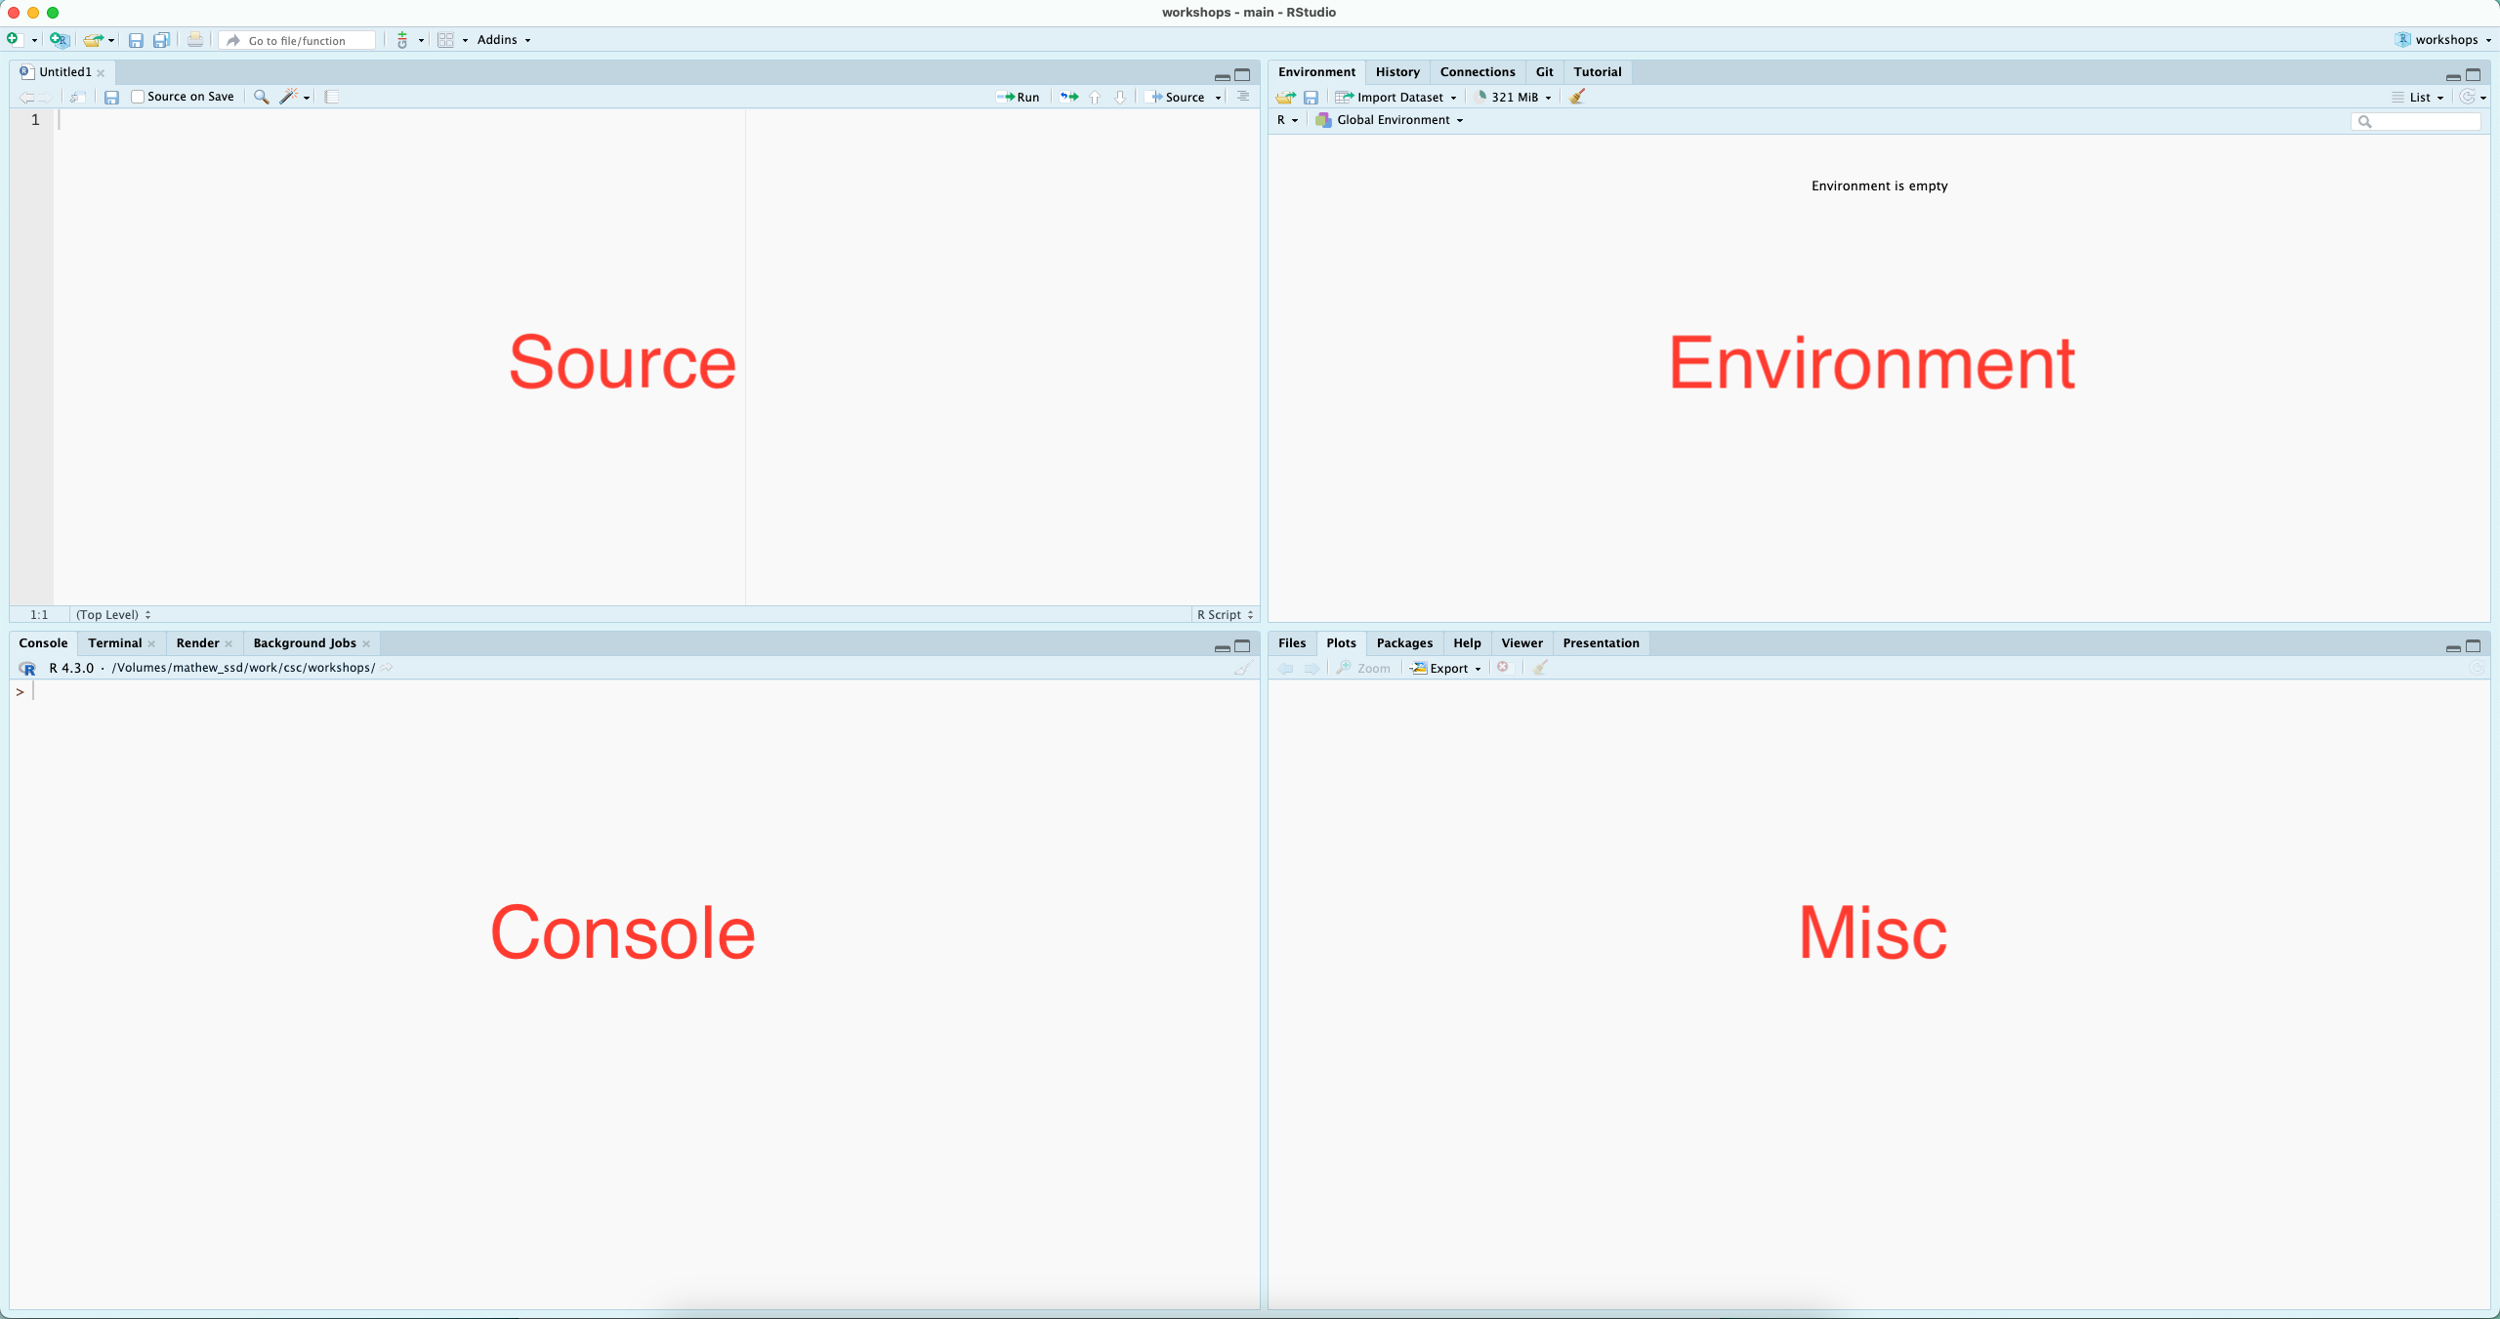
RStudio
Notes:
R is great for interactive computational analysis, allowing for easy exploration and iteration. Using an IDE - Integrated Development Environment - such as RStudio, facilitates this interactivity, providing you with easy access to a place to quickly code (the console), a place to write saveable scripts (source editor), a place to view the objects that you create (environment pane), and a place to interact with your file system, visual outputs from your code, and help documentation (the miscellaneous pane, for lack of a better word).

Slide 4
Installing packages
# install.packages("dplyr") # This call installs a package # library(dplyr) # This loads a package # devtools packages # install.packages("devtools") # install_github("username/repositoryname")
Notes:
Base R (as it’s affectionately called) is great, but the cool thing about R is it’s huge ecosystem of packages which are constantly being expanded both on the central repository for the R programming language Comprehensive R Archive Network (CRAN) and outside of CRAN. As of the writing of this RMD there are over 22,000 packages on CRAN.

Slide 5
Reading in Data in Base R
badTable <- read.table("../data/health_data.csv") # this will be an ugly mess of strings--trust me badTable[1,]
## [1] "id,group,gender,age,smoker,weight_pre,weight_post,bmi_pre,bmi_post,vo2max_pre,vo2max_post,improved"
Notes:
read.table() is Base R’s primary means of importing data, allowing the user to specify a variety of options. By default read.table will not know what delimeter (or separator hence the word sep in the second read.table() call). It will also not know whether or not your data include a header and so when you go to look at the first row of data it will just spit out your header as one long string.

Slide 6
Reading in Data in Base R Cont’d
head(read.table("../data/health_data.csv", sep = ",", header=TRUE))
## id group gender age smoker weight_pre weight_post bmi_pre bmi_post ## 1 1 Control Female 28 No 78.3 78.4 26.2 26.3 ## 2 2 Control Male 24 No 73.9 72.0 24.5 23.4 ## 3 3 Control Female 14 No 62.6 62.0 21.8 21.1 ## 4 4 Control Male 29 Yes 72.7 71.7 24.1 23.1 ## 5 5 Control Female 37 No 93.3 92.6 24.6 25.6 ## 6 6 Control Male 40 Yes 93.0 93.2 25.1 25.0 ## vo2max_pre vo2max_post improved ## 1 46.4 45.4 False ## 2 42.5 42.4 False ## 3 32.6 37.3 True ## 4 43.3 43.3 True ## 5 30.0 31.2 True ## 6 42.4 44.1 True
Notes:
Thankfully, you can fix this with a few extra parameters. However, there are smarter, less clumsy options out there.

Slide 7
A quick note on read_excel from the Tidyverse
suppressWarnings(library(readxl)) data_xls <- suppressWarnings(read_excel("../data/gapminder.xlsx")) # `read_excel` also supports reading in specific data_xls <- read_excel("../data/gapminder.xlsx", sheet = '1952', range = "A1:D5")
Notes:
Base R does not include a package for loading in Excel files. For this we’ll use the tidyverse package readxl, which can read both legacy xls as well as more recent xlsx files. This is tidyverse, and so read_excel() loads a tibble object. If you need or want a data frame, you’ll need to adjust for that…
You can specify specific sheets and ranges with the sheet and range arguments…Additional options and their defaults can be found with ?readxl or by visiting https://readxl.tidyverse.org/.

Slide 8
# a set of possible NA values na_values <- c("NULL", "NA", "N/A", "99", "", " ") data_custom_na <- read.csv("../data/gapminder.csv", na.strings = na_values) # a file with no header data_no_header <- read.csv("../data/gapminder.csv", header = FALSE) data_nows <- read.csv("../data/gapminder.csv", strip.white = TRUE)
TRUE and FALSE can be denoted with either T and F or TRUE and FALSE. However, T and F as variable names can be overwritten to point to other objects, whereas TRUE and FALSE cannot. It is advisable to always use TRUE and FALSE. notes using read.csv() is as simple as specifying a directory or url from which to import data…By default, it assumes your file has a header and that any blank values contain the characters NA. Depending on our data source, however, we may need to adjust these parameters… Additional options and their defaults can be found with ?read.table().
It may also be a good idea to trim excess white space, which is not done by default…

Slide 9
Tidyverse
suppressWarnings(library(readr)) data_readr <- suppressWarnings(read_csv("../data/gapminder.csv", show_col_types = FALSE))
Notes:
read.csv() and read_csv() are very similar. read_csv() is ostensibly faster, it also loads data into a tibble as opposed to a data frame, and has more user friendly defaults. It does, however, require loading additional packages.
As with read.csv() and read.delim, read_csv() and read_tsv() – for tab separated values – are wrappers on read_delim() that is more flexible.
read_csv() assumes the file has a header, it trims white space by default, and that missing data are either blank cells or contain the character NA. To adjust these, use the arguments col_names = FALSE, na = na_values, trim_ws = FALSE.

Slide 10
Moving fast with data.table
suppressWarnings(library(data.table)) # we'll load the data.table package
## ## Attaching package: 'data.table'
## The following objects are masked from 'package:dplyr': ## ## between, first, last
# now we'll load our tiny health sciences dataset using the `fread` function health_dt <- data.table::fread("../data/health_data.csv")
Notes:
A newer package for working with data is called data.table. It is becoming well-known for being very fast. This is because data.table uses C/C++ as it’s backend. So it might be a good choice for those who are working with especially large datasets. However, I will note that the syntax for working with data tables is a little confusing so the learning curve is higher than working with standard data frames.

Slide 11
Functions
# c() is a common function for concatenating things together c(1:10)
## [1] 1 2 3 4 5 6 7 8 9 10
Notes:
At least initially, everything you do in R will be applying functions to data. In the above section, the mathematical operators, sqrt(), and log10(), are all functions. Functions take in data (or values) and process them, providing an output. The output is displayed in your console by default.

Slide 12

Variables

Slide 13
Variables Cont’d
# You can then recall the values (object) associated with your variable... my_variable <- c(1:10) myAlphabet <- letters[1:5] myNumbers <- c(1:5) #And plug it into functions, ie, do computations on it... my_variable
## [1] 1 2 3 4 5 6 7 8 9 10
my_variable * 2
## [1] 2 4 6 8 10 12 14 16 18 20
Notes:
While having outputs directed to the console is convenient for interactive analysis, often we need to store data and / or outputs for later use. We do this with variable assignment, where the greater than and dash are used to assign the values (object) on the right to the name (variable) on the left. When naming variables in R, keep in mind that variable names:

Slide 14
Naming variables
# camel case myNumber <- "Hello" # bad naming myNumber <- 10 # good naming # skeleton case my_number <- 10
Notes:
Should first and foremost be meaningful. This is not a rule, just best practice. Cannot start with a number or a dot followed by a number. Cannot contain spaces or hyphens. Can contain letters, numbers, dots, and underscores.
Additionally, some words are reserved and cannot be used, such as if and for. More details can be found with ?make.names

Slide 15
Data Types
Note: The function typeof(), will tell you what data type you have…
Notes:
Data types are elemental data constructs that R is able to distinguish between. The most common data types in R are numeric, character, and boolean. These come with intrinsic properties, for example, numeric data can be computed (added, divided, etc), character data can be strung together (character data, especially groups of characters are referred to as strings), and boolean data facilitates working with dichotomous values.

Slide 16
Boolean (Logical Data)
boolean data are generally referred to as logical
myBool <- TRUE # this is camel case typeof(myBool)
## [1] "logical"

Slide 17
Numeric (Double)
numeric data are subdivided into double and integer; the difference is generally of little significance, as R manages the distinctions for you, but be wary if you’re dealing with particularly large numbers
myDouble <- 10.5 typeof(myDouble)
## [1] "double"

Slide 18
Numeric (Integer)
myInteger <- 10L typeof(myInteger)
## [1] "integer"

Slide 19
Characters
character data always needs to be wrapped in single or double quotations.
myChar <- "a" # Note that R does not distinguish between '' and "" but the use has to match typeof(myChar)
## [1] "character"

Slide 20
Complex
myComplexNum <- 9 + 3i typeof(myComplexNum)
## [1] "complex"

Slide 21
Data Structures
Data structures are ways to hold multiple pieces of data together in a meaningful way. R has four convenient ways of storing multiple pieces of data: vectors, matrices, data frames, and lists.

Slide 22
Vectors
# numeric vector c(1:10)
## [1] 1 2 3 4 5 6 7 8 9 10
# character vector c("a", "b", "c")
## [1] "a" "b" "c"
# logical vector c(TRUE, TRUE, FALSE)
## [1] TRUE TRUE FALSE
# note that vectors do not allow you to mix types # c(TRUE, 10) # this will convert TRUE to 1 # c(TRUE, "10") # this will convert TRUE to "TRUE"
Notes:
The most basic is a vector. In fact, everything in R is a vector, and all other data structures are composed of vectors in various ways. It’s convenient to think of a vector as a simple list of like things; everything in a vector needs to be of the same data type. So, a vector can be:
numeric, holding numeric data;
character, holding character data; or
logical, holding boolean data.
A vector can be created with c()

Slide 23
Matrices
matrix(1:10, nrow = 2)
## [,1] [,2] [,3] [,4] [,5] ## [1,] 1 3 5 7 9 ## [2,] 2 4 6 8 10
Notes:
A matrix is a vector with 2 dimensions; while a vector only has a length, a matrix is a grid with both length and width, or alternatively, rows and columns.
You can create a matrix with the matrix() function, providing it first with a series of values followed by an argument for the number of rows or columns you’d like. A matrix must be perfectly rectangular, that is, each column must be of equal length. R will recycle values to ensure this condition is met. A matrix must also be atomic - the data type must be the same throughout.

Slide 24
Data frames
data.frame(letter = letters[1:5], nol = 1:5) # nol mean number of letter
## letter nol ## 1 a 1 ## 2 b 2 ## 3 c 3 ## 4 d 4 ## 5 e 5
Notes:
In general, these will be the most likely data structures that you’ll encounter and the most familiar, as they are designed for tabular data and look like a spreadsheet.
Data frames are collections of vectors, where each vector must be of the same length, but can be of a different data type. If you import data from an Excel or csv file, these will be read in as a data frame. You can also create them with the data.frame() function.

Slide 25
Lists
list(item_1 = myAlphabet, item_2 = c(1:3))
## $item_1 ## [1] "a" "b" "c" "d" "e" ## ## $item_2 ## [1] 1 2 3
Notes:
Like data frames, lists are collections of vectors. However, unlike data frames, the length of these vectors can change. So far, this is the only non-rectangular data structure that we have to work with.
If you are importing tabular data, you are unlikely to create a list yourself, however, when performing operations (using functions) on your data, the output, or result, might be in the form of a list. For demonstration puropses, a list can be created with the list() function.

Slide 26
Arrays
array(c(1, 2, 3, 4), dim = c(1, 2, 2))
## , , 1 ## ## [,1] [,2] ## [1,] 1 2 ## ## , , 2 ## ## [,1] [,2] ## [1,] 3 4
Notes:
Arrays are an n-dimensional generalization of the

Slide 27
Identifying Data Structures
class(c(1:10))
## [1] "integer"
class(matrix(1:10, ncol = 2))
## [1] "matrix" "array"
class(data.frame(var_1 = letters,var_2 = 1:26))
## [1] "data.frame"
class(list(item_1 = letters,item_2 = 1:10,item_3 = c(TRUE, FALSE)))
## [1] "list"
Notes:
The function class() will tell you what kind of structure your data are held in. class(), when called on a vector, will report on the data type, which should be read as the type of atomic vector you have. An array is a multi-dimensional vector, a matrix is the special case where there are only two dimensions.

Slide 28
# again we'll load the health data set health_df <- read.csv("../data/health_data.csv") health_names <- names(health_df) # this will load the column names health_names[1:3]
## [1] "id" "group" "gender"
Notes:
Once I have loaded a new dataset one of the first things I like to do is insepect the columns so I can get an idea of the types of data that might be present. This can be easily done with function names which is native to Base R. I won’t load all of the name here to save space, but I will load a few.

Slide 29
Getting Help
The learnr package is a resource for learning how to navigate R!
?sqrt()
Notes:
These pages can be both enlightening and frustrating, as they assume some pre-existing familiarity with certain concepts as well as reading this kind of documentation.
The second is from forums. These are useful when you have a specific issue that you’re trying to resolve, and can often provide a quick fix, but the explanations also often require a degree of familiarity to make sense.
The third is blog posts and course supports posted on line. These generally provide more context than forum posts, and are useful when tyring to learn a new approach or a new library.
The fourth is journal publications that accompany the release of specific packages or libraries. These offer in depth descriptions of the packages and their arguments, often with examples.
The fourth is more in depth texts. Many of these are available publicly online, and include titles such as:

Slide 30
References
aRrgh: a newcomer’s (angry) guide to R, by Tim Smith and Kevin Ushey - http://arrgh.tim-smith.us/
YaRrr! The Pirate’s Guide to R, by Nathaniel D. Phillips - https://bookdown.org/ndphillips/YaRrr/
R for Graduate Students, by Wendy Huynh. - https://bookdown.org/yih_huynh/Guide-to-R-Book/
Advanced R, by Hadley Wickham - http://adv-r.had.co.nz/Introduction.html And through the library, the O’Reilly platform hosts a plethora of titles related to R.
https://www.w3schools.com/r/r_data_types.asp

