Slide 1

Office
Manager

Slide 2
Description: This app will keep track of office status in every aspect. It should have a part to keep the projects Managed, a page to summarize current work hours for each worker, a page for important document upload and download, a page for material order, and a page for colleague discussion and messaging. It can also include more functions that is needed for office environment.
Basic components/ How it will manage:
Project List
Work hours
Important Document
(Maybe via Google Drive)
Order List
Discussion Board
Threads
Threads
Progress
Progress
Third Party Libraries: Google Drive
Why it need to be mobile? It will be easy for workers to track current work status.
Challenge point:
1. Message
2. API learning

Slide 3

ShouldiSki

Slide 4

Description
Thinking of hitting the slopes but unsure about the conditions? The Ski Decision App is here to help. By tracking popular hotel booking website at ski resorts and surrounding areas, the app provides a real-time crowd index, so you're always in the know about potential crowding.
In addition, stay updated with information on the weather, distance, and ski track conditions, ensuring your skiing experience is always top-notch. Make every ski trip worthwhile and avoid unforeseen disappointments.
Third Party Libraries: Booking.com-bookings and availability API, Ski Resort website for track information
Why it need to be mobile? User usually check these status information by phone before they check google map
Challenge point: API learning, data process

Slide 5
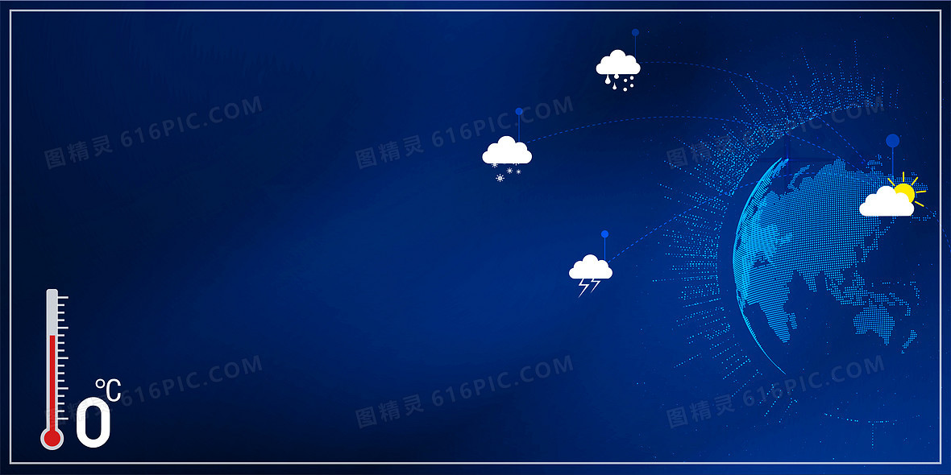
Weather Helper

Slide 6
App Description:
The weather forecast app provides current weather conditions and forecasts for the next few days. It allows users to search for locations, view detailed weather stats, and receive alerts for severe weather conditions.
Third-party Libraries:
Retrofit, Glide or Picasso, Moshi or Gson
Why Mobile:
Sensors: Use GPS to automatically detect the user's current location for relevant weather updates.
Personalization: Remember user's preferred locations and display customized weather alerts.
Why Mobile?: A mobile app offers on-the-go access to weather updates, ensuring users are always informed, especially during travel or outdoor activities.
Challenges:
API Limitations: Handling rate limits or changes in third-party weather APIs.
Data Accuracy: Ensuring reliable and precise weather data.
Learning Needs: Understand the intricacies of the chosen weather API, optimize location-based queries, and potentially learn about push notifications for weather alerts.
Notes:
Retrofit: To handle API requests for fetching weather data.
Glide or Picasso: To load and display weather icons or images.
Moshi or Gson: For JSON parsing of the API responses.

