Slide 1
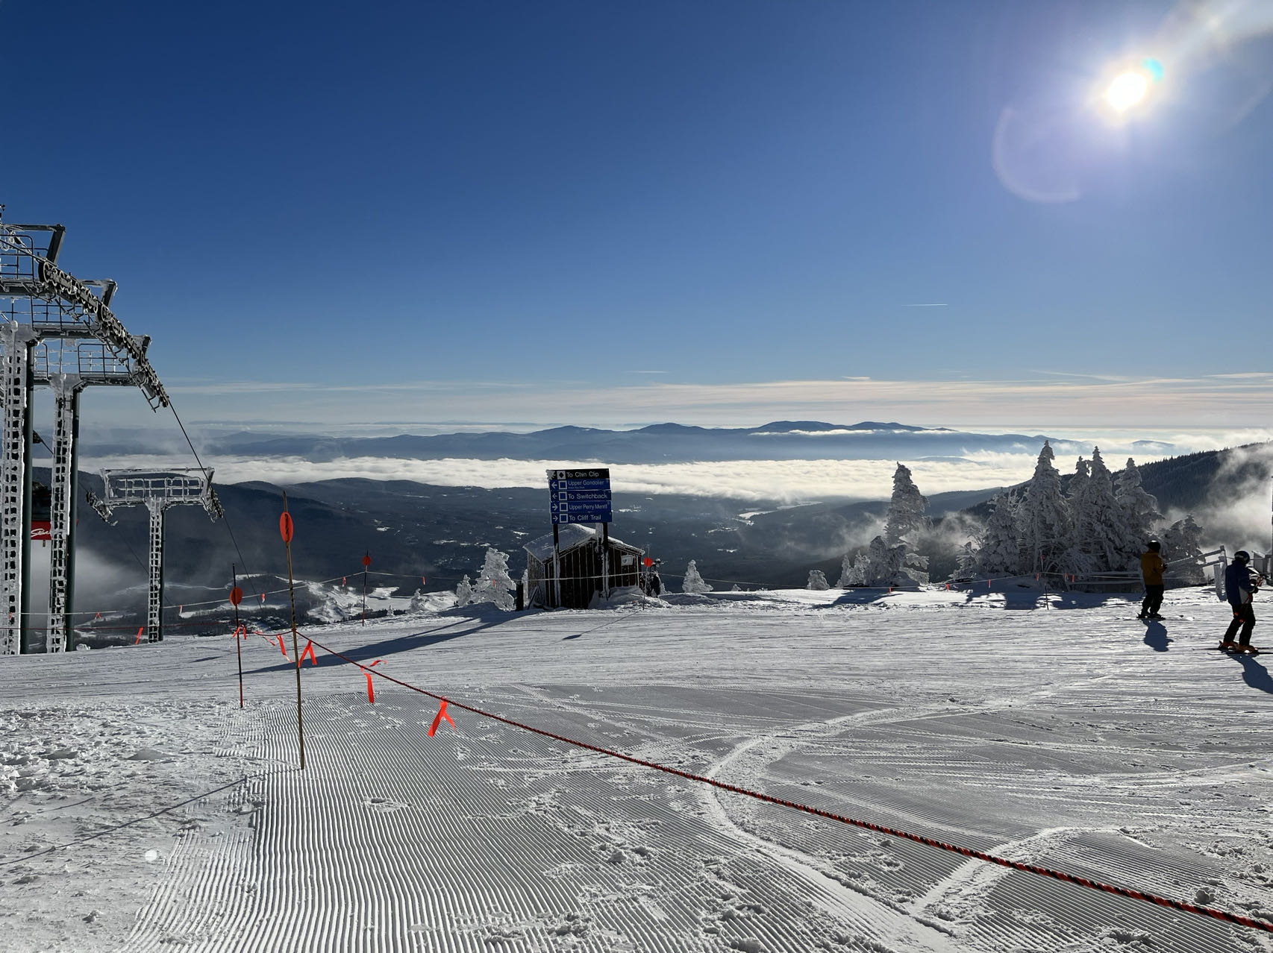
ShouldISki
Team Tuesday and Thursday
Siyi Du
Sicheng Chen
Team GitHub Repo:
csc0007/CS501_GroupWork: Group Work Only (github.com)

Slide 2
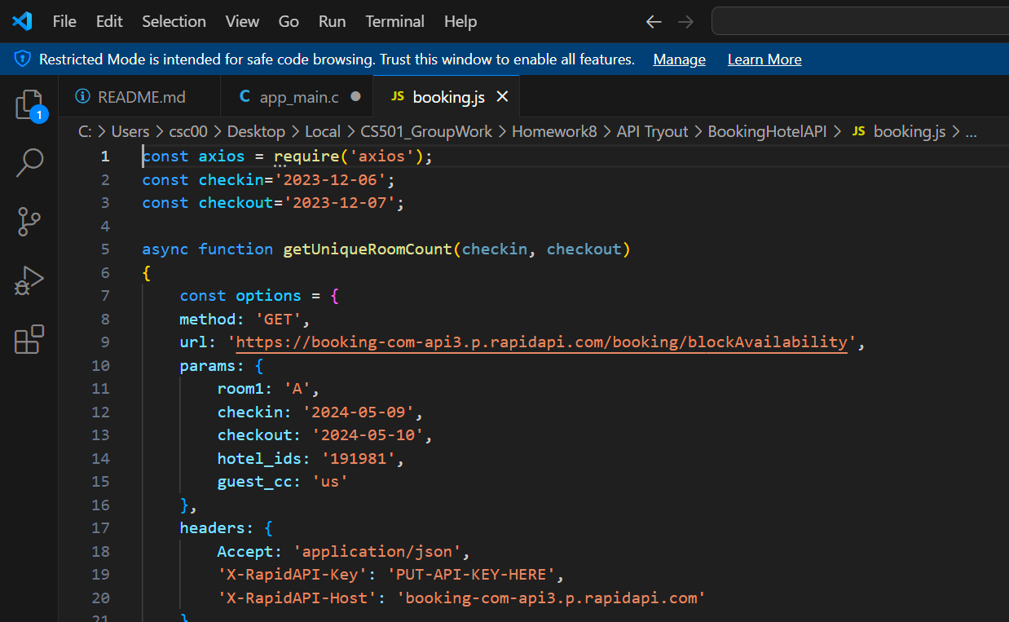
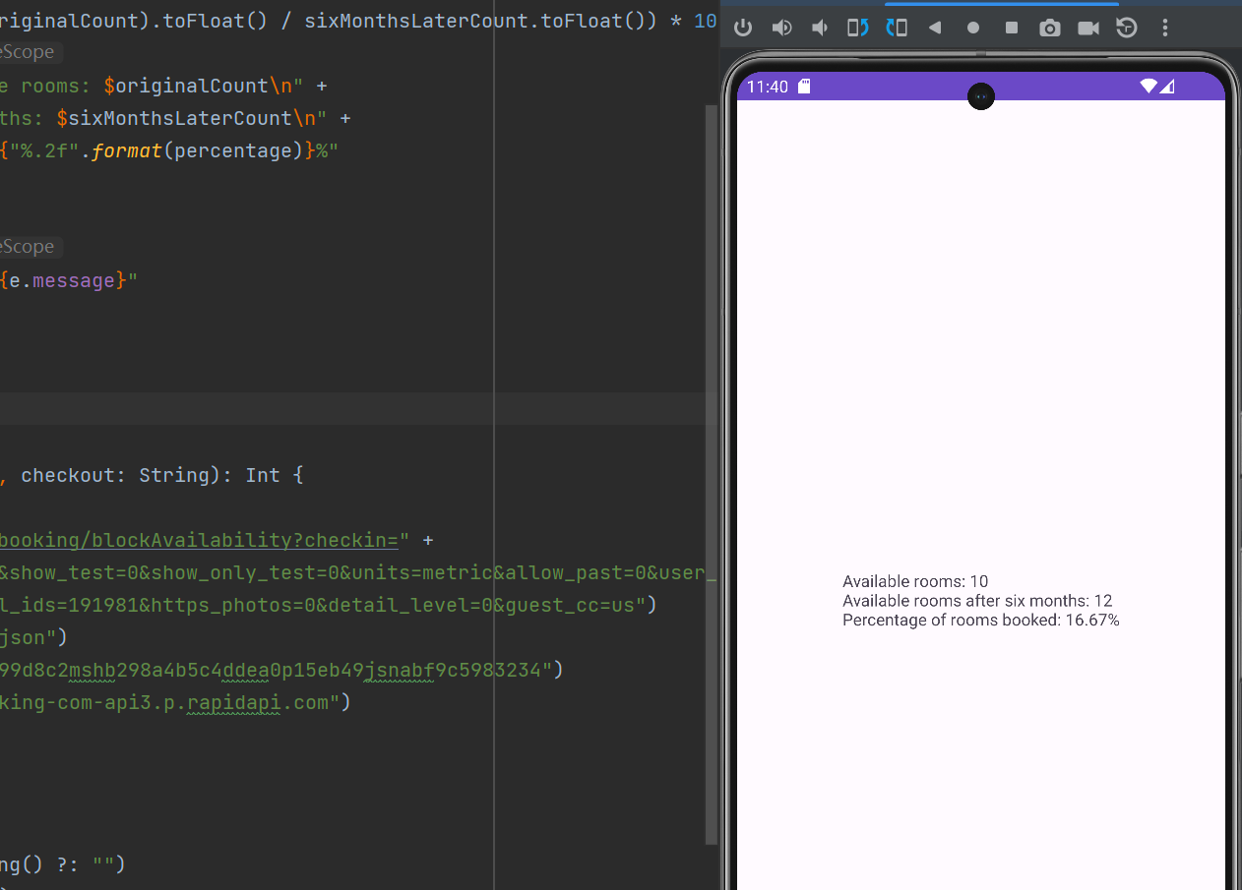
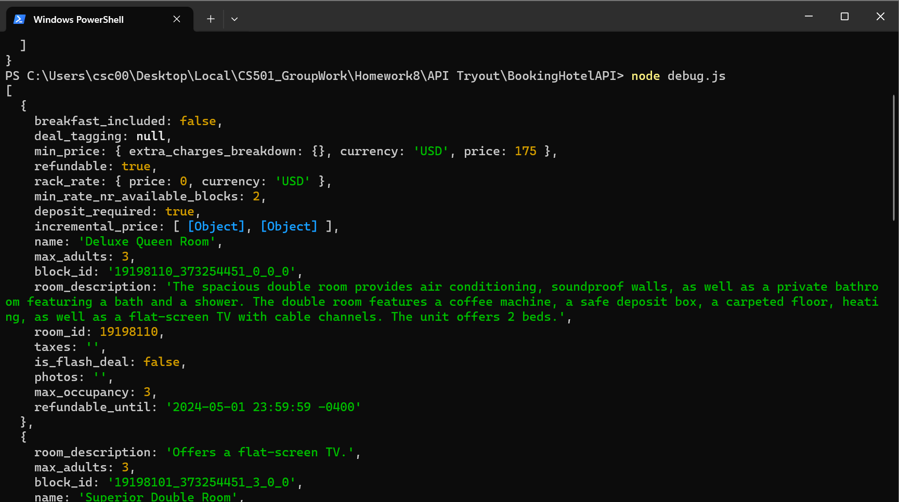
Node.js Program
Changes from the previous:
API Implementation
Android Tryout

Slide 3
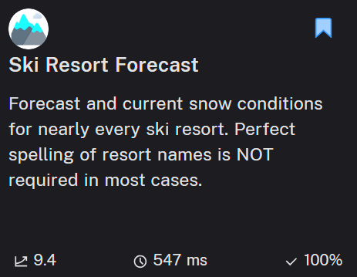
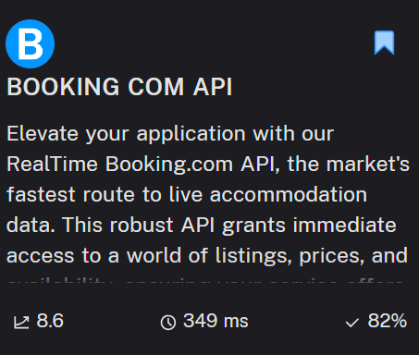
API Usage
Current Snow Condition API
Block Availability API

Slide 4
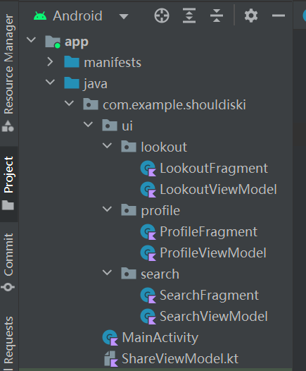
Structural Update
1. One Shared ViewModel
2. Passing Data Between Fragments:
MutableLiveData -> Observe
3. Only Pop-up Dialog For Date Picker
4. Debug TextView
5. Tintable Icon
6. Input From User

Slide 5
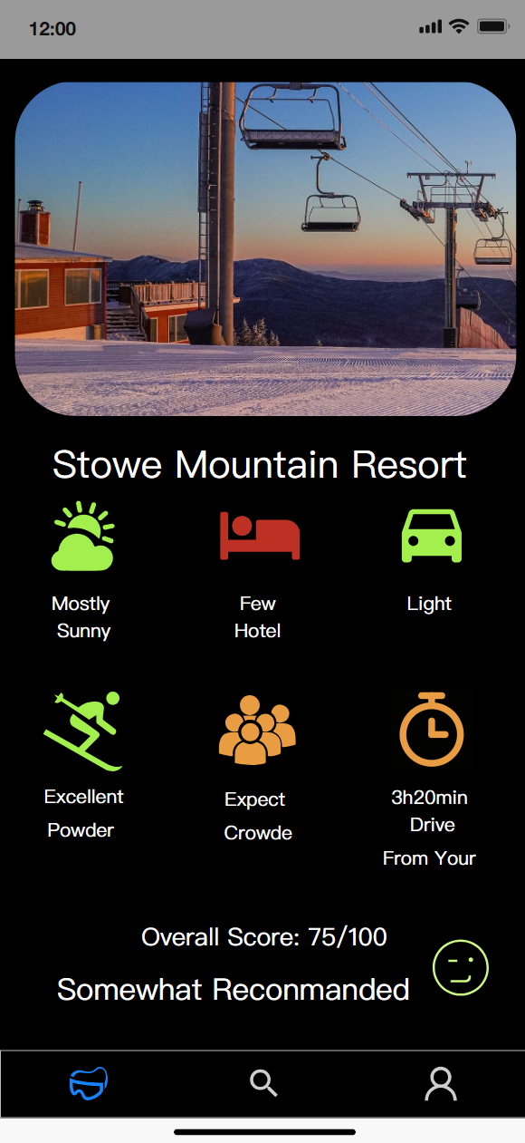
1. Brief Introduction
2. Changes from the previous
Structure build
Layout build
Widget build
3. Planned for the next
API connection
MVP prototype

Slide 6
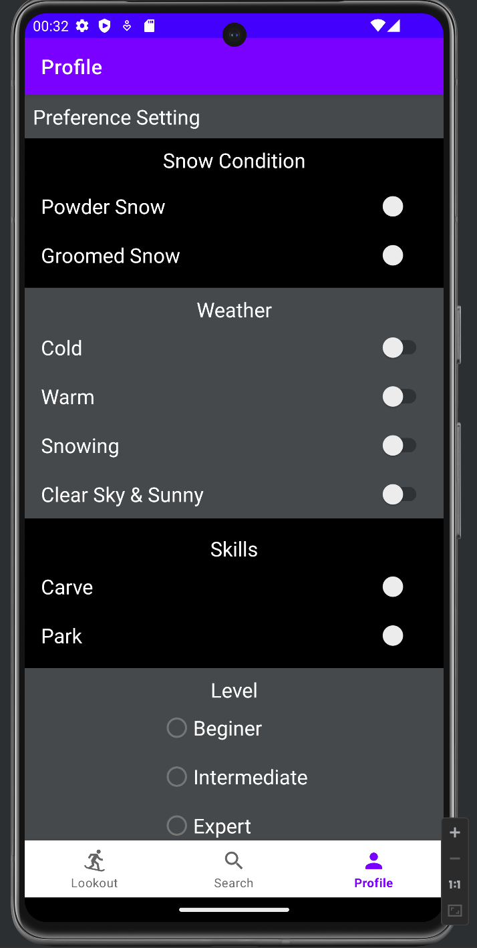
Plan for next
Link user preference setting with recommendation
Build database to for supported resort, location ….
Implement detail dialog when icon pressed

Slide 7
Demo

Slide 8
Risk
What is worrying us about getting to done?
Database setup is a chanllenge

Slide 9
Reference & AI Usage
1. Chatgpt Prompt
how to insert svg image into a xml android file?
how to set the background to dark mode? or set dark mode for entire app?
my page is getting full, but it does’t seem like I can scroll down the page if I put more stuff in it does it?
2. Other Reference
a. BOOKING COM API API Documentation (LnTtechnologies) | RapidAPI
b. Ski Resort Forecast API Documentation (joeykyber) | RapidAPI

