Slide 1
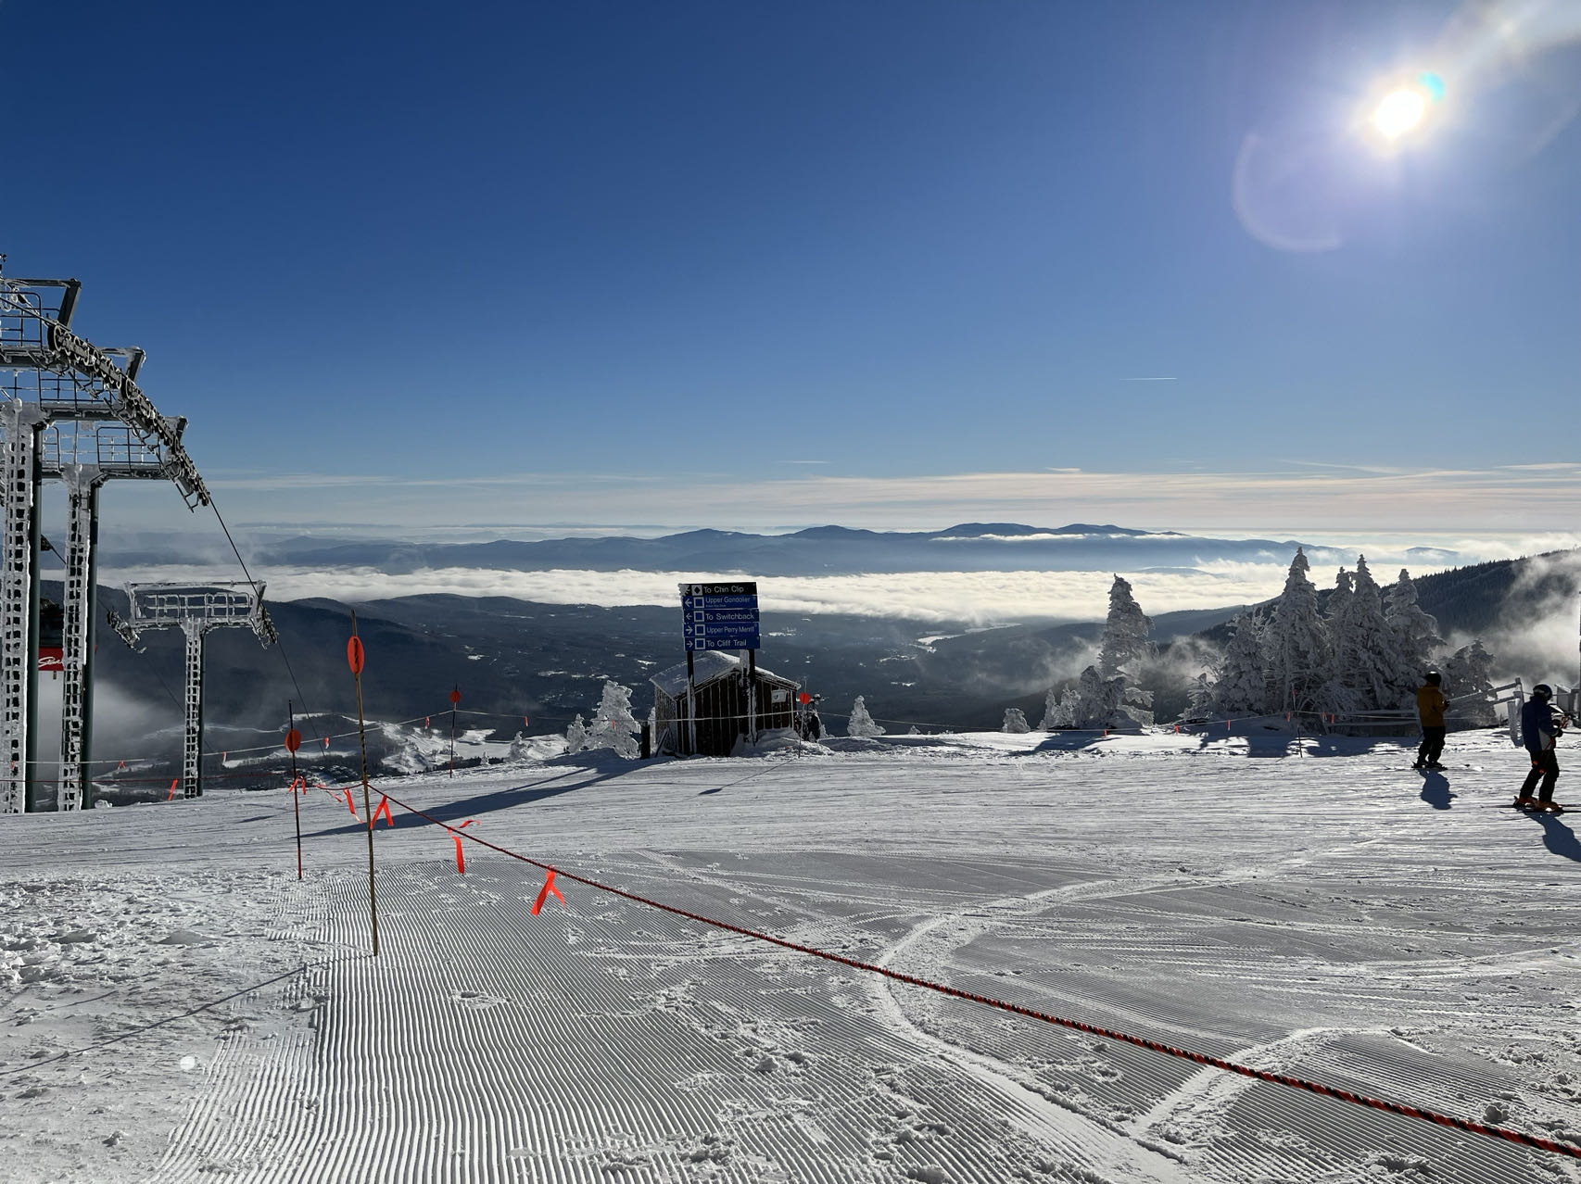
ShouldISki
Team Tuesday and Thursday
Siyi Du
Sicheng Chen
Team GitHub Repo:
csc0007/CS501_GroupWork: Group Work Only (github.com)

Slide 2
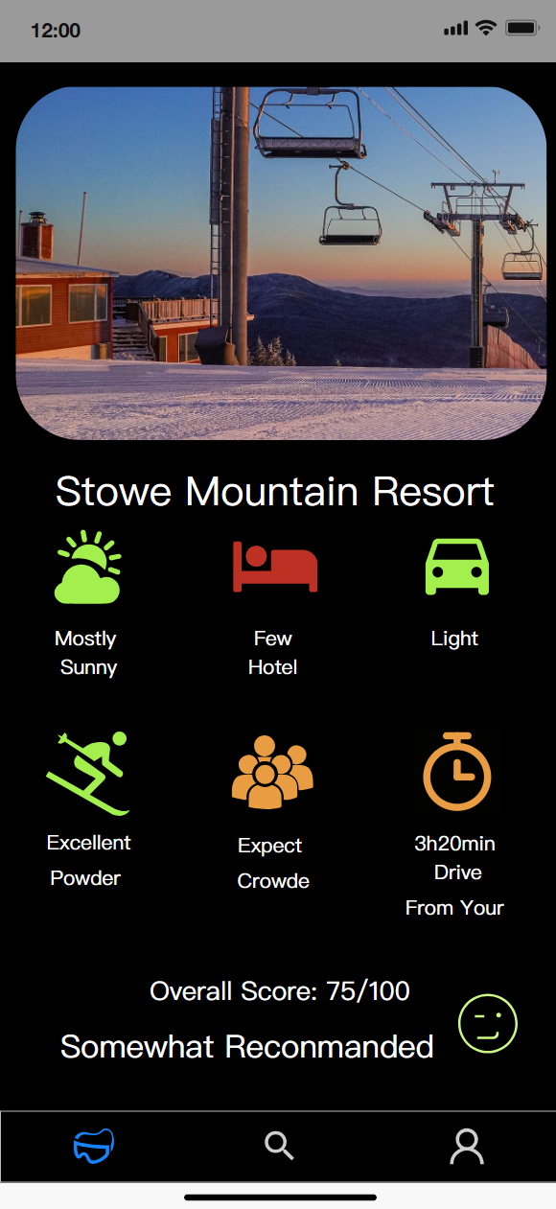
1. Brief Introduction
2. Changes from the previous
Structure build
Layout build
Widget build
3. Planned for the next
API connection
MVP prototype

Slide 3
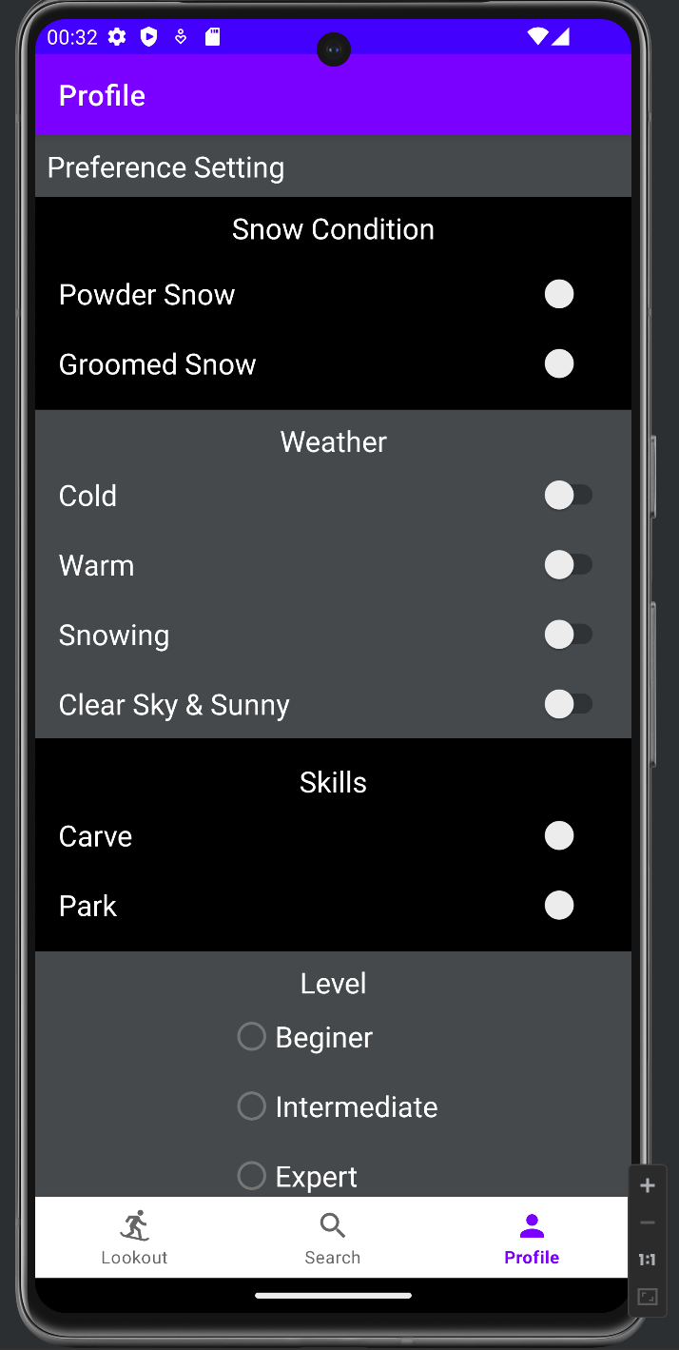
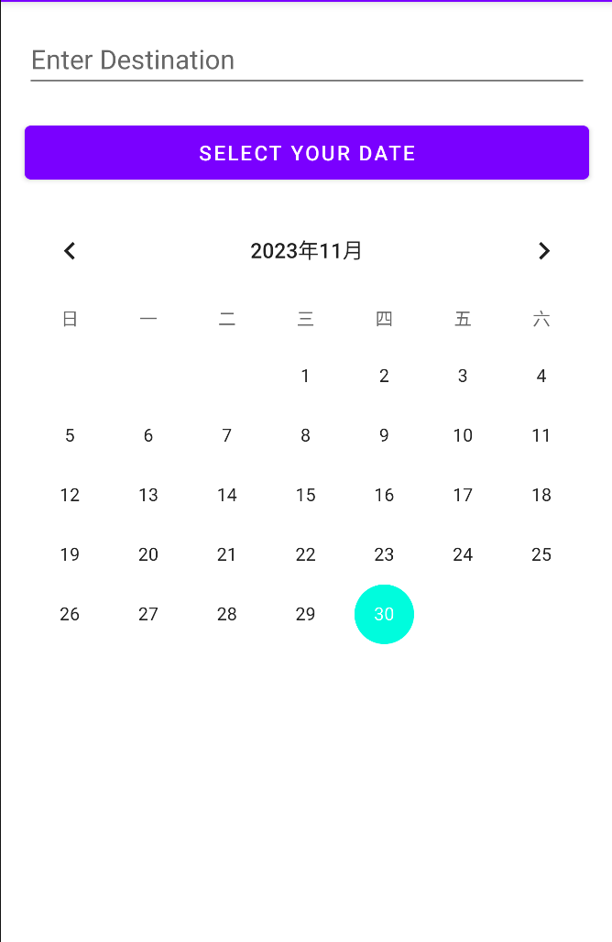
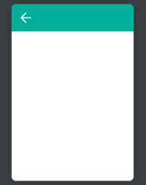
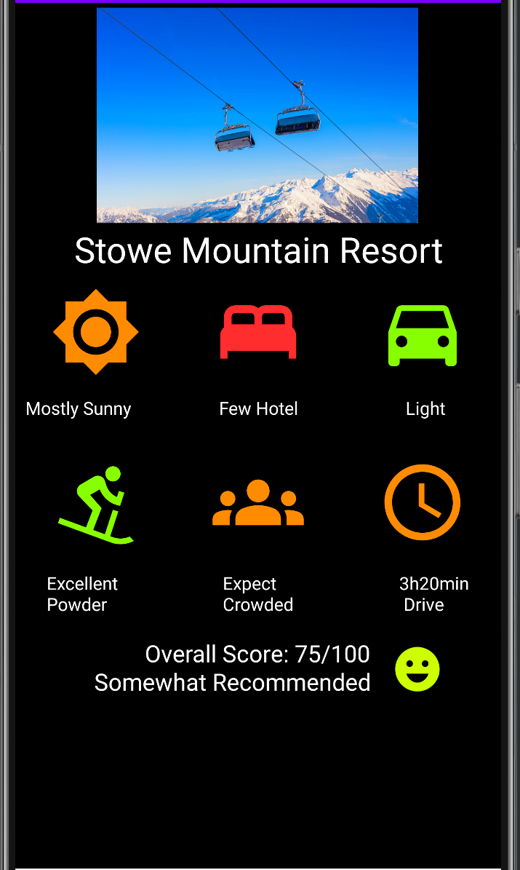

Profile Fragment
Search Fragment
APP Architecture
Navigation Host Fragment
Main Activity
Lookout Fragment
Bottom Navigation View

Slide 4
No Database used so far
No API used so far
No user stories fufilled yet

Slide 5
Demo

Slide 6
Risk
What is worrying us about getting to done?
API usage
Solution: Divide and conquer strategy, each person is responsible for 2 APIs

Slide 7
Reference & AI Usage
1. Chatgpt Prompt
how to insert svg image into a xml android file?
how to set the background to dark mode? or set dark mode for entire app?
my page is getting full, but it does’t seem like I can scroll down the page if I put more stuff in it does it?
2. Other Reference
a. BottomNavigationView | Android Developers
b. ScrollView | Android Developers
c. Add toggle buttons | Android Developers

