Slide 1
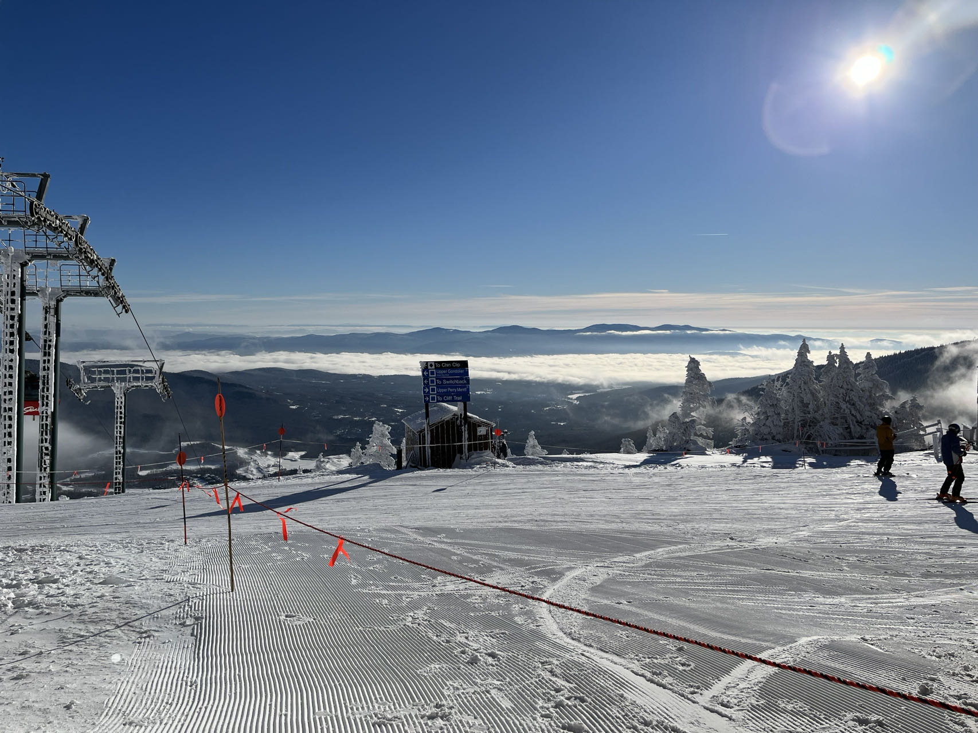
ShouldISki
Team Tuesday and Thursday
Siyi Du
Sicheng Chen

Slide 2
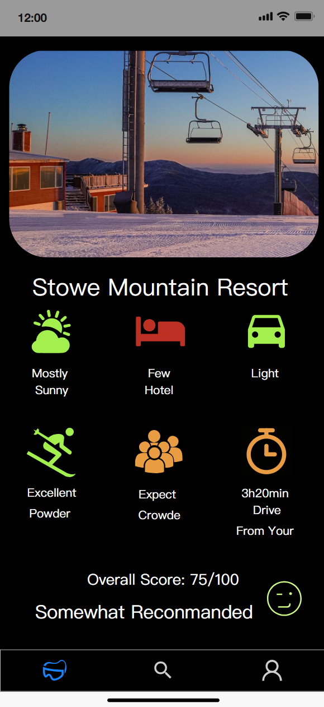
Brief Introduction
Changes from the previous
Structure build
Layout build
Widget build
Stories
Planned for the next

Slide 3
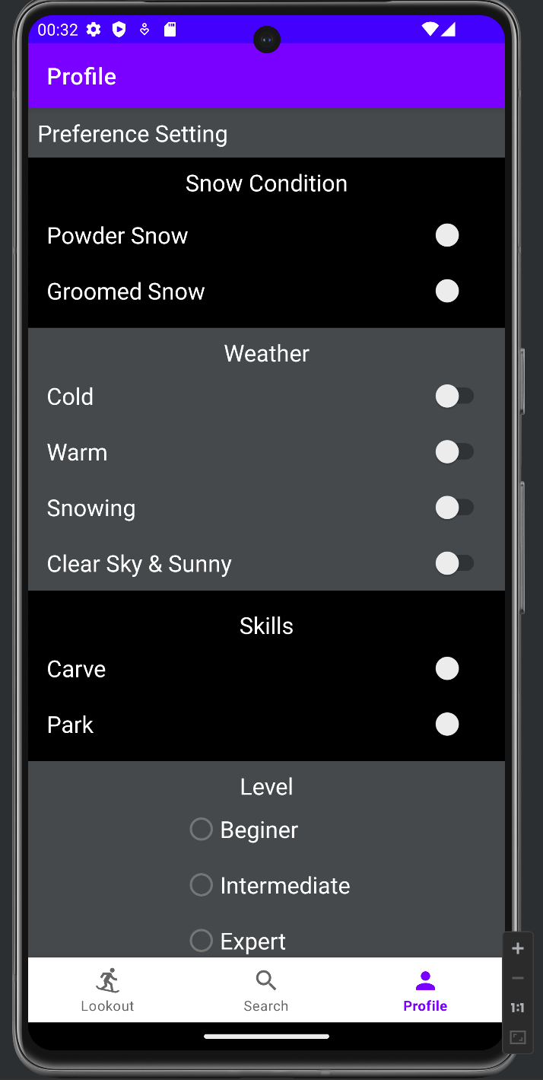
Update on the architecture, include:
Database
Fragments/activities
APIs used, any changes, are they working?

Slide 4
Demo

Slide 5
Risk
What is worrying you about getting to done?
API usage

Slide 6
Reference & AI Usage
Chatgpt…..

