Slide 1

Office
Manager

Slide 2
Description: This app will keep track of office status in every aspect. It should have a part to keep the projects Managed, a page to summarize current work hours for each worker, a page for important document upload and download, a page for material order, and a page for colleague discussion and messaging. It can also include more functions that is needed for office environment.
Basic components/ How it will manage:
Project List
Work hours
Important Document
(Maybe via Google Drive)
Order List
Discussion Board
Threads
Threads
Progress
Progress
Third Party Libraries: Google Drive
Why it need to be mobile? It will be easy for workers to track current work status.
Challenge point:
1. Message
2. API learning

Slide 3
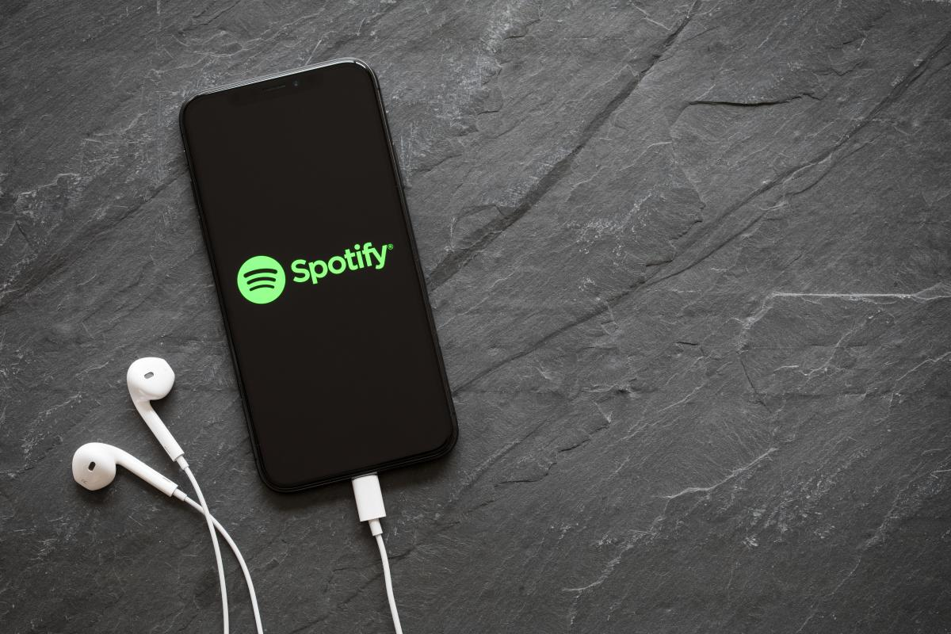
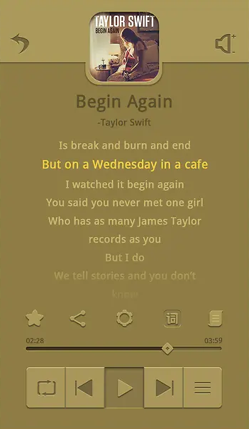
MiniSpotify

Slide 4
Description: The music player app allows users to play, pause, skip, and rewind songs stored on their device. It provides an intuitive interface to browse, create playlists, and adjust settings like volume and equalizer.
Third-party Libraries: ExoPlayer, Glide
Mobility Attributes:
Sensors: Use accelerometer for gestures like shaking the phone to shuffle songs.
Personalization: Remember user's favorite tracks, most-played songs, and preferred settings.
Why Mobile?: Mobility allows users to have their music collection on-the-go, listening anywhere, anytime without needing an internet connection.
Pinch Points:
Music File Access: Ensuring efficient and swift access to large music libraries.
UI Responsiveness: Smooth scrolling and fast loading of album art.
Learning Needs: Dive deeper into ExoPlayer's advanced features, understand media session controls, and potentially learn about background services for continuous playback.
Notes:
ExoPlayer: A powerful, flexible media playback library for Android that supports audio and various streaming formats.
Glide: To efficiently load and display album arts.

Slide 5
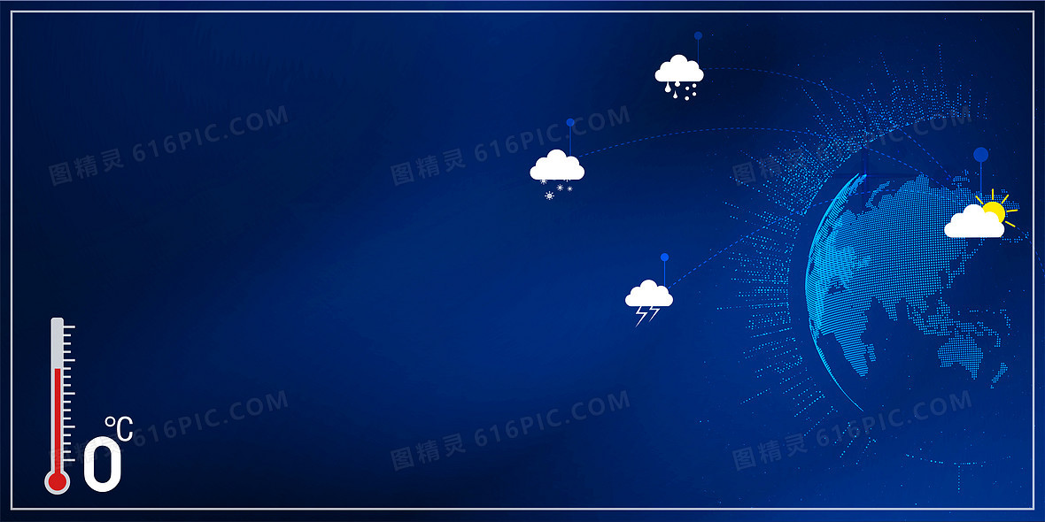
Weather Helper

Slide 6
App Description:
The weather forecast app provides current weather conditions and forecasts for the next few days. It allows users to search for locations, view detailed weather stats, and receive alerts for severe weather conditions.
Third-party Libraries:
Retrofit, Glide or Picasso, Moshi or Gson
Mobility Attributes:
Sensors: Use GPS to automatically detect the user's current location for relevant weather updates.
Personalization: Remember user's preferred locations and display customized weather alerts.
Why Mobile?: A mobile app offers on-the-go access to weather updates, ensuring users are always informed, especially during travel or outdoor activities.
Pinch Points:
API Limitations: Handling rate limits or changes in third-party weather APIs.
Data Accuracy: Ensuring reliable and precise weather data.
Learning Needs: Understand the intricacies of the chosen weather API, optimize location-based queries, and potentially learn about push notifications for weather alerts.
Notes:
Retrofit: To handle API requests for fetching weather data.
Glide or Picasso: To load and display weather icons or images.
Moshi or Gson: For JSON parsing of the API responses.

