Slide 1

ShouldISki
Team Tuesday and Thursday
Siyi Du
Sicheng Chen
Team GitHub Repo:
csc0007/CS501_GroupWork: Group Work Only (github.com)

Slide 2
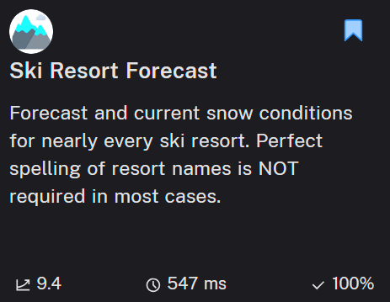
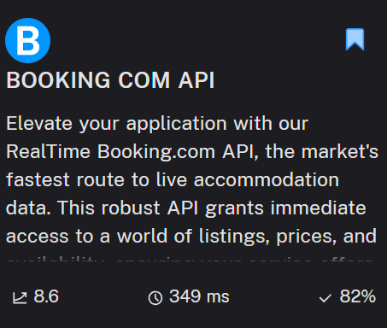
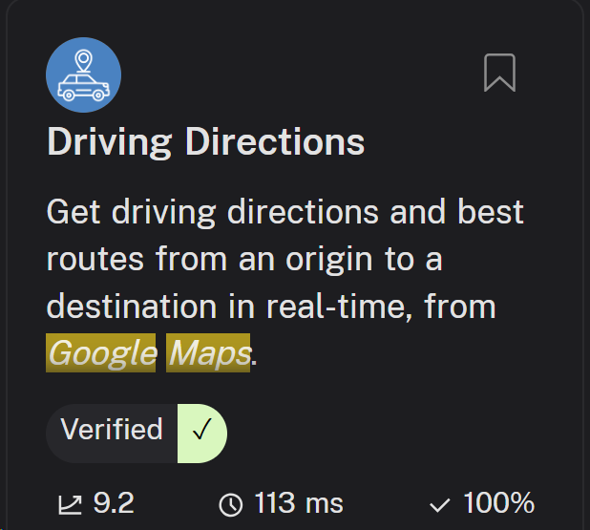
API Usage
Current Snow Condition API
Block Availability API
Weather API
Traffic Map API

Slide 3
Hotel Status Query Workflow
Input Date and hotelID
Iterate all the “Block”
In each “Block”, iterate through all the items
Count unique room_id
room_count
__________
3m_room_count
X100%
API Call
Re-organize the JSON API response
Add 3 month to Date
Iterate all the “Block”
In each “Block”, iterate through all the items
Count unique room_id
API Call
Re-organize the JSON API response

Slide 4
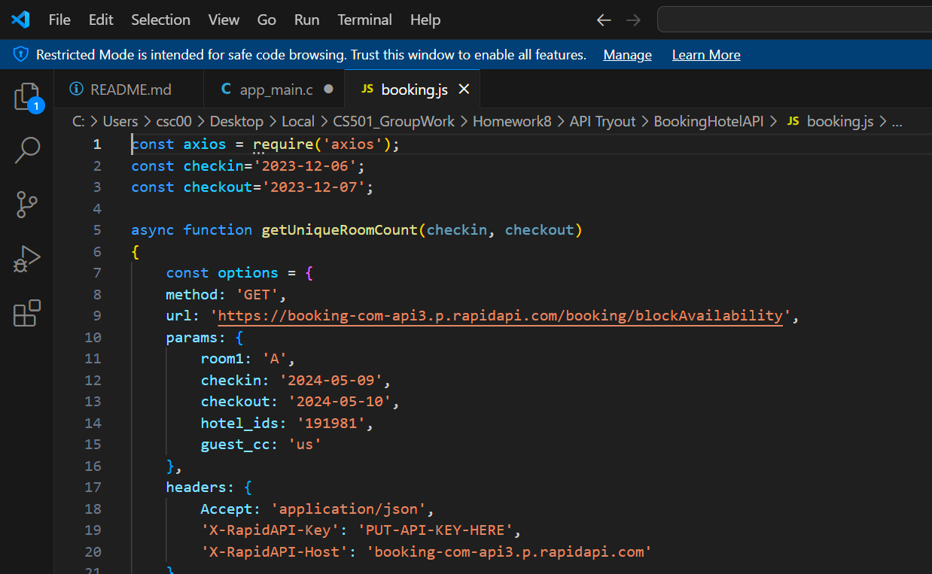
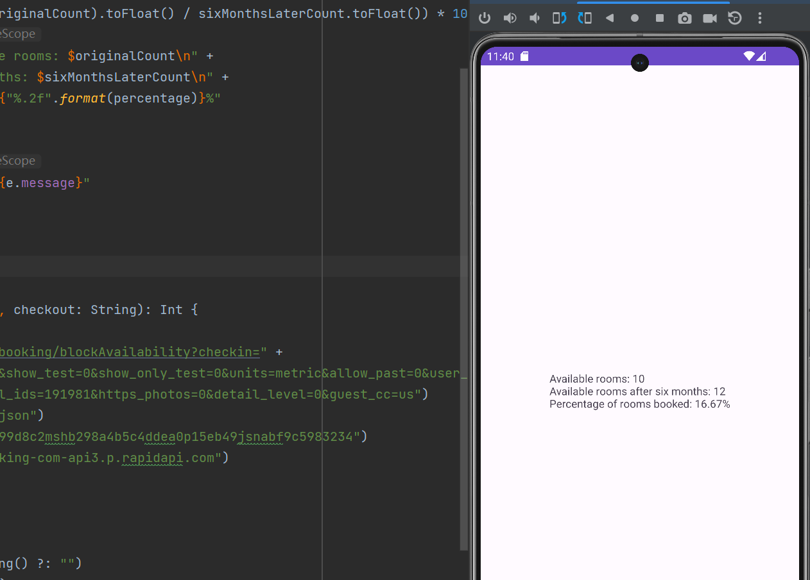
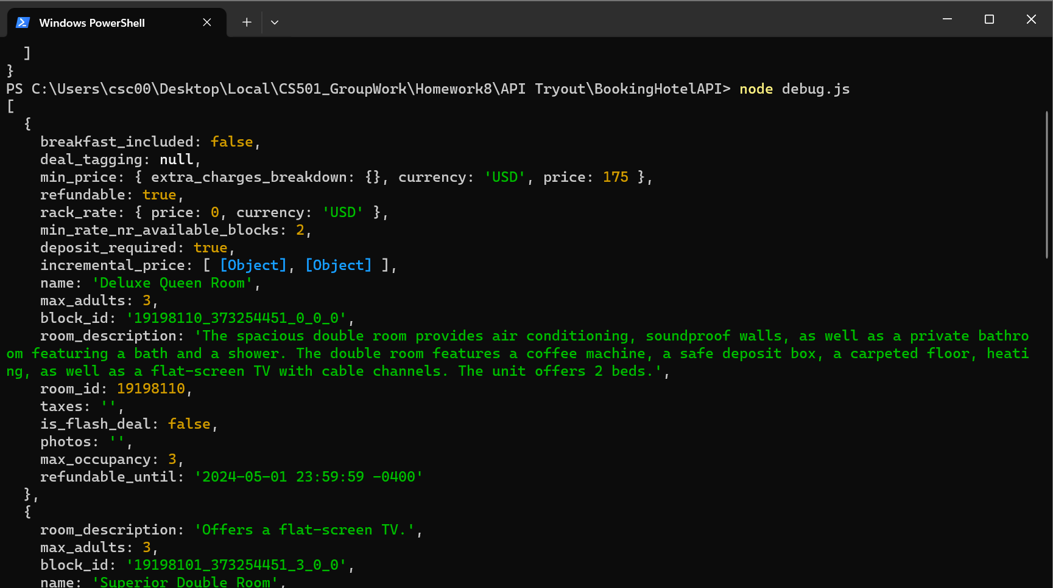
Node.js Program
Changes from the previous:
API Implementation
Android Tryout

Slide 5
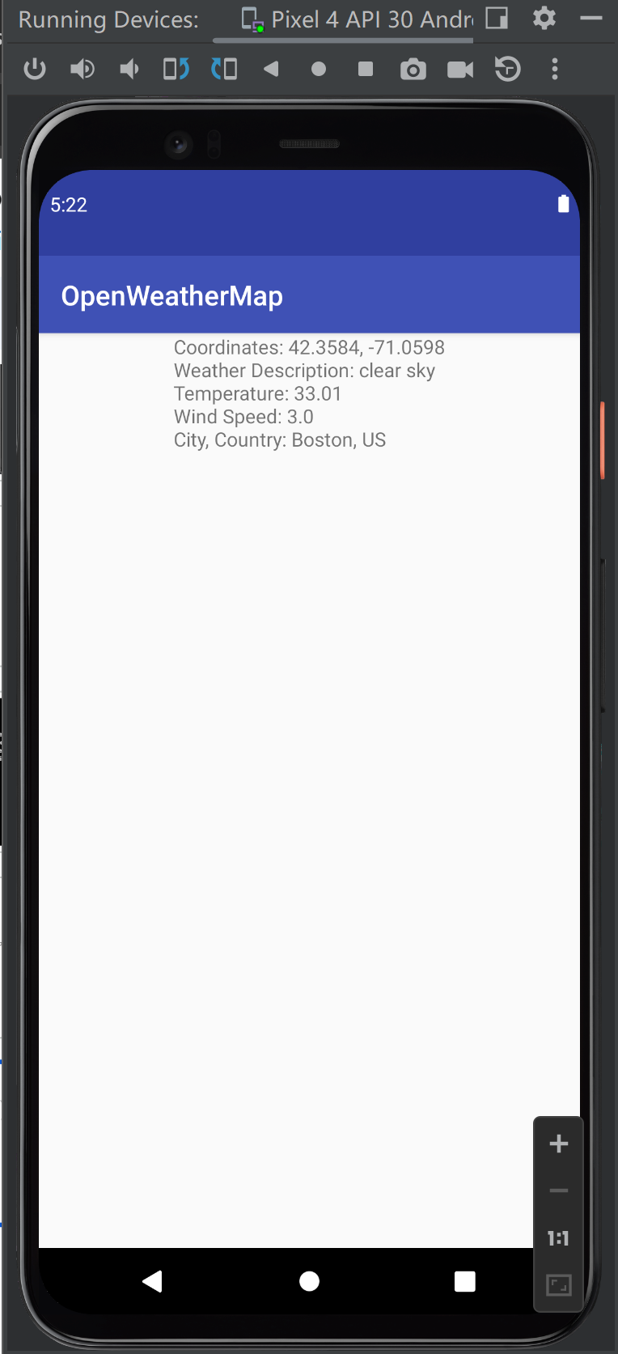
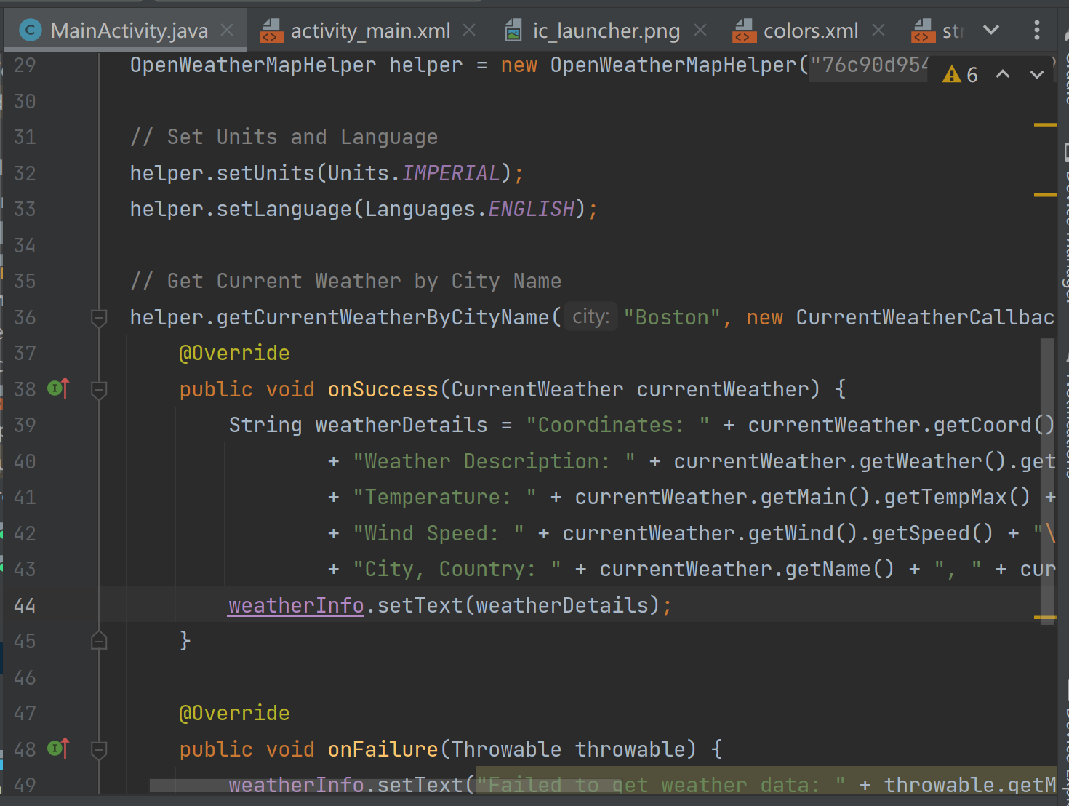
Android Tryout
Changes from the previous:
API Implementation
Weather API implementation:
Kotlin Project

Slide 6
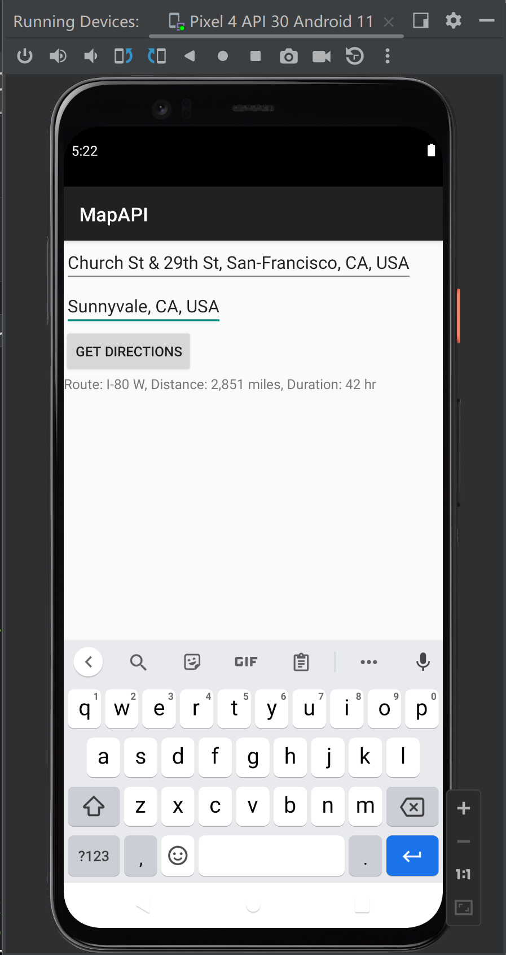
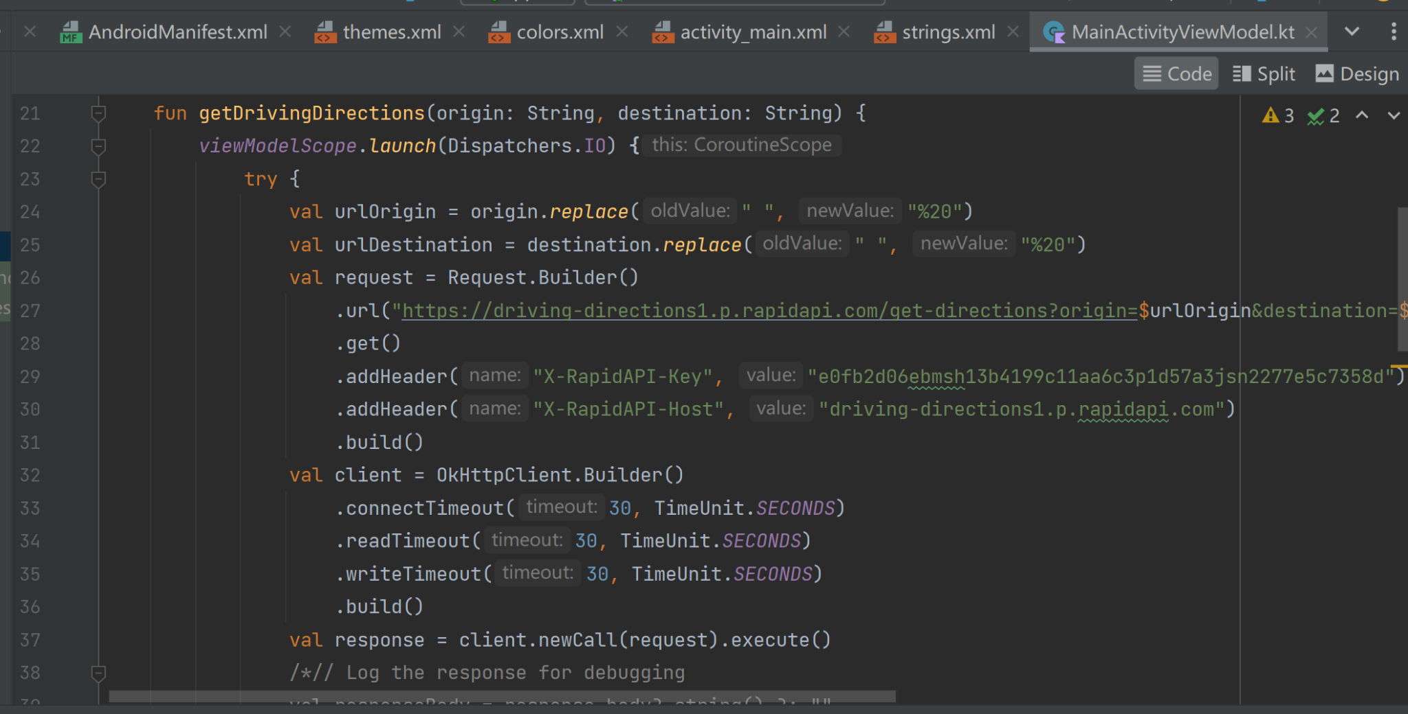
Android Tryout
Changes from the previous:
API Implementation
Traffic Map API implementation:
Kotlin Project

Slide 7
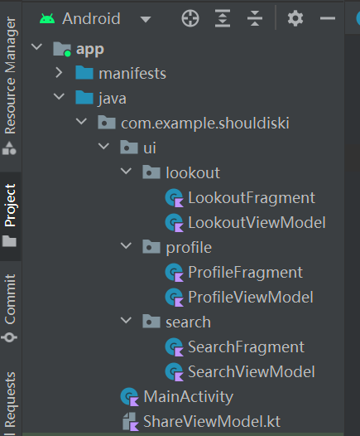
Structural Update
1. One Shared ViewModel
2. Passing Data Between Fragments:
LiveData -> Observe
3. Only Pop-up Dialog For Date Picker
4. Debug TextView
5. Tintable Icon
6. Input From User

Slide 8
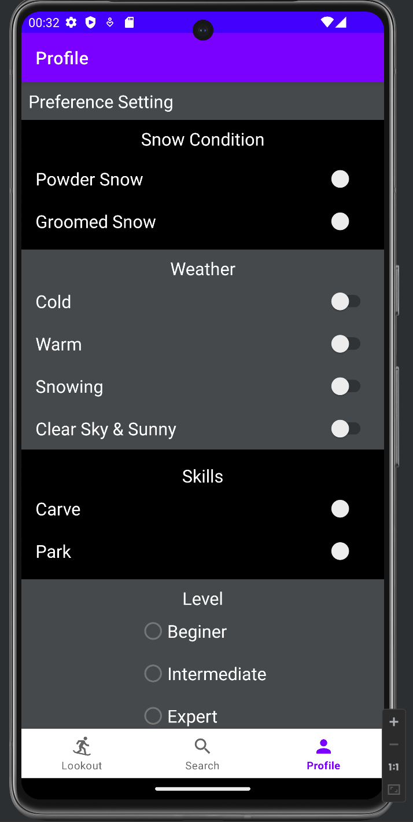
Plan for next
Link user preference setting with recommendation
Build database to for supported resort, location ….
Implement detail dialog when icon pressed
Link WeatherAPI and MapAPI to ShouldSki

Slide 9
Demo

Slide 10
User Story
Accomplished Functions
User is able to check weather status
User is able to check snow condition
User is able to check traffic status
User is able to check travel time to the resort
User is able to check hotel status
User is able to check anticipated crowd index
Not yet… but close
Unable to check other snow resort
Unable to give personalized recommendation

Slide 11
Risk
What is worrying us about getting to done?
Database setup is a challenge

Slide 12
Reference & AI Usage
1. Chatgpt Prompt
The textview in my app shows Error: Permission denied (missing INTERNET permission?), what is this error?
Can i access this data in other fragment ViewModel?
Which means if i have 3 fragments in a activity that wishes to use the same data, I should create a shared ViewModel for this activity, and give access to these 3 fragments?
I want to change the color of an icon in the fragment code, not in .XML. how can I do this?
What is the 8-bit color code for red, green, orange? It should be in this format: #FFBB86FC
2. Other Reference
a. BOOKING COM API API Documentation (LnTtechnologies) | RapidAPI
b. Ski Resort Forecast API Documentation (joeykyber) | RapidAPI
c. LocalDate | Android Developers
d. LiveData overview | Android Developers
e.Driving Directions API | RapidAPI

