Slide 1
Team 42 Presentation
Team Collab

Slide 2
Presentation & Demo
Partner:
David
Problem:
A method to acknowledge others’ work done in a relatively small (less than 2000 people) Slack workspace
Demo
Multiple user story:
As an employee or manager, you want to acknowledge other people for their work
As a manager, you want to view the amount of kudos that a specific employee has received throughout the past week
As a manager, you want to add a new company value to the corporation

Slide 3
Architecture & Technical Discussion

Slide 4
Architecture & Technical Discussion
Tech Stack
Python & PostgreSQL
Microsoft Azure
Docker & PHP Web Server
Proper Documentation for clean coding styles and practices
Notion
Choices we make when deploy the application and the database
Azure
Notes:
Tech Stack: Python & PostgreSQL & Microsoft Azure & Docker & PHP Web Server
Proper Documentation for clean coding styles and practices (quick demo on Notion)
(Quick demo going into Azure to demonstrate what’s going on, mention how we chose Azure over Heroku for deployment [linked to course content])

Slide 5
Process & Deployment

Slide 6
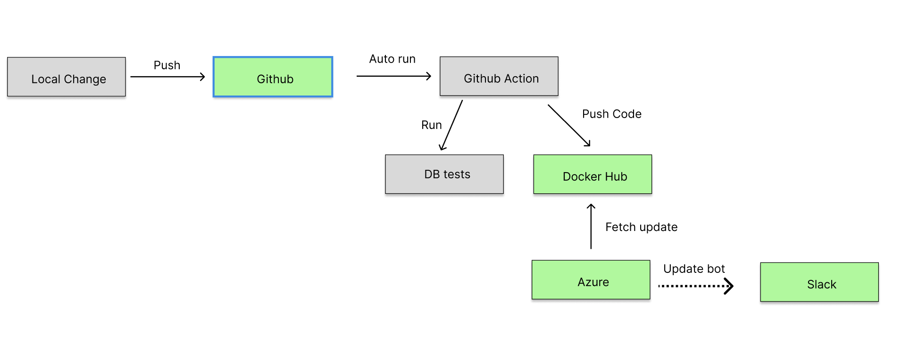
Process & Deployment: CI/CD pipelines
CI/CD pipelines
Push to Git
Github Action automatically runs DB tests and push the code to Docker Hub Registry
Azure fetches the update from Docker Hub and deploys latest version of the product
Notes:
CI/CD pipelines: Using GitHub Actions & Azure
When we push something into the Git repository, it will upload the image into Docker Hub, then Azure will fetch that image and deploy the product directly.
It is deployed on Microsoft Azure as a Docker container app
We utilized GitHub as a media to collaborate and utilized Git to ensure that we are working on separate components of the application before finally pushing to the repository.
After each separate component is done, we start Pull Requests and reviews to ensure that the code that is added to our codebase is valid.
Also, we have added GitHub notifications to our Slack workspace, which helps us identify if there is any updates on GitHub.

Slide 7
Process & Deployment: Agile
Utilized GitHub as a media to collaborate and ensure that we are working on separate components of the application before finally pushing to the repository.
After each separate component is done, we start Pull Requests and reviews to ensure that the code that is added to our codebase is valid.
GitHub notifications to our Slack workspace that helps us identify updates on GitHub.

Slide 8
Deployment (Continued)
Deployment
With these, the development process is widely simplified, as we are utilizing automation tools to make our development process easier. Also, for any new developers picking up the project, we have included multiple shell scripts (Linux / MacOS) and batch scripts (Windows) to help aid development.
Notes:
In the end of the semester, the project will be provided as a Github repository, contained with a markdown file that describes what a regular user have to do to use the Slack bot, and what a developer needs to know before the developer can start adding more features to it. Currently, this file doesn’t exist, but we will work towards it before the end of D5.

Slide 9
Accessing your application
Delivered as a Git Repo with Documentations for future developers and users (In progress).
For developers: How to create the environment and add more functionalities
For users: How to include the bot to a workspace and how to access its features
Note that the bot might not be available if no server hosts the bot.

Slide 10
Next steps for the project
Continue refining the project for it to be better utilized by our partner in the future
Continue with more documentation (non-existent at the moment), for future developers to quickly catch up and be able to extend on our development progress (and hopefully in other workspace communication platforms)
All the tokens and accounts used in our development process are “throwaway accounts”, meaning that we can easily pass these information to the next set of developers.
Notes:
We will continue refining the project for it to be better utilized by our partner in the future
We will also continue with more documentation (non-existent at the moment), for future developers to quickly catch up and be able to extend on our development progress (and hopefully in other workspace communication platforms)
All the tokens and accounts used in our development process are “throwaway accounts”, meaning that we can easily pass these information to the next set of developers.

Slide 11
Reflection & Key Learnings

Slide 12
Reflection & Key Learnings
What did you learn?
How to learn a new programming technology / framework within a short timespan (PHP, Web server hosting, Microsoft Azure, Dockerization)
Collaboration with teammates and assigning tasks
Working with a partner with specific requirements instead of an open-ended project
What would you do differently next time?
More communication with partners and TAs.
Agree upon a fixed convention, for coding and naming files etc. and strictly adhere to those conventions throughout the development process.
Document what we have done as we develop, don’t wait and document them all after developing the entire software.

Slide 13
Individual Contribution
Xiling Zhao (Will):
Implement functionality of /kudos feature: including checkbox utility, submission function.
Implement Custom Kudos feature
Code format: Including organize the front end code, writing docstring to most functions.

Slide 14
Individual Contributions
Jiaxu Li (Arthur):
Implemented General layout of /kudo command: Implemented the general static layout of the /kudo command, including the general layout of the modal(i.e. the title, the recipient, the channel etc.)
Implemented /kudos_overview feature: Implemented the /kudos_overview feature, which allows users to view the kudos history of a specific user.

Slide 15
Individual Contribution
Jiawei Yu:
Implemented Database Functionalities
Add/Delete Users, Channels, Workspaces
Retrieve and Modify Corporation Values
Wrote up Database Tests
Deliverable and Team Development Documentations

Slide 16
Individual contributions (Ray)
Led and assigned tasks to team members
Setting up a PHP Script and Web server for the Slack bot installation script
Started up a prototype for the Slack bot that we are deploying
Wrote multiple Docker setup scripts (in different OS) and READMEs to aid development within the group, which included requirements.txt for easier Python setup within the Docker environment
Enhanced User Experience with the bot by implementing changes requested by David after D2, including UI changes and Database side bug fixes
Hosted PostgreSQL and Docker containers on Microsoft Azure and compared them with Heroku and AWS
Completed a logging module and enforced strict logging rules for teammates to print out certain key steps within each function

