Slide 1
Abstract/Factory Design Pattern
Team 8

Slide 2
What is Abstract/Factory Design?
This particular design pattern abstracts the object instantiation process, making the overall system more independent from its objects are created or composed.
Benefit:
  System more flexible and reusable due to the absence of application-specific instantiation
  Application only deals with the interface

Slide 3
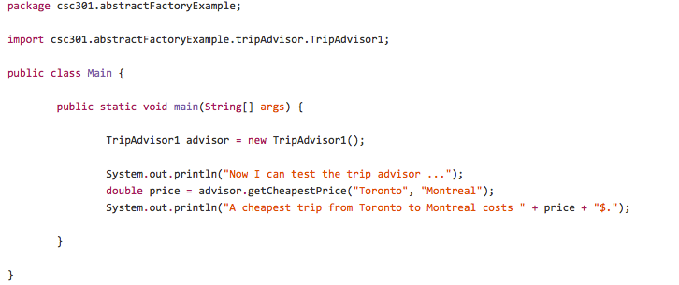
Example: Identifying the Issue
Instantiating the object directly
in the application. Doesn't even
take into account the possibility
that we may want to implement
different algorithms for our trip
advisor

Slide 4
First Attempt

Slide 5
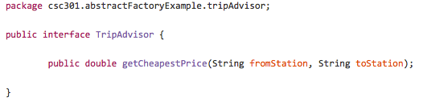
Example: 1st attempt
Create an interface to allow different concrete implementations.

Slide 6
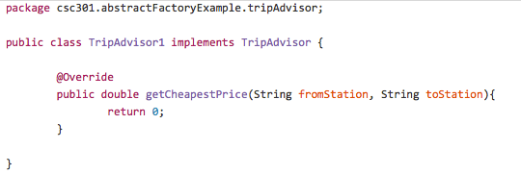
Example: 1st attempt
Create a class to instantiate and override the interface method

Slide 7
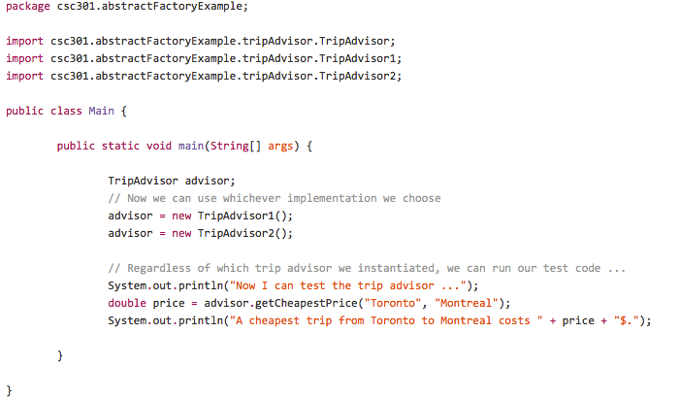
Example: 1st attempt
Alert!
An interface is created and used
but the code is still responsible
for instantiating the tripAdvisor
instance, and the code will not
compile without the dependencies.
dependencies

Slide 8
Second Attempt

Slide 9
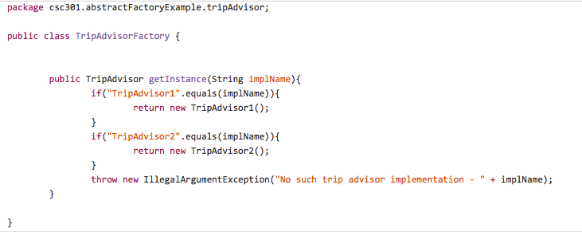
Example: 2nd attempt
Create a class for the application so it does not instantiate the instances
Return the instance based on user interest

Slide 10
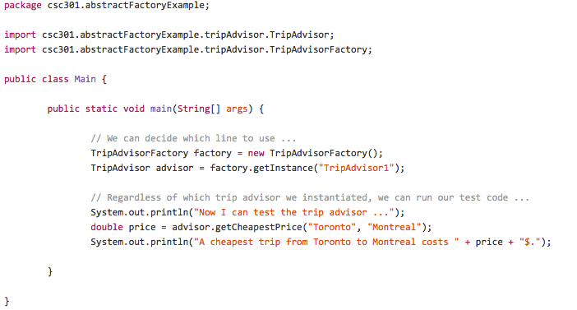
Example: 2nd attempt
It looks like it’s not instantiating directly now?
False! Although this code does not instantiate directly but it relies on TripAdvisorFactory which instantiates through its dependencies.

Slide 11
Third Attempt

Slide 12
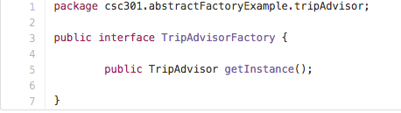
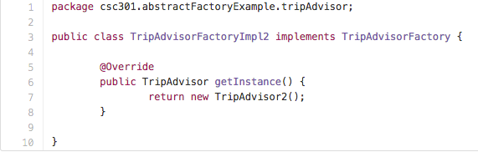
Example: 3rd attempt
Create an interface as a middleman to solve the problem in our 2nd attempt
We then implement the interface similar to subclassing.

Slide 13
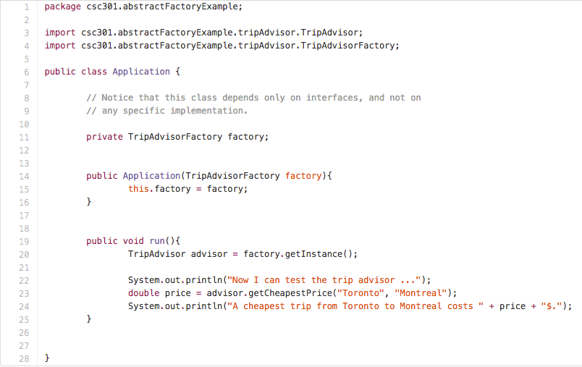
Example: 3rd attempt
This application class only relies on the two Abstract classes we created, nothing regarding specific implementation

Slide 14
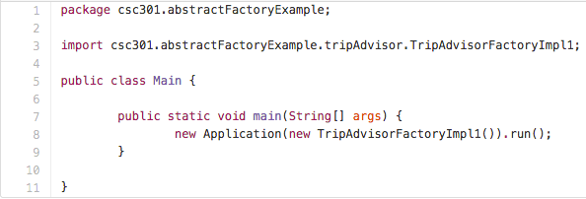
Example: 3rd attempt
Then in our main function we can create a new Application of our specific TripAdvisor implementation, however we still rely on knowing the specific implementation so we can import it, can we do better?

Slide 15
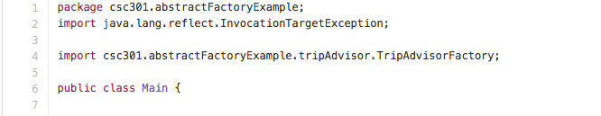
Lets go a bit further
Its possible to only rely on the abstract class TripAdvisorFactory

Slide 16
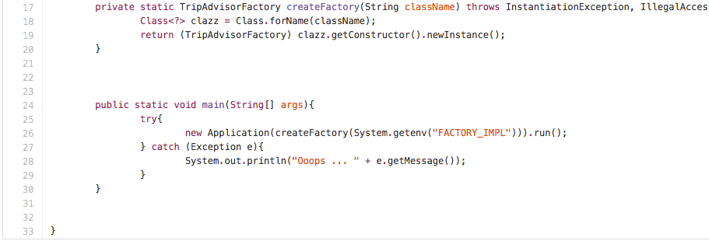
Further continued
Notice the use of private and static in the method header.
We use the environment variable (class name) to ask the class for what kind of class it is.
We can then use the specific class type to instantiate a new instance of said class.
Environemnt variables: Dynamic names values that are part of the operating environment. They can affect the way a running process will behave.

Slide 17
Q & A
Questions?

