Slide 1
Data Access Object (DAO)
DAO abstracts the underlying data store, which allows us to:
Architect our system without concerning ourselves with the details of using a database.
Implement our first version quickly, using a simple (e.g. in-memory) DAO implementation.
Avoid committing to a specific database technology.

Slide 2
Data Access Object (DAO)
We use the DAO pattern when:
We want to use multiple data storages.
We want to write code that will work for all of them.
That is, we abstract the details of the underlying data storage, and define a unified way of accessing the data.

Slide 3
Data Access Object (DAO)
We can chose to implement a simple DAO design pattern by using:
In-memory DAO - Keeps everything in memory.
Local-file DAO - Data is saved/loaded to/from a local file.

Slide 4
Implementation
We're going to create a Student object acting as a Model or Value Object.
StudentDao is Data Access Object Interface. StudentDaoImpl is concrete class implementing Data Access Object Interface.
DaoPatternDemo, our demo class will use StudentDao demonstrate use of Data Access Object pattern.

Slide 5
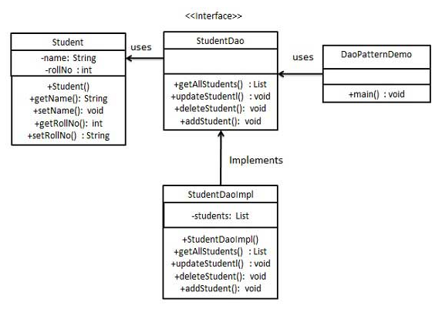
A pictorial representation

Slide 6
// Step 1
// Create Value Object.
// Student.java
public class Student {
private String name; private int rollNo;
Student(String name, int rollNo){
this.name = name;
this.rollNo = rollNo;
}
public String getName() {
return name;
}
public void setName(String name) {
this.name = name;
}
public int getRollNo() {
return rollNo;
}
public void setRollNo(int rollNo) {
this.rollNo = rollNo;
}
}

Slide 7
//Step 2
//Create Data Access Object Interface.
//StudentDao.java
import java.util.List;
public interface StudentDao {
public List<Student> getAllStudents();
public Student getStudent(int rollNo);
public void updateStudent(Student student);
public void deleteStudent(Student student);
}

Slide 8
//Step 3
// Create concreate class inplementing above interface.
//StudentDaoImpl.java
import java.util.ArrayList; import java.util.List;
public class StudentDaoImpl implements StudentDao {
//list is working as a database
List<Student> students;
public StudentDaoImpl(){
students = new ArrayList<Student>();
Student student1 = new Student("Robert",0); Student student2 = new Student("John",1);
students.add(student1); students.add(student2); }
@Override
public void deleteStudent(Student student) {
students.remove(student.getRollNo());
System.out.println("Student: Roll No " + student.getRollNo() +", deleted from database"); }
//retrieve list of students from the database
@Override
public List<Student> getAllStudents() {
return students; }
@Override
public Student getStudent(int rollNo) {
return students.get(rollNo); }
@Override
public void updateStudent(Student student) {
students.get(student.getRollNo()).setName(student.getName());
System.out.println("Student: Roll No " + student.getRollNo() +", updated in the database"); }
}

Slide 9
//Step 4
//Use the StudentDao to demonstrate Data Access Object pattern usage.
//CompositeEntityPatternDemo.java
public class DaoPatternDemo {
public static void main(String[] args) {
StudentDao studentDao = new StudentDaoImpl();
//print all students
for (Student student : studentDao.getAllStudents()) {
System.out.println("Student: [RollNo : " +student.getRollNo()+", Name : "+student.getName() +" ]");
}
//update student
Student student =studentDao.getAllStudents().get(0); student.setName("Michael");
studentDao.updateStudent(student);
//get the student
studentDao.getStudent(0);
System.out.println("Student: [RollNo : " +student.getRollNo()+", Name : "+student.getName()+”
}
}

Slide 10
//Step 5
//Verify the output
Student: [RollNo : 0, Name : Robert ]
Student: [RollNo : 1, Name : John ]
Student: Roll No 0, updated in the database
Student: [RollNo : 0, Name : Michael ]
Thank you.

