Slide 1
Observer & Adapter Design Patterns
Team 4

Slide 2
Observer Design Pattern
Used when we want to receive a “notification” after an object changes.
The Observer design pattern is also known as the ‘publisher-subscriber’ pattern
Examples :
Stock price changes
Facebook updates
A new message being posted in a forum
Refreshing a screen when new data is available

Slide 3
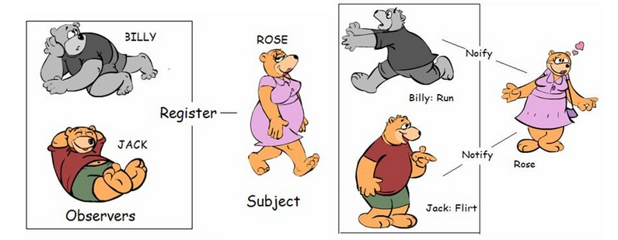
Real world...

Slide 4
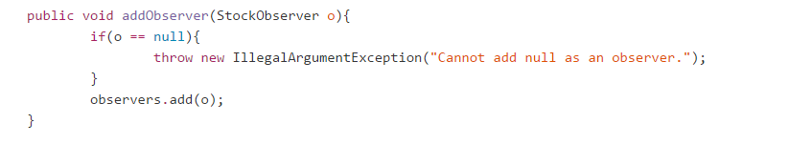
An observable (Publisher)
Each object that is being observed needs to...
Keep track of it’s observers (Add and remove)
Notify all of its observers
Have the ability to inherit from a parent class

Slide 5
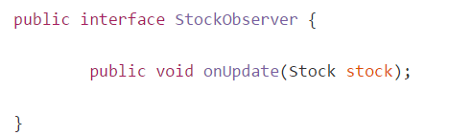
An observer (Subscriber)
Each observer needs to...
Have a set of instructions (an update method) so that it knows what to do when being notified.

Slide 6
Observer pattern in Java
Java observable object + Observer interface
Observable class has to be extended from the Observable object.
However, in java, a class can only have one parent so the solution is not always possible.
So we create our own...

Slide 7
Observer pattern in Java
Custom Observable object + observer interface
We can recreate an observable object with the necessary methods. But that means we will need to write more code that’s already done by the observer class.
Fair tradeoff?

Slide 8
Stocks stocks stocks!
Observer
Application A
implements
notifies
Custom Observer Interface
StockObserver
Observable Stock
Stocks
Observer B
Application B
extends

Slide 9
Twist
Assuming that we can’t modify the observable object..
What if the observable object doesn’t provide all the information needed by the observer?
The observer now wants to know the previous price of the stock as well as the current stock quote.
Notes:
For the purpose of the presentation, we assume that the stock can’t store the last price of the stock. Instead, we get a whole different object instance to do the job for us..

Slide 10
Solutions
Have the observer store all the values of the observables. Not efficient.
What we need is an object to interpret the information given by the Observable stocks and feed it to the stock observer in the correct format

Slide 11
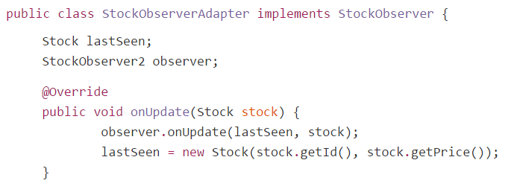
Adapter pattern
Allows incompatible classes to work together by converting the interface of one class into an interface expected by the clients.

Slide 12
Stocks again...
implements
notify
Stock Observer
Interface
Observable Stock
Stocks
Observer
Stock Adapter
interpret and feed
extends

Slide 13
Django observer pattern
Senders
A post_save signal for an event)
Receivers
A method that creates notifications for all the students)
Method
The receiver “connects” to a specific signal type
Sender creates a signal, which then invokes the receiver.

Slide 14
Sources
All code presented is taken from the CSC301 evening section demos (https://github.com/csc301-fall2014/ObserverAndAdapterExample )
The observer pattern illustration taken from http://2.bp.blogspot.com/-qc7y5pmqiIQ/UN4lCJcDm_I/AAAAAAAAAJc/4LqxvrFerrc/s1600/Observer+Pattern.JPG

