Slide 1
CSC4200/5200 – Computer Networking
Routing - Continued
Instructor: Susmit Shannigrahi
sshannigrahi@tntech.edu
GTA: dereddick42@students.tntech.edu

Slide 2

Apps (HTTP)
Data
Apps (HTTP)
Segments
Transport (TCP/UDP)
Transport (TCP/UDP)
Network (IP)
Packets
Network (IP)
Link (Ethernet)
Frames
Link (Ethernet)
Ethernet Interface
Ethernet Interface
Bits (1010001)

Slide 3
So far...
Routing – Link state
Notes:
Ndn can help organizing the namespaces
Once that’s done, data discovery and provenance is
Straight forward
Retrieval, transparent failover, and specialized operations
In this work, we take a real access log and try to quantify NDN’s improvements to a climate
workflow

Slide 4
Dijkstra’s algorithm: example
D(v)
p(v)
D(w)
p(w)
D(x)
p(x)
D(y)
p(y)
D(z)
p(z)
Step
N'
0
u
7,u
3,u
5,u
∞
∞
1
uw
6,w
5,u
11,w
∞
2
uwx
6,w
11,w
14,x
uwxv
10,v
14,x
x
3
9
4
uwxvy
12,y
5
uwxvyz
5
7
4
8
notes:
construct shortest path tree by tracing predecessor nodes
ties can exist (can be broken arbitrarily)
u
3
w
y
z
2
3
7
4
v
Kurose/ross

Slide 5
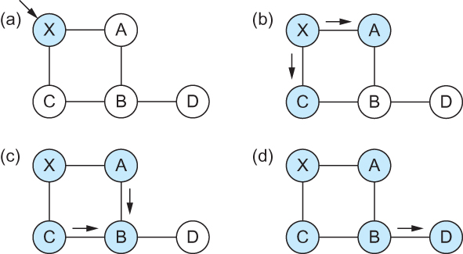
Link State Routing – controlled flooding
Flooding of link-state packets. (a) LSP arrives at node X; (b) X floods LSP to A and C; (c) A and C flood LSP to B (but not X); (d) flooding is complete

Slide 6
Example
OSPF – Open shortest path first
Problems -
  does not scale!
  Overhead
  Reliable flooding may not be reliable
Notes:
Ndn can help organizing the namespaces
Once that’s done, data discovery and provenance is
Straight forward
Retrieval, transparent failover, and specialized operations
In this work, we take a real access log and try to quantify NDN’s improvements to a climate
workflow

Slide 7
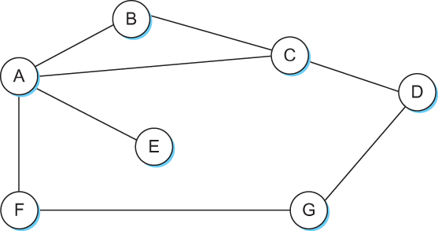
Distance Vector
Each node has an one dimensional array (a vector) containing the “distances” (costs) to all other nodes
Each node knows the cost to neighbors
Each node distributes that vector to its immediate neighbors
Notes:
Ndn can help organizing the namespaces
Once that’s done, data discovery and provenance is
Straight forward
Retrieval, transparent failover, and specialized operations
In this work, we take a real access log and try to quantify NDN’s improvements to a climate
workflow

Slide 8
Distance vector algorithm
Bellman-Ford equation (dynamic programming)
let
d_{x}(y) := cost of least-cost path from x to y
then
d_{x}(y) = min {c(x,v) + d_{v}(y) }
v
cost to neighbor v
cost from neighbor v to destination y
min taken over all neighbors v of x
4-<number>

Slide 9
D_{x}(y) = min{c(x,y) + D_{y}(y), c(x,z) + D_{z}(y)}
= min{2+0 , 7+1} = 2
D_{x}(z) = min{c(x,y) + D_{y}(z), c(x,z) + D_{z}(z)}
= min{2+1 , 7+0} = 3
node x
table
cost to
cost to
x y z
x y z
x
0 2 7
x
0
2
3
from
y
∞
∞
∞
from
y
2 0 1
z
∞
∞
∞
z
7 1 0
node y
table
cost to
x y z
y
2
1
x
∞
∞
z
∞
2 0 1
x
from
y
7
z
∞
∞
∞
node z
table
cost to
x y z
x
∞ ∞ ∞
from
y
∞
∞
∞
z
7
1
0
time

Slide 10
D_{x}(z) = min{c(x,y) +
D_{y}(z), c(x,z) + D_{z}(z)}
= min{2+1 , 7+0} = 3
D_{x}(y) = min{c(x,y) + D_{y}(y), c(x,z) + D_{z}(y)}
= min{2+0 , 7+1} = 2
node x
table
cost to
cost to
cost to
x y z
x y z
x y z
x
0 2 7
x
0
2
3
x
0 2 3
from
y
∞
∞
∞
from
y
2 0 1
y
2 0 1
z
z
from
∞
∞
∞
7 1 0
z
3 1 0
node y
table
cost to
cost to
cost to
x y z
x y z
x y z
y
2
1
x
∞
∞
x
0 2 7
∞
2 0 1
x
0 2 3
x
z
from
y
from
y
2 0 1
y
2 0 1
7
z
z
from
∞
∞
∞
7 1 0
z
3 1 0
node z
table
cost to
cost to
cost to
x y z
x y z
x y z
x
∞ ∞ ∞
x
0 2 7
x
0 2 3
from
y
from
y
2 0 1
from
y
2 0 1
∞
∞
∞
z
z
3 1 0
z
3 1 0
7
1
0
time
time

Slide 11
Distance vector algorithm
key idea:
from time-to-time, each node sends its own distance vector estimate to neighbors
when x receives new DV estimate from neighbor, it updates its own DV using B-F equation:
D_{x}(y) ← min_{v}{c(x,v) + D_{v}(y)} for each node y ∊ N
under minor, natural conditions, the estimate D_{x}(y) converge to the actual least cost d_{x}(y)

Slide 12
Distance vector algorithm
iterative, asynchronous: each local iteration caused by:
local link cost change
DV update message from neighbor
distributed:
each node notifies neighbors only when its DV changes
  neighbors then notify their neighbors if necessary
each node:
wait for (change in local link cost or msg from neighbor)
recompute estimates
if DV to any dest has changed, notify neighbors

Slide 13
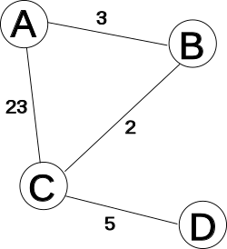
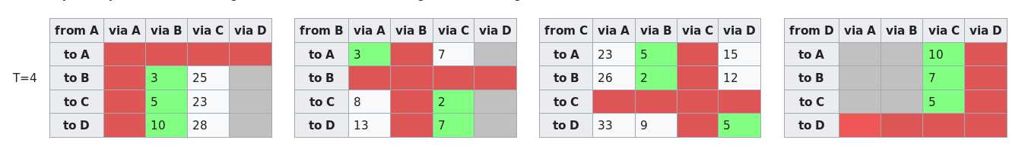
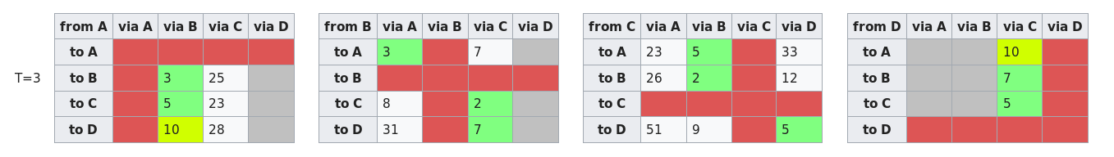
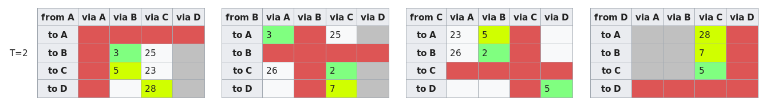
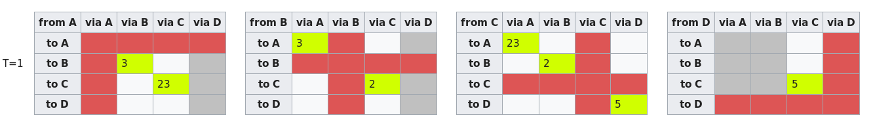
Distance vector algorithm
Initial distances stored at each node (global view)
Wikipedia

Slide 14
Distance vector: link cost changes
link cost changes:
node detects local link cost change
updates routing info, recalculates
distance vector
if DV changes, notify neighbors
1
y
4
1
x
z
50
“good
news
travels
fast”
t₀ : y detects link-cost change, updates its DV, informs its neighbors.
t₁ : z receives update from y, updates its table, computes new least cost to x , sends its neighbors its DV.
t₂ : y receives z’s update, updates its distance table. y’s least costs do not change, so y does not send a message to z.

Slide 15
Distance vector: link cost changes
link cost changes:
node detects local link cost change
bad news travels slow - “count to infinity” problem!
44 iterations before algorithm stabilizes
60
y
4
1
x
z
50
poisoned reverse:
If Z routes through Y to get to X :
  Z tells Y its (Z’s) distance to X is infinite (so Y won’t route to X via Z)
will this completely solve count to infinity problem?

Slide 16
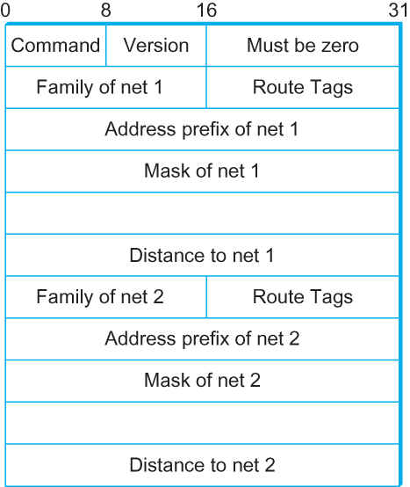
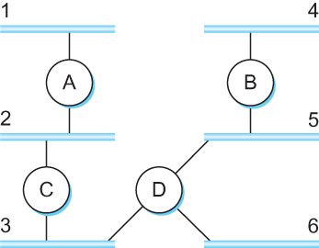
Distance vector: Routing Information Protocol (RIP)
Max hops = 16

Slide 17
Comparison of LS and DV algorithms
message complexity
LS: with n nodes, E links, O(nE) msgs sent
DV: exchange between neighbors only
  convergence time varies
speed of convergence
LS: O(n²) algorithm requires O(nE) msgs
  may have oscillations
DV: convergence time varies
  may be routing loops
  count-to-infinity problem
robustness: what happens if router malfunctions?
LS:
  node can advertise incorrect link cost
  each node computes only its own table
DV:
  DV node can advertise incorrect path cost
  each node’s table used by others
    error propagate thru network

Slide 18
Apps (HTTP)
Data
Apps (HTTP)
Segments
Transport (TCP/UDP)
Transport (TCP/UDP)
Network (IP)
Packets
Network (IP)
Link (Ethernet)
Frames
Link (Ethernet)
Ethernet Interface
Ethernet Interface
Bits (1010001)

Slide 19
Next Steps
How do we scale this routing to the Internet?
Notes:
Ndn can help organizing the namespaces
Once that’s done, data discovery and provenance is
Straight forward
Retrieval, transparent failover, and specialized operations
In this work, we take a real access log and try to quantify NDN’s improvements to a climate
workflow

