Slide 1
CSC4200/5200 – Computer Networking
Network performance
Instructor: Susmit Shannigrahi
sshannigrahi@tntech.edu

Slide 2
Breakout - Questions
Slide 8
Slide 15
Slide 19

Slide 3
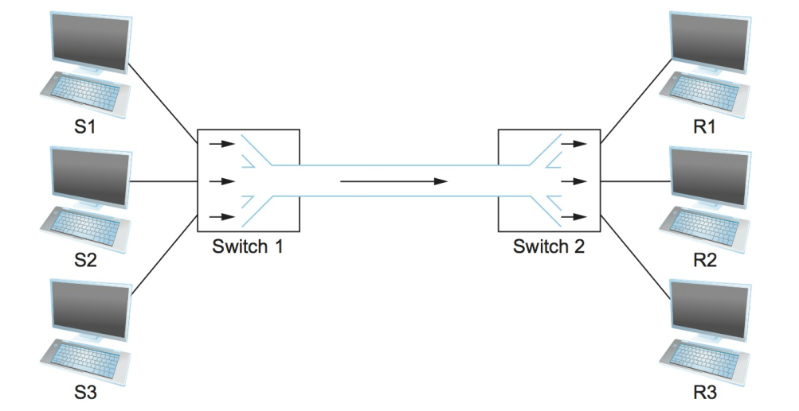
Recap - Circuit Switching – TDM and FDM
Notes:
Ndn can help organizing the namespaces
Once that’s done, data discovery and provenance is
Straight forward
Retrieval, transparent failover, and specialized operations
In this work, we take a real access log and try to quantify NDN’s improvements to a climate
workflow

Slide 4
Circuit vs Packet Switching
Circuit Switching
Dedicated resource divided among participants
Requires setup, guaranteed performance (unless the link breaks)
Packet Switching
Shared resource
Use small chunks of data (packets), send as soon as possible
Store-and-forward packets

Slide 5
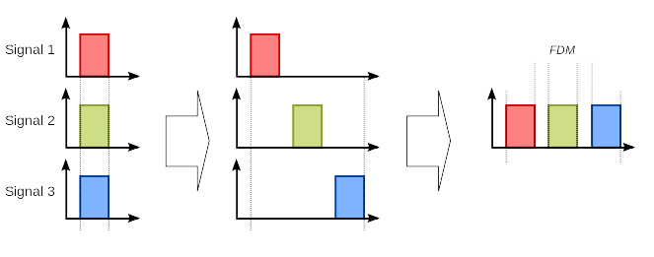
Frequency Division Multiplexing for Circuit Switching
wikipedia
Notes:
Ndn can help organizing the namespaces
Once that’s done, data discovery and provenance is
Straight forward
Retrieval, transparent failover, and specialized operations
In this work, we take a real access log and try to quantify NDN’s improvements to a climate
workflow

Slide 6
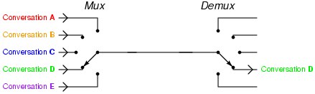
Time Division Multiplexing for Circuit Switching
wikipedia
Notes:
Ndn can help organizing the namespaces
Once that’s done, data discovery and provenance is
Straight forward
Retrieval, transparent failover, and specialized operations
In this work, we take a real access log and try to quantify NDN’s improvements to a climate
workflow

Slide 7
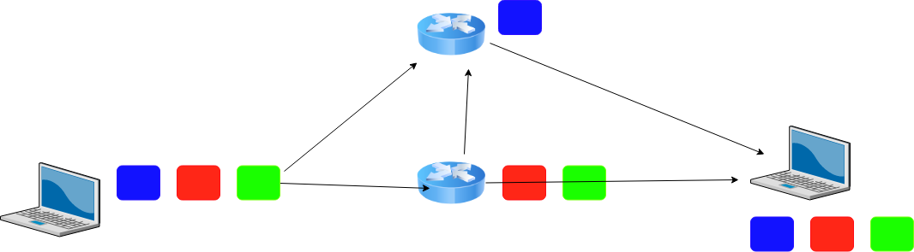
Packet Switching

Slide 8
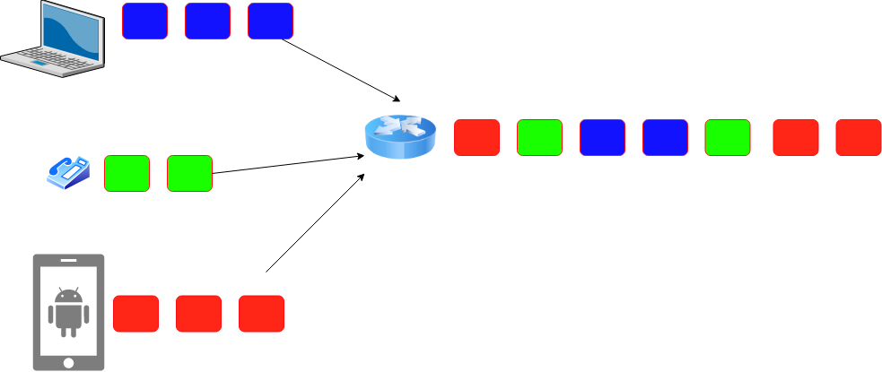
Statistical Multiplexing for Packet Switching
Ensures that slots will not be wasted
Introduces queuing delay
Breakout:
  What actions can you take when queue becomes full? There may be many choices.
  Your choice would have profound implications on performance
  Drop packets, tell the sender to slow down, direct to another routers

Slide 9
How many users can you support?
1Mbps link
  Users are active 10% of the time
  10 Simultaneous users = full capacity
Circuit switching = 10 users
Packet switching with 35 users < Probability of 10 sim. Users < 0.0004
https://math.stackexchange.com/questions/918861/probability-problem-in-networking

Slide 10
Performance - Bandwidth and Latency
Bandwidth = Size of the network pipe
Latency = Delay in sending packets
Throughput = How fast your can send data, function of both bandwidth and latency (and other things)
Notes:
Ndn can help organizing the namespaces
Once that’s done, data discovery and provenance is
Straight forward
Retrieval, transparent failover, and specialized operations
In this work, we take a real access log and try to quantify NDN’s improvements to a climate
workflow

Slide 11
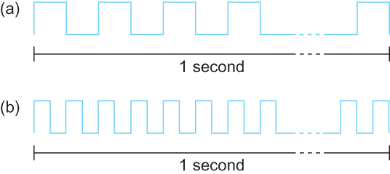
Performance - Bandwidth
Bits transmitted at a particular bandwidth can be regarded as having some width:
(a) bits transmitted at 1Mbps (each bit 1 μs wide);
(b) bits transmitted at 2Mbps (each bit 0.5 μs wide).
Packets are made of bits – each bit need some time to be processed at the router. This is transmission delay!
Notes:
Ndn can help organizing the namespaces
Once that’s done, data discovery and provenance is
Straight forward
Retrieval, transparent failover, and specialized operations
In this work, we take a real access log and try to quantify NDN’s improvements to a climate
workflow

Slide 12
Performance - Latency
Latency = Propagation Delay + Transmission Delay + Queuing Delay
Propagation = Distance/Speed Of Light (in Copper or Fiber)
Transmit = Size/Bandwidth
How long to “put it on the wire?”
How long to traverse the link?
How long to queue?
Notes:
Ndn can help organizing the namespaces
Once that’s done, data discovery and provenance is
Straight forward
Retrieval, transparent failover, and specialized operations
In this work, we take a real access log and try to quantify NDN’s improvements to a climate
workflow

Slide 13


Performance – Queuing Delay
R: link bandwidth (bps)
L: packet length (bits)
A: Average packet arrival rate
Traffic delay = AL/R
AL/R ~ 1
AL/R ~ 0
Everyone in the front has to be serviced first!!!!!
Notes:
Ndn can help organizing the namespaces
Once that’s done, data discovery and provenance is
Straight forward
Retrieval, transparent failover, and specialized operations
In this work, we take a real access log and try to quantify NDN’s improvements to a climate
workflow

Slide 14
Performance – Terminology
Bits = b
Bytes = B
Kilobytes = KB (1024 Bytes or 1000Bytes)
Megabytes = MB (1024KB or 1000KB)
Ask ECE folks = 1000, 1Mbps = 1000*1000Bps
Ask CS folks = 1024, 1MB = 1024*1024Bytes
Notes:
Ndn can help organizing the namespaces
Once that’s done, data discovery and provenance is
Straight forward
Retrieval, transparent failover, and specialized operations
In this work, we take a real access log and try to quantify NDN’s improvements to a climate
workflow

Slide 15
Performance – Example
Breakout
  Calculate the total time required to transfer a 1000-KB file using 1KB packets. Assuming bandwidth is 1.5 Mbps, the RTT of 50 ms, an initial 2 × RTT of “handshaking” before any data is sent.
Delay = Handshake + Transmission + Propagation + Queuing
Delay = 2*50ms + (1000*1024*8)/(1.5*1000*1000) second + 50/2ms + 0 = 5.586seconds
Propagation delay = First bit from sender to receiver
Transmission delay = All bits on the wire
Notes:
Delay = 2*50ms + (1000*1024*8)/(1.5*1000*1000) second + 50/2ms + 0 = 5.586seconds
Propagation delay = First bit from sender to receiver
Transmission delay = All bits on the wire

Slide 16
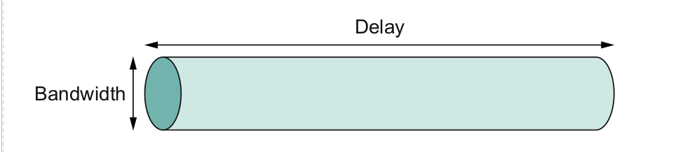
Bandwidth x Delay Product
Capacity of a network pipe = Bandwidth (bits) x Two way Delay (Seconds) (a.k.a RTT or Round Trip Delay)
This is the amount of bits that a pipe can hold!
Notes:
Ndn can help organizing the namespaces
Once that’s done, data discovery and provenance is
Straight forward
Retrieval, transparent failover, and specialized operations
In this work, we take a real access log and try to quantify NDN’s improvements to a climate
workflow

Slide 17
Bandwidth x Delay Product - Example
Bandwidth = 50Mbps
Latency = 100ms
Bandwidth x Delay = 50x10⁶x100x10⁻³ ⁼ 5x10⁶ bits = 625 kilobytes
Notes:
Ndn can help organizing the namespaces
Once that’s done, data discovery and provenance is
Straight forward
Retrieval, transparent failover, and specialized operations
In this work, we take a real access log and try to quantify NDN’s improvements to a climate
workflow

Slide 18
Bandwidth x Delay - Some more examples
Bandwidth = 54Mbps (Wireless G)
RTT = 1ms
How much data can the pipe hold?
BxD = 54x10⁶x1x10⁻³
Notes:
Ndn can help organizing the namespaces
Once that’s done, data discovery and provenance is
Straight forward
Retrieval, transparent failover, and specialized operations
In this work, we take a real access log and try to quantify NDN’s improvements to a climate
workflow

Slide 19
Bandwidth x Delay – Mars Rover
https://mars.nasa.gov/msl/mission/communications/
https://www.youtube.com/watch?v=NGgzq8eXZOQ
Breakout:
- Bit rate of curiosity: 32000bits/second
- Delay = 14 minutes each way
- BxD = 32000*14*60*2
Notes:
Ndn can help organizing the namespaces
Once that’s done, data discovery and provenance is
Straight forward
Retrieval, transparent failover, and specialized operations
In this work, we take a real access log and try to quantify NDN’s improvements to a climate
workflow

Slide 20
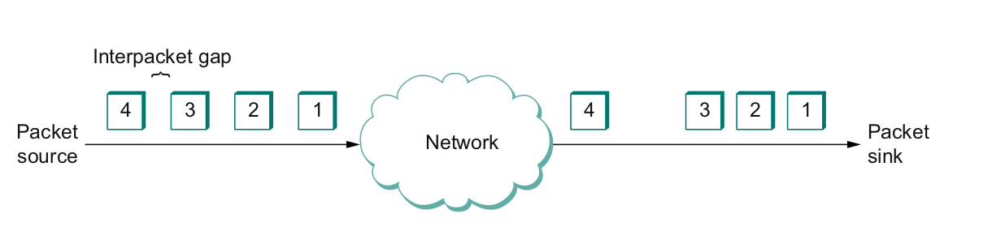
And one more thing - Jitter
Also called Interpacket gap
  why does it happen (which artifact of packet switching?)
  why is it important (think video applications)?
  How do you solve this?
Notes:
Ndn can help organizing the namespaces
Once that’s done, data discovery and provenance is
Straight forward
Retrieval, transparent failover, and specialized operations
In this work, we take a real access log and try to quantify NDN’s improvements to a climate
workflow

Slide 21
Next Steps
Read Chapter 1
Next lecture – Network performance basics

