Slide 1
CSC4200/5200 – Computer Networking
SoFtware Defined networking
Instructor: Susmit Shannigrahi
sshannigrahi@tntech.edu
GTA: dereddick42@students.tntech.edu

Slide 2
Where we are.
* 55 points so far
* 45 points remaining ← ← ← ←
  15 points – Final
  15 points – PA3
  15 points – Participation

Slide 3
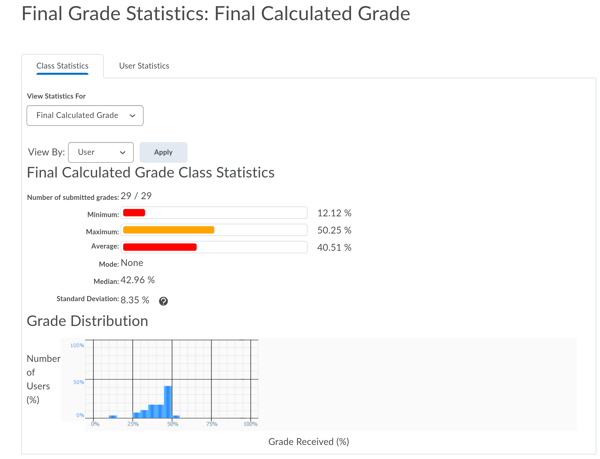
CSC4200
Couple of missing HW/PA grades!
You should have received an email from me/David.

Slide 4
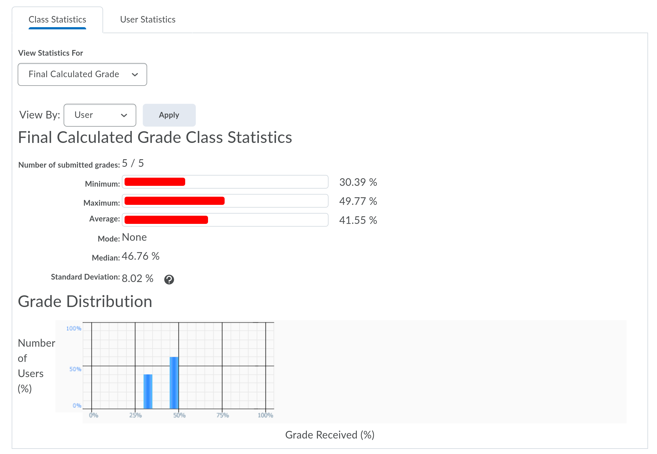
CSC5200
Couple of missing HW/PA grades!
You should have received an email from me/David.

Slide 5
Data VS Control Plane
Data plane is (mostly) in the hardware -
  Forward packets
Control plane
  How do we tell routers how to forward packets?
  BGP?
  How do you change something when network
  changes?

Slide 6
Data and Control Plane together
Problems?
  No separate channel
  Expensive
  Hard to change

Slide 7
What is SDN?
Software-defined networking (SDN) provides abstraction for
  Configuration, security, and forwarding
SDN makes the network
  Directly programmable
  Agile: administrator can change the network
  Centrally managed: network management is logically centralized.
  Vendor-neutral

Slide 8
Simple Example: Access Control
Source: Scott Shenker, UC Berkeley
What
Abstract Network
Model
Global
Network View
How
Notes:
What is access control?

Slide 9
Software Defined Networks
Source: Scott Shenker, UC Berkeley
Specifies behavior
Control Program
Abstract Network Model
Compiles to topology
Network Virtualization
Global Network View
Transmits to switches
Network OS

Slide 10
What Does This Picture Mean?
Source: Scott Shenker, UC Berkeley
Write a simple program to configure a simple model
  Configuration merely a way to specify what you want
Examples
  ACLs: who can talk to who
  Isolation: who can hear my broadcasts
  Routing: only specify routing to the degree you care
    Some flows over satellite, others over landline
  TE: specify in terms of quality of service, not routes
Virtualization layer “compiles” these requirements
  Produces suitable configuration of actual network devices
NOS then transmits these settings to physical boxes

Slide 11
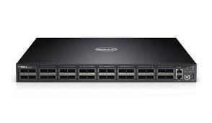
What is SDN?
Control Plane
Data Plane
Very high queuing delay
Control Plane
Data Plane
Control Plane
Data Plane

Slide 12
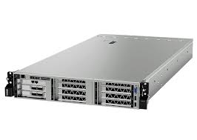
What is SDN?
Controller
Control Plane
Data Plane
Bypass
Very high queuing delay
Control Plane
Data Plane
Control Plane
Data Plane

