Slide 1
CSC4200/5200 – Computer Networking
Ethernet and WIFI
Instructor: Susmit Shannigrahi
sshannigrahi@tntech.edu

Slide 2

Apps (HTTP)
Data
Apps (HTTP)
Segments
Transport (TCP/UDP)
Transport (TCP/UDP)
Network (IP)
Packets
Network (IP)
Link (Ethernet)
Frames
Link (Ethernet)
Ethernet Interface
Ethernet Interface
Bits (1010001)

Slide 3

So far...
We have connected two machines using point to point wires
  Encoded bits
  Sent bits as Frames
  Caught and corrected errors
  Tuned efficiency and reliability using sliding window
What happens when there are more than two machines?
Notes:
Ndn can help organizing the namespaces
Once that’s done, data discovery and provenance is
Straight forward
Retrieval, transparent failover, and specialized operations
In this work, we take a real access log and try to quantify NDN’s improvements to a climate
workflow

Slide 4

Map of Hawaii
wikipedia
Notes:
Ndn can help organizing the namespaces
Once that’s done, data discovery and provenance is
Straight forward
Retrieval, transparent failover, and specialized operations
In this work, we take a real access log and try to quantify NDN’s improvements to a climate
workflow

Slide 5
AlohaNET
Connect University of Hawaiʻi’s computers using wireless radio to main campus in Oahu
Random access to radio channel
  If you have data, send
  If you hear someone else, collision! Resend “later”
Fixed frequency channels
  Shared medium
Abramson, Norman. "Development of the ALOHANET." IEEE transactions on Information Theory 31.2 (1985): 119-123.
Notes:
Ndn can help organizing the namespaces
Once that’s done, data discovery and provenance is
Straight forward
Retrieval, transparent failover, and specialized operations
In this work, we take a real access log and try to quantify NDN’s improvements to a climate
workflow

Slide 6
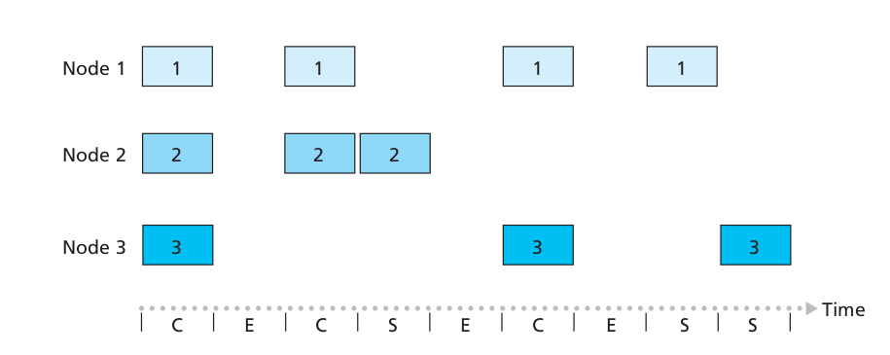
Slotted ALOHA – Problems?
Wasted slots
Idle slots
Need to sync
Low efficiency
Notes:
Ndn can help organizing the namespaces
Once that’s done, data discovery and provenance is
Straight forward
Retrieval, transparent failover, and specialized operations
In this work, we take a real access log and try to quantify NDN’s improvements to a climate
workflow

Slide 7

CSMA
Listen first -
  If chennel is idle, send
  If channel is busy, wait
  and send later
Propagation delay
  You may not hear others
  before it’s too late!
wikipedia
Notes:
Ndn can help organizing the namespaces
Once that’s done, data discovery and provenance is
Straight forward
Retrieval, transparent failover, and specialized operations
In this work, we take a real access log and try to quantify NDN’s improvements to a climate
workflow

Slide 8
Ethernet – Wire as Shared Medium
Most successful local area networking technology of last 20 years.
Developed in the mid-1970s by researchers at the Xerox Palo Alto Research Centers (PARC).
For alohanet the medium was the atmosphere, for ethernet, coax cables
Frames
Frames
Notes:
Ndn can help organizing the namespaces
Once that’s done, data discovery and provenance is
Straight forward
Retrieval, transparent failover, and specialized operations
In this work, we take a real access log and try to quantify NDN’s improvements to a climate
workflow

Slide 9
Ethernet – IEEE Standard 802.3
How to allow many adaptors to send frames over the wire?
  Access protocol
Frames
Frames
Notes:
Ndn can help organizing the namespaces
Once that’s done, data discovery and provenance is
Straight forward
Retrieval, transparent failover, and specialized operations
In this work, we take a real access log and try to quantify NDN’s improvements to a climate
workflow

Slide 10

Ethernet
Ethernet repeater
Notes:
The University of Adelaide, School of Computer Science
September 13, 2019
Chapter 2 — Instructions: Language of the Computer

Slide 11
Ethernet – Random Access
How to allow many adaptors to send frames over the wire?
  Random access
  When you have data – send at Full channel rate!
  No coordination needed.
If collision happens
  Detect
  Recover
  Retransmit
Notes:
Ndn can help organizing the namespaces
Once that’s done, data discovery and provenance is
Straight forward
Retrieval, transparent failover, and specialized operations
In this work, we take a real access log and try to quantify NDN’s improvements to a climate
workflow

Slide 12
CSMA/CD – Listen first, talk later!
CSMA – Carrier sense Multiple access
  Listen if anyone is transmitting
  Wait until carrier is free, do not interrupt others
  What is the carrier here?
CD – Collision Detection
  If you hear anyone while talking, collision, stop!
  Monitor signal strength at the adapter
  Higher than normal = collision
Random wait before retransmitting
  Why?
Notes:
Ndn can help organizing the namespaces
Once that’s done, data discovery and provenance is
Straight forward
Retrieval, transparent failover, and specialized operations
In this work, we take a real access log and try to quantify NDN’s improvements to a climate
workflow

Slide 13
CSMA/CD – Ethernet
CS – wait until idle
  Channel idle – trasmit
  Channel busy – wait
CD – listen while transmitting
  No collision: transmission successful
  Collission: abort, send jam signal (32bit special sequence)
Wait random time
  Try again
  After m^{th} collision,
  t = random(0,2^{m –} 1),
  Wait t*512 bit times before retry
Notes:
Ndn can help organizing the namespaces
Once that’s done, data discovery and provenance is
Straight forward
Retrieval, transparent failover, and specialized operations
In this work, we take a real access log and try to quantify NDN’s improvements to a climate
workflow

Slide 14

Ethernet Frame
SYNC- 7 bytes of 10101010
1 byte of 10101011
Payload
Upper layer protocol
(usually IP)
MAC ADDRESSES
Notes:
The University of Adelaide, School of Computer Science
September 13, 2019
Chapter 2 — Instructions: Language of the Computer

Slide 15
Access Protocol for Ethernet
The algorithm is commonly called Ethernet’s Media Access Control (MAC).
  It is implemented in Hardware on the network adaptor.
Frame format
  Preamble (64bit): allows the receiver to synchronize with the signal (sequence of alternating 0s and 1s).
  Host and Destination Address (48bit each).
    Hardcoded
  Packet type (16bit): acts as demux key to identify the higher level protocol.
  Data (up to 1500 bytes)
    Minimally a frame must contain at least 46 bytes of data.
    Frame must be long enough to detect collision.
  CRC (32bit)
Notes:
The University of Adelaide, School of Computer Science
September 13, 2019
Chapter 2 — Instructions: Language of the Computer

Slide 16
Ethernet Transmitter Algorithm
Once an adaptor has detected a collision, and stopped its transmission, it waits a certain amount of time and tries again.
Each time the adaptor tries to transmit but fails, it doubles the amount of time it waits before trying again.
This strategy of doubling the delay interval between each retransmission attempt is known as Exponential Backoff.
Notes:
The University of Adelaide, School of Computer Science
September 13, 2019
Chapter 2 — Instructions: Language of the Computer

Slide 17
Ethernet Transmitter Algorithm
The adaptor first delays either 0 or 51.2 μs, selected at random
If this effort fails, it then waits 0, 51.2, 102.4, 153.6 μs (selected randomly) before trying again;
  This is k * 51.2 for k = 0, 1, 2, 3
After the third collision, it waits k * 51.2 for k = 0…2³ – 1 (again selected at random).
In general, the algorithm randomly selects a k between 0 and 2^{n} – 1 and waits for k * 51.2 μs, where n is the number of collisions experienced so far.
Notes:
The University of Adelaide, School of Computer Science
September 13, 2019
Chapter 2 — Instructions: Language of the Computer

Slide 18
Ethernet Transmitter Algorithm
An adaptor may begin transmitting at/near the same time
  Either because both found the line to be idle,
  Or, both had been waiting for a busy line to become idle.
Simultaneously transmitted frames collide
Each sender can detect collisions (CDMA/CS)
  Detection MUST happen during transmission
  Each transmits a 32-bit jamming sequence
  Will minimally send 96 bits (runt frame)
    64-bit preamble + 32-bit jamming sequence
    Works if hosts are close to each other
  Worst case: transmitter may need to send up to 512 bits
    Every Ethernet frame must be at least 512 bits (64 bytes) long.
    14 bytes of header + 46 bytes of data + 4 bytes of CRC
Notes:
The University of Adelaide, School of Computer Science
September 13, 2019
Chapter 2 — Instructions: Language of the Computer

Slide 19
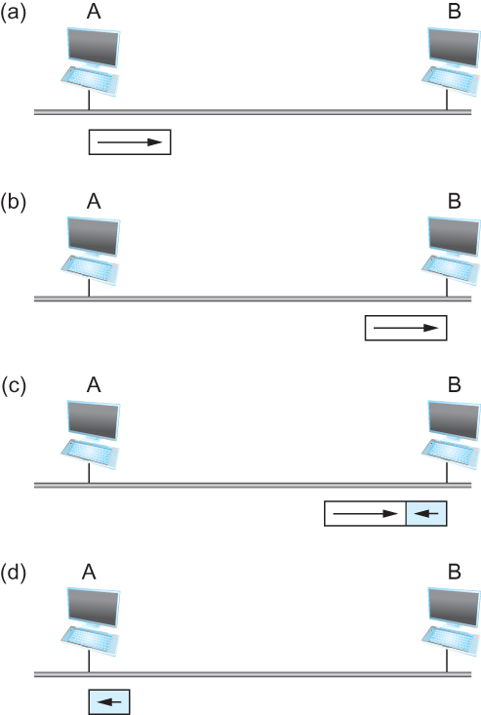
Ethernet Transmitter Algorithm
Worst-case scenario:
(a) A sends a frame at time t;
(b) A’s frame arrives at B at time t + d;
(c) B begins transmitting at time t + d,
collides with A’s frame;
(d) B’s runt (32-bit) frame arrives at A at time t + 2d.
Notes:
The University of Adelaide, School of Computer Science
September 13, 2019
Chapter 2 — Instructions: Language of the Computer

Slide 20
Ethernet Transmitter Algorithm
Ethernet max length = 2500 meters
RTT in worst case is 51.2 μs, which corresponds to the transmission time of 512 bits
Each ethernet frame MUST be at least 512 bits
Notes:
The University of Adelaide, School of Computer Science
September 13, 2019
Chapter 2 — Instructions: Language of the Computer

Slide 21
Experience with Ethernet
Ethernets work best under lightly loaded conditions.
  Under heavy loads, too much of the network’s capacity is wasted by collisions.
Most Ethernets are far shorter than 2500m with a round-trip delay of closer to 5 μs than 51.2 μs.
Ethernets are easy to administer and maintain.
  There are no switches that can fail and no routing and configuration tables that have to be kept up-to-date.
  Cable is cheap, and only other cost is the network adaptor on each host.
Notes:
The University of Adelaide, School of Computer Science
September 13, 2019
Chapter 2 — Instructions: Language of the Computer

Slide 22
Wireless
Wireless links transmit electromagnetic signals
  Radio, microwave, infrared
Wireless links all share the same “wire” (so to speak)
  The challenge is to share it efficiently without unduly interfering with each other
  Most of this sharing is accomplished by dividing the “wire” along the dimensions of frequency and space
Exclusive use of a particular frequency in a particular geographic area may be allocated to an individual entity such as a corporation
Notes:
The University of Adelaide, School of Computer Science
September 13, 2019
Chapter 2 — Instructions: Language of the Computer

Slide 23
Wireless Links
Wireless technologies differ in a variety of dimensions
  How much bandwidth they provide
  How far apart the communication nodes can be
Four prominent wireless technologies
  Bluetooth
  Wi-Fi (more formally known as 802.11)
  WiMAX (802.16)
  Cellular wireless (3/4/5G) – 6G anyone?
Notes:
The University of Adelaide, School of Computer Science
September 13, 2019
Chapter 2 — Instructions: Language of the Computer

Slide 24
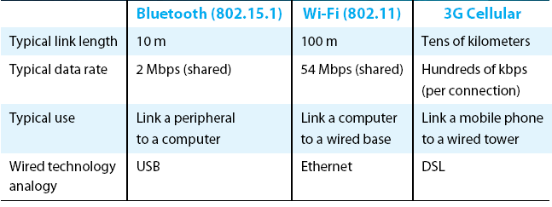
Wireless Links
Overview of leading wireless technologies

Slide 25


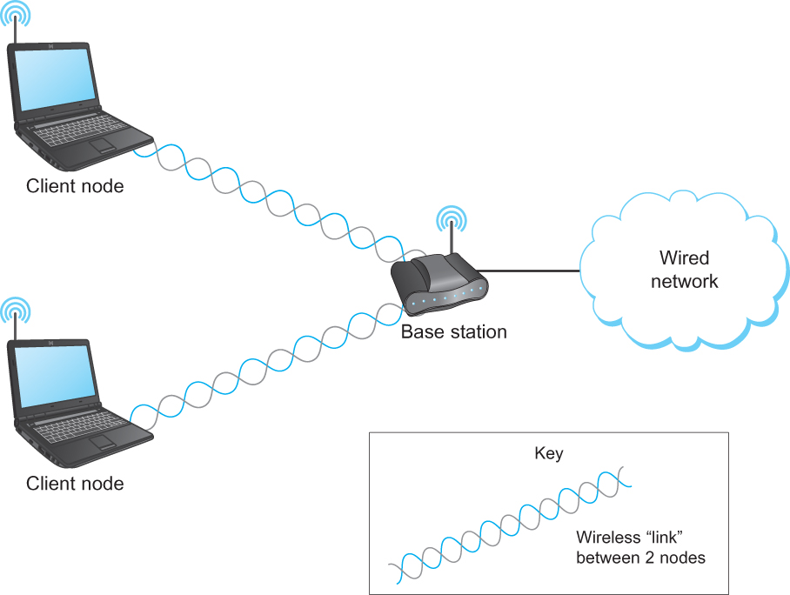
Wireless Links - Infrastructure
Typically connects to
Base stations
Multiple access
Handoff protocols
Wireless != Mobile
A wireless network using a base station

Slide 26
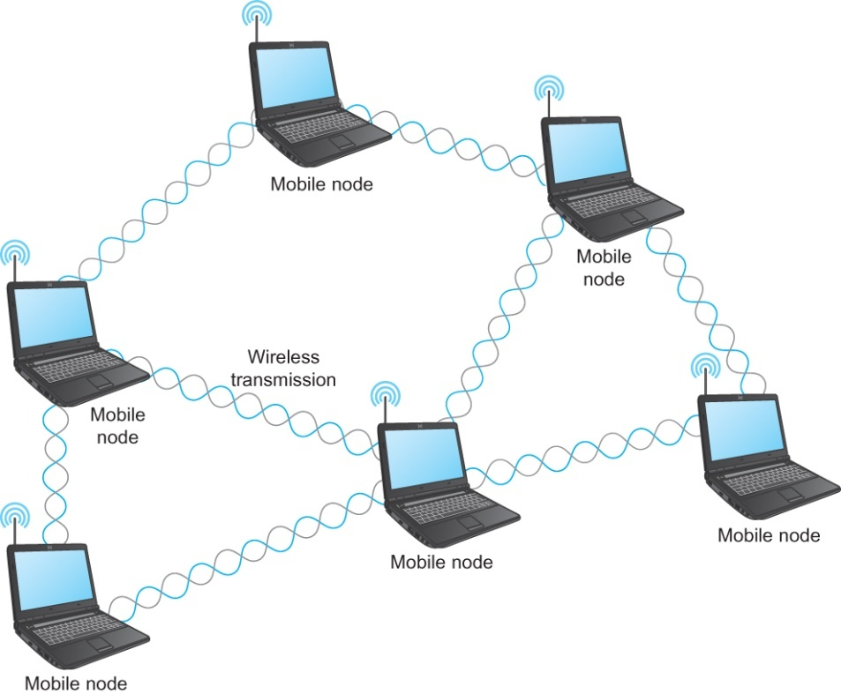
Wireless Links – Ad hoc
Mesh or Ad-hoc network
  Nodes are peers
  Messages may be forwarded via a chain of peer nodes
Notes:
The University of Adelaide, School of Computer Science
September 13, 2019
Chapter 2 — Instructions: Language of the Computer

Slide 27



Wireless Links – Characteristics
Difference from wired?
  Decreased signal strength (radio signals travel through the atmosphere)
  Interference (Other signals interfere, microwave, phones, each other)
  Multipath and noise
    Reflects of objects
Can’t hear you!!!!
Notes:
The University of Adelaide, School of Computer Science
September 13, 2019
Chapter 2 — Instructions: Language of the Computer

Slide 28



Wireless Links – other problems
B
Hidden terminal
Signal Fading
C
A
B
C
A
A’s signal
strength
C’s signal
strength
A and C can talk
B and C can talk
A and B can not!!!
Interference at B
space
Notes:
The University of Adelaide, School of Computer Science
September 13, 2019
Chapter 2 — Instructions: Language of the Computer

Slide 29
WiFi – 802.11 Wireless Lan
802.11 b
2.4-5 GHZ unlicensed spectrum
Divided into 11 (or 13) channels
Widely deployed
Uses base stations, 11Mbps
802.11 G
54Mbps
802.11 N
450Mbps
802.11 A/C
1.3 Gbps
All use base station or ac-hoc versions
All use CSMA/CA for multiple access
Notes:
The University of Adelaide, School of Computer Science
September 13, 2019
Chapter 2 — Instructions: Language of the Computer

Slide 30
802.11 – CSMA/Collision Avoidance (CA)
802.11: no collision detection! Why?
  It won’t work anyway, hidden node, signal fading
Avoid Collisions
CSMA - sense before transmitting
Notes:
The University of Adelaide, School of Computer Science
September 13, 2019
Chapter 2 — Instructions: Language of the Computer

Slide 31


IEEE 802.11: Multiple Access
A
B
C
Avoid collisions: 2⁺ nodes transmitting at same time
802.11: CSMA - sense before transmitting
  don’t collide with ongoing transmission by other node
802.11: no collision detection!
  difficult to receive (sense collisions) when transmitting due to weak received signals (fading)
  can’t sense all collisions in any case: hidden terminal, fading
  goal: avoid collisions: CSMA/C(ollision)A(voidance)
A’s signal
strength
C’s signal
strength
space
C
B
Wireless, Mobile Networks
6-<number>
A

Slide 32
IEEE 802.11 MAC Protocol: CSMA/CA
802.11 sender
1 if sense channel idle for DIFS then
  transmit entire frame (no CD)
2 if sense channel busy then
  start random backoff time
  timer counts down while channel idle
  transmit when timer expires
  if no ACK, increase random backoff interval, repeat 2
802.11 receiver
- if frame received OK
return ACK after SIFS (ACK needed due to hidden terminal problem)
DIFS = SIFS + (2 * Slot time)
sender
receiver
DIFS
Defined by
Standard
(34-50µs)
data
SIFS
Defined by
Standard
(10-16µs)
ACK

Slide 33
Avoiding collisions – Reserve before Send
idea: allow sender to “reserve” channel rather than random access
sender first transmits small request-to-send (RTS) packets to BS using CSMA
  RTSs may still collide with each other (but they’re short)
BS broadcasts clear-to-send CTS in response to RTS
CTS heard by all nodes
  sender transmits data frame
  other stations defer transmissions
avoid data frame collisions completely
using small reservation packets!

Slide 34



Collision Avoidance: RTS-CTS exchange
A
B
AP
RTS(B)
RTS(A)
reservation collision
RTS(A)
CTS(A)
CTS(A)
DATA (A)
defer
time
ACK(A)
ACK(A)
Wireless, Mobile Networks
6-<number>

Slide 35
802.11 frame: Addressing
2
2
6
6
6
2
6
0 - 2312
4
frame
control
duration
address
1
address
2
address
3
seq
control
address
4
payload
CRC
Address 4: used only in ad hoc mode
Address 1: MAC address
of wireless host or AP
to receive this frame
Address 3: MAC address
of router interface to which AP is attached
Address 2: MAC address
of wireless host or AP
transmitting this frame
Wireless, Mobile Networks
6-<number>

Slide 36
802.11 frame: More
frame seq #
(for RDT)
duration of reserved
transmission time (RTS/CTS)
2
2
6
6
6
2
6
0 - 2312
4
frame
control
duration
address
1
address
2
address
3
seq
control
address
4
payload
CRC
2
2
4
1
1
1
1
1
1
1
1
Protocol
version
Type
Subtype
To
AP
From
AP
More
frag
Retry
Power
mgt
More
data
WEP
Rsvd
frame type
(RTS, CTS, ACK, data)
Wireless, Mobile Networks
6-<number>

Slide 37
Link Layer Recap – All this for a cat picture
Apps (HTTP)
Data
Apps (HTTP)
Segments
Transport (TCP/UDP)
Transport (TCP/UDP)
Network (IP)
Packets
Network (IP)
Link (Ethernet)
Frames
Link (Ethernet)
Ethernet Interface
Ethernet Interface
Bits (1010001)

