Slide 1
CSC4200/5200 – Computer Networking
Physical and link layer recap
Instructor: Susmit Shannigrahi
sshannigrahi@tntech.edu

Slide 2

Recap – All this for a cat picture!!
Apps (HTTP)
Data
Apps (HTTP)
Segments
Transport (TCP/UDP)
Transport (TCP/UDP)
Network (IP)
Packets
Network (IP)
Link (Ethernet)
Frames
Link (Ethernet)
Ethernet Interface
Ethernet Interface
Bits (1010001)

Slide 3
Links, Nodes, Network, Internet
You can view the network as a graph
Each device (a phone, a computer) is a node
Each connection is a link
  Wires = real links
  Bluetooth, Radio, Infrared = virtual links
Nodes + links = a network
  Many connected networks = Internet
Notes:
Ndn can help organizing the namespaces
Once that’s done, data discovery and provenance is
Straight forward
Retrieval, transparent failover, and specialized operations
In this work, we take a real access log and try to quantify NDN’s improvements to a climate
workflow

Slide 4
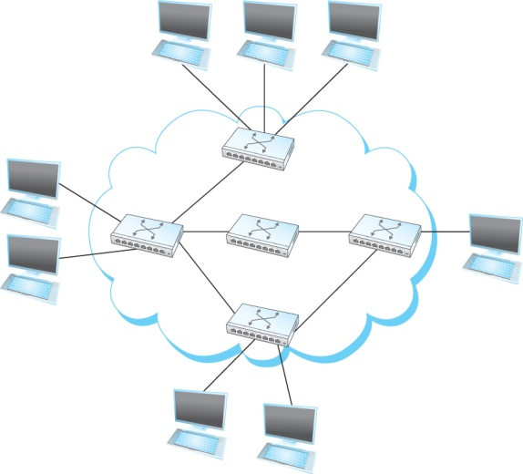
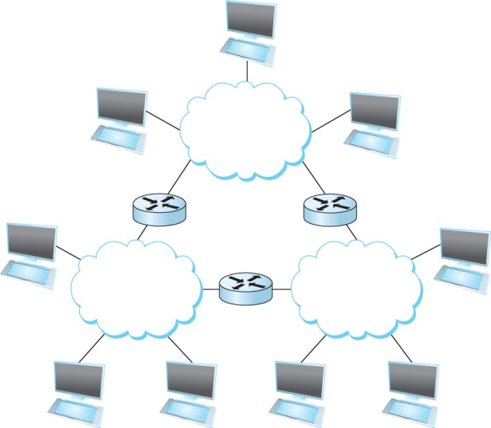
A Network and the Internet
Notes:
Ndn can help organizing the namespaces
Once that’s done, data discovery and provenance is
Straight forward
Retrieval, transparent failover, and specialized operations
In this work, we take a real access log and try to quantify NDN’s improvements to a climate
workflow

Slide 5
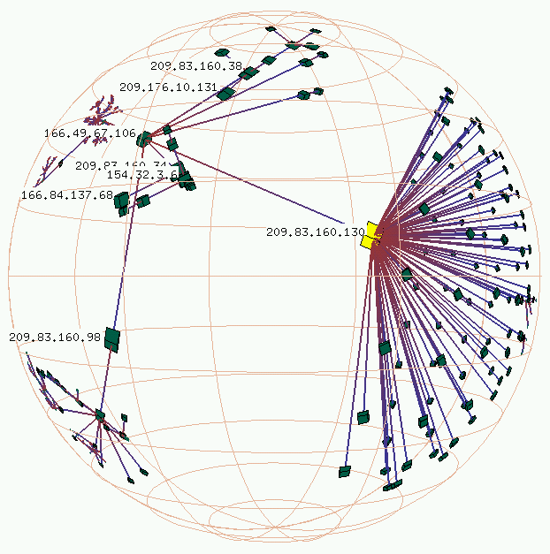

Links, Nodes, Network, Internet
Not
Actual data
https://www.caida.org/tools/visualization/walrus/gallery1/lhr-old.png
Notes:
Ndn can help organizing the namespaces
Once that’s done, data discovery and provenance is
Straight forward
Retrieval, transparent failover, and specialized operations
In this work, we take a real access log and try to quantify NDN’s improvements to a climate
workflow

Slide 6
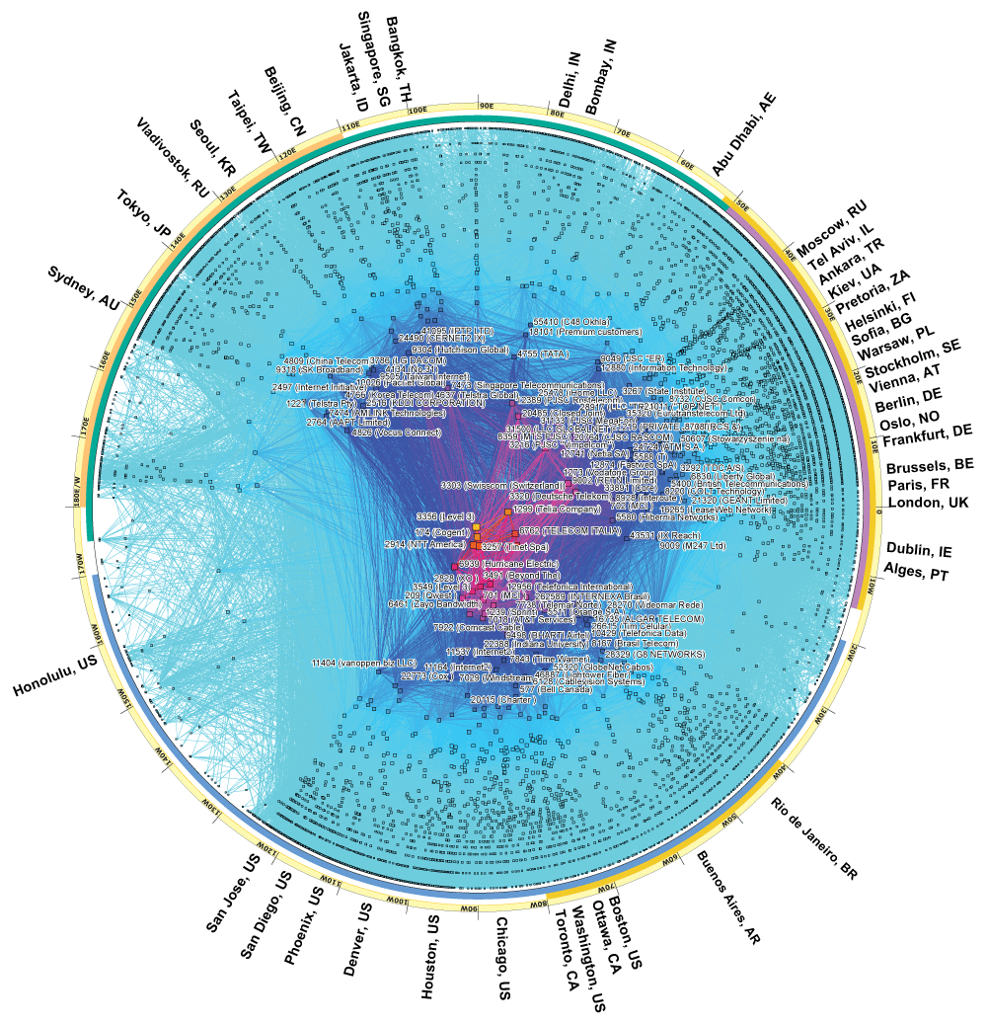
Links, Nodes,
Network, Internet
https://www.caida.org/research/topology/as_core_network/2017/
https://www.caida.org/tools/visualization/walrus/gallery1/lhr-old.png
Notes:
Ndn can help organizing the namespaces
Once that’s done, data discovery and provenance is
Straight forward
Retrieval, transparent failover, and specialized operations
In this work, we take a real access log and try to quantify NDN’s improvements to a climate
workflow

Slide 7
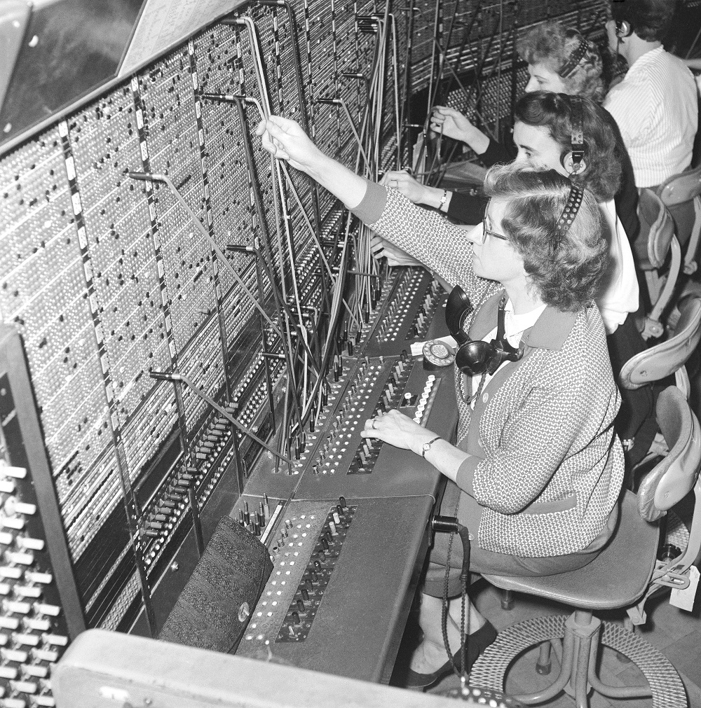


Circuit Switching – Old telephone networks
Operator, get me the navy
Build physical wire:
  Guaranteed resources
  Great for voice
Why change?
Notes:
Ndn can help organizing the namespaces
Once that’s done, data discovery and provenance is
Straight forward
Retrieval, transparent failover, and specialized operations
In this work, we take a real access log and try to quantify NDN’s improvements to a climate
workflow

Slide 8
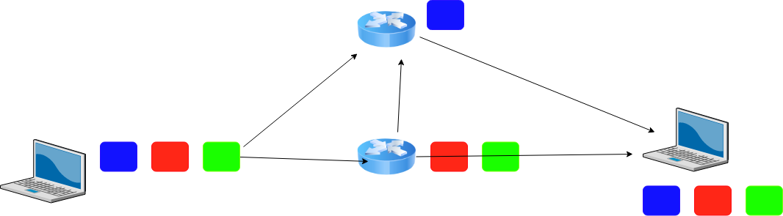
Packet Switching

Slide 9
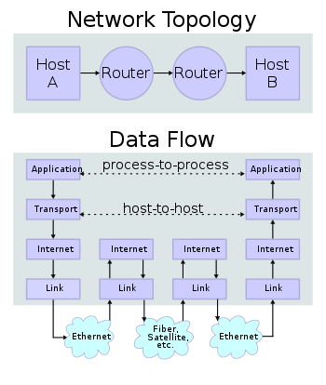
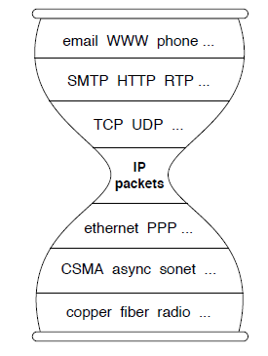
IP Suite
We reject kings, presidents, and voting. We believe in rough consensus
and running code. (David Clark, IETF, July 1992)
wikipedia

Slide 10
Apps (HTTP)
Data
Apps (HTTP)
Segments
Transport (TCP/UDP)
Transport (TCP/UDP)
Network (IP)
Packets
Network (IP)
Link (Ethernet)
Frames
Link (Ethernet)
Ethernet Interface
Ethernet Interface
Bits (1010001)

Slide 11
Performance - Bandwidth and Latency
Bandwidth = Size of the network pipe
Latency = Delay in sending packets
Throughput = How fast your can send data, function of both bandwidth and latency (and other things)
Notes:
Ndn can help organizing the namespaces
Once that’s done, data discovery and provenance is
Straight forward
Retrieval, transparent failover, and specialized operations
In this work, we take a real access log and try to quantify NDN’s improvements to a climate
workflow

Slide 12
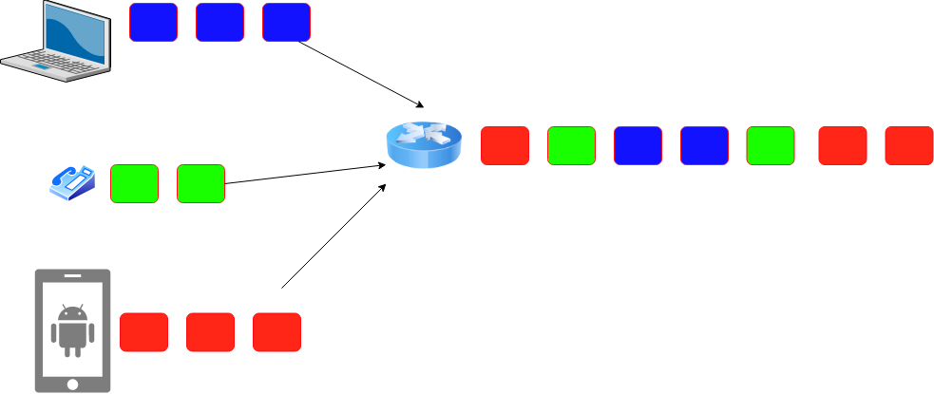
Performance - Latency
Latency = Propagation Delay + Transmission Delay + Queuing Delay
Propagation = Distance/Speed Of Light (in Copper or Fiber)
Transmit = Size/Bandwidth
How long to “put it on the wire?”
How long to traverse the link?
How long to queue?
Notes:
Ndn can help organizing the namespaces
Once that’s done, data discovery and provenance is
Straight forward
Retrieval, transparent failover, and specialized operations
In this work, we take a real access log and try to quantify NDN’s improvements to a climate
workflow

Slide 13
Link Layer Recap – How much work for a cat picture?
Apps (HTTP)
Data
Apps (HTTP)
Segments
Transport (TCP/UDP)
Transport (TCP/UDP)
Network (IP)
Packets
Network (IP)
Link (Ethernet)
Frames
Link (Ethernet)
Ethernet Interface
Ethernet Interface
Bits (1010001)

Slide 14
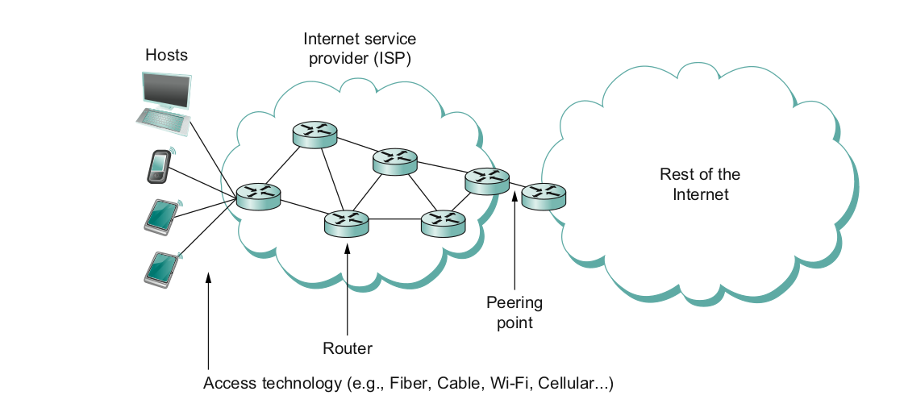
What does it take to create a link?
Common abstractions
  Why?

Slide 15
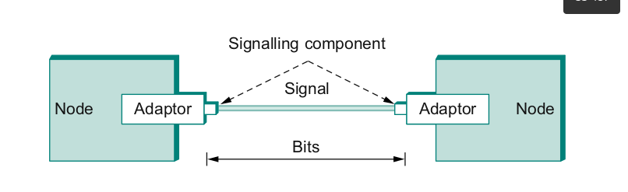
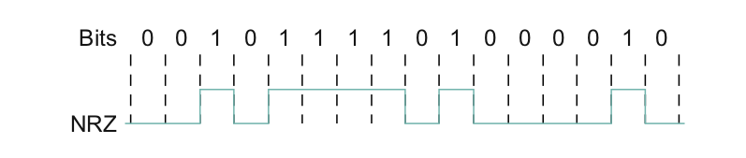
Packet to Low level Signals
Bit pattern - 0101001
  Must encode it into electrical signals and then decode it on the other end!

Slide 16
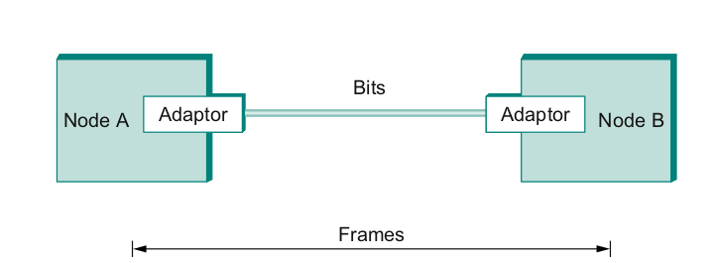
Frames – bag of bits
Sending side – encapsulation, add error check bits, flow control
Receiving side – extract frames, check for error, flow control
Notes:
Ndn can help organizing the namespaces
Once that’s done, data discovery and provenance is
Straight forward
Retrieval, transparent failover, and specialized operations
In this work, we take a real access log and try to quantify NDN’s improvements to a climate
workflow

Slide 17
Error Detection
Bit errors are introduced into frames
  Because of electrical interference and thermal noises
Detecting Error
Correction Error
Two approaches when the recipient detects an error
  Notify the sender that the message was corrupted, so the sender can send again.
    If the error is rare, then the retransmitted message will be error-free
  Using some error correct detection and correction algorithm, the receiver reconstructs the message
Notes:
The University of Adelaide, School of Computer Science
September 13, 2019
Chapter 2 — Instructions: Language of the Computer

Slide 18
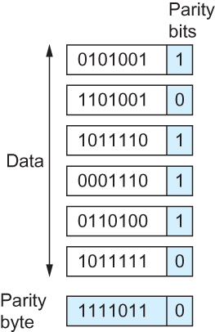
One an Two-dimensional parity
0
1
0
1
0
0
0
1
0
1
1
1
Number of 1s
Odd 1s = Parity bit 0
Even 1s = Parity bit 1
Two Dimensional Parity

Slide 19
Internet Checksum Algorithm (RFC 1071)
A = 0110011001100110
B = 0101010101010101
------------------------
A+B = 1011101110111011
C = 0000111100001111
------------------------
1100101011001010 (sum of all segments)
0011010100110101 (1’s complement, 1→0, 0→ 1) <= this is the checksum
At receiver:
Add sum of all segments and checksum
  If correct, all 1s
Notes:
The University of Adelaide, School of Computer Science
September 13, 2019
Chapter 2 — Instructions: Language of the Computer

Slide 20
Reliable Delivery – Correct FRAMEs!!!
Frames might get lost
  Too many bits lost
  Clock did not sync properly
  Error detected but the report got lost
Can we build links that does not have errors?
  Not possible
How about all those error correction stuff we learned?
  Can we add them to frames?
  We could, but think of the overhead
  What happens when the entire frame is lost?
Notes:
Ndn can help organizing the namespaces
Once that’s done, data discovery and provenance is
Straight forward
Retrieval, transparent failover, and specialized operations
In this work, we take a real access log and try to quantify NDN’s improvements to a climate
workflow

Slide 21
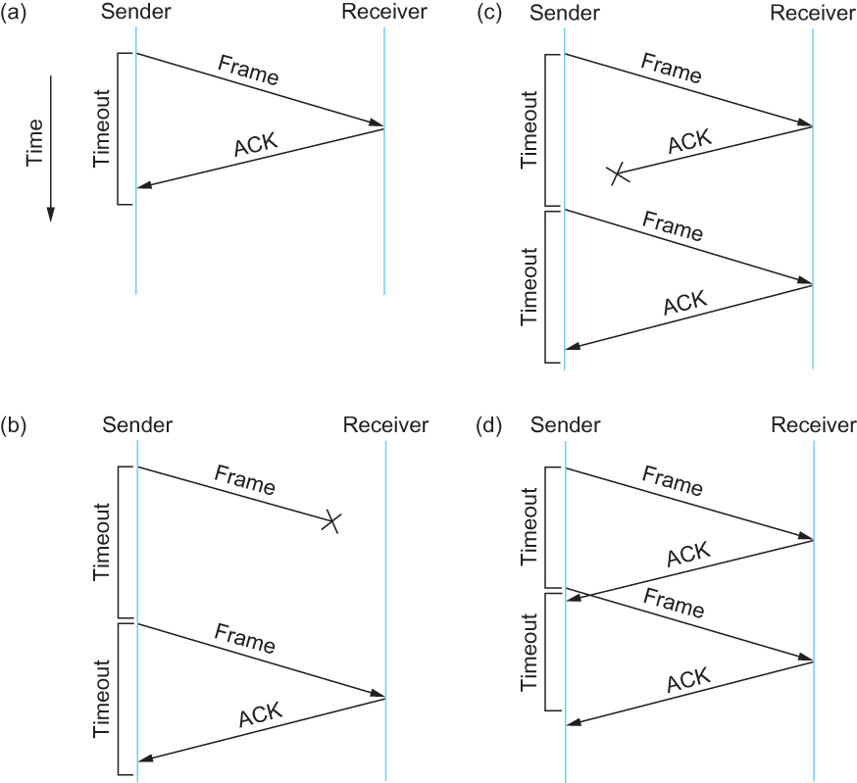
Stop and Wait
Sender sends a frame, sets a
timeout (e.g., 1 sec)
Receiver receives the frame,
sends an ACK
Sender
  sends the next frame on ACK
  retransmits the same frame if timeout happens
Spot the bugs in the protocol
Notes:
Ndn can help organizing the namespaces
Once that’s done, data discovery and provenance is
Straight forward
Retrieval, transparent failover, and specialized operations
In this work, we take a real access log and try to quantify NDN’s improvements to a climate
workflow

Slide 22
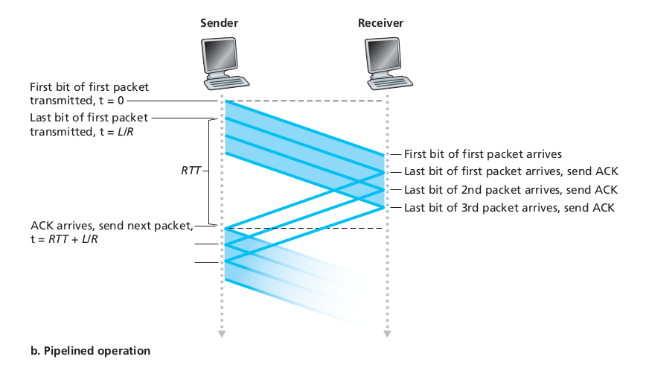
Sliding window to the rescue!
Utilization = 0.008*3/30.008 = 0.00079 (3 times increase)
Notes:
Ndn can help organizing the namespaces
Once that’s done, data discovery and provenance is
Straight forward
Retrieval, transparent failover, and specialized operations
In this work, we take a real access log and try to quantify NDN’s improvements to a climate
workflow

Slide 23
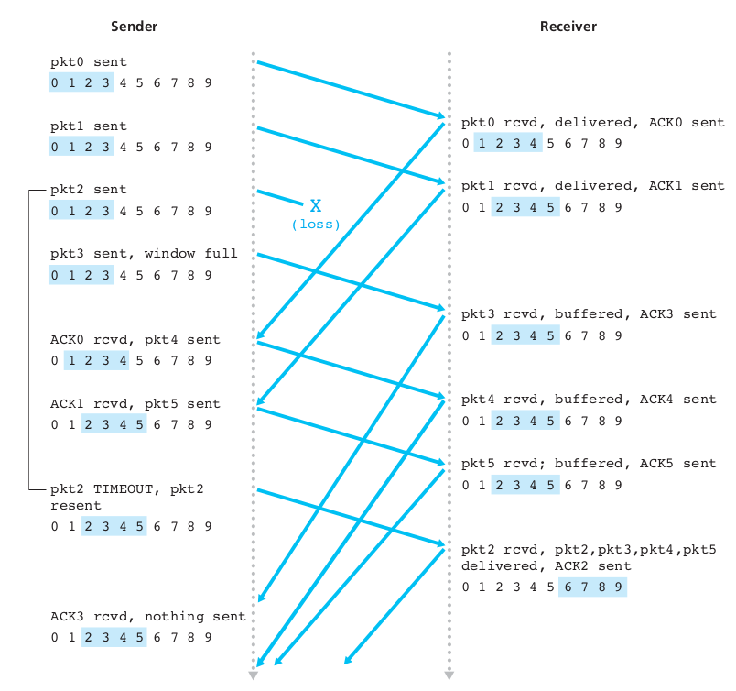
Notes:
Ndn can help organizing the namespaces
Once that’s done, data discovery and provenance is
Straight forward
Retrieval, transparent failover, and specialized operations
In this work, we take a real access log and try to quantify NDN’s improvements to a climate
workflow

Slide 24
So far we connected two machines – how about more than two?
We have connected two machines using point to point wires
  Encoded bits
  Sent bits as Frames
  Caught and corrected errors
  Tuned efficiency and reliability using sliding window
What happens when there are more than two machines?
Notes:
Ndn can help organizing the namespaces
Once that’s done, data discovery and provenance is
Straight forward
Retrieval, transparent failover, and specialized operations
In this work, we take a real access log and try to quantify NDN’s improvements to a climate
workflow

Slide 25
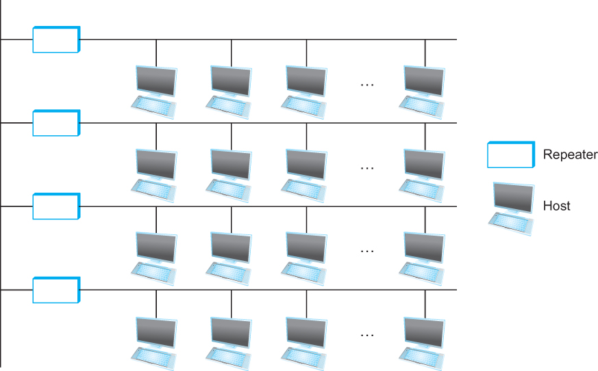
Ethernet
Ethernet repeater
Notes:
The University of Adelaide, School of Computer Science
September 13, 2019
Chapter 2 — Instructions: Language of the Computer

Slide 26
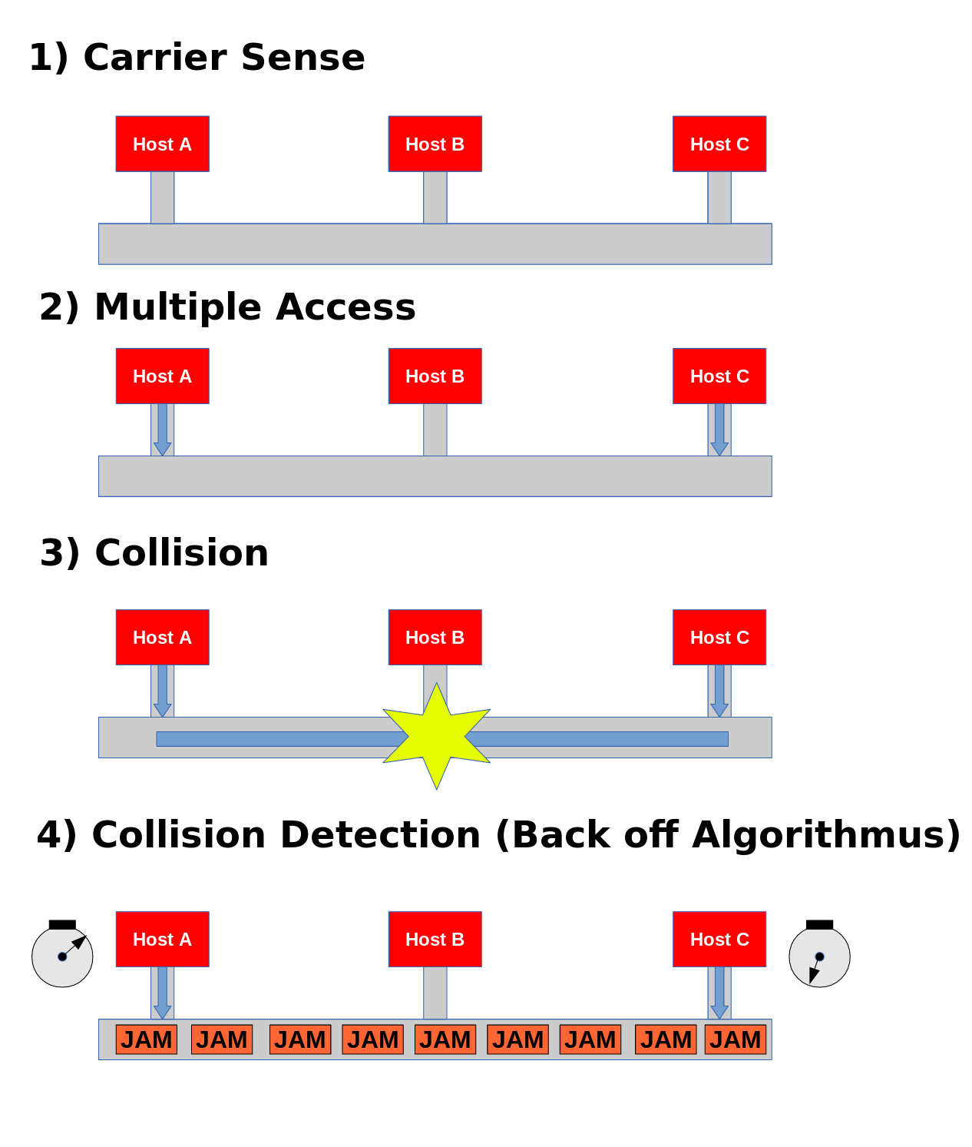
CSMA/CD – Ethernet
CS – wait until idle
  Channel idle – trasmit
  Channel busy – wait
CD – listen while transmitting
  No collision: transmission successful
  Collission: abort, send jam signal (32bit special sequence)
Wait random time
  Try again
  After m^{th} collision,
  t = random(0,2^{m –} 1),
  Wait t*512 bit times before retry
Notes:
Ndn can help organizing the namespaces
Once that’s done, data discovery and provenance is
Straight forward
Retrieval, transparent failover, and specialized operations
In this work, we take a real access log and try to quantify NDN’s improvements to a climate
workflow

Slide 27


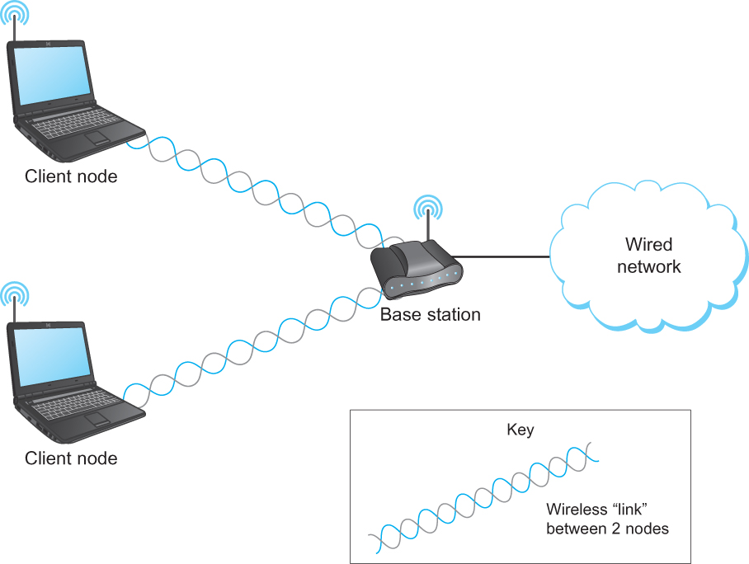
Wireless Links - Infrastructure
Typically connects to
Base stations
Multiple access
Handoff protocols
Wireless != Mobile
A wireless network using a base station

Slide 28
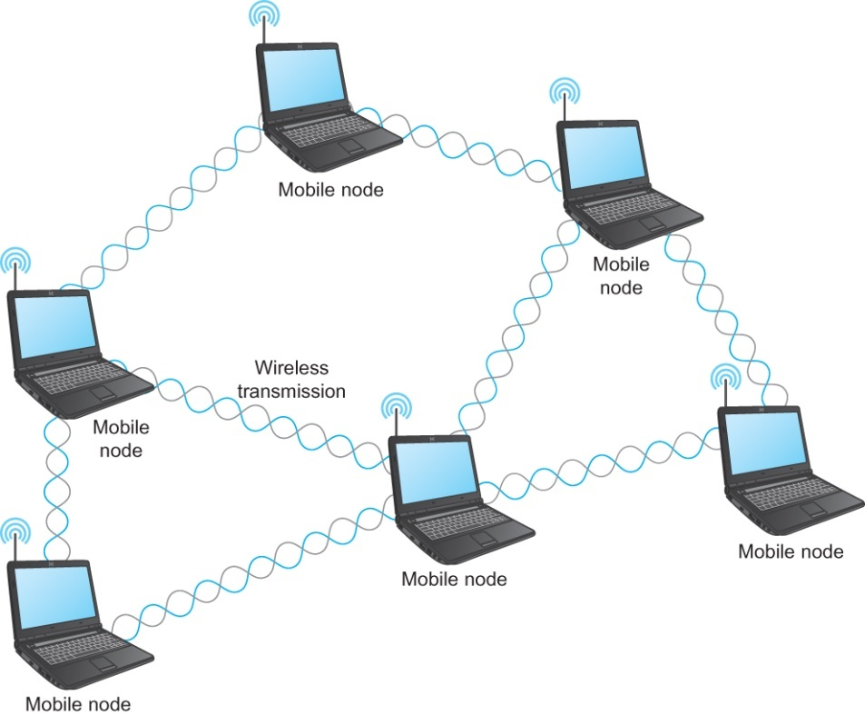
Wireless Links – Ad hoc
Mesh or Ad-hoc network
  Nodes are peers
  Messages may be forwarded via a chain of peer nodes
Notes:
The University of Adelaide, School of Computer Science
September 13, 2019
Chapter 2 — Instructions: Language of the Computer

Slide 29





Wireless Links – problems
B
Hidden terminal
Signal Fading
C
A
B
C
A
A’s signal
strength
C’s signal
strength
A and C can talk
B and C can talk
A and B can not!!!
Interference at B
space
Notes:
The University of Adelaide, School of Computer Science
September 13, 2019
Chapter 2 — Instructions: Language of the Computer

Slide 30
IEEE 802.11 MAC Protocol: CSMA/CA
802.11 sender
1 if sense channel idle for DIFS then
  transmit entire frame (no CD)
2 if sense channel busy then
  start random backoff time
  timer counts down while channel idle
  transmit when timer expires
  if no ACK, increase random backoff interval, repeat 2
802.11 receiver
- if frame received OK
return ACK after SIFS (ACK needed due to hidden terminal problem)
DIFS = SIFS + (2 * Slot time)
sender
receiver
DIFS
Defined by
Standard
(34-50µs)
data
SIFS
Defined by
Standard
(10-16µs)
ACK

Slide 31



Collision Avoidance: RTS-CTS exchange
A
B
AP
RTS(B)
RTS(A)
reservation collision
RTS(A)
CTS(A)
CTS(A)
DATA (A)
defer
time
ACK(A)
ACK(A)
Wireless, Mobile Networks
6-<number>

Slide 32
Next Step – Cat in bits
To Cat in packets!!!!
Apps (HTTP)
Data
Apps (HTTP)
Segments
Transport (TCP/UDP)
Transport (TCP/UDP)
Network (IP)
Packets
Network (IP)
Link (Ethernet)
Frames
Link (Ethernet)
Ethernet Interface
Ethernet Interface
Bits (1010001)

