Slide 1
CSC4200/5200 – Computer Networking
Introduction
Instructor: Susmit Shannigrahi
sshannigrahi@tntech.edu

Slide 2
Welcome
Class website: https://tntech-ngin.github.io/csc4200/
  Syllabus
  Grading policies
  Homework and assignments
  First homework already posted
Instructor: Susmit Shannigrahi
  Office hours: Wednesday and Thursday
  Email : sshannigrahi@tntech.edu
GTA: David Reddick - dereddick42@tntech.edu
GTA : Ethan Newman - etnewman43@tntech.edu

Slide 3
Resources
Class website:
  https://tntech-ngin.github.io/csc4200/
Slack: CSC4200-spring2021
  Will add
Zoom (you need a password sent separately):
  See on iLearn, Announcement section

Slide 4
Grading
Homework – 15%
  Every 2 weeks or so
Projects + Demo – 35%
  You will set up meetings with the TA(s) to go over your code
3 exams – 35%
  approximately once every month (February, March, April) – 35%
  No midterm, no final
Class participation – 15%
  Participate in breakout sessions and discussions.
  Each student will need to lead a breakout session.
Notes:
Ndn can help organizing the namespaces
Once that’s done, data discovery and provenance is
Straight forward
Retrieval, transparent failover, and specialized operations
In this work, we take a real access log and try to quantify NDN’s improvements to a climate
workflow

Slide 5
CSC5200
Extra reading and writing assignments
  Expect to read one paper each month and present it
Notes:
Ndn can help organizing the namespaces
Once that’s done, data discovery and provenance is
Straight forward
Retrieval, transparent failover, and specialized operations
In this work, we take a real access log and try to quantify NDN’s improvements to a climate
workflow

Slide 6
Policies
One late submission allowed (programming assignment), no questions asked. Homeworks due on time.
  Use it wisely
  Max 7 days late
  Submit to iLearn
Other late submissions
  Flat 50% deducted
  No exceptions!
No make-up exams.
  Your responsibility to find conflicts and work with the instructor to resolve them
Notes:
Ndn can help organizing the namespaces
Once that’s done, data discovery and provenance is
Straight forward
Retrieval, transparent failover, and specialized operations
In this work, we take a real access log and try to quantify NDN’s improvements to a climate
workflow

Slide 7
Exams
3 exams.
Open book
  Will be challenging
  Memorizing will not help, you need to understand the topics
Notes:
Ndn can help organizing the namespaces
Once that’s done, data discovery and provenance is
Straight forward
Retrieval, transparent failover, and specialized operations
In this work, we take a real access log and try to quantify NDN’s improvements to a climate
workflow

Slide 8
Programming Assignments
Must run on Google Cloud Vms – Ubuntu-18.04
First and second assignments are individual. Third is a group project.
C/C++/Python
  If you want to use other languages, talk to the GTA/Instructor
Notes:
Ndn can help organizing the namespaces
Once that’s done, data discovery and provenance is
Straight forward
Retrieval, transparent failover, and specialized operations
In this work, we take a real access log and try to quantify NDN’s improvements to a climate
workflow

Slide 9
Logistics
Slides and recordings will be posted on the class website in the evening
Exams and announcements will be on iLearn
Do not use iLearn email to reach me – use sshannigrahi@tntech.edu
Use slack for instant messaging.
I will reply twice a day – around noon and in the evening.
Notes:
Ndn can help organizing the namespaces
Once that’s done, data discovery and provenance is
Straight forward
Retrieval, transparent failover, and specialized operations
In this work, we take a real access log and try to quantify NDN’s improvements to a climate
workflow

Slide 10
Logistics
Grading
  You will get your grades back with feedback in a week
  If your code doesn’t work, the TA will try to reach you, but it is your responsibility to make sure your code works
Notes:
Ndn can help organizing the namespaces
Once that’s done, data discovery and provenance is
Straight forward
Retrieval, transparent failover, and specialized operations
In this work, we take a real access log and try to quantify NDN’s improvements to a climate
workflow

Slide 11
Expectations from You
Be communicative – if you need help, ask
Get started on the assignments sooner – they will take time
This class is not easy!
  you haven’t learned the background material so far
Expect to study about 3-5 hours a week
  Some will need more
Each lecture will have reading material
Notes:
Ndn can help organizing the namespaces
Once that’s done, data discovery and provenance is
Straight forward
Retrieval, transparent failover, and specialized operations
In this work, we take a real access log and try to quantify NDN’s improvements to a climate
workflow

Slide 12
Chapter 1: Fundamentals
Networking is ubiquitous
  (Breakout) What did you use it for today?
First things first:
  Terminology
  Basic tools
  What does it take to build an Internet?
Notes:
Ndn can help organizing the namespaces
Once that’s done, data discovery and provenance is
Straight forward
Retrieval, transparent failover, and specialized operations
In this work, we take a real access log and try to quantify NDN’s improvements to a climate
workflow

Slide 13
Links, Nodes, Network, Internet
You can view the network as a graph
Each device (a phone, a computer) is a node
Each connection is a link
  Wires = real links
  Bluetooth, Radio, Infrared = virtual links
Nodes + links = a network
  Many connected networks = Internet
Notes:
Ndn can help organizing the namespaces
Once that’s done, data discovery and provenance is
Straight forward
Retrieval, transparent failover, and specialized operations
In this work, we take a real access log and try to quantify NDN’s improvements to a climate
workflow

Slide 14
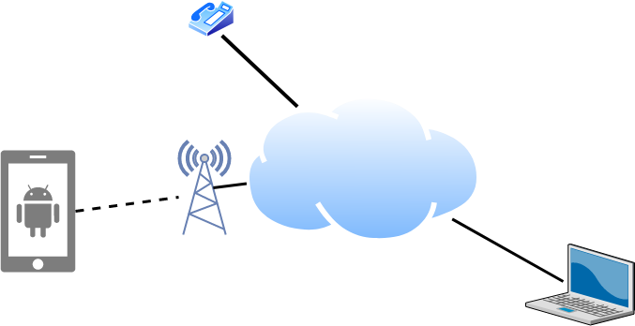
Links, Nodes, Cloud, Routers, Switches
Notes:
Ndn can help organizing the namespaces
Once that’s done, data discovery and provenance is
Straight forward
Retrieval, transparent failover, and specialized operations
In this work, we take a real access log and try to quantify NDN’s improvements to a climate
workflow

Slide 15
Client and Server
My laptop with a browser = client
  It requests a service
  Email, chat, video, youtube
A node running a program that serves the requests = server
  Runs a service
  Chat, video, messaging
A node can both be a client and a server
Notes:
Ndn can help organizing the namespaces
Once that’s done, data discovery and provenance is
Straight forward
Retrieval, transparent failover, and specialized operations
In this work, we take a real access log and try to quantify NDN’s improvements to a climate
workflow

Slide 16
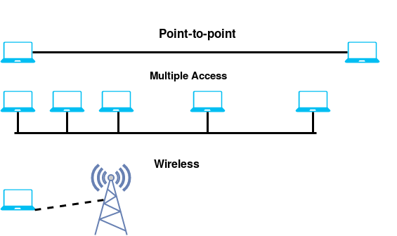
Connectivity
Point to Point
Multiple access
Wireless
Notes:
Ndn can help organizing the namespaces
Once that’s done, data discovery and provenance is
Straight forward
Retrieval, transparent failover, and specialized operations
In this work, we take a real access log and try to quantify NDN’s improvements to a climate
workflow

Slide 17
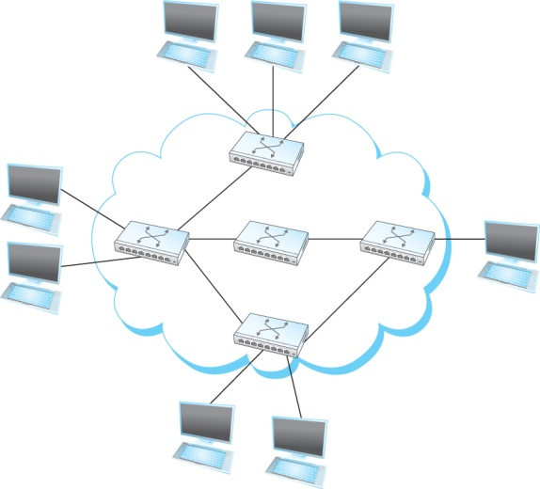
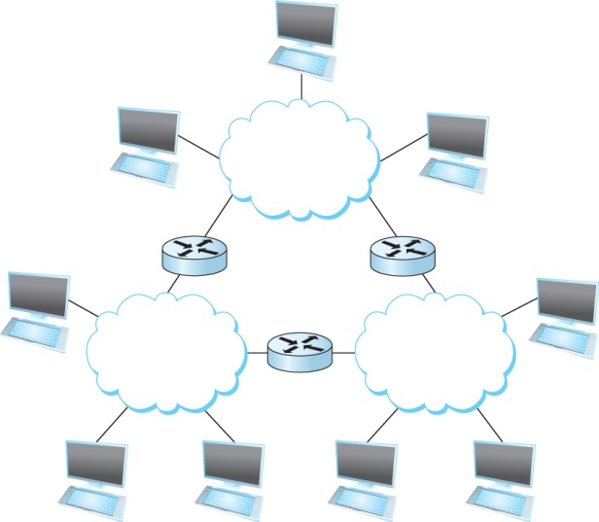
A Network and the Internet
Notes:
Ndn can help organizing the namespaces
Once that’s done, data discovery and provenance is
Straight forward
Retrieval, transparent failover, and specialized operations
In this work, we take a real access log and try to quantify NDN’s improvements to a climate
workflow

Slide 18
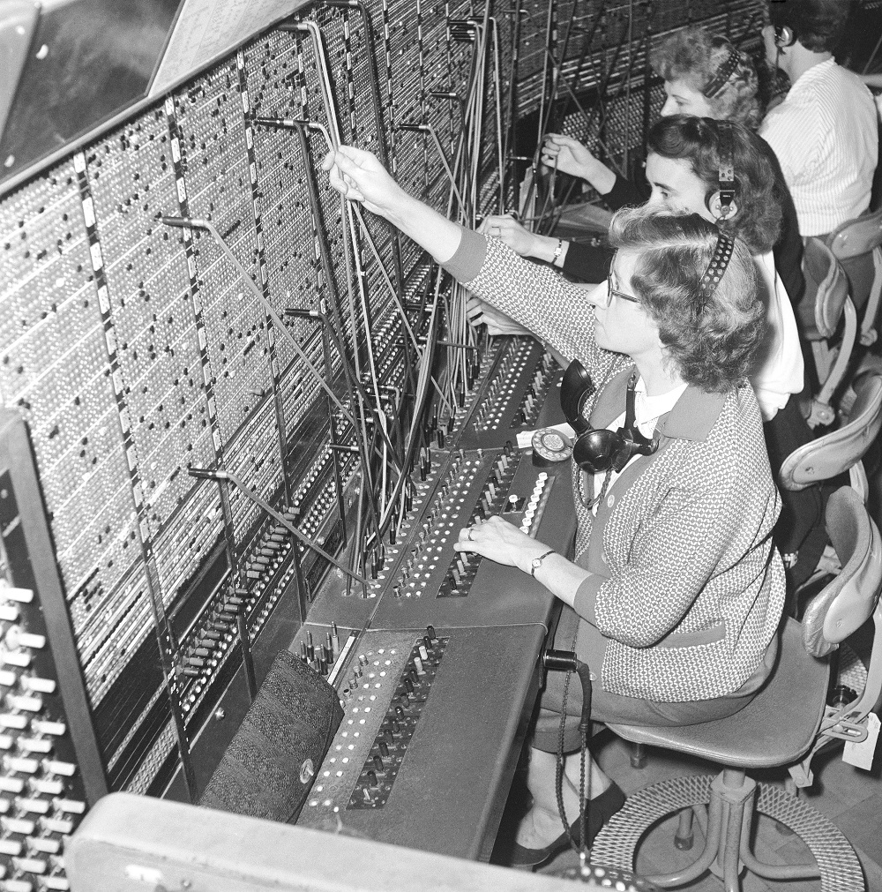


Circuit Switching – Old telephone networks
Operator, get me the navy
Build physical wire:
  Guaranteed resources
  Great for voice
Breakout - Why change a working system?
Notes:
Ndn can help organizing the namespaces
Once that’s done, data discovery and provenance is
Straight forward
Retrieval, transparent failover, and specialized operations
In this work, we take a real access log and try to quantify NDN’s improvements to a climate
workflow

Slide 19
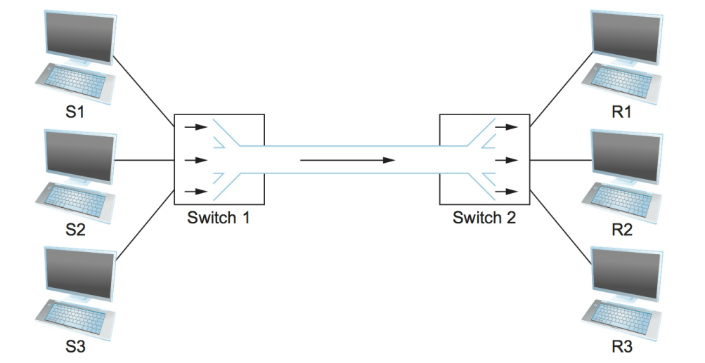
Circuit Switching – TDM and FDM
Breakout - What are the problems?
Notes:
Ndn can help organizing the namespaces
Once that’s done, data discovery and provenance is
Straight forward
Retrieval, transparent failover, and specialized operations
In this work, we take a real access log and try to quantify NDN’s improvements to a climate
workflow

Slide 20
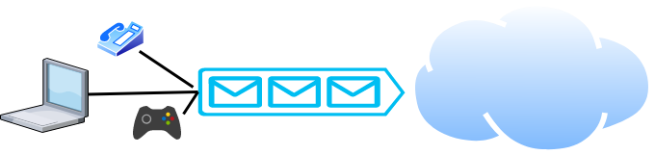
Packet Switching
Packets are low level components
Multiple kind of traffic with different requirements
  Gaming vs Phone
Dumb network – How do you ensure quality of service?
End points must be smart
Notes:
Ndn can help organizing the namespaces
Once that’s done, data discovery and provenance is
Straight forward
Retrieval, transparent failover, and specialized operations
In this work, we take a real access log and try to quantify NDN’s improvements to a climate
workflow

Slide 21
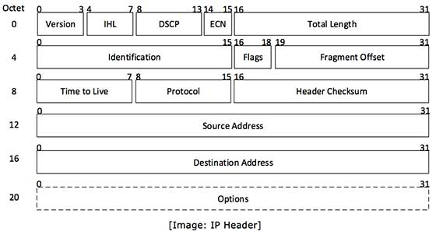
But What is a Packet?
Self-contained data unit
Has two parts (generally)
  Control information
  Payload
Breakout
How do we transmit “Hello World?”
How do we transmit a dictionary?

Slide 22
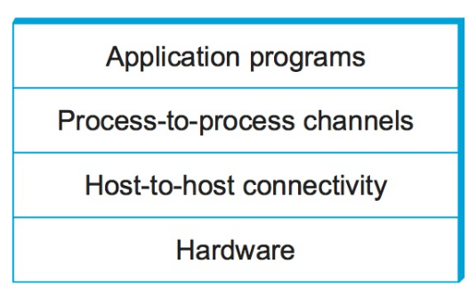
Network Architecture
What are the requirements from a network?
Architecture = High-level blueprint
  Protocols = Building blocks of the architecture
  Layering = Break down the problem in smaller pieces

Slide 23
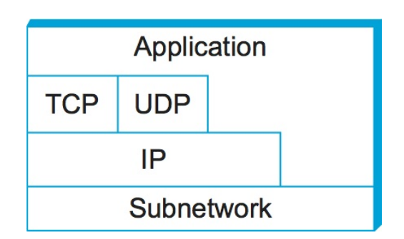
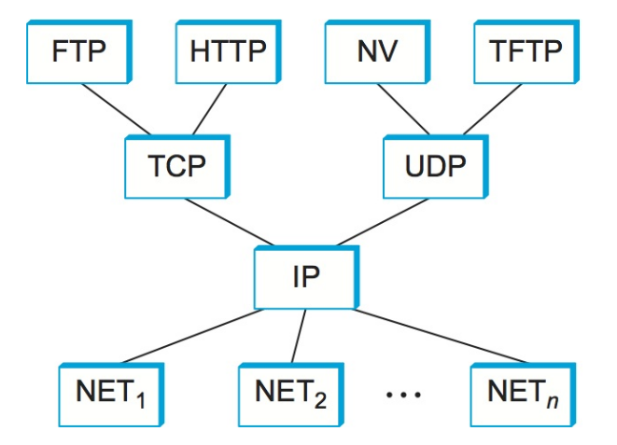
Network Layers
Use Service
Export Service
Makes it easier to divide functionality
Hides implementation details
Breakout – few other reasons?

Slide 24


IP Suite
We reject kings, presidents, and voting. We believe in rough consensus
and running code. (David Clark, IETF, July 1992)
wikipedia

Slide 25
Next Steps
Read Chapter 1
Homework 1 has posted – due on next Monday – 09/07
  Substantial hands-on component, start ASAP
Project 1 has posted – due on 09/15
Next lecture – Network performance basics

