Slide 1
CSC4200/5200 – Computer Networking
ARP and DHCP
Instructor: Susmit Shannigrahi
sshannigrahi@tntech.edu
GTA: dereddick42@students.tntech.edu

Slide 2

Apps (HTTP)
Data
Apps (HTTP)
Segments
Transport (TCP/UDP)
Transport (TCP/UDP)
Network (IP)
Packets
Network (IP)
Link (Ethernet)
Frames
Link (Ethernet)
Ethernet Interface
Ethernet Interface
Bits (1010001)

Slide 3
So far...
We now know how to address hosts and networks!
Subnetting for scale
Notes:
Ndn can help organizing the namespaces
Once that’s done, data discovery and provenance is
Straight forward
Retrieval, transparent failover, and specialized operations
In this work, we take a real access log and try to quantify NDN’s improvements to a climate
workflow

Slide 4
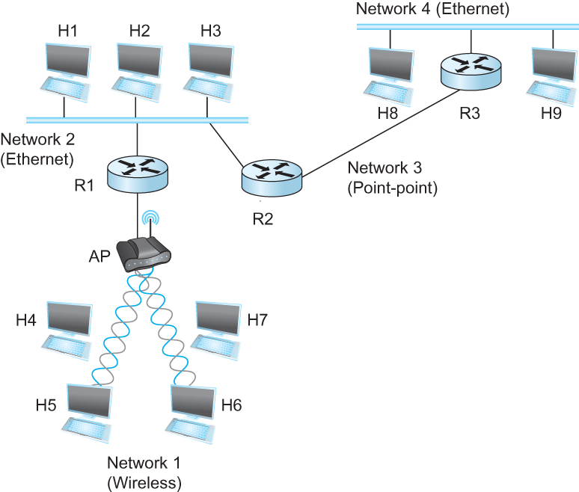
Internetworking Protocol (IP)
    What is an internetwork?
      An arbitrary collection of networks
      provide some sort of host-host to packet delivery service
Notes:
Ndn can help organizing the namespaces
Once that’s done, data discovery and provenance is
Straight forward
Retrieval, transparent failover, and specialized operations
In this work, we take a real access log and try to quantify NDN’s improvements to a climate
workflow

Slide 5

Global Address in IP – Each node has an unique address
    A 32 bit number in quad-dot notation
    Identifies an Interface
      A host might have several interfaces!!!
    129.82.138.254
    10000001.01010010.10001010.11111110
Notes:
Ndn can help organizing the namespaces
Once that’s done, data discovery and provenance is
Straight forward
Retrieval, transparent failover, and specialized operations
In this work, we take a real access log and try to quantify NDN’s improvements to a climate
workflow

Slide 6
IP addresses are in Network + Host
    1.1.2.1 →
      1.1 → Network part
      2.1 → host part
    Each octet can range from 1- 255
    Hierarchical address
1.1.2.1
5.1.6.7
1.1.2.2
1.1.*.* | Interface 3
129.82.138.254
10000001.01010010.10001010.11111110
Network part (24 bits). Host part(8 bits)
Notes:
Ndn can help organizing the namespaces
Once that’s done, data discovery and provenance is
Straight forward
Retrieval, transparent failover, and specialized operations
In this work, we take a real access log and try to quantify NDN’s improvements to a climate
workflow

Slide 7
Calculate the first and the last IP address of a subnet
129.82.138.254/27
First host - host bits 0
10000001.01010010.10001010.11111110
11111111.11111111.11111111.11100000 (LOGICAL AND)
__________________________________________________
10000001.01010010.10001010.11100000 → 129.82.138.224
Last host – host bits 1
10000001.01010010.10001010.11111110
11111111.11111111.11111111.11111111 (LOGICAL AND)
__________________________________________________
10000001.01010010.10001010.11111110 → 129.82.138.255
Perform logical AND to get the network part = 129.82.138.224
Available addresses – 129.82.138.225-129.82.138.254
Broadcast address – 129.82.138.255
Notes:
Ndn can help organizing the namespaces
Once that’s done, data discovery and provenance is
Straight forward
Retrieval, transparent failover, and specialized operations
In this work, we take a real access log and try to quantify NDN’s improvements to a climate
workflow

Slide 8
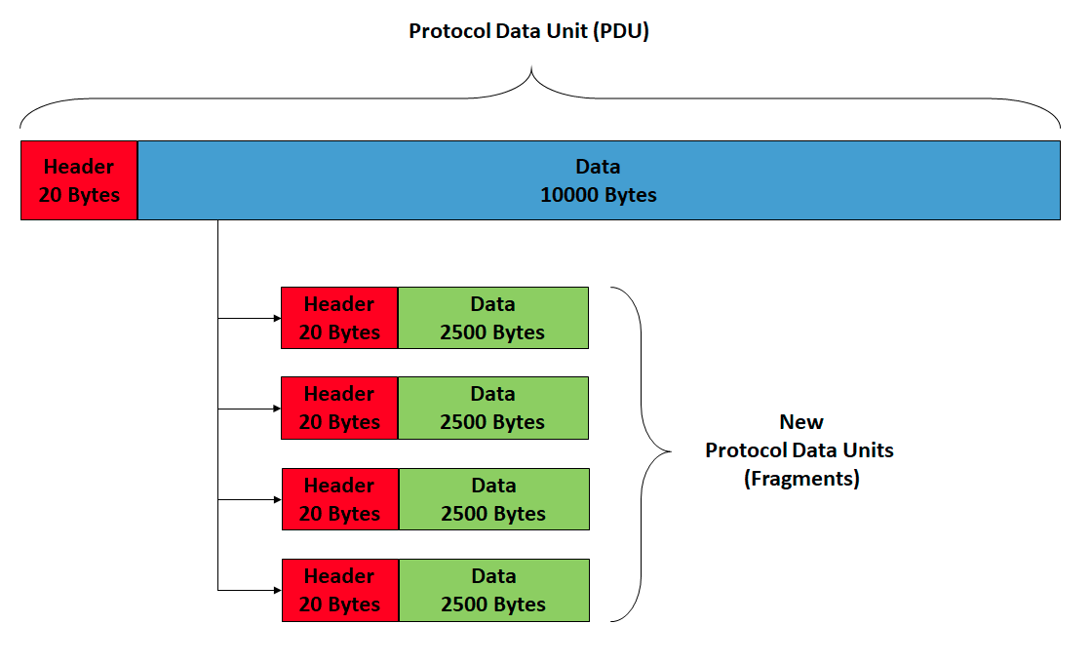
IP Fragmentation and Reassembly
wikipedia
Notes:
Ndn can help organizing the namespaces
Once that’s done, data discovery and provenance is
Straight forward
Retrieval, transparent failover, and specialized operations
In this work, we take a real access log and try to quantify NDN’s improvements to a climate
workflow

Slide 9
IP addresses are in Network + Host
    1.1.2.1 →
      1.1 → Network part
      2.1 → host part
    Each octet can range from 1- 255
    Hierarchical address
1.1.2.1
5.1.6.7
1.1.2.2
1.1.*.* | Interface 3
129.82.138.254
10000001.01010010.10001010.11111110
Network part (24 bits). Host part(8 bits)
Notes:
Ndn can help organizing the namespaces
Once that’s done, data discovery and provenance is
Straight forward
Retrieval, transparent failover, and specialized operations
In this work, we take a real access log and try to quantify NDN’s improvements to a climate
workflow

Slide 10
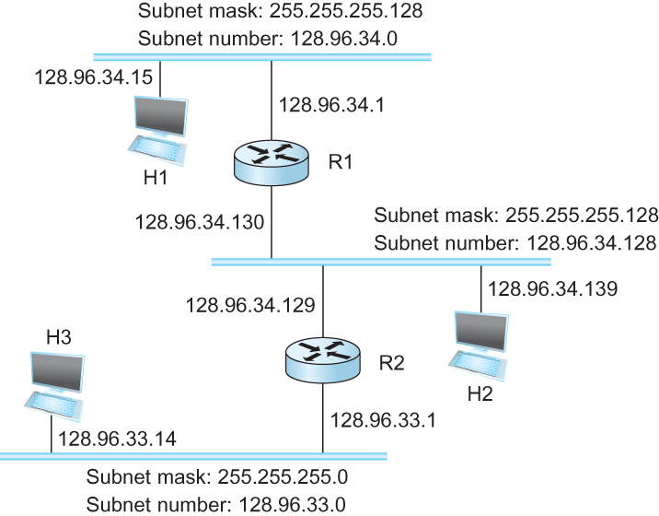

Subnetting
Forwarding Table at Router R1
Notes:
Ndn can help organizing the namespaces
Once that’s done, data discovery and provenance is
Straight forward
Retrieval, transparent failover, and specialized operations
In this work, we take a real access log and try to quantify NDN’s improvements to a climate
workflow

Slide 11
Now let’s map that to MAC address
    Adaptors only understand MAC addresses
    Source: 129.82.138.254, Destination: 129.82.138.5
    You machine does not know what that means:
      Routers for getting you to the room
      In the room, you still need to use the MAC address
    Put IP packet in a frame → Encapsulation
Notes:
Ndn can help organizing the namespaces
Once that’s done, data discovery and provenance is
Straight forward
Retrieval, transparent failover, and specialized operations
In this work, we take a real access log and try to quantify NDN’s improvements to a climate
workflow

Slide 12

IP ↔ MAC mapping: Address Resolution Protocol (ARP)
IP:57.67.92.2
MAC: 07:00:01:CD:ED:01
IP:129.92.138.254
MAC: 00:02:FF:CD:ED:01
AA:AB:00:FF:01:01
Router
00:10:03:FF:01:01
LAN 2
LAN 1
Notes:
Ndn can help organizing the namespaces
Once that’s done, data discovery and provenance is
Straight forward
Retrieval, transparent failover, and specialized operations
In this work, we take a real access log and try to quantify NDN’s improvements to a climate
workflow

Slide 13
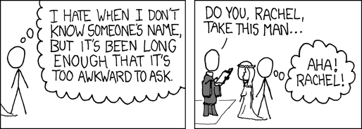
IP ↔ MAC mapping: Address Resolution Protocol (ARP)
    Important concept → Broadcast
      Shout in the room → Who here is Rachel?
Notes:
Ndn can help organizing the namespaces
Once that’s done, data discovery and provenance is
Straight forward
Retrieval, transparent failover, and specialized operations
In this work, we take a real access log and try to quantify NDN’s improvements to a climate
workflow

Slide 14

ARP table
    Important concept → Broadcast
      Shout in the room → Who here is Rachel?
Ethernet address for 129.82.138.254?
Send to : FF-FF-FF-FF-FF-FF
Everyone receives it!!
It’s me, my MAC is 00:00:22:33:01:21
Notes:
Ndn can help organizing the namespaces
Once that’s done, data discovery and provenance is
Straight forward
Retrieval, transparent failover, and specialized operations
In this work, we take a real access log and try to quantify NDN’s improvements to a climate
workflow

Slide 15
IP ↔ MAC mapping: Address Resolution Protocol (ARP)
    Every node maintains an ARP table
      <MAC, IP> mapping
    Consult this table when sending IP packets
    Encapsulate with the MAC address, send it the address
    If address is not known, broadcast!
    Cache the response for some time, and eventually forget
      Why not broadcast the IP packet?
Notes:
Ndn can help organizing the namespaces
Once that’s done, data discovery and provenance is
Straight forward
Retrieval, transparent failover, and specialized operations
In this work, we take a real access log and try to quantify NDN’s improvements to a climate
workflow

Slide 16
How does A talk to D?
A
IP:57.67.92.2
MAC: 07:00:01:CD:ED:01
IP:129.92.138.254
MAC: 00:02:FF:CD:ED:01
10:03:FF:01:01:AB
Router
D
129.92.138.1
0A:05:FD:01:01:02
IP:129.92.138.253
MAC: 00:01:FC:AA:ED:01
IP:57.67.92.2
MAC: 05:BC:01:CD:ED:05
LAN 2
LAN 1
Notes:
Ndn can help organizing the namespaces
Once that’s done, data discovery and provenance is
Straight forward
Retrieval, transparent failover, and specialized operations
In this work, we take a real access log and try to quantify NDN’s improvements to a climate
workflow

Slide 17
How does A talk to D?
IP packet:
SRC: 129.92.138.254
DST: 57.67.92.4
A
IP:57.67.92.4
MAC: 07:00:01:CD:ED:01
IP:129.92.138.254
MAC: 00:02:FF:CD:ED:01
10:03:FF:01:01:AB
Router
D
129.92.138.1
0A:05:FD:01:01:02
IP:129.92.138.253
MAC: 00:01:FC:AA:ED:01
IP:57.67.92.2
MAC: 05:BC:01:CD:ED:05
LAN 2
LAN 1
Notes:
Ndn can help organizing the namespaces
Once that’s done, data discovery and provenance is
Straight forward
Retrieval, transparent failover, and specialized operations
In this work, we take a real access log and try to quantify NDN’s improvements to a climate
workflow

Slide 18
How does A talk to D?
Send IP packet to Gateway router
SRC: 129.92.138.254
DST: 57.67.92.4
A
IP:57.67.92.4
MAC: 07:00:01:CD:ED:01
IP:129.92.138.254
MAC: 00:02:FF:CD:ED:01
10:03:FF:01:01:AB
Router
D
129.92.138.1
0A:05:FD:01:01:02
IP:129.92.138.253
MAC: 00:01:FC:AA:ED:01
IP:57.67.92.2
MAC: 05:BC:01:CD:ED:05
LAN 2
LAN 1
Notes:
Ndn can help organizing the namespaces
Once that’s done, data discovery and provenance is
Straight forward
Retrieval, transparent failover, and specialized operations
In this work, we take a real access log and try to quantify NDN’s improvements to a climate
workflow

Slide 19
How does A talk to D?
Who has 129.82.138.1?
Router: I do! Mac: 10:03:FF:01:01:AB
A
IP:57.67.92.4
MAC: 07:00:01:CD:ED:01
IP:129.92.138.254
MAC: 00:02:FF:CD:ED:01
10:03:FF:01:01:AB
Router
D
129.92.138.1
0A:05:FD:01:01:02
IP:129.92.138.253
MAC: 00:01:FC:AA:ED:01
IP:57.67.92.2
MAC: 05:BC:01:CD:ED:05
LAN 2
LAN 1
Notes:
Ndn can help organizing the namespaces
Once that’s done, data discovery and provenance is
Straight forward
Retrieval, transparent failover, and specialized operations
In this work, we take a real access log and try to quantify NDN’s improvements to a climate
workflow

Slide 20
How does A talk to D?
Encapsulate IP packet with :10:03:FF:01:01:AB
Send it to router
A
IP:57.67.92.4
MAC: 07:00:01:CD:ED:01
IP:129.92.138.254
MAC: 00:02:FF:CD:ED:01
10:03:FF:01:01:AB
Router
D
129.92.138.1
0A:05:FD:01:01:02
IP:129.92.138.253
MAC: 00:01:FC:AA:ED:01
IP:57.67.92.2
MAC: 05:BC:01:CD:ED:05
LAN 2
LAN 1
Notes:
Ndn can help organizing the namespaces
Once that’s done, data discovery and provenance is
Straight forward
Retrieval, transparent failover, and specialized operations
In this work, we take a real access log and try to quantify NDN’s improvements to a climate
workflow

Slide 21
How does A talk to D?
Router: sees it has a destination of 57.67.92.2
ARP: Who is 57.67.92.2?
D: I do, mac is : 05:BC:01:CD:ED:05
A
IP:57.67.92.4
MAC: 07:00:01:CD:ED:01
IP:129.92.138.254
MAC: 00:02:FF:CD:ED:01
10:03:FF:01:01:AB
Router
D
129.92.138.1
0A:05:FD:01:01:02
IP:129.92.138.253
MAC: 00:01:FC:AA:ED:01
IP:57.67.92.2
MAC: 05:BC:01:CD:ED:05
LAN 2
LAN 1
Notes:
Ndn can help organizing the namespaces
Once that’s done, data discovery and provenance is
Straight forward
Retrieval, transparent failover, and specialized operations
In this work, we take a real access log and try to quantify NDN’s improvements to a climate
workflow

Slide 22
How does A talk to D?
Router: encapsulates and sends it to 05:BC:01:CD:ED:05
A
IP:57.67.92.4
MAC: 07:00:01:CD:ED:01
IP:129.92.138.254
MAC: 00:02:FF:CD:ED:01
10:03:FF:01:01:AB
Router
D
129.92.138.1
0A:05:FD:01:01:02
IP:129.92.138.253
MAC: 00:01:FC:AA:ED:01
IP:57.67.92.2
MAC: 05:BC:01:CD:ED:05
LAN 2
LAN 1
Notes:
Ndn can help organizing the namespaces
Once that’s done, data discovery and provenance is
Straight forward
Retrieval, transparent failover, and specialized operations
In this work, we take a real access log and try to quantify NDN’s improvements to a climate
workflow

Slide 23

Subnets Revisited
223.1.1.0/24
223.1.2.0/24
recipe
to determine the subnets, detach each interface from its host or router, creating islands of isolated networks
each isolated network is called a subnet
223.1.1.1
223.1.1.2
223.1.2.1
223.1.1.4
223.1.2.9
223.1.2.2
223.1.1.3
223.1.3.27
subnet
223.1.3.1
223.1.3.2
223.1.3.0/24
subnet mask: /24
Network Layer
4-<number>

Slide 24
IP addresses are in Network + Host
    1.1.2.1 →
      1.1 → Network part
      2.1 → host part
    Each octet can range from 1- 255
    Hierarchical address
1.1.2.1
5.1.6.7
1.1.2.2
1.1.*.* | Interface 3
129.82.138.254
10000001.01010010.10001010.11111110
Network part (24 bits). Host part(8 bits)
Notes:
Ndn can help organizing the namespaces
Once that’s done, data discovery and provenance is
Straight forward
Retrieval, transparent failover, and specialized operations
In this work, we take a real access log and try to quantify NDN’s improvements to a climate
workflow

Slide 25
Calculate the first and the last IP address of a subnet
129.82.138.254/27
First host - host bits 0
10000001.01010010.10001010.11111110
11111111.11111111.11111111.11100000 (LOGICAL AND)
__________________________________________________
10000001.01010010.10001010.11100000 → 129.82.138.224
Last host – host bits 1
10000001.01010010.10001010.11111110
11111111.11111111.11111111.11111111 (LOGICAL AND)
__________________________________________________
10000001.01010010.10001010.11111110 → 129.82.138.255
Perform logical AND to get the network part = 129.82.138.224
Available addresses – 129.82.138.225-129.82.138.254
Broadcast address – 129.82.138.255
Notes:
Ndn can help organizing the namespaces
Once that’s done, data discovery and provenance is
Straight forward
Retrieval, transparent failover, and specialized operations
In this work, we take a real access log and try to quantify NDN’s improvements to a climate
workflow

Slide 26
Problem
192.168.123.192
192.168.123.0
192.168.123.128
You have an address block:
192.168.123.0/24
  CSC needs 50 addresses
  Library needs 50
  Math needs 50
  ME needs 50
They can not overlap!
Borrow some bits from the host part.
24 bits - 1111111.11111111.1111111.00000000
2 bits for network – 1111111.11111111.1111111.11000000
How many networks?
How many hosts in each of these networks?
subnet
192.168.123.192
subnet mask: /26

Slide 27
DHCP
New laptop joins a network
  Does not have source address
  Does not know who to ask
  Does not know other network parameters like DNS or Gateway router information
Notes:
Ndn can help organizing the namespaces
Once that’s done, data discovery and provenance is
Straight forward
Retrieval, transparent failover, and specialized operations
In this work, we take a real access log and try to quantify NDN’s improvements to a climate
workflow

Slide 28


DHCP client-server scenario
DHCP server: 223.1.2.5
DHCP discover
arriving
client
src : 0.0.0.0, 68
dest.: 255.255.255.255,67
yiaddr: 0.0.0.0
transaction ID: 654
Broadcast: is there a DHCP server out there?
DHCP offer
src: 223.1.2.5, 67
dest: 255.255.255.255, 68
yiaddrr: 223.1.2.4
transaction ID: 654
lifetime: 3600 secs
Broadcast: I’m a DHCP server! Here’s an IP address you can use
DHCP request
src: 0.0.0.0, 68
dest:: 255.255.255.255, 67
yiaddrr: 223.1.2.4
transaction ID: 655
lifetime: 3600 secs
Broadcast: OK. I’ll take that IP address!
DHCP ACK
kurose/ross
src: 223.1.2.5, 67
dest: 255.255.255.255, 68
yiaddrr: 223.1.2.4
transaction ID: 655
lifetime: 3600 secs
Broadcast: OK. You’ve got that IP address!

Slide 29
DHCP Server
A local central database with a list of IP addresses
  10.0.0.1/8
Offers an available IP to a client for a period of time
  Lease time – 24 hours, 1 hour, configurable ← Soft State
Multiple servers might coexist and offer IP to the same request
  Broadcast medium
  Client decides which one to accept
Notes:
Ndn can help organizing the namespaces
Once that’s done, data discovery and provenance is
Straight forward
Retrieval, transparent failover, and specialized operations
In this work, we take a real access log and try to quantify NDN’s improvements to a climate
workflow

Slide 30
DHCP Client – Keep refreshing!
IP address provided expires after time t
Client can release DHCP lease
  Shutdown the laptop
If you walk away from the building
  Crash
Performance trade off
  Short time – too many broadcasts, quick recovery of addresses
  Long time – less network traffic, longer recovery of addresses
Notes:
Ndn can help organizing the namespaces
Once that’s done, data discovery and provenance is
Straight forward
Retrieval, transparent failover, and specialized operations
In this work, we take a real access log and try to quantify NDN’s improvements to a climate
workflow

Slide 31
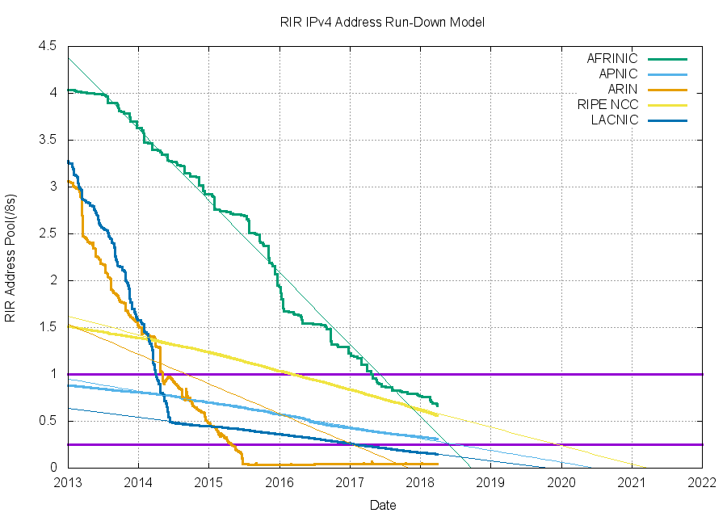
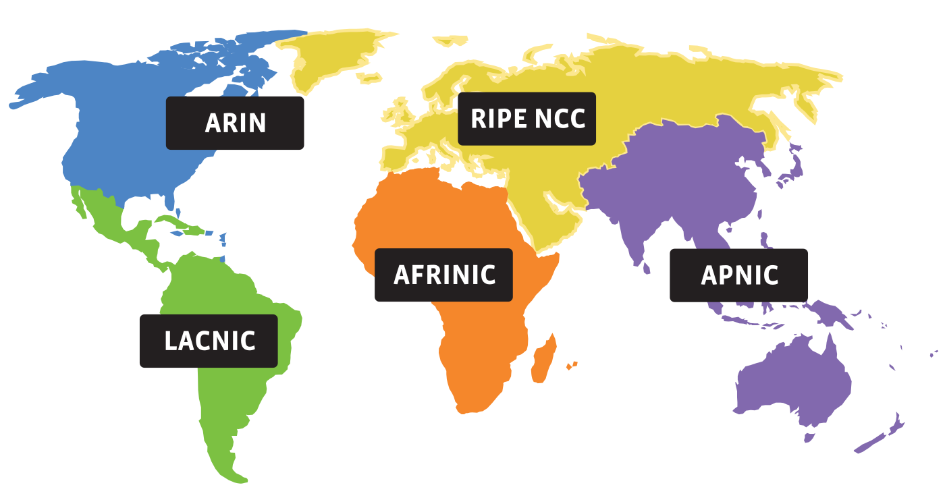
Address shortage
IPv4 – 32 bits – Around 4 billion
Notes:
Ndn can help organizing the namespaces
Once that’s done, data discovery and provenance is
Straight forward
Retrieval, transparent failover, and specialized operations
In this work, we take a real access log and try to quantify NDN’s improvements to a climate
workflow

Slide 32
NAT: network address translation
rest of
Internet
local network
(e.g., home network)
10.0.0/24
10.0.0.1
10.0.0.4
10.0.0.2
138.76.29.7
10.0.0.3
datagrams with source or
destination in this network
have 10.0.0/24 address for
source, destination (as usual)
Notes:
Ndn can help organizing the namespaces
Once that’s done, data discovery and provenance is
Straight forward
Retrieval, transparent failover, and specialized operations
In this work, we take a real access log and try to quantify NDN’s improvements to a climate
workflow

Slide 33
NAT: Network Address Translation
rest of
Internet
local network
(e.g., home network)
10.0.0/24
10.0.0.1
10.0.0.4
10.0.0.2
138.76.29.7
10.0.0.3
datagrams with source or
destination in this network
have 10.0.0/24 address for
source, destination (as usual)
Notes:
Ndn can help organizing the namespaces
Once that’s done, data discovery and provenance is
Straight forward
Retrieval, transparent failover, and specialized operations
In this work, we take a real access log and try to quantify NDN’s improvements to a climate
workflow

Slide 34
NAT: network address translation
NAT translation table
WAN side addr LAN side addr
2: NAT router
changes datagram
source addr from
10.0.0.1, 3345 to
138.76.29.7, 5001,
updates table
1: host 10.0.0.1
sends datagram to
128.119.40.186, 80
138.76.29.7, 5001 10.0.0.1, 3345
…… ……
S: 10.0.0.1, 3345
D: 128.119.40.186, 80
10.0.0.1
1
2
S: 138.76.29.7, 5001
D: 128.119.40.186, 80
10.0.0.4
10.0.0.2
138.76.29.7
S: 128.119.40.186, 80
D: 10.0.0.1, 3345
4
S: 128.119.40.186, 80
D: 138.76.29.7, 5001
3
4: NAT router
changes datagram
dest addr from
138.76.29.7, 5001 to 10.0.0.1, 3345
10.0.0.3
3: reply arrives
dest. address:
138.76.29.7, 5001
Kurose/Ross

Slide 35
NAT
One IP address for all devices
  Addresses the address space problem
Can change local addresses without involving the ISP
NAT traversal problem
  Is a server is behind NAT, how does
  the client talk to it?
10.0.0.1
client
?
10.0.0.4
138.76.29.7
NAT
router
Notes:
Ndn can help organizing the namespaces
Once that’s done, data discovery and provenance is
Straight forward
Retrieval, transparent failover, and specialized operations
In this work, we take a real access log and try to quantify NDN’s improvements to a climate
workflow

Slide 36
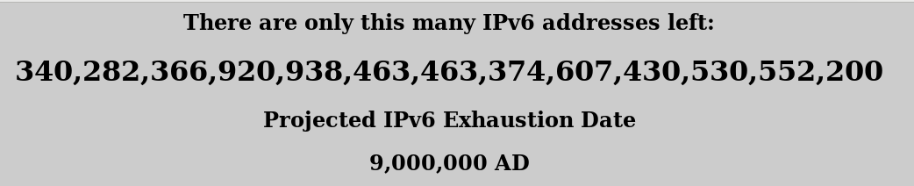
Address shortage – Better solution? IPv6
https://samsclass.info/ipv6/exhaustion-2016.htm
IPv4 – 128 bits
Notes:
Ndn can help organizing the namespaces
Once that’s done, data discovery and provenance is
Straight forward
Retrieval, transparent failover, and specialized operations
In this work, we take a real access log and try to quantify NDN’s improvements to a climate
workflow

Slide 37
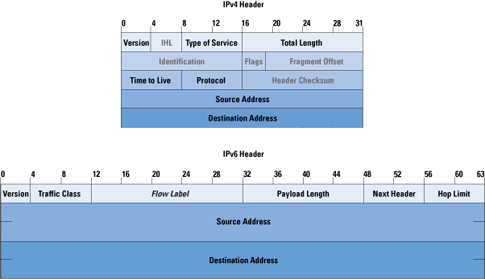
Address shortage – Better solution? IPv6
https://samsclass.info/ipv6/exhaustion-2016.htm
IPv4 – 128 bits
Notes:
Ndn can help organizing the namespaces
Once that’s done, data discovery and provenance is
Straight forward
Retrieval, transparent failover, and specialized operations
In this work, we take a real access log and try to quantify NDN’s improvements to a climate
workflow

Slide 38



Address shortage – Better solution?
Get rid of the Addresses!
Next generation of the Internet
You don’t care about the hosts anyway
  For most part
Why not ask for content directly?
  Information Centric Networking (ICN)
ICN
(name based forwarding)
Interest
(/google/index.html)
Data
(/google)
Notes:
Ndn can help organizing the namespaces
Once that’s done, data discovery and provenance is
Straight forward
Retrieval, transparent failover, and specialized operations
In this work, we take a real access log and try to quantify NDN’s improvements to a climate
workflow

Slide 39
ICMP: Internet Control Message Protocol
Errors in network:
  Router does not know how to forward a packet
  Packet is broken
IP is best effort
  Can silently drop packets
How would be ever know something is wrong?
  Feedback about the problem
  ICMP

Slide 40
ICMP: Internet Control Message Protocol
Used for
  error reporting: unreachable host, network, port, protocol
  echo request/reply (used by ping)
Application at network-layer
  ICMP msgs carried in IP datagrams
  Essentially at application layer
  Considered part of IP
Type Code description
0 0 echo reply (ping)
3 0 dest. network unreachable
3 1 dest host unreachable
3 2 dest protocol unreachable
3 3 dest port unreachable
3 6 dest network unknown
3 7 dest host unknown
4 0 source quench (congestion
control - not used)
8 0 echo request (ping)
9 0 route advertisement
10 0 router discovery
11 0 TTL expired
12 0 bad IP header
Network Layer
4-<number>

Slide 41
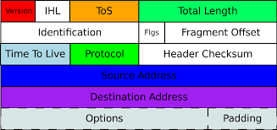
ICMP and Time to Live
Each time a host sends a packet it sets the TTL field
Each router that forwards it decrements the number
When TTL reaches 0, send a time exceeded message
TTL=3
TTL=1
TTL=2
TTL=0

Slide 42
Traceroute and ICMP
source sends series of UDP segments to dest
  first set has TTL =1
  second set has TTL=2, etc.
  unlikely port number
when nth set of datagrams arrives to nth router:
  router discards datagrams
  and sends source ICMP messages (type 11, code 0)
  ICMP messages includes name of router & IP address
when ICMP messages arrives, source records RTTs
stopping criteria:
UDP segment eventually arrives at destination host
destination returns ICMP “port unreachable” message (type 3, code 3)
source stops
3 probes
3 probes
3 probes

Slide 43
Ping and ICMP
source sends an ICMP echo message
Destination sends an ICMP echo reply
ICMP echo message
ICMP echo reply

Slide 44
Apps (HTTP)
Data
Apps (HTTP)
Segments
Transport (TCP/UDP)
Transport (TCP/UDP)
Network (IP)
Packets
Network (IP)
Link (Ethernet)
Frames
Link (Ethernet)
Ethernet Interface
Ethernet Interface
Bits (1010001)

Slide 45
Tying it all together in the network layer
Internetworking Protocol (IP)

Slide 46




Tying it all together in the network layer
SRC | cccc
DST | aaaa
Encapsulate IP packet in an Ethernet frame!
SRC | 2.2.2.2
DST | 5.5.5.5
SRC | 2.2.2.2
DST | 5.5.5.5
Youtube
5.5.5.5
Ether: dddd
L1H1
2.2.2.2
Ether: cccc
Gateway: I do! Ethernet address: aaaa
Your address:2.2.2.2
Gateway: 2.2.2.1
Iface 1:
2.2.2.1
Ether: aaaa
Iface 2:
5.5.5.1
Ether: bbbb
DHCP
server
SRC | 2.2.2.2
DST | 5.5.5.5
Routing Table
5.5.5.0/8 | IF: 2
2.2.2.0/8 | IF: 1
DST in another network. send it to the gateway. gateway address 2.2.2.1 ARP: WHO HAS 2.2.2.1?
Decapsulate IP packet

Slide 47
Tying it all together in the network layer
SRC | 2.2.2.2
DST | 5.5.5.5
SRC | bbbb
DST | dddd
Decapsulate IP packet
L1H1
2.2.2.2
Ether: cccc
SRC | 2.2.2.2
DST | 5.5.5.5
SRC | 2.2.2.2
DST | 5.5.5.5
Youtube
5.5.5.5
Ether: dddd
ARP: WHO HAS 5.5.5.5?
youtube: I do! Ethernet address: dddd
Iface 1:
2.2.2.1
Ether: aaaa
Iface 2:
5.5.5.1
Ether: bbbb
DHCP
server
SRC | 2.2.2.2
DST | 5.5.5.5
Routing Table
5.5.5.0/8 | IF: 2
2.2.2.0/8 | IF: 1

Slide 48
Next Steps
Wait - how are the routing tables populated?
Read through chapter 3.2.
Very useful video: https://www.youtube.com/watch?v=rYodcvhh7b8
Notes:
Ndn can help organizing the namespaces
Once that’s done, data discovery and provenance is
Straight forward
Retrieval, transparent failover, and specialized operations
In this work, we take a real access log and try to quantify NDN’s improvements to a climate
workflow

