Slide 1
CSC4200/5200 – Computer Networking
Routing - Continued
Instructor: Susmit Shannigrahi
sshannigrahi@tntech.edu
GTA: dereddick42@students.tntech.edu

Slide 2

Apps (HTTP)
Data
Apps (HTTP)
Segments
Transport (TCP/UDP)
Transport (TCP/UDP)
Network (IP)
Packets
Network (IP)
Link (Ethernet)
Frames
Link (Ethernet)
Ethernet Interface
Ethernet Interface
Bits (1010001)

Slide 3
So far...
Midterm → 10/11 → 1:15 to 2:30. Location: Still TBA
  Chapter 1 – 3 (Up to page 164 in the Ebook)
  Pay attention to why and how, rather than memorizing
Routing – Link state
Notes:
Ndn can help organizing the namespaces
Once that’s done, data discovery and provenance is
Straight forward
Retrieval, transparent failover, and specialized operations
In this work, we take a real access log and try to quantify NDN’s improvements to a climate
workflow

Slide 4




Tying it all together in the network layer
SRC | 2.2.2.2
DST | 5.5.5.5
SRC | bbbb
DST | dddd
Decapsulate IP packet
L1H1
2.2.2.2
Ether: cccc
SRC | 2.2.2.2
DST | 5.5.5.5
SRC | 2.2.2.2
DST | 5.5.5.5
Youtube
5.5.5.5
Ether: dddd
ARP: WHO HAS 5.5.5.5?
youtube: I do! Ethernet address: dddd
Iface 1:
2.2.2.1
Ether: aaaa
Iface 2:
5.5.5.1
Ether: bbbb
DHCP
server
SRC | 2.2.2.2
DST | 5.5.5.5
Routing Table
5.5.5.0/8 | IF: 2
2.2.2.0/8 | IF: 1
We are populating this!!!

Slide 5

Why bother?
5
v
3
w
2
5
Quality of path affects performance
  Longer path = more delay
Balance path usage, avoid congested paths
Deal with failures
u
2
1
z
3
1
2
x
y
1
Notes:
Ndn can help organizing the namespaces
Once that’s done, data discovery and provenance is
Straight forward
Retrieval, transparent failover, and specialized operations
In this work, we take a real access log and try to quantify NDN’s improvements to a climate
workflow

Slide 6
Dijsktra’s Algorithm
1 Initialization:
2 N' = {u}
3 for all nodes v
4 if v adjacent to u
5 then D(v) = c(u,v)
6 else D(v) = ∞
7
8 Loop
9 find w not in N' such that D(w) is a minimum
10 add w to N'
11 update D(v) for all v adjacent to w and not in N' :
12 D(v) = min( D(v), D(w) + c(w,v) )
13 /* new cost to v is either old cost to v or known
14 shortest path cost to w plus cost from w to v */
15 until all nodes in N'

Slide 7
Dijkstra’s algorithm: example
D(v)
p(v)
D(w)
p(w)
D(x)
p(x)
D(y)
p(y)
D(z)
p(z)
Step
N'
0
u
7,u
3,u
5,u
∞
∞
1
uw
6,w
5,u
11,w
∞
2
uwx
6,w
11,w
14,x
uwxv
10,v
14,x
x
3
9
4
uwxvy
12,y
5
uwxvyz
5
7
4
8
notes:
construct shortest path tree by tracing predecessor nodes
ties can exist (can be broken arbitrarily)
u
3
w
y
z
2
3
7
4
v
Kurose/ross

Slide 8
Dijsktra’s Algorithm usage→ Link State Routing
5
Each node keeps track of adjacent links
Each router broadcasts it’s state
Each router runs Dijkstra’s algorithm
Each router has complete picture of the network
Example: Open Shortest Path First (OSPF)
v
3
w
2
5
u
2
1
z
3
1
x
2
1
y

Slide 9
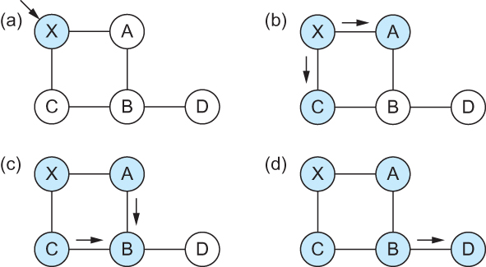
Link State Routing – controlled flooding
Flooding of link-state packets. (a) LSP arrives at node X; (b) X floods LSP to A and C; (c) A and C flood LSP to B (but not X); (d) flooding is complete

Slide 10
Link State Routing – controlled flooding
Flood when topology changes or link goes down
  Detected by periodic hello messages
  If message missed → link down
Refresh and flood periodically
Problems?
  High computational cost
  Reliable flooding may not be reliable

Slide 11
Apps (HTTP)
Data
Apps (HTTP)
Segments
Transport (TCP/UDP)
Transport (TCP/UDP)
Network (IP)
Packets
Network (IP)
Link (Ethernet)
Frames
Link (Ethernet)
Ethernet Interface
Ethernet Interface
Bits (1010001)

Slide 12
Next Steps
Homework 1 and 2 review
Programming assignment 1 review
Distance vector
Monday – Midterm review!!!!
Notes:
Ndn can help organizing the namespaces
Once that’s done, data discovery and provenance is
Straight forward
Retrieval, transparent failover, and specialized operations
In this work, we take a real access log and try to quantify NDN’s improvements to a climate
workflow

