Slide 1
CSC4200/5200 – Computer Networking
Global Internet
Instructor: Susmit Shannigrahi
sshannigrahi@tntech.edu
GTA: dereddick42@students.tntech.edu

Slide 2

Apps (HTTP)
Data
Apps (HTTP)
Segments
Transport (TCP/UDP)
Transport (TCP/UDP)
Network (IP)
Packets
Network (IP)
Link (Ethernet)
Frames
Link (Ethernet)
Ethernet Interface
Ethernet Interface
Bits (1010001)

Slide 3
So far...
Routing
How do we scale routing?
Notes:
Ndn can help organizing the namespaces
Once that’s done, data discovery and provenance is
Straight forward
Retrieval, transparent failover, and specialized operations
In this work, we take a real access log and try to quantify NDN’s improvements to a climate
workflow

Slide 4

Back to Addressing
    A 32 bit number in quad-dot notation
    Identifies an Interface
      A host might have several interfaces!!!
    129.82.138.254
    10000001.01010010.10001010.11111110
Notes:
Ndn can help organizing the namespaces
Once that’s done, data discovery and provenance is
Straight forward
Retrieval, transparent failover, and specialized operations
In this work, we take a real access log and try to quantify NDN’s improvements to a climate
workflow

Slide 5

Subnets Revisited
223.1.1.0/24
223.1.2.0/24
Recipe:
Create isolated networks – subnets
No longer need to know
individual Ips – knowing
the subnet is enough
  223.1.1.0/14 → Interface 2
223.1.1.1
223.1.1.2
223.1.2.1
223.1.1.4
223.1.2.9
223.1.2.2
223.1.1.3
223.1.3.27
subnet
223.1.3.1
223.1.3.2
223.1.3.0/24
subnet mask: /24

Slide 6
Subnets – Class based
Originally – only rigid boundaries
  Class A – 5.0.0.0/8 - 0*
  Class B – 149.149.0.0/16 - 10*
  Class C – 129.82.138.0/14 - 110*
  Class D – 224.0.0.0 – 1110*
  Class E - reserved

Slide 7
Subnets – Classless CIDR
No rigid boundaries
  129.82.138.0/25
  10000001.01010010.10001010.10000000

Slide 8

Subnets (Prefixes) scales the Internet
Addresses are allocated in contiguous prefixes (tntech 149.149.0.0/16)
Routing protocols operate based on prefixes (how do I reach 149.149.0.0/16)?
149.149.5.0/24
149.149.6.0/24
149.149.7.0/24
149.149.0.0/16
.
.
.
.
.
149.160.0.0/16
149.0.0.0/8
Internet
How do I reach
149.0.0.0/8?
Not
How do I reach 149.149.5.0/24
How do I reach 149.149.6.0/24
149.160.0.0/17
149.160.128.0/17

Slide 9
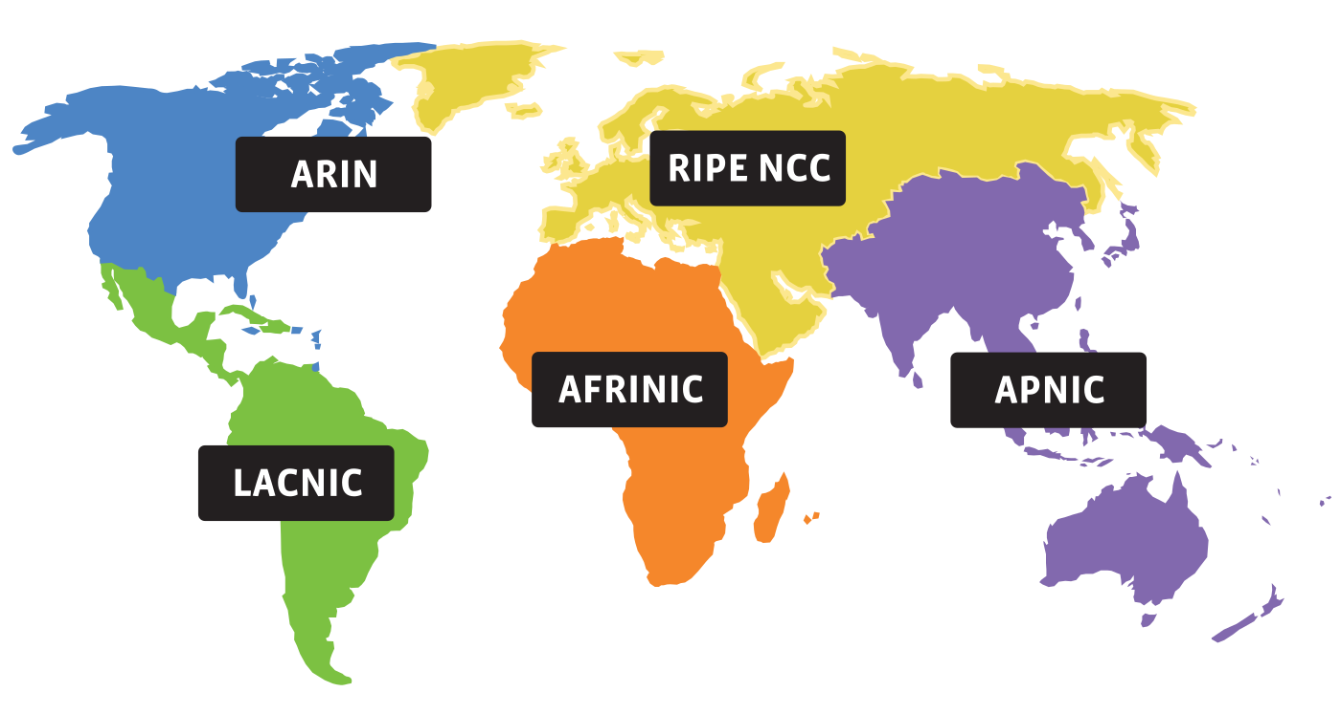
Who gets what prefix?
0. Internet Corporation for Assigned Names and Numbers (ICANN) – Decides which RIRs get what address
1. Regional Internet Registries (RIRs) – Which orgs get what address
2. ISPs – Which customers get which address
Notes:
Ndn can help organizing the namespaces
Once that’s done, data discovery and provenance is
Straight forward
Retrieval, transparent failover, and specialized operations
In this work, we take a real access log and try to quantify NDN’s improvements to a climate
workflow

Slide 10
How do you know who has a prefix?
whois
whois tntech.edu
Domain Name: TNTECH.EDU
Registrant:
Tennessee Technological University
Information Technology Service
1010 N. Peachtree Street
Cookeville, TN 38505
USA
Domain record activated: 09-Sep-1992
Domain record last updated: 26-Sep-2019
Domain expires: 31-Jul-2020

Slide 11
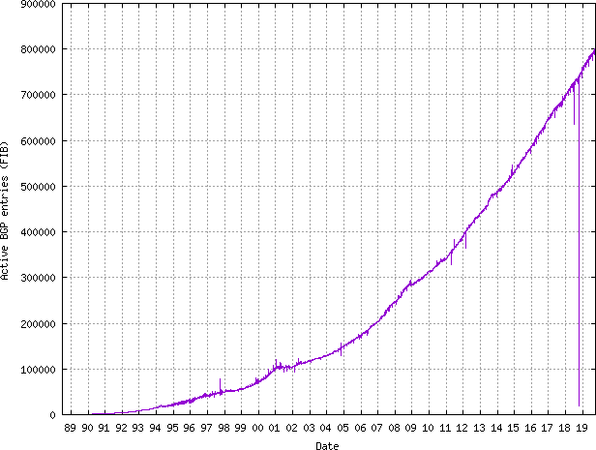
How many prefixes are there?
https://www.cidr-report.org/
100K in 2001 → 800K in 2019

Slide 12
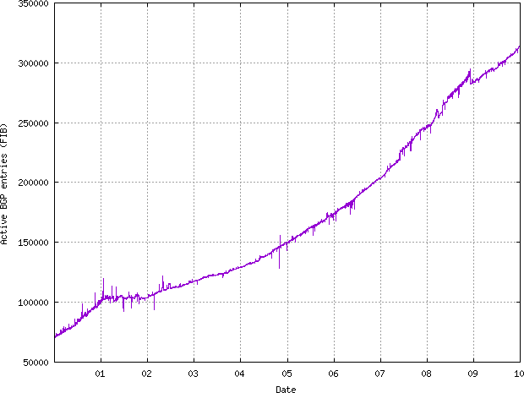
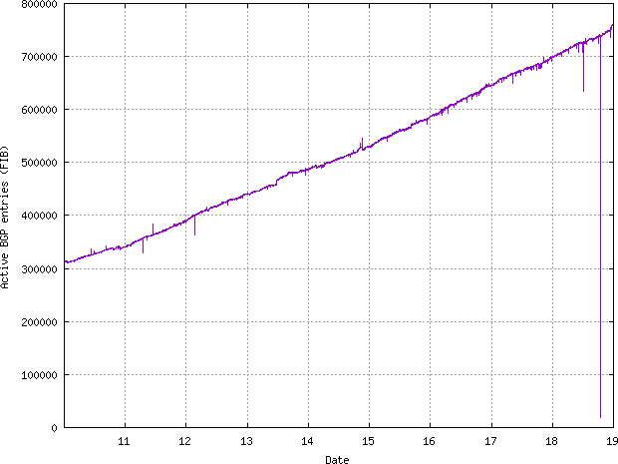
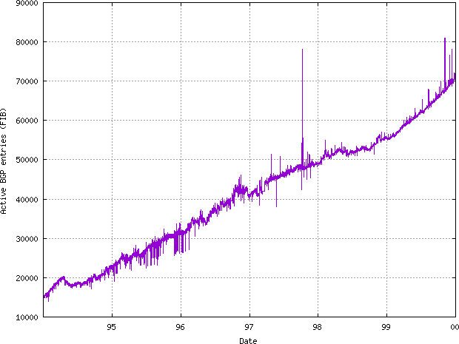
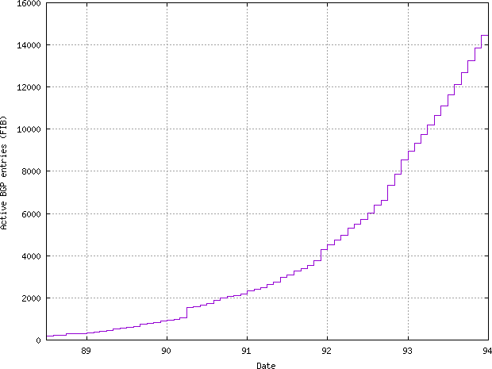
Bit of history – how the Internet evolved
‘88-’94 - 0 → 14000
‘94-’00 – 90000 – Linear growth
’00-’10 – up to 300,000
’10-’19 – up to 800,000

Slide 13
Next steps
Monday – Midterm review and Solutions to homework 3
Homework due on the 6^{th,} Sunday, 10PM CST
More on Internet routing and policies.
Notes:
Ndn can help organizing the namespaces
Once that’s done, data discovery and provenance is
Straight forward
Retrieval, transparent failover, and specialized operations
In this work, we take a real access log and try to quantify NDN’s improvements to a climate
workflow

