Slide 1
CSC4200/5200 – Computer Networking
Global Internet
Instructor: Susmit Shannigrahi
sshannigrahi@tntech.edu
GTA: dereddick42@students.tntech.edu

Slide 2

Apps (HTTP)
Data
Apps (HTTP)
Segments
Transport (TCP/UDP)
Transport (TCP/UDP)
Network (IP)
Packets
Network (IP)
Link (Ethernet)
Frames
Link (Ethernet)
Ethernet Interface
Ethernet Interface
Bits (1010001)

Slide 3
So far...
Routing
How do we scale routing?
Notes:
Ndn can help organizing the namespaces
Once that’s done, data discovery and provenance is
Straight forward
Retrieval, transparent failover, and specialized operations
In this work, we take a real access log and try to quantify NDN’s improvements to a climate
workflow

Slide 4
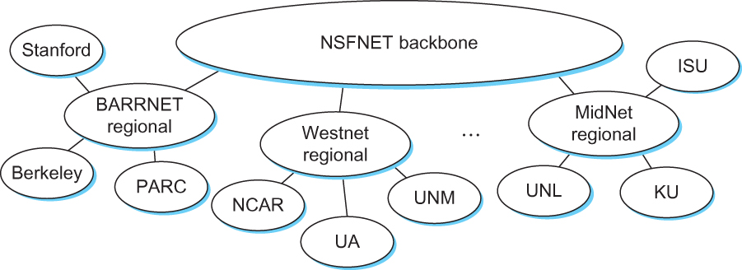
Internet in the 1990s
Notes:
Ndn can help organizing the namespaces
Once that’s done, data discovery and provenance is
Straight forward
Retrieval, transparent failover, and specialized operations
In this work, we take a real access log and try to quantify NDN’s improvements to a climate
workflow

Slide 5
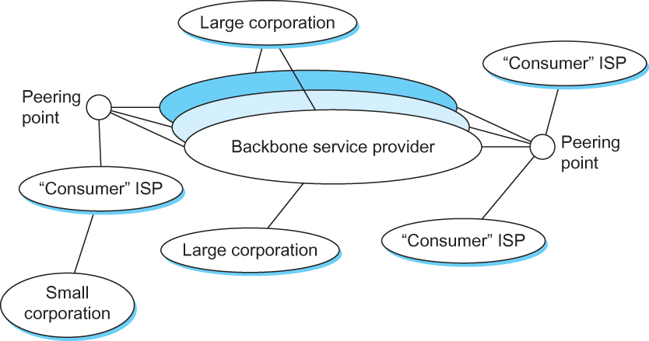
Internet now
Notes:
Ndn can help organizing the namespaces
Once that’s done, data discovery and provenance is
Straight forward
Retrieval, transparent failover, and specialized operations
In this work, we take a real access log and try to quantify NDN’s improvements to a climate
workflow

Slide 6
Hierarchical routing - Policy
scale: with 600 million destinations:
can’t store all dest’s in routing tables!
routing table exchange would swamp links!
administrative autonomy
internet = network of networks
each network admin may want to control routing in its own network

Slide 7
Autonomous systems (ASes)
AS
  A set of routers under a single technical administration
  Uses IGP within the AS to route packets
  Uses BGP between Ases to route packets
What happens inside an AS stays within that AS!
  That is, AS decides routing metrics internally
Notes:
Ndn can help organizing the namespaces
Once that’s done, data discovery and provenance is
Straight forward
Retrieval, transparent failover, and specialized operations
In this work, we take a real access log and try to quantify NDN’s improvements to a climate
workflow

Slide 8
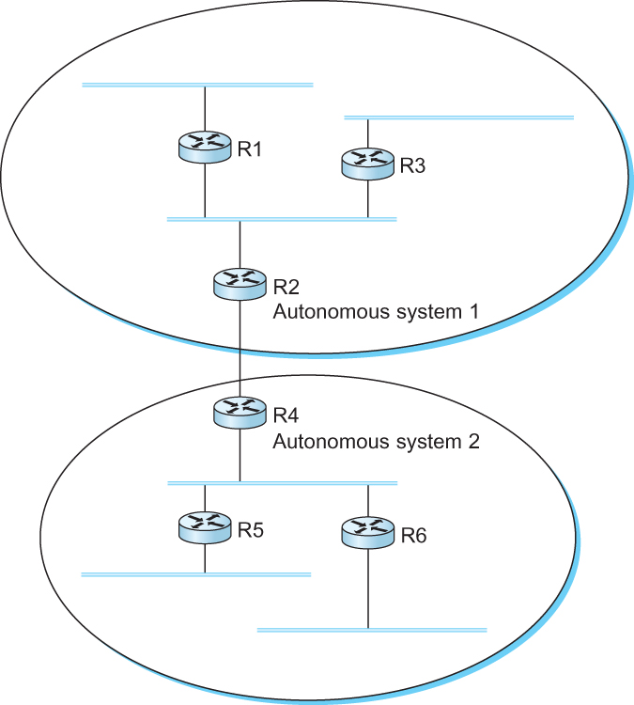
Interdomain Routing
IGP
Interior gateway protocol
IGP
Interior gateway protocol
BGP
Border gateway protocol
IGP
Interior gateway protocol
IGP
Interior gateway protocol
A network with four autonomous systems

Slide 9
BGP-4: Border Gateway Protocol
Assumes the Internet is an arbitrarily interconnected set of AS's.
Local traffic – within the AS
Transit traffic – from AS1 to AS3 via AS2
Three types of AS’s
  Stub AS
  Multihomed AS
  Transit AS

Slide 10
BGP-4: Border Gateway Protocol
IGP
Interior gateway protocol
R7
Stub AS
R3 Will not carry traffic between R2 and R1
R6
Transit AS
R3
Multihomed
AS
R6 Will carry traffic between R2 and R7
R5
Stub AS

Slide 11
BGP: Which routing protocol?
Link state?
Does not scale
you can have loops
exposes routing costs to others
Distance vector?
Slow to converge, count-to-infinity
No universal metrics

Slide 12
BGP - goals
The goal of Inter-domain routing is to find any path to the intended destination that is loop free
  We are concerned with reachability than optimality
  Finding path anywhere close to optimal is considered to be a great achievement
Why?

Slide 13
BGP - Goals
Scalability: Forward any packet destined anywhere in the Internet
  Having a routing table that will provide a match for any valid IP address
Autonomous nature of the domains
  impossible to calculate meaningful costs for a path crossing multiple ASs
  A cost of 1000 is great at provider 1, terrible at provider 2
Issues of trust
  Provider A might be unwilling to believe certain advertisements from provider B

Slide 14
BGP: Path vector protocol
Send the whole path with the routing update
Loops are detected if an AS finds itself in the path
  Reject if so
  Accept otherwise
Add self to the path and advertise to the neighbors
Advantage: No loops, Local decision before advertizing

Slide 15
BGP: Path vector protocol
Send the whole path with the routing update
Loops are detected if an AS finds itself in the path
  Reject if so
  Accept otherwise
Add self to the path and advertise to the neighbors
Advantage: No loops, Local decision before advertising

Slide 16
BGP: Path vector protocol
Loop!
Path: AS 223, AS 225, AS 245, AS 7770
Path: AS 223, AS 225, AS 245, AS 7770
AS 7770
AS 223
AS 225
Path: AS 223
Path: AS 223, AS 225
AS 245
Path: AS 223, AS 225, AS 245

Slide 17
BGP: Interconnections
Uses TCP port 179 to connect to peers
Arbitrary connections between AS’s
Advantages:
  Much simpler, no periodic update
  Valid as long as TCP connection is valid (or withdrawn)
  Incremental update (only a portion of the routing table)
Disadvantages:
  No security
  Congestion control on routing messages

Slide 18
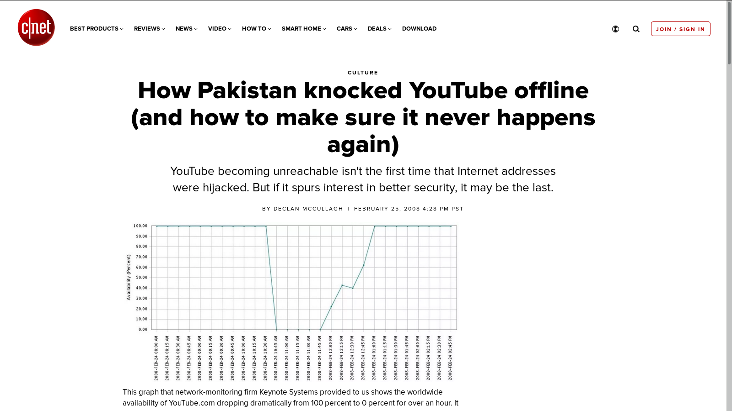
BGP: Security problems
Anyone can advertise
anything!!!

Slide 19
BGP: Hop by Hop model
You can only tell others what you are using
  But you control what you say
BGP advertises only to peers
  Tell them what you are using
  Hop-by-hop model

Slide 20
BGP: Allows for policy
Capable of enforcing various policies
  AS2 → Don’t use AS1 to get to AS3
Not part of BGP – configuration information that controls propagation of paths

Slide 21
Next steps
How does BGP enforce policies?

