Slide 1
CSC4200/5200 – Computer Networking
BGP - Continued
Instructor: Susmit Shannigrahi
sshannigrahi@tntech.edu
GTA: dereddick42@students.tntech.edu

Slide 2

Apps (HTTP)
Data
Apps (HTTP)
Segments
Transport (TCP/UDP)
Transport (TCP/UDP)
Network (IP)
Packets
Network (IP)
Link (Ethernet)
Frames
Link (Ethernet)
Ethernet Interface
Ethernet Interface
Bits (1010001)

Slide 3
So far...
Routing
How do we scale routing?
Notes:
Ndn can help organizing the namespaces
Once that’s done, data discovery and provenance is
Straight forward
Retrieval, transparent failover, and specialized operations
In this work, we take a real access log and try to quantify NDN’s improvements to a climate
workflow

Slide 4
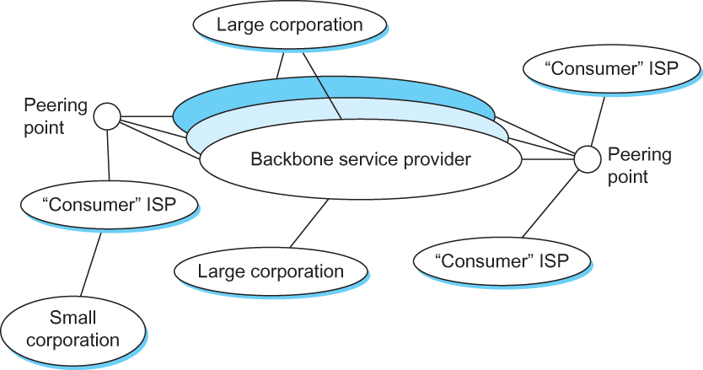
Internet now
Notes:
Ndn can help organizing the namespaces
Once that’s done, data discovery and provenance is
Straight forward
Retrieval, transparent failover, and specialized operations
In this work, we take a real access log and try to quantify NDN’s improvements to a climate
workflow

Slide 5
Hierarchical routing - Policy
scale: with 600 million destinations:
can’t store all dest’s in routing tables!
routing table exchange would swamp links!
administrative autonomy
internet = network of networks
each network admin may want to control routing in its own network

Slide 6
Autonomous systems (ASes)
AS
  A set of routers under a single technical administration
  Uses IGP within the AS to route packets
  Uses BGP between Ases to route packets
What happens inside an AS stays within that AS!
  That is, AS decides routing metrics internally
Notes:
Ndn can help organizing the namespaces
Once that’s done, data discovery and provenance is
Straight forward
Retrieval, transparent failover, and specialized operations
In this work, we take a real access log and try to quantify NDN’s improvements to a climate
workflow

Slide 7
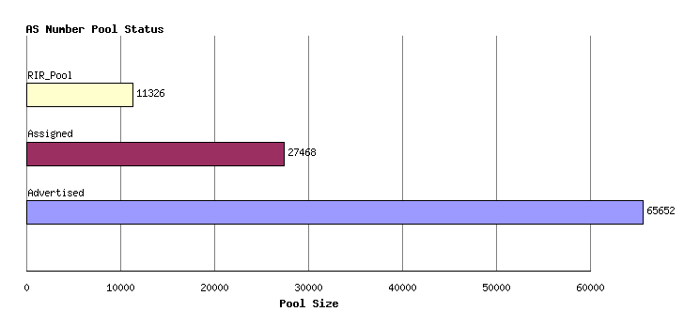
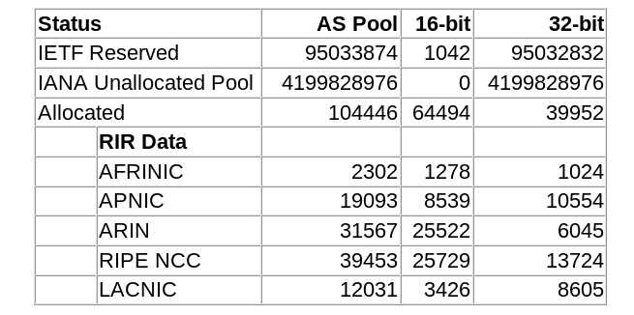
Status of ASNs
http://www.potaroo.net/tools/asn32/
Notes:
Ndn can help organizing the namespaces
Once that’s done, data discovery and provenance is
Straight forward
Retrieval, transparent failover, and specialized operations
In this work, we take a real access log and try to quantify NDN’s improvements to a climate
workflow

Slide 8
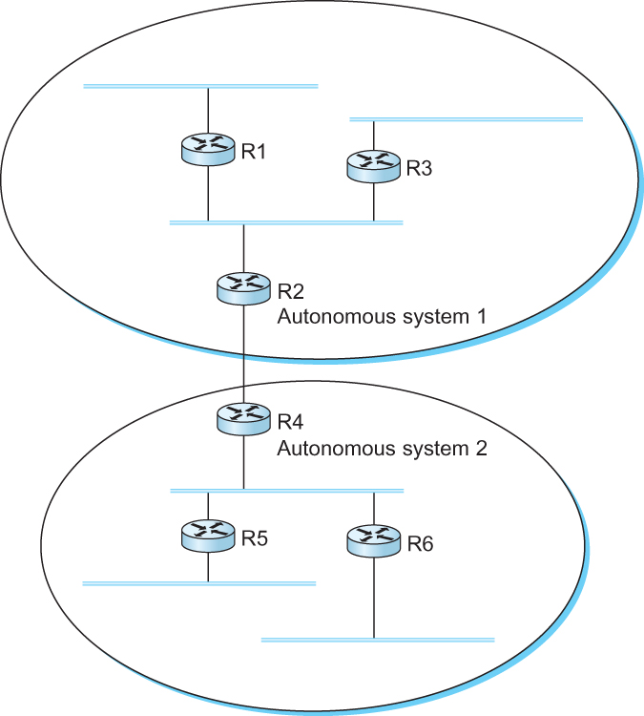
Interdomain Routing
IGP
Interior gateway protocol
IGP
Interior gateway protocol
BGP
Border gateway protocol
IGP
Interior gateway protocol
IGP
Interior gateway protocol
A network with four autonomous systems

Slide 9
BGP-4: Border Gateway Protocol
IGP
Interior gateway protocol
AS1000
AS1
R3 Will not carry traffic between R2 and R1
AS5000
Transit AS
AS2
Multihomed
AS
AS5000 Will carry traffic between AS1 and AS1000
AS3
AS7
Stub AS

Slide 10
BGP - goals
The goal of Inter-domain routing is to find any path to the intended destination that is loop free
  We are concerned with reachability than optimality
  Finding path anywhere close to optimal is considered to be a great achievement
Why?

Slide 11
BGP: Path vector protocol
Send the whole path with the routing update
Loops are detected if an AS finds itself in the path
  Reject if so
  Accept otherwise
Add self to the path and advertise to the neighbors
Advantage: No loops, Local decision before advertising

Slide 12
BGP: Path vector protocol
Loop!
Path: AS 223, AS 225, AS 245, AS 7770
Path: AS 223, AS 225, AS 245, AS 7770
AS 7770
AS 223
AS 225
Path: AS 223
Path: AS 223, AS 225
AS 245
Path: AS 223, AS 225, AS 245

Slide 13
BGP: Allows for policy
Capable of enforcing various policies
  AS2 → Don’t use AS1 to get to AS3
Not part of BGP – configuration information that controls propagation of paths

Slide 14
BGP: Hop by Hop model and control what you tell your neighbors
You can only tell others what you are using
  But you control what you say
BGP advertises only to peers
  Tell them what you are using
  Hop-by-hop model

Slide 15
What should AS2 (multihomed) tell AS3?
IGP
Interior gateway protocol
AS1000
AS1
R3 Will not carry traffic between R2 and R1
AS5000
Transit AS
AS2
Multihomed
AS
AS5000 Will carry traffic between AS1 and AS1000
AS3
AS2 does not want to carry traffic
between AS3 and AS1
AS7
Stub AS

Slide 16
Examples BGP Policies
Multihomed AS100 does not want to act as a transit
  Limit advertisement
If someone pays AS100 – yes
  Advertise only to those who are paying
Prefer one path over the other
  Play with the cost, artificially increase path length and so on ← more on this late

Slide 17
Examples BGP Policies
Multihomed AS100 does not want to act as a transit
  Limit advertisement
If someone pays AS100 – yes
  Advertise only to those who are paying
Prefer one path over the other
  Play with the cost, artificially increase path length and so on ← more on this late

Slide 18
You don’t need BGP for Stub ASes
IGP
Interior gateway protocol
Default IP route should be sufficient
AS1
AS3
AS7
Stub AS

Slide 19
BGP Messages
Open – Open a TCP connection to a peer
Update – Update route attributes or withdraw
Notification – Error notification, close connection
Keep alive – Periodic update to peers

Slide 20
Routing Information Bases (RIB)
RIB-Local
Prefix, Next Hop, Path
129.82.138.0/24, 192.20.2.1 , AS100
149.149.0.0/16, 149.149.0.1, AS200
150.150.0.0/17, 192.20.1.1, AS50, AS100
ADJ-
RIB-OUT
Input
From peer
ADJ-
RIB-IN
Output
to peer

Slide 21
BGP Attributes - AS_PATH
AS 100
1.0.0.0/8
AS 200
2.0.0.0/8
AS 300
2.0.0.0/8 Path = 300, 200
1.0.0.0/8 Path = 300, 200, 100
AS 400

Slide 22


BGP Attributes – Next hop?
AS 100
1.0.0.0/8
AS 200
2.0.0.0/8
AS 300
IP router that does not speak BGP
3.0.0.0/8
Tells you where to send traffic - Separate from BGP
BGP is a control protocol – IP forwards traffic
BGP tells you how to send IP traffic
AS200, 3.0.0.0/8 Path = 300, 200
AS 400

Slide 23
BGP Attributes – LOCAL-PREF
To AS400, PREF 100
AS 100
1.0.0.0/8
AS 200
2.0.0.0/8
AS 300
Provided by a BGP router to all other internal BGP routers
3.0.0.0/8
Tells you which way to send traffic
Lower preference wins!
AS 400
To AS400, PREF 200

Slide 24
BGP Attributes – LOCAL-PREF Example
AS 100
1.0.0.0/8
AS 200
2.0.0.0/8
a
4.0.0.0/8
b
4.0.0.0/8
c
AS 400
d
4.0.0.0/8
How to force all traffic to 400 over path b:d?
Set local preference 100 at b
Set local preference 200 at a

