Slide 1
CSC4200/5200 – Computer Networking
Networked applications – EMAIL and DNS
Instructor: Susmit Shannigrahi
sshannigrahi@tntech.edu
GTA: dereddick42@students.tntech.edu

Slide 2

Apps (HTTP)
Data
Apps (HTTP)
Segments
Transport (TCP/UDP)
Transport (TCP/UDP)
Network (IP)
Packets
Network (IP)
Link (Ethernet)
Frames
Link (Ethernet)
Ethernet Interface
Ethernet Interface
Bits (1010001)

Slide 3
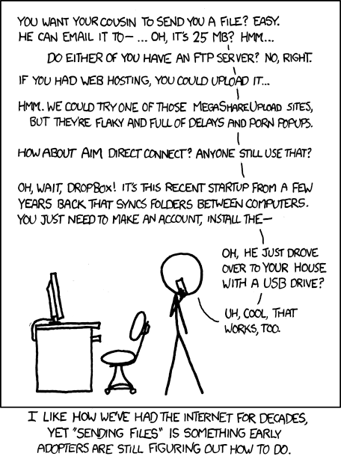
How do you send the cat picture?
Looked at Web
How about email?
https://xkcd.com/949/
Notes:
Ndn can help organizing the namespaces
Once that’s done, data discovery and provenance is
Straight forward
Retrieval, transparent failover, and specialized operations
In this work, we take a real access log and try to quantify NDN’s improvements to a climate
workflow

Slide 4

Electronic mail
outgoing
message queue
user mailbox
user
agent
Three major components:
user agents
mail servers
simple mail transfer protocol: SMTP
User Agent
a.k.a. “mail reader”
composing, editing, reading mail messages
e.g., Outlook, Thunderbird, iPhone mail client
outgoing, incoming messages stored on server
mail
server
user
agent
SMTP
mail
server
user
agent
SMTP
SMTP
user
agent
mail
server
user
agent
user
agent

Slide 5
Electronic Mail: SMTP [RFC 2821]
uses TCP to reliably transfer email message from client to server, port 25
direct transfer: sending server to receiving server
three phases of transfer
  handshaking (greeting)
  transfer of messages
  closure
command/response interaction (like HTTP, FTP)
  commands: ASCII text
  response: status code and phrase
messages must be in 7-bit ASCI

Slide 6


Scenario: Alice sends message to Bob
4) SMTP client sends Alice’s message over the TCP connection
5) Bob’s mail server places the message in Bob’s mailbox
6) Bob invokes his user agent to read message
1) Alice uses UA to compose message “to” bob@someschool.edu
2) Alice’s UA sends message to her mail server; message placed in message queue
3) client side of SMTP opens TCP connection with Bob’s mail server
1
user
agent
mail
server
user
agent
mail
server
2
3
6
4
Alice’s mail server
5
Bob’s mail server

Slide 7
Sample SMTP interaction
S: 220 hamburger.edu
C: HELO crepes.fr
S: 250 Hello crepes.fr, pleased to meet you
C: MAIL FROM: <alice@crepes.fr>
S: 250 alice@crepes.fr... Sender ok
C: RCPT TO: <bob@hamburger.edu>
S: 250 bob@hamburger.edu ... Recipient ok
C: DATA
S: 354 Enter mail, end with "." on a line by itself
C: Do you like ketchup?
C: How about pickles?
C: .
S: 250 Message accepted for delivery
C: QUIT
S: 221 hamburger.edu closing connection

Slide 8
Mail message format
SMTP: protocol for exchanging email msgs
RFC 822: standard for text message format:
header lines, e.g.,
  To:
  From:
  Subject:
  different from SMTP MAIL FROM, RCPT TO: commands!
Body: the “message”
  ASCII characters only
header
blank
line
body

Slide 9
Mail access protocols
user
agent
mail access
protocol
user
agent
SMTP
SMTP
(e.g., POP,
IMAP)
sender’s mail
server
receiver’s mail
server
SMTP: delivery/storage to receiver’s server
mail access protocol: retrieval from server
  POP: Post Office Protocol [RFC 1939]: authorization, download
  IMAP: Internet Mail Access Protocol [RFC 1730]: more features, including manipulation of stored msgs on server
  HTTP: gmail, Hotmail, Yahoo! Mail, etc.

Slide 10
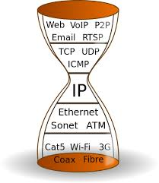
IP Based Communication
youtube.com/catvideo1
Notes:
Mention interest aggregation
Caching

Slide 11




IP Based Communication
google.com
216.58.217.46
GET google.com/index.html
Lookup google.com
216.58.217.46
Get Data
google.com
216.58.217.49
Notes:
Mention interest aggregation
Caching

Slide 12
DNS – IP to Name
People: Good with names
Machines: Good with numbers
Ask a person to remember 100s of Ips
- May not work well
DNS maps IP addresses to human readable names.

Slide 13
DNS: a distributed, hierarchical database
Root DNS Servers
…
…
com DNS servers
org DNS servers
edu DNS servers
yahoo.com
DNS servers
pbs.org
DNS servers
poly.edu
DNS servers
umass.edu
DNS servers
amazon.com
DNS servers
client wants IP for www.amazon.com;
client queries root server to find com DNS server
client queries .com DNS server to get amazon.com DNS server
client queries amazon.com DNS server to get IP address for www.amazon.com

Slide 14

DNS: root name servers
contacted by local name server that can not resolve name
root name server:
  contacts authoritative name server if name mapping not known
  gets mapping
  returns mapping to local name server
c. Cogent, Herndon, VA (5 other sites)
d. U Maryland College Park, MD
h. ARL Aberdeen, MD
j. Verisign, Dulles VA (69 other sites )
k. RIPE London (17 other sites)
i. Netnod, Stockholm (37 other sites)
e. NASA Mt View, CA
f. Internet Software C.
Palo Alto, CA (and 48 other sites)
m. WIDE Tokyo
(5 other sites)
13 root name “servers” worldwide
a. Verisign, Los Angeles CA
(5 other sites)
b. USC-ISI Marina del Rey, CA
l. ICANN Los Angeles, CA
(41 other sites)
g. US DoD Columbus, OH (5 other sites)

Slide 15
TLD, authoritative servers
top-level domain (TLD) servers:
  responsible for com, org, net, edu, aero, jobs, museums, and all top-level country domains, e.g.: uk, fr, ca, jp
  Network Solutions maintains servers for .com TLD
  Educause for .edu TLD
authoritative DNS servers:
  organization’s own DNS server(s), providing authoritative hostname to IP mappings for organization’s named hosts
  can be maintained by organization or service provider

Slide 16
Local DNS name server
does not strictly belong to hierarchy
each ISP (residential ISP, company, university) has one
  also called “default name server”
when host makes DNS query, query is sent to its local DNS server
  Served from cache
  Looked up
  Attack?

Slide 17
DNS name resolution example -Iterative
root DNS server
2
host at tntech.edu wants IP address for youtube.com
3
TLD DNS server
4
5
iterated query:
contacted server replies with name of server to contact
“I don’t know this name, but ask this server”
local DNS server
dns.tntech.edu
7
6
1
8
authoritative DNS server
dns.youtube.com
requesting host
your laptop
Youtube.com

Slide 18
DNS name resolution example- Recursive
root DNS server
2
3
recursive query:
puts burden of name resolution on contacted name server
heavy load at upper levels of hierarchy?
7
6
TLD DNS
server
local DNS server
dns.poly.edu
5
4
1
8
authoritative DNS server
dns.cs.umass.edu
requesting host
cis.poly.edu
gaia.cs.umass.edu
Application Layer
2-<number>

Slide 19
DNS protocol, messages
query and reply messages, both with same message format
2 bytes
2 bytes
msg header
identification: 16 bit # for query, reply to query uses same #
flags:
  query or reply
  recursion desired
  recursion available
  reply is authoritative
identification
flags
# questions
# answer RRs
# authority RRs
# additional RRs
questions (variable # of questions)
answers (variable # of RRs)
authority (variable # of RRs)
additional info (variable # of RRs)

Slide 20
Inserting records into DNS
example: new startup “tornadogurard”
register name tornadoguard.com at DNS registrar (godaddy, gandi.net)
  Tell them the IP of your local DNS server and name
  registrar inserts two RRs into .com TLD server

Slide 21
Attacking DNS
DDoS attacks
Bombard root servers with traffic
  Not successful to date
  Traffic Filtering
  Local DNS servers cache IPs of TLD servers, allowing root server bypass
Bombard TLD servers
  Potentially more dangerous
Redirect attacks
Man-in-middle
  Intercept queries
DNS poisoning
  Send bogus relies to DNS server, which caches
Exploit DNS for DDoS
Send queries with spoofed source address: target IP
Requires amplification

