Slide 1
CSC4200/5200 – Computer Networking
Connecting machines to a network
Instructor: Susmit Shannigrahi
sshannigrahi@tntech.edu

Slide 2

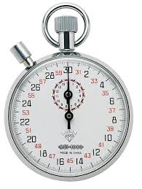
Recap – Propagation and Transmission delay
Packets are made of bits. All bits must make it the next router
before it can be forwarded.
Propagation delay = 50ms (time it takes for a bit to go from A to B)
Transmission delay = 1 ms (time it takes for each bit to be converted into signal)
A
B
50ms
10110...
50ms
t0
1
0
1
1
0
1
0
1
1
0
t50
50ms
t1
t51
50ms
t2
t52
50ms
t3
t53
50ms
t5
t55

Slide 3
Performance – Example
Calculate the total time required to transfer a 1000-KB file in the following case, assuming bandwidth is 1.5 Mbps, an RTT of 50 ms, a packet size of 1 KB data, and an initial 2 × RTT of “handshaking” before data is sent. (Peterson-Davie Exercise 3, Chapter 1)
Delay = Handshake + Transmission + Propagation + Queuing
Delay = 2*50ms + (1000*1024*8)/(1.5*1000*1000) second + 50/2ms + 0 = 5.586seconds
Propagation delay = First bit from sender to receiver
Notes:
Ndn can help organizing the namespaces
Once that’s done, data discovery and provenance is
Straight forward
Retrieval, transparent failover, and specialized operations
In this work, we take a real access log and try to quantify NDN’s improvements to a climate
workflow

Slide 4
Performance – Example
Calculate the total time required to transfer a 1.5-MB file in the following cases, assuming an RTT of 80 ms, bandwidth= 10Mbps, a packet size of 1 KB data, and an initial 2 × RTT of “handshaking” before data is sent:
Delay = Handshake + Transmission + Propagation + Queuing
Propagation delay = First bit from sender to receiver
Notes:
Ndn can help organizing the namespaces
Once that’s done, data discovery and provenance is
Straight forward
Retrieval, transparent failover, and specialized operations
In this work, we take a real access log and try to quantify NDN’s improvements to a climate
workflow

Slide 5
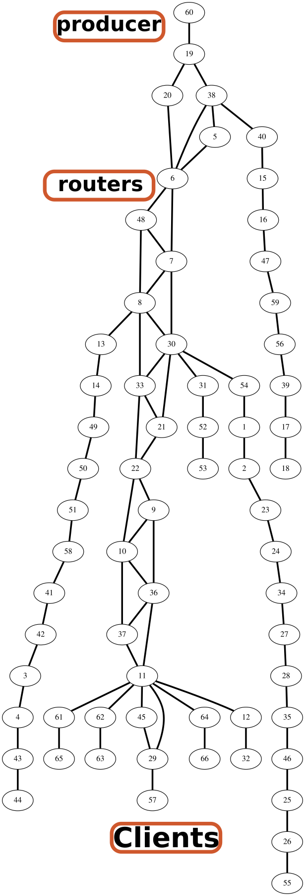
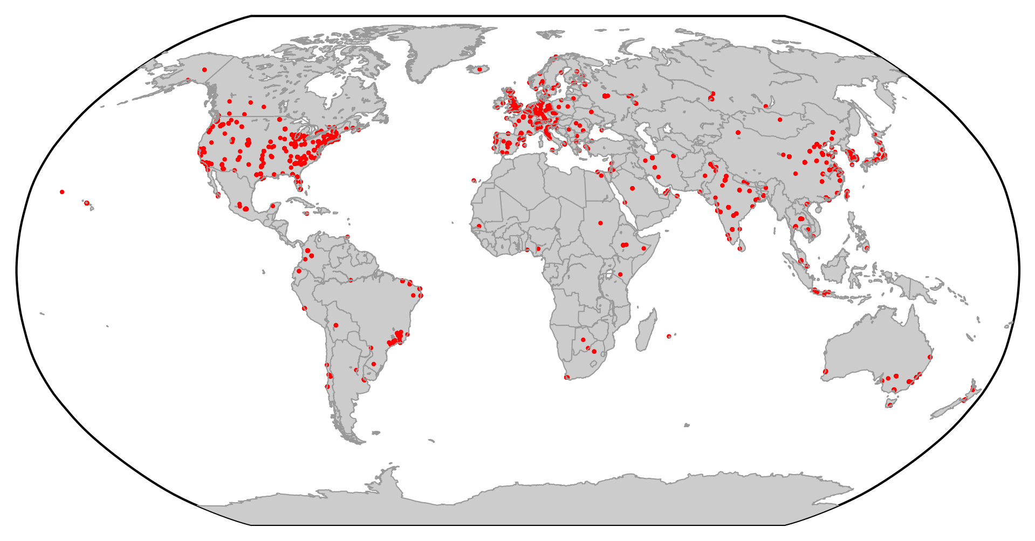
Recap – Network = Graph (Nodes + Links)
Notes:
Ndn can help organizing the namespaces
Once that’s done, data discovery and provenance is
Straight forward
Retrieval, transparent failover, and specialized operations
In this work, we take a real access log and try to quantify NDN’s improvements to a climate
workflow

Slide 6
Apps (HTTP)
Data
Apps (HTTP)
Segments
Transport (TCP/UDP)
Transport (TCP/UDP)
Network (IP)
Packets
Network (IP)
Link (Ethernet)
Frames
Link (Ethernet)
Ethernet Interface
Ethernet Interface
Bits (1010001)

Slide 7
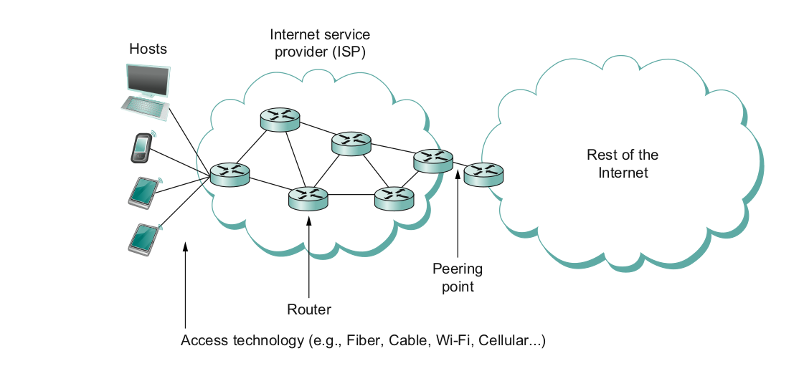
What does it take to create a link?
Common abstractions
  Why?

Slide 8
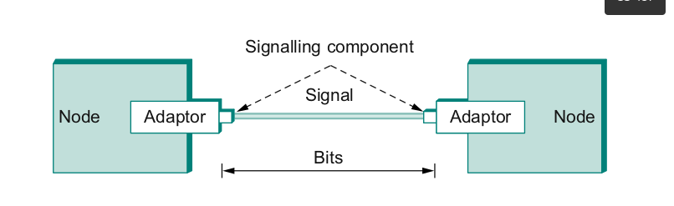
Packet to Low level Signals
Bit pattern - 0101001
  Must encode it into electrical signals and then decode it on the other end!

Slide 9
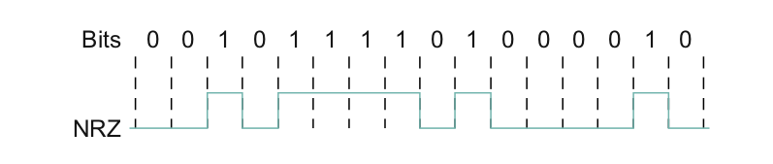
One easy way - NRZ
0 = low, 1= low
Problem if you have too many 0s or 1s in a row
  Baseline wander (read it in the book)

Slide 10
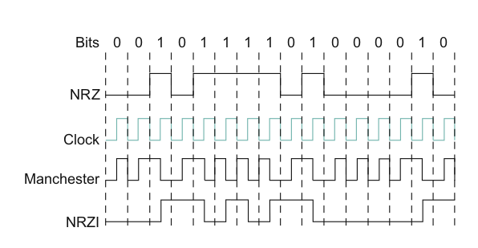
Other ways – NRZI/ Manchester Encoding
NRZI – 1=transition, 0= Don’t
Machester encoding – XOR of clock + NRZ data

Slide 11
Apps (HTTP)
Data
Apps (HTTP)
Segments
Transport (TCP/UDP)
Transport (TCP/UDP)
Network (IP)
Packets
Network (IP)
Link (Ethernet)
Frames
Link (Ethernet)
Ethernet Interface
Ethernet Interface
Bits (1010001)

Slide 12

Frames – bag of bits
Bits - between adaptors
Frames – between hosts (two computers)
  The job of adaptors is to find frames in a bit sequence
Frames are link layer protocols
Notes:
Ndn can help organizing the namespaces
Once that’s done, data discovery and provenance is
Straight forward
Retrieval, transparent failover, and specialized operations
In this work, we take a real access log and try to quantify NDN’s improvements to a climate
workflow

Slide 13
Frames – bag of bits
Bits flow between adaptors, frames between hosts
Let’s see it in wireshark!
Notes:
Ndn can help organizing the namespaces
Once that’s done, data discovery and provenance is
Straight forward
Retrieval, transparent failover, and specialized operations
In this work, we take a real access log and try to quantify NDN’s improvements to a climate
workflow

Slide 14
Frames – bag of bits
Sending side – encapsulation, add error check bits, flow control
Receiving side – extract frames, check for error, flow control
Notes:
Ndn can help organizing the namespaces
Once that’s done, data discovery and provenance is
Straight forward
Retrieval, transparent failover, and specialized operations
In this work, we take a real access log and try to quantify NDN’s improvements to a climate
workflow

Slide 15

Framing
Point-to-point
  Special start of text character denoted as Flag
    0 1 1 1 1 1 1 0
  Address, control : default numbers
  Protocol for demux : IP / IPX
  Payload : negotiated (1500 bytes)
  Checksum : for error detection
Notes:
The University of Adelaide, School of Computer Science
August 31, 2020
Chapter 2 — Instructions: Language of the Computer

Slide 16
Point to Point Links
Requirements:
  Packet framing: encapsulation of network-layer datagram in data link frame
  Bit transparency: Does not care about what its carrying
  Error Detection: Correction is on upper layers
  Connection liveness
  Network layer address negotiation
Notes:
The University of Adelaide, School of Computer Science
August 31, 2020
Chapter 2 — Instructions: Language of the Computer

Slide 17
Point to Point Links
Flag: 01111110
  Address: Does nothing
  Control; Does nothing
  Protocol: IP/ATM
  Payload: Whatever
  Checksum: Discussing later
Flag: 01111110
Notes:
The University of Adelaide, School of Computer Science
August 31, 2020
Chapter 2 — Instructions: Language of the Computer

Slide 18
Point to Point Links – Byte stuffing
Flag: 01111110
  Data transparency means it can also carry 01111110
  How do you differentiate between data and flag?
    Two back to back sequences of 01111110
    Two sequences = Data, discard first
    One sequence = Flag
Notes:
The University of Adelaide, School of Computer Science
August 31, 2020
Chapter 2 — Instructions: Language of the Computer

Slide 19
Error Detection
Bit errors are introduced into frames
  Because of electrical interference and thermal noises
Detecting Error
Correction Error
Two approaches when the recipient detects an error
  Notify the sender that the message was corrupted, so the sender can send again.
    If the error is rare, then the retransmitted message will be error-free
  Using some error correct detection and correction algorithm, the receiver reconstructs the message
Notes:
The University of Adelaide, School of Computer Science
August 31, 2020
Chapter 2 — Instructions: Language of the Computer

Slide 20
Error Detection
Common technique for detecting transmission error
  CRC (Cyclic Redundancy Check)
    Used in HDLC, DDCMP, CSMA/CD, Token Ring
  Other approaches
    Two Dimensional Parity (BISYNC)
    Checksum (IP)
Notes:
The University of Adelaide, School of Computer Science
August 31, 2020
Chapter 2 — Instructions: Language of the Computer

Slide 21
Error Detection
Basic Idea of Error Detection
  To add redundant information to a frame that can be used to determine if errors have been introduced
0
1
0
1
0
0
0
1
0
1
1
1
Number of 1s
Odd 1s = Parity bit 0
Even 1s = Parity bit 1
Notes:
The University of Adelaide, School of Computer Science
August 31, 2020
Chapter 2 — Instructions: Language of the Computer

Slide 22
Two-dimensional parity
Two-dimensional parity does a similar calculation
Extra parity byte for the entire frame, in addition to a parity bit for each byte
Two-dimensional parity catches all 1-, 2-, and 3-bit errors and most 4-bit errors
Notes:
The University of Adelaide, School of Computer Science
August 31, 2020
Chapter 2 — Instructions: Language of the Computer

Slide 23
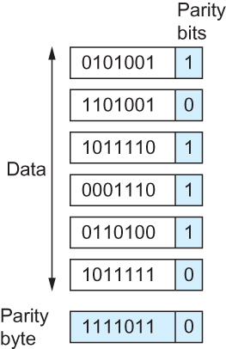
Two-dimensional parity
Two Dimensional Parity

Slide 24
Internet Checksum Algorithm
Not used at the link level
Add up all the words that are transmitted and then transmit the result of that sum
  The result is called the checksum
The receiver performs the same calculation on the received data and compares the result with the received checksum
Notes:
The University of Adelaide, School of Computer Science
August 31, 2020
Chapter 2 — Instructions: Language of the Computer

Slide 25
Internet Checksum Algorithm
Server Side
1. It treats segment contents as sequence of 16-bit integers.
2. All segments are added. Let's call it sum.
3. Checksum : 1's complement of sum.(In 1's complement all 0s are converted into 1s and all 1s are converted into 0s).
4. Sender puts this checksum value in UDP checksum field.
Client Side:
1. Calculate checksum
2. All segments are added and then sum is added with sender's checksum.
3. Check that any 0 bit is presented in checksum. If receiver side checksum contains any 0 then error is detected. So the packet is discarded by receiver.
Notes:
The University of Adelaide, School of Computer Science
August 31, 2020
Chapter 2 — Instructions: Language of the Computer

Slide 26
Internet Checksum Algorithm (RFC 1071)
A = 0110011001100110
B = 0101010101010101
------------------------
A+B = 1011101110111011
C = 0000111100001111
------------------------
1100101011001010 (sum of all segments)
0011010100110101 (1’s complement, 1→0, 0→ 1) <= this is the checksum
At receiver:
Add sum of all segments and checksum
  If correct, all 1s
Notes:
The University of Adelaide, School of Computer Science
August 31, 2020
Chapter 2 — Instructions: Language of the Computer

Slide 27
Others - Cyclic Redundancy Check (CRC)
Reduce the number of extra bits and maximize protection
Very interesting but we will skip it for now.
Notes:
The University of Adelaide, School of Computer Science
August 31, 2020
Chapter 2 — Instructions: Language of the Computer

Slide 28
Apps (HTTP)
Data
Apps (HTTP)
Segments
Transport (TCP/UDP)
Transport (TCP/UDP)
Network (IP)
Packets
Network (IP)
Link (Ethernet)
Frames
Link (Ethernet)
Ethernet Interface
Ethernet Interface
Bits (1010001)

Slide 29
All these for what?
Handles bit transmission errors that might occur
Link access – who can access the link at a given time?
Flow control – control the pace that does not overwhelm sending and receiving devices
Reliable delivery – next topic
It permits the transmission of data to Layer 3, the network layer, where it is addressed and routed.

Slide 30
Next Steps
Read Chapter 2
Next lecture – Reliable Delivery

