Slide 1
CSC4200/5200 – Computer Networking
Review and Course Correction
Instructor: Susmit Shannigrahi
sshannigrahi@tntech.edu
GTA: dereddick42@students.tntech.edu

Slide 2
ILearn Updates
HW2 posted – due March 28th.
PA2 due on March 31st.
Exam 2 is on March 31st.
PA1 solution is on iLearn.
  All grades should be updated. Check carefully and let me know if you see any problems.
Exam1 solutions are on iLearn.
  Check carefully and let me know if you see any problems.
Notes:
Ndn can help organizing the namespaces
Once that’s done, data discovery and provenance is
Straight forward
Retrieval, transparent failover, and specialized operations
In this work, we take a real access log and try to quantify NDN’s improvements to a climate
workflow

Slide 3
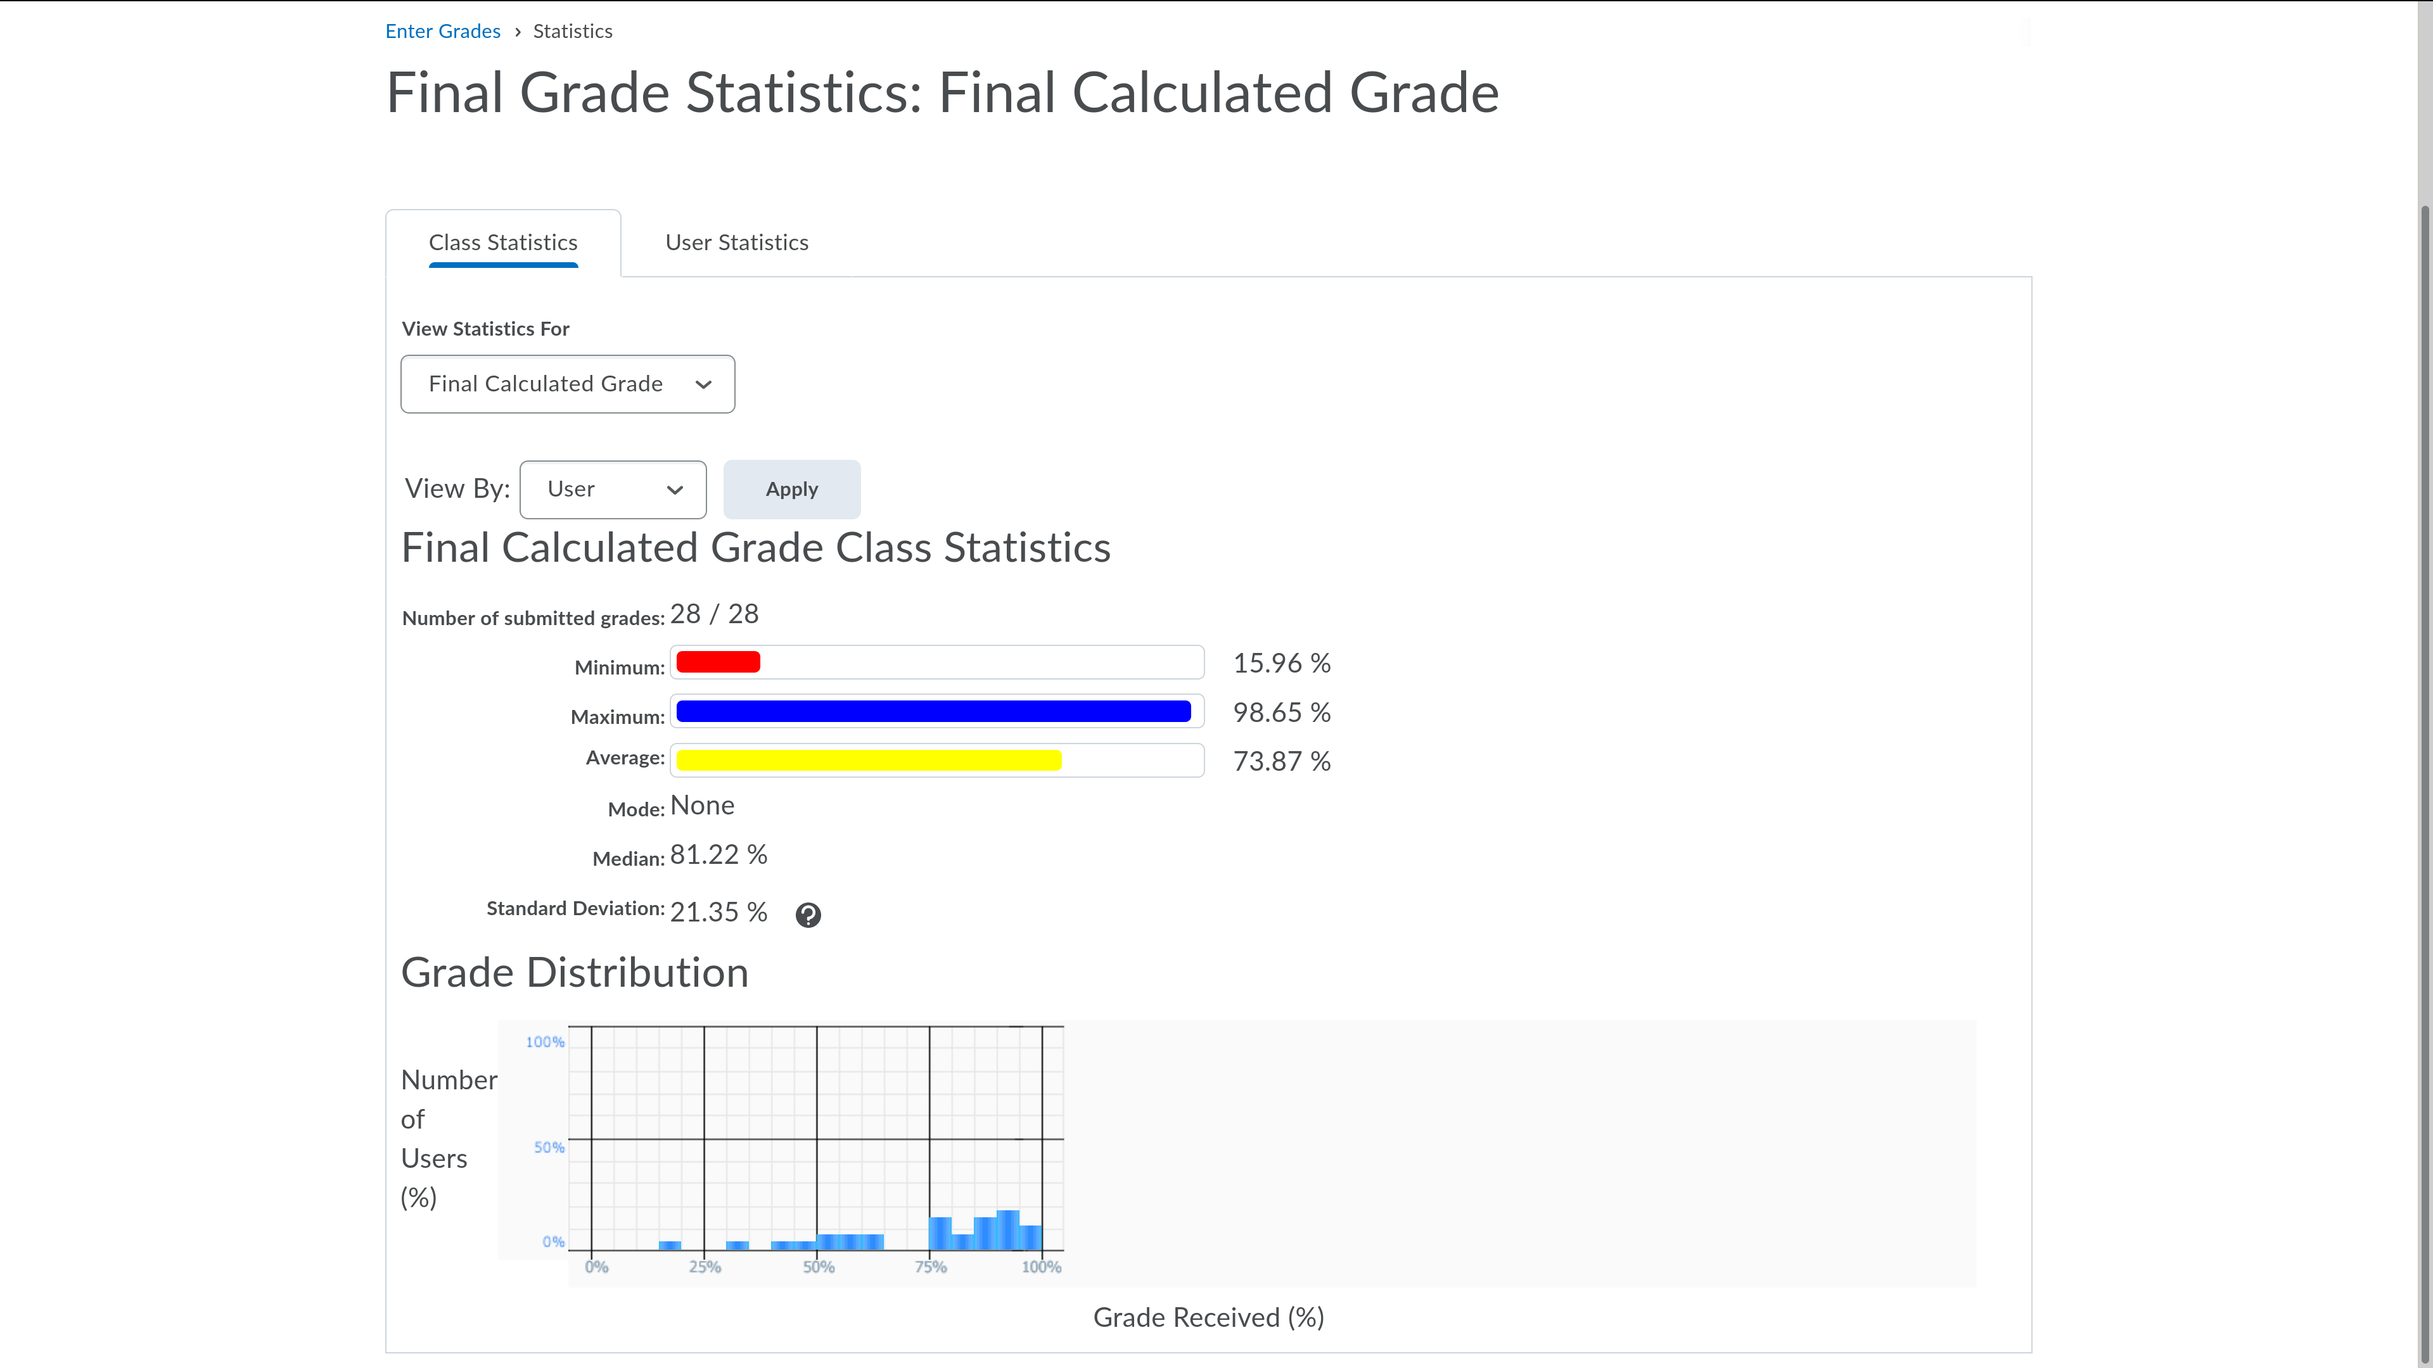
Here is where the class stands
Notes:
Ndn can help organizing the namespaces
Once that’s done, data discovery and provenance is
Straight forward
Retrieval, transparent failover, and specialized operations
In this work, we take a real access log and try to quantify NDN’s improvements to a climate
workflow

Slide 4
Today’s Agenda
Go over Exam1 Solutions (15 minutes)
Feedback Survey (5 minutes)
  https://tntech.co1.qualtrics.com/jfe/form/SV_eLoKUMIEpCYP6WW
Go around the class (10 minutes)
Go over PA1 solution (25 minutes)
Notes:
Ndn can help organizing the namespaces
Once that’s done, data discovery and provenance is
Straight forward
Retrieval, transparent failover, and specialized operations
In this work, we take a real access log and try to quantify NDN’s improvements to a climate
workflow

