Slide 1
CSC4200/5200 – Computer Networking
Internetworking
Instructor: Susmit Shannigrahi
sshannigrahi@tntech.edu
GTA: dereddick42@students.tntech.edu

Slide 2

Apps (HTTP)
Data
Apps (HTTP)
Segments
Transport (TCP/UDP)
Transport (TCP/UDP)
Network (IP)
Packets
Network (IP)
Link (Ethernet)
Frames
Link (Ethernet)
Ethernet Interface
Ethernet Interface
Bits (1010001)

Slide 3
So far...
we saw how to build a local network
How do we interconnect different types of networks to build a large global network?
Notes:
Ndn can help organizing the namespaces
Once that’s done, data discovery and provenance is
Straight forward
Retrieval, transparent failover, and specialized operations
In this work, we take a real access log and try to quantify NDN’s improvements to a climate
workflow

Slide 4
















Why another layer?
application
transport
network
data link
physical
network
data link
physical
network
data link
physical
network
data link
physical
network
data link
physical
network
data link
physical
network
data link
physical
network
data link
physical
network
data link
physical
network
data link
physical
application
transport
network
data link
physical
network
data link
physical
network
data link
physical
Kurose -Ross
Notes:
Ndn can help organizing the namespaces
Once that’s done, data discovery and provenance is
Straight forward
Retrieval, transparent failover, and specialized operations
In this work, we take a real access log and try to quantify NDN’s improvements to a climate
workflow

Slide 5

Switching
Switch
  A mechanism to interconnect
  links to form a large network
  Forward frames
  Separate the collision domains
  Filter packets between LANs
  Connects two or more LAN segments - Bridging
LAN 1
Collision domain 1
LAN 2
Collision domain 2
Notes:
Ndn can help organizing the namespaces
Once that’s done, data discovery and provenance is
Straight forward
Retrieval, transparent failover, and specialized operations
In this work, we take a real access log and try to quantify NDN’s improvements to a climate
workflow

Slide 6
Switches are
Self learning!
No configuration needed
Send frames to needed segments
How do they construct such a
table?
LAN 1
Collision domain 1
LAN 2
Collision domain 2
Notes:
Ndn can help organizing the namespaces
Once that’s done, data discovery and provenance is
Straight forward
Retrieval, transparent failover, and specialized operations
In this work, we take a real access log and try to quantify NDN’s improvements to a climate
workflow

Slide 7
Switches are self learning!
Inspect the source MAC address
  What is a mac address?
Associate mac address and incoming interface
Store this association for later use, (for some time)
  aging-timer
Notes:
Ndn can help organizing the namespaces
Once that’s done, data discovery and provenance is
Straight forward
Retrieval, transparent failover, and specialized operations
In this work, we take a real access log and try to quantify NDN’s improvements to a climate
workflow

Slide 8

Switching Table
To decide how to forward a packet, a switch consults a forwarding table
Destination, Port
-------------------------------------
A 3
B 0
C 3
D 3
E 2
F 1
G 0
H 0
Forwarding Table for Switch 2
Notes:
Ndn can help organizing the namespaces
Once that’s done, data discovery and provenance is
Straight forward
Retrieval, transparent failover, and specialized operations
In this work, we take a real access log and try to quantify NDN’s improvements to a climate
workflow

Slide 9
Switching Table
Unknown destination → send out on all Interfaces (flooding)
  Skip the incoming interface
Destination, Port
-------------------------------------
A 3
B 0
C 3
D 3
E 2
F 1
G 0
H 0
Forwarding Table for Switch 2
Notes:
Ndn can help organizing the namespaces
Once that’s done, data discovery and provenance is
Straight forward
Retrieval, transparent failover, and specialized operations
In this work, we take a real access log and try to quantify NDN’s improvements to a climate
workflow

Slide 10
Switching Table Algorithm
Create the table first!
  For each packet
    If destination address in arriving segment
      Drop
    If destination is in another segment
      Forward
    If destination unknown
      Flood!
Notes:
Ndn can help organizing the namespaces
Once that’s done, data discovery and provenance is
Straight forward
Retrieval, transparent failover, and specialized operations
In this work, we take a real access log and try to quantify NDN’s improvements to a climate
workflow

Slide 11
Switching Table Algorithm
Send frame from C to F
Switch 1 →
  Notes C is on Interface 3
  Floods
Switch 2 →
  Notes C is on Interface 3
  Floods
Host F replies
  Switch 2 notes F is on Interface 1
  Sends back over Interface 3
Switch 1 notes F is on Interface 1
  Sends back over Interface 3
  Host c receives frame
Notes:
Ndn can help organizing the namespaces
Once that’s done, data discovery and provenance is
Straight forward
Retrieval, transparent failover, and specialized operations
In this work, we take a real access log and try to quantify NDN’s improvements to a climate
workflow

Slide 12
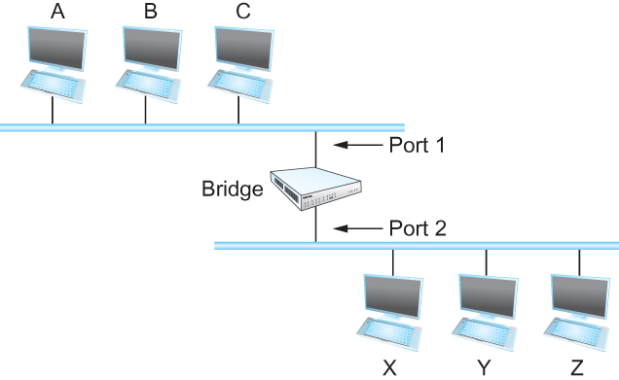
Bridges
Bridges and LAN Switches
    Class of switches that is used to forward packets between shared-media LANs such as Ethernets
  Known as LAN switches
  Referred to as Bridges
Suppose you have a pair of Ethernets that you want to interconnect
  One approach is put a repeater in between them, physical limitations
An alternative would be to put a node between the two Ethernets and have the node forward frames from one Ethernet to the other
  This node is called a Bridge
  A collection of LANs connected by one or more bridges is usually said to form an Extended LAN
Notes:
Ndn can help organizing the namespaces
Once that’s done, data discovery and provenance is
Straight forward
Retrieval, transparent failover, and specialized operations
In this work, we take a real access log and try to quantify NDN’s improvements to a climate
workflow

Slide 13
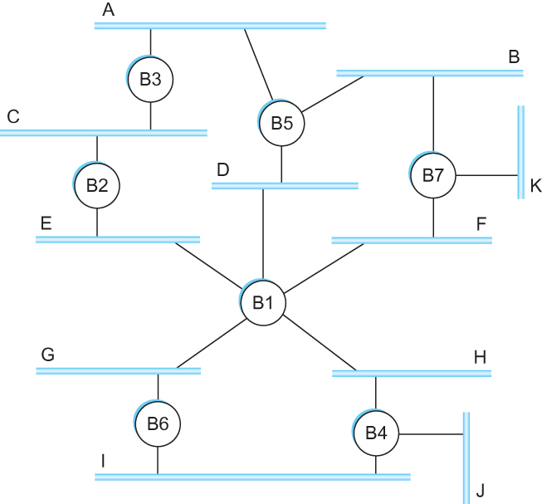
Flooding over bridges causes forwarding loops
Spot the loop
Why?
Notes:
Ndn can help organizing the namespaces
Once that’s done, data discovery and provenance is
Straight forward
Retrieval, transparent failover, and specialized operations
In this work, we take a real access log and try to quantify NDN’s improvements to a climate
workflow

Slide 14
Loop
Spot the loop
Why?
Notes:
Ndn can help organizing the namespaces
Once that’s done, data discovery and provenance is
Straight forward
Retrieval, transparent failover, and specialized operations
In this work, we take a real access log and try to quantify NDN’s improvements to a climate
workflow

Slide 15
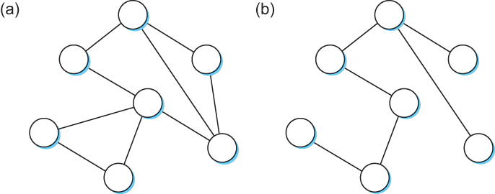
Solution? Spanning Tree
Think of the extended LAN as being represented by a graph that possibly has loops (cycles)
A spanning tree is a sub-graph of this graph that covers all the vertices but contains no cycles
Spanning tree keeps all the vertices of the original graph but throws out some of the edges
Example of (a) a cyclic graph; (b) a corresponding spanning tree.
Notes:
Ndn can help organizing the namespaces
Once that’s done, data discovery and provenance is
Straight forward
Retrieval, transparent failover, and specialized operations
In this work, we take a real access log and try to quantify NDN’s improvements to a climate
workflow

Slide 16
How do we create a spanning tree?
    Properties: No loops
    How?
      Selectively flood
      Distributed algorithm, no coordination!
      Automatic reconciliation when failure occurs
Notes:
Ndn can help organizing the namespaces
Once that’s done, data discovery and provenance is
Straight forward
Retrieval, transparent failover, and specialized operations
In this work, we take a real access log and try to quantify NDN’s improvements to a climate
workflow

Slide 17
How do we create a spanning tree?
    Properties: No loops
    How?
      Selectively flood
      Distributed algorithm, no coordination!
      Automatic reconciliation when failure occurs
    Switches elect a root
      The switch with the smallest identifier
      Each switch identifies if its interface is
      on the shortest path from the root
      Exclude if not
    Send message (Y,d,X)
    From x, claims Y is the root, distance is d
Notes:
Ndn can help organizing the namespaces
Once that’s done, data discovery and provenance is
Straight forward
Retrieval, transparent failover, and specialized operations
In this work, we take a real access log and try to quantify NDN’s improvements to a climate
workflow

Slide 18
How do we create a spanning tree?
1
    Message (Y, d, X) - (to, distance, from)
    4 thinks it’s the root
    Sends (4, 0, 4) to 3 and 5
    Receives (3,0,3) from 3
      Sets it to as the root since 3 < 4
    Receives (3,1,5) from 5
      Sees that this is a longer path to 3
      2 hops vs direct path (1 hop)
      Removes 4-5 link from the tree
2
7
3
6
4
5
Notes:
Ndn can help organizing the namespaces
Once that’s done, data discovery and provenance is
Straight forward
Retrieval, transparent failover, and specialized operations
In this work, we take a real access log and try to quantify NDN’s improvements to a climate
workflow

Slide 19
What does 4 do when it hears from 2?
1
    Message (Y, d, X) - (to, distance, from)
    2 hears (1, 0, 1) from 1
    2 sends (1, 1, 2) to 3
    3 sends (1, 2, 3) to 5 and 4
    4 receives (1, 2, 3) from 3
    4 receives (1, 3, 5) from 5
    Sets 1 as root (id=1 is < id=4)
    Prunes the 4-5 path since it is 4 hops compared to
    3 hops via 3
2
7
3
6
4
5
Notes:
Ndn can help organizing the namespaces
Once that’s done, data discovery and provenance is
Straight forward
Retrieval, transparent failover, and specialized operations
In this work, we take a real access log and try to quantify NDN’s improvements to a climate
workflow

Slide 20
Failure and Downsides
1
    Even after the system has stabilized, the root
    continues to send messages periodically
      Other bridges continue to forward these messages
    When a bridge fails, the downstream bridges will not
    receive the configuration messages
      After waiting a specified period of time, they will
      once again claim to be the root and the
      algorithm starts again
    No load balancing
2
7
3
6
4
5
Notes:
Ndn can help organizing the namespaces
Once that’s done, data discovery and provenance is
Straight forward
Retrieval, transparent failover, and specialized operations
In this work, we take a real access log and try to quantify NDN’s improvements to a climate
workflow

Slide 21
Virtual LAN (VLANs)
    LANs are on the same Ethernet segments
    Does not scale very well – too many wires
    How can we put multiple people in different locations on the same Ethernet segment (LAN)?
    How do we create multiple LANs over the same wire?
Notes:
Ndn can help organizing the namespaces
Once that’s done, data discovery and provenance is
Straight forward
Retrieval, transparent failover, and specialized operations
In this work, we take a real access log and try to quantify NDN’s improvements to a climate
workflow

Slide 22

Why separate at all?
    LANs are on the same Ethernet segments! Security.
    Isolation – sensitive traffic vs normal traffic
    Containment of traffic – your for loop broke the internet
    How do we create multiple LANs over the same wire?
Notes:
Ndn can help organizing the namespaces
Once that’s done, data discovery and provenance is
Straight forward
Retrieval, transparent failover, and specialized operations
In this work, we take a real access log and try to quantify NDN’s improvements to a climate
workflow

Slide 23
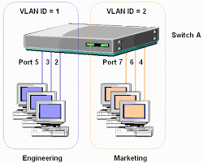
VLANs
    Switches specify which VLAN is accessible over which interface
    Each interface can have a VLAN color
    Each Mac address can have a interface color
    Add VLAN tag to the Ethernet header
Notes:
Ndn can help organizing the namespaces
Once that’s done, data discovery and provenance is
Straight forward
Retrieval, transparent failover, and specialized operations
In this work, we take a real access log and try to quantify NDN’s improvements to a climate
workflow

Slide 24
Reading Assignment
Switching Basics – Chapter 3.1
  https://book.systemsapproach.org/internetworking/switching.html#switching-basics
  Up to (but not including) Virtual Circuit Switching
  20 minutes read
Switched Ethernet, learning bridges, spanning tree algorithm, VLANs – Chapter 3.2
https://book.systemsapproach.org/internetworking/ethernet.html#switched-ethernet
  30-40 minutes read

