Slide 1
CSC4200/5200 – Computer Networking
Socket programming
Instructor: Susmit Shannigrahi
sshannigrahi@tntech.edu
GTA – David Reddick
dereddick42@tntech.edu

Slide 2

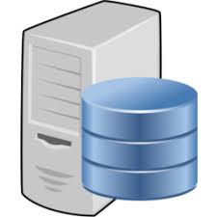
Socket Programming Basics

Slide 3
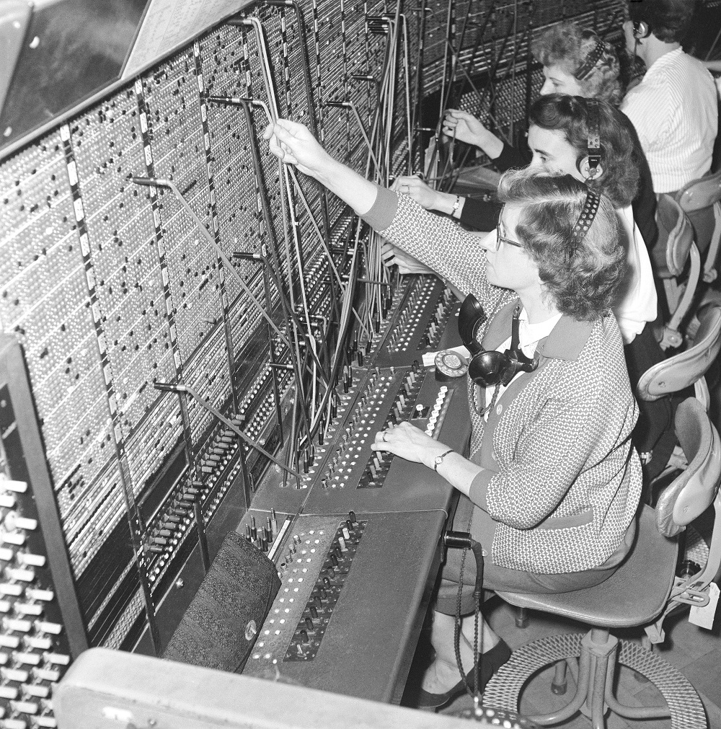
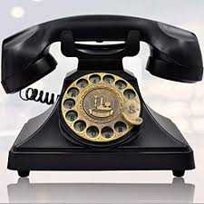
Telephone networks
For a telephone system to work, what kind of addressing do you need?
Notes:
Ndn can help organizing the namespaces
Once that’s done, data discovery and provenance is
Straight forward
Retrieval, transparent failover, and specialized operations
In this work, we take a real access log and try to quantify NDN’s improvements to a climate
workflow

Slide 4
Socket Programming Basics
192.168.1.1 ← IP address
8080 ← Port
192.168.1.2 ← IP address
60613 ← Port
Imagine you are calling someone
- You are the client
What does the server need to know?
What does the client need to know?

Slide 5

Apps (HTTP)
Data
Apps (HTTP)
Socket Layer
Socket Layer
Segments
Transport (TCP/UDP)
Transport (TCP/UDP)
Network (IP)
Packets
Network (IP)
Link (Ethernet)
Frames
Link (Ethernet)
Ethernet Interface
Ethernet Interface
Bits (1010001)

Slide 6
Steps
Server | Client
1. Create a TCP/UDP socket object (get a phone)
2. BIND to an address (get a phone number)
3. LISTEN for connections (someone might call you) | 1. Create a socket object (get a phone)
4. ACCEPT a connection (If someone calls you, pick it up) | 2. CONNECT to server at server IP and port (call the server’s number)
5. RECEIVE data (hear the first “hello”) | 3. SEND data (Say “hello”)
6. SEND data (say “hello”) | 4. RECEIVE data (hear server’s “hello”)
7. Exchange data (talk for some time) | 5. Exchange data (talk for some time)
8. Close (hang up) | 6. Close (hang up)
Notes:
Ndn can help organizing the namespaces
Once that’s done, data discovery and provenance is
Straight forward
Retrieval, transparent failover, and specialized operations
In this work, we take a real access log and try to quantify NDN’s improvements to a climate
workflow

Slide 7
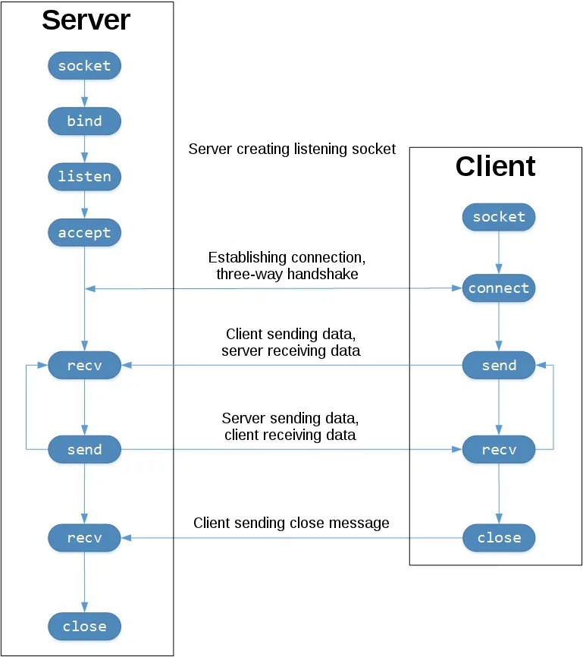
Overview
https://upload.wikimedia.org/wikipedia/commons/a/a1/InternetSocketBasicDiagram_zhtw.png
https://realpython.com/python-sockets/

Slide 8
Byte Ordering
Network and Hosts use different “endianness”!
Convert integers into Network Order before you transmit!
You can also send an encoded string
https://pythontic.com/modules/socket/byteordering-coversion-functions
Notes:
Ndn can help organizing the namespaces
Once that’s done, data discovery and provenance is
Straight forward
Retrieval, transparent failover, and specialized operations
In this work, we take a real access log and try to quantify NDN’s improvements to a climate
workflow

Slide 9
Headers
RECV() call!
How much data should the server receive?
Tell the server first – fixed length header.
Read the header first.
Then read whatever bytes the header tells you.
Notes:
Ndn can help organizing the namespaces
Once that’s done, data discovery and provenance is
Straight forward
Retrieval, transparent failover, and specialized operations
In this work, we take a real access log and try to quantify NDN’s improvements to a climate
workflow

