Slide 1
CSC4200 – Next-generation Networking
Information Centric networking
Instructor: Susmit Shannigrahi
sshannigrahi@tntech.edu

Slide 2
TCP/IP Design Rationale
The Internet was designed for communication between a source and a destination
  Networks were slow and computers super expensive
  Sharing computing resources across long distances was desirable
  Security was not even considered
  First use-case: file transfer from/to a server
Do these assumption hold today?

Slide 3
Today...
Internet users are streaming data..
  Many different streaming services
  (Amazon, Hulu, Netflix..)
Internet users generate huge amounts of data
  2.5 quintillion (10¹⁸) bytes per day
  So many devices (IoT, mobile phones)
  generating data
So many heterogeneous network environments
  Vehicular, core Internet, building sensors, mobile,
  data center, etc…

Slide 4
Internet is a success because of applications
Applications today are “data-centric”
  They request the data they need
  They do not care where the data comes from
  All they need is to verify data authenticity
“Data-centric” applications combined with a “host-centric” Internet and tech companies?
  Internet consolidation! [1]
[1] https://tools.ietf.org/html/draft-arkko-iab-internet-consolidation-02

Slide 5
What is Internet Consolidation?
Internet was meant to enable communication among humans
  Tech companies want any sort of communication to pass through them
  Why?
Result: The Internet has become extremely centralized
  Communication typically passes through a cloud server
  If users cannot reach the cloud, they cannot communicate
  Example: messaging app with participants next to each other
From the IAB draft: “If the world changes, the Internet and its technology/architecture may have to match those changes”

Slide 6
The world is changing..
“Data-centric” applications
  That’s the way applications are designed
  They request data through names (URLs..)
Heterogeneous network environments
  Not only file transfers from/to a server!
  Multicast support necessary
Security by design
  We do not know every Internet user anymore…
  We trust the data we download if we trust the server that we communicate with (i.e., secure connection). What if the server gets hacked?

Slide 7
Information-Centric Networking (ICN)
Shift from a host-centric to a data-centric communication model
  Instead of using IP addresses, entities communicate based on ”named-information”
Named Data Networking (NDN): The most prominent realization of ICN
  Started as an NSF-funded Future Internet Architecture (FIA) project in 2010
  http://named-data.net

Slide 8
Architectural Comparison with IP

Slide 9




IP Based Communication
google.com
216.58.217.46
GET google.com/index.html
Lookup google.com
216.58.217.46
Get Data
google.com
216.58.217.49

Slide 10

Named Data Networking
A clean slate future Internet architecture
  Emphasizes on what (named content), not where (hosts)
NDN
(name based forwarding)
Interest
(/cmip5/precipitation/2001.nc)
Data
(/cmip5)

Slide 11
Name Based Communication in NDN
GET /google/index.html
Prefix | Interfaces
/google | 67
Prefix | Interfaces
/google | 31,32
/google
/google/index.html
Face 31
Face 32
/google/index.html
/google/index.html
/google

Slide 12
Interest aggregation and caching
GET /google/index.html
Prefix | Interfaces
/google | 67
Prefix | Interfaces
/google | 31,32
/google
/google/index.html
Face 31
Face 32
/google/index.html
/google/index.html
/google

Slide 13
Intelligent Forwarding Strategy
GET /google/large_data
Prefix | Interfaces
/google | 67
Prefix | Interfaces
/google | 31,32
/google
/google/large_data
Face 31
Face 32
/google/large_data
/google/large_data
/google

Slide 14




NDN at Scale
ISP
ISP

Slide 15

NDN Packet Format

Slide 16

NDN Forwarding Daemon Workflow

Slide 17
Why Stateful Forwarding?
“End-to-end principle”
  Only significantly beneficial functions must be implemented by lower layers of the architecture
  IP is state-less
  Why shifting so much? Can state be so beneficial?
Scale multicast data delivery!
  Load balancing, congestion control, data retrieval through multiple paths
Heterogeneous and dynamic network environments
  Adapt to network failures
  Multi-homing and intermittent-connectivity

Slide 18
Security in NDN
Every data packet has a publicly verifiable signature
  binds content name to actual payload
  data packets have key locators that points to the signing key
  enables content from anywhere
Signature verification is either done by applications or at the network
  applications choose what to trust

Slide 19
Privacy Point of View
Interests do not contain the consumer identification
  What is the consumer identification in IP?
  Enhances consumer privacy
Name of requested data may be in plain-text
  It may give away what we are looking for
Privacy vs forwarding capability

Slide 20

The CDN model
Single server model
Multi-server model
(replicated content)
CDN model

Slide 21

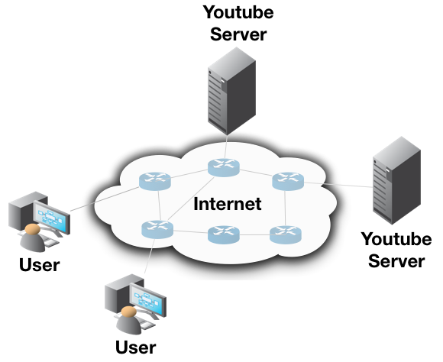


NDN Communication Model Example
Request
Aggregation!
Content Cached!
Content Cached!
Content Cached!

Slide 22
IP vs NDN
IP | NDN
Identifies end-hosts (IP addresses) | Identifies data by name
Stateless forwarding | Stateful forwarding
Packet delivery to destination | Request/Response data model
Secure connection | Data-centric security

Slide 23
Conclusion
NDN is based on content
  Name it
  Secure it
  Forward it
Better or worse?

