Slide 1
ADEPT
Amani Konduru
Benjamin Garber (Daniel)
Edward Bull
Paul David Utesch
Team
Software Engineering- CSC 4350
Spring 2017
4/24/17

Slide 2
Roles- ADEPT
Amani Konduru: Project Manager, Tester, Document handler and Database
Daniel Garber: Developer
Edward Bull: Developer and Tester
Paul Utesch: GUI and Database

Slide 3
Overview
A mail system.

Slide 5
Packages and tools
Programing Language: JAVA
GUI: JavaFX
Database: SQLite and PostgreSQL
Repository: GitHub
IDE: Eclipse
Agile Management System: VersionOne
Cloud: Digital Ocean (Droplet)

Slide 6
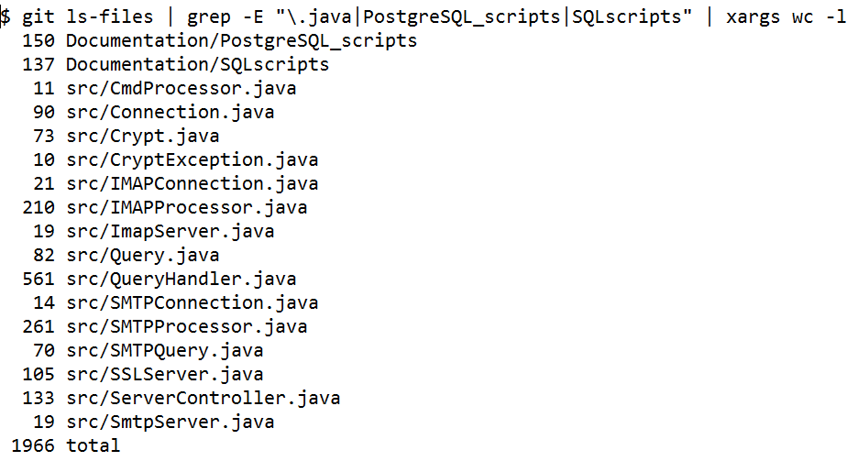
Metrics

Slide 7
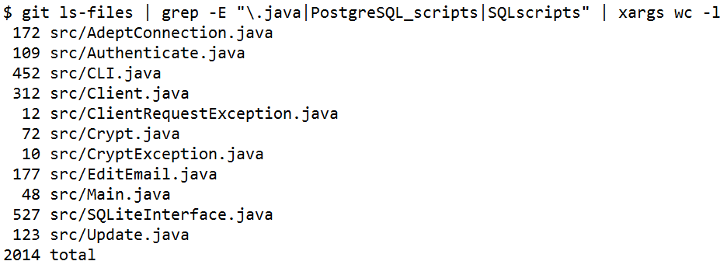
Metrics

Slide 8
System Model
Server and client

Slide 9
UML Diagram

Slide 12
Sequence Diagram

Slide 15
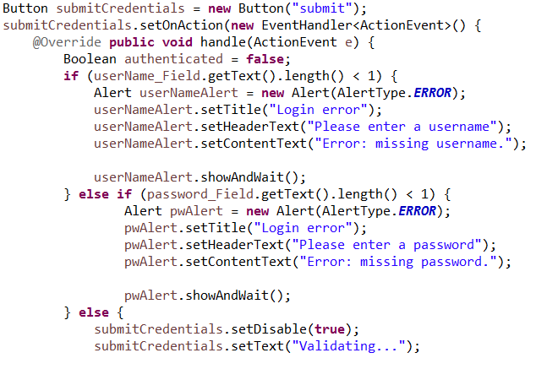
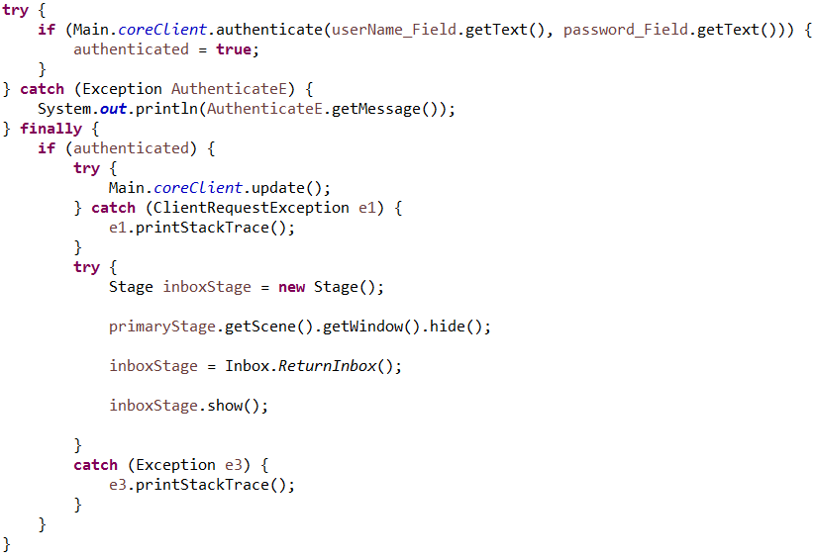
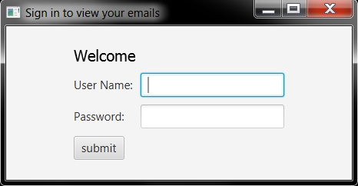
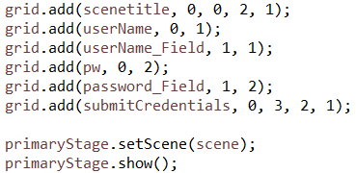
Login Screen

Slide 16
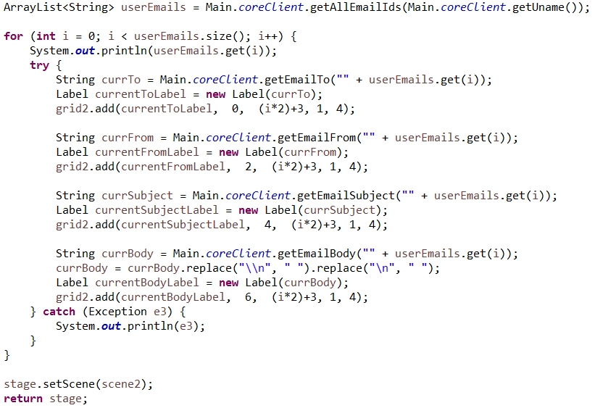
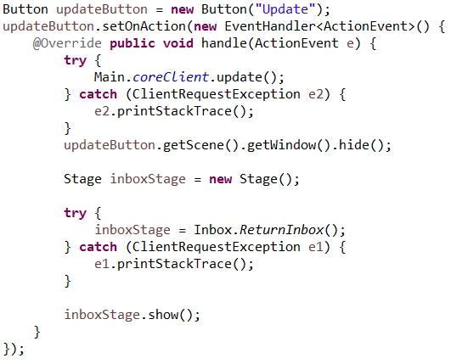
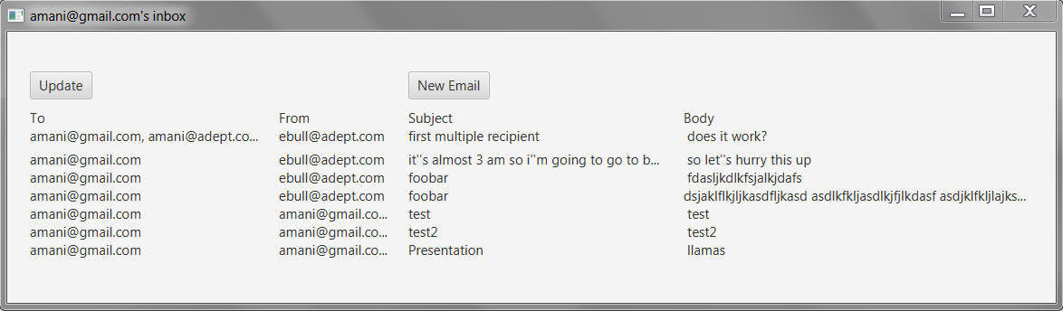
Inbox

Slide 17
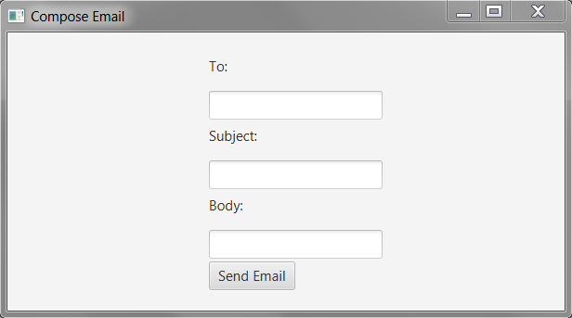
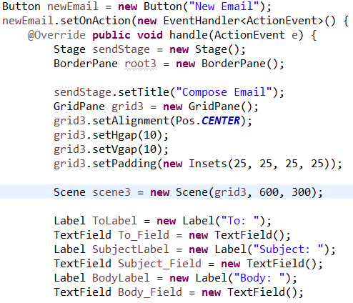
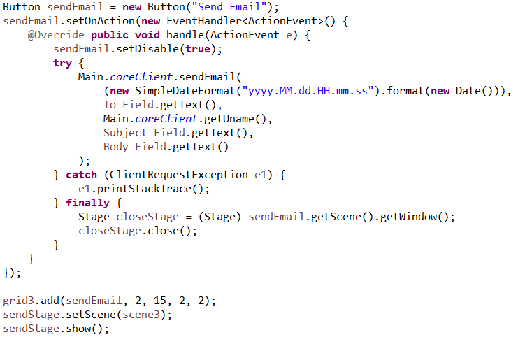
New Email

Slide 18
Demonstration

Slide 19
Summary

Slide 20
Questions?

