Slide 1

AirBnB Listings
Irene “Nhi” Ong
BINH Le
JACOB Nguyen

Slide 2
Introduction
- We propose a comparative analysis of Milan, Lombardy, Italy - AirBnB listings from last year and this current year. We choose this location because Lombardy was one of the COVID-19 hotspots earlier this year in mid-March.
- We specifically chose Milan because the city has maintained its status as a global fashion capital for many years, attracting millions of tourists each year. We hope to find meaningful patterns that can help the company understand how the pandemic has affected their clients.

Slide 3
Our Goal
- Our goal is to seek patterns that provide insight into how the pandemic has impacted Airbnb lodging in Lombardy, Italy by looking at the pre-pandemic listings (2019) and intra-pandemic listings (2020). With that purpose in mind, we will take an exploratory approach and use unsupervised learning algorithms to represent and visualize the datasets.
- We will perform a comparative analysis of the results of the two datasets. Using the findings from this analysis, we will predict the lodging prices post-pandemic.
- Besides, we will perform an analysis of intra-pandemic listings (2020). Using the findings from this analysis, we will check which factors affect the price of the lodging and help customers make the right decision when choosing to rent.

Slide 4
Data Source
- AirBnB provides free, open data sets on a secondary website. Several csv files including listings, reviews, and neighborhoods are provided. Archived data from last year included. We will use the “Milan, Lombardy, Italy” data set found at
http://insideairbnb.com/get-the-data.html
- The “Milan, Lombardy, Italy” listings.csv file for 29 April 2020 has 16 features such as id, name, host_id, host_name, neighbourhood_group, neighbourhood, latitude, longitude,… The features describe 19,786 data points. In this file, there are both categorical and numerical data values.

Slide 5
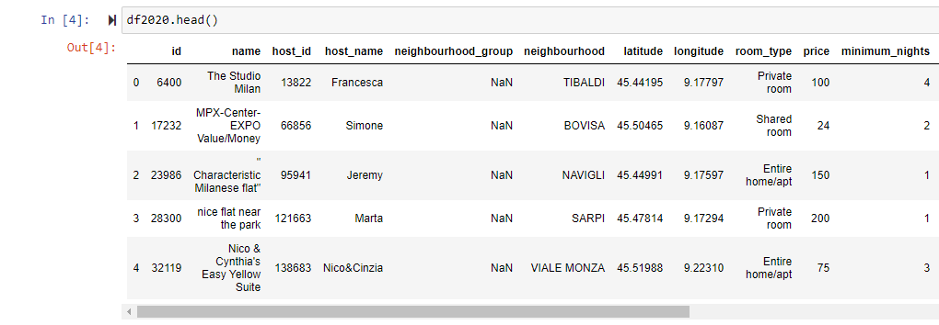
Database

Slide 6
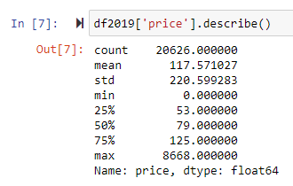

Original Comment
Even though Covid-19 is happening, the price in listings (2020) is still higher than in listings (2019). In detail, the price mean in 2019 is only 117.57 USD, while the price mean in 2020 is 121.01 USD. The maximum price in 2019 is 8668 USD, whereas the maximum price in 2020 is 9000 USD.

Slide 7
Preprocessing
- Both datasets listings (2019) and listings (2020) contain columns that have missing data. The values of columns such as 'name', 'host_name', 'id', 'host_id' contains identifiers that don't relate to the price column. Especially, the 'neighbourhood_group' column does not contain any values. The 'last_review' column just indicates the date of the last review which doesn't relate to the price column either. These are all noise values, so we need to remove them.
- After deleting unrelated columns or the column with only NaN values, there is still a column 'reviews_per_month' that contains some NaN values. For processing, we will enter the mean value instead of the NaN values (fill missing value).

Slide 8
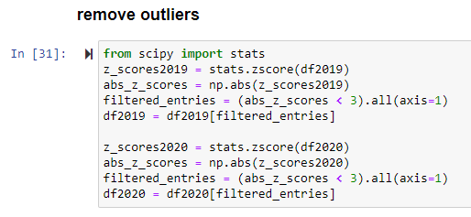
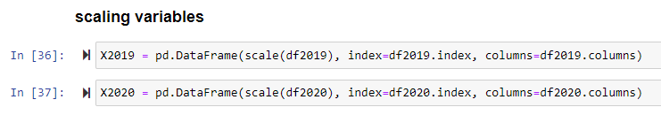
Preprocessing

Slide 9
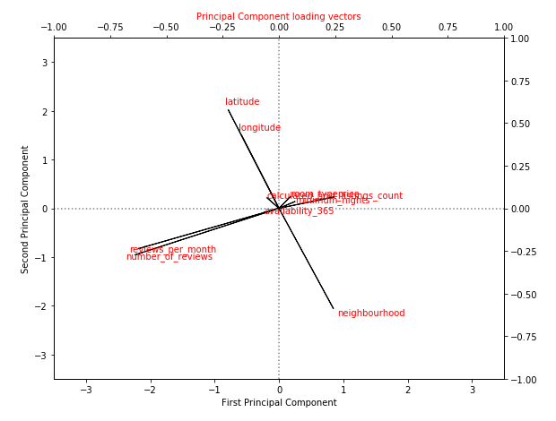
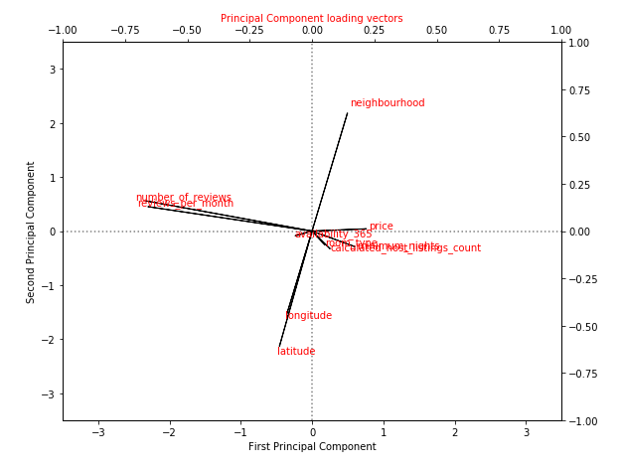
Principle Component Analysis
Based on both graphs, we see that:
'latitude', 'longitude', and 'neighbourhood' do not correlate with the 'price' attribute.
'reviews_per_month', 'number_of_reviews', and 'minimum_nights' are negative correlated with 'price' attribute.
'calculated_host_listings_count' and 'room_type' are positive correlated with 'price' attribute.

Slide 10
Ordinary Least Squares (OLS)
In 2019 and 2020 datasets, 'review_per_month', 'number_of_reviews', 'calculated_host_listings_count', 'minimum_nights' and 'room_type' attributes are correlated with 'price', so we choose those 5 attributes as independent variables for the model and 'price' is the dependent variable.

Slide 11
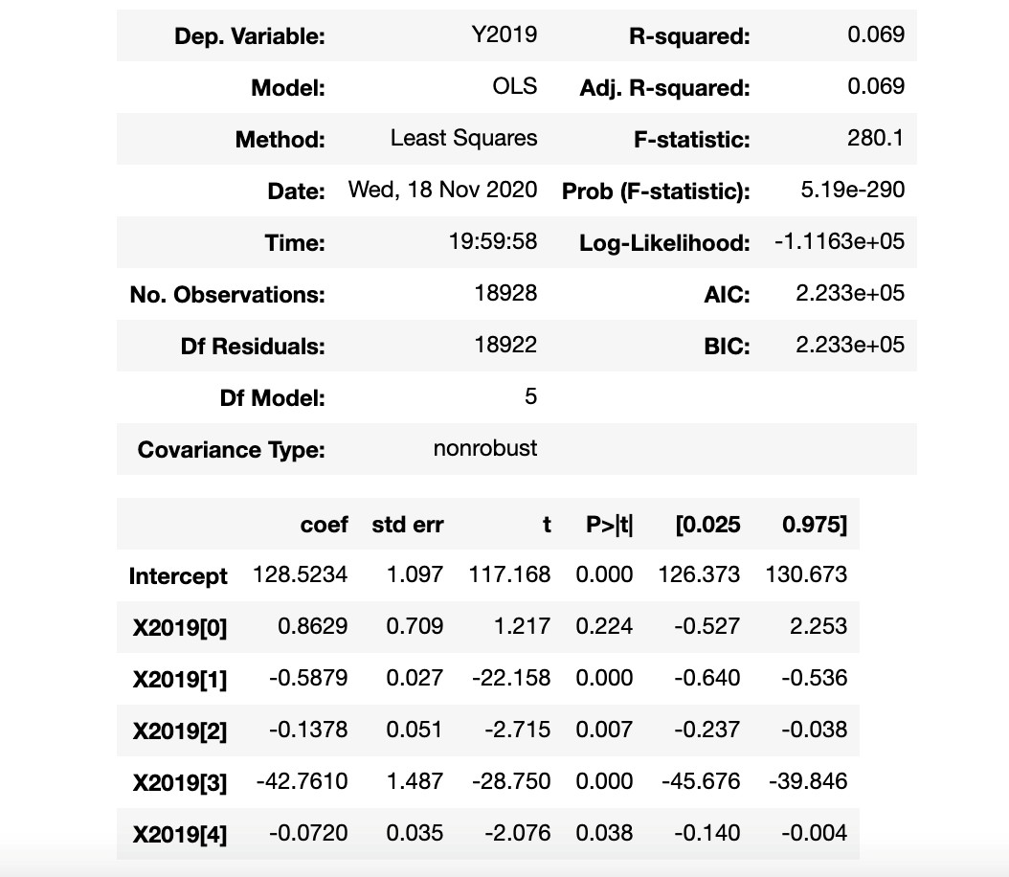
OLS for listings 2019
- X2019[0] which is the coefficient of 'reviews_per_month' attribute has p-value = 0.224 which is higher than 0.05, so we cannot reject the null hypothesis of this coefficient which means the true value of this coefficient can be 0.
- Model:
price = 128.5234 + 0.8629*reviews_per_month - 0.5879*number_of_review -0.1378*calculated_host_listings_count -42.7610*room_type - 0.0720*minimum_nights.

Slide 12
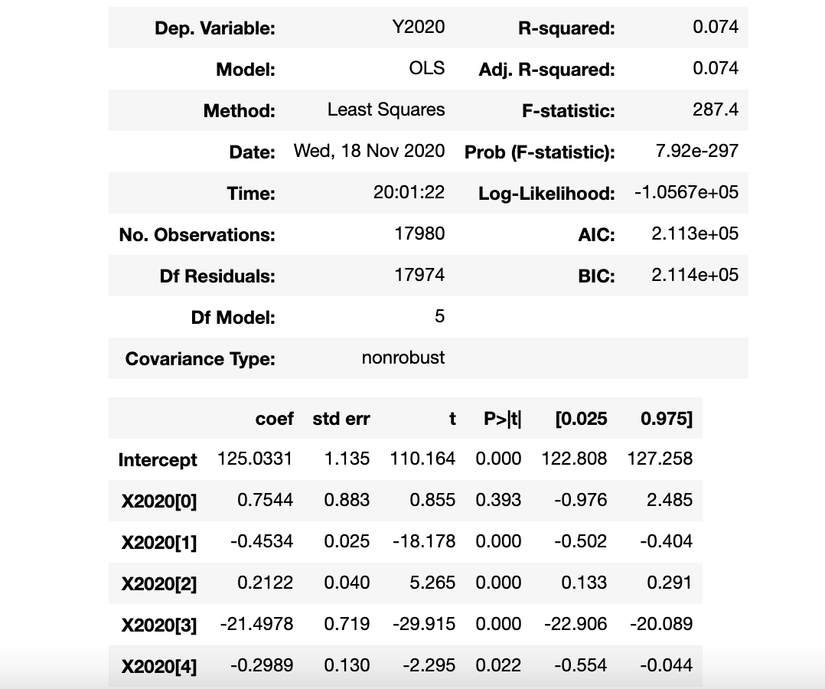
OLS for listings 2020
- X2020[0] which is the coefficient of 'reviews_per_month' attribute has p-value = 0.393 which is higher than 0.05, so we cannot reject the null hypothesis of this coefficient which means the true value of this coefficient can be 0.
- Model:
price = 125.0331 + 0.7544*reviews_per_month - 0.4534*number_of_review + 0.2122*calculated_host_listings_count -21.4978*room_type - 0.2989*minimum_nights.

Slide 13
Compare 2 models
The price of 2019 starts at 128.52 USD and the price of 2020 starts at 125.03 USD.
For reviews_per_month attribute, in 2019, 1 unit goes up in this attribute raises the price 0.86 USD. In 2020, 1 unit goes up only raises the price 0.75 USD.
For number_of_reviews attribute, in 2019, 1 unit goes up in this attribute decreases the price 0.59 USD. In 2020, 1 unit goes up decreases the price 0.45 USD.
For calculated_host_listings_count attribute, between 2019 and 2020, this attribute has an obvious change. In particular, in 2019, 1 unit goes up in this attribute decreases the price 0.14 USD. However, in 2020, 1 unit goes up raises the price 0.21 USD.
With room_type attribute, between 2019 and 2020, this attribute a significant change in number. In 2019, 1 unit goes up in this attribute decreases the price to 42.76 USD. However, in 2020, 1 unit goes up decreases only 21.50 USD.
With minimum_nights attribute, in 2019, 1 unit goes up decreases the price 0.07 USD and in 2020 1 unit goes up decreases the price 0.30 USD.

Slide 14

K-Fold Cross-validation
- Model evaluation is a very important step to determine if the model is usable, so we can re-select features or use another model.
- The accuracy of the model is 100%.

Slide 15
Decision Tree
- The purpose of using the decision tree in this problem:
Evaluate what factors are affecting the price of a lodging.
Based on the above criteria to help customers make decisions when choosing to rent a lodging.

Slide 16
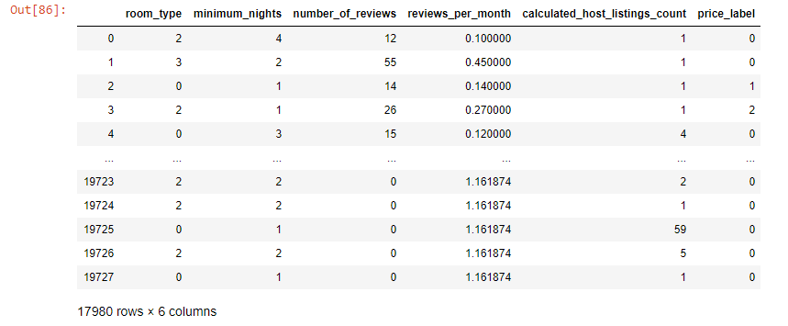
Decision Tree
- Because the price has too much value, we will create a column to evaluate - price_label with 3 values: ​​0 (low price), 1 (medium price), 2 (high price). Then, we will divide the price into 3 ranges of 0-100, 100-150, 150-10000 respectively with the value 0, 1, 2 of the price_label column.
- Eliminate unnecessary attributes to ensure the decision tree can deliver highly reliable information.

Slide 17
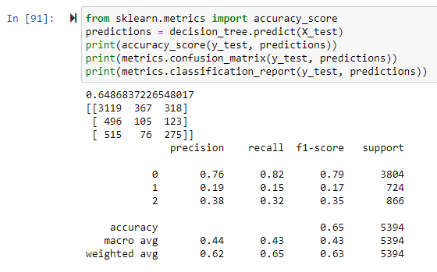
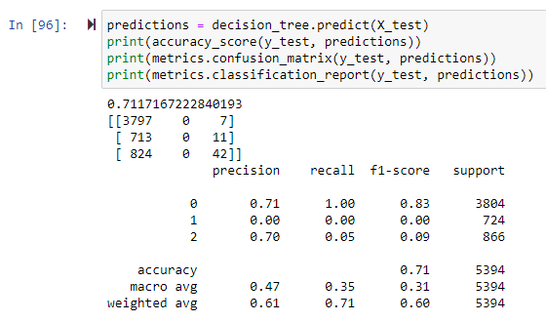
Decision Tree
When we explicitly show the max_length for the decision tree, we will see increased accuracy from 0.65 to 0.71 (The shorter the decision tree, the easier it is to make a decision)

Slide 18
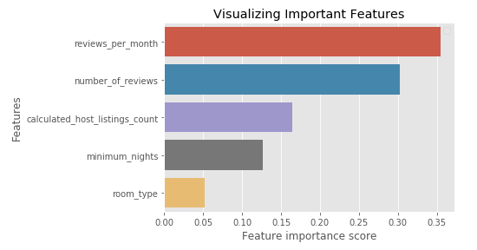
Decision Tree
Based on the chart, we will see the influence of each factor. The factors that most affect the price are 'reviews_per_month'. Factors that have little influence on price are 'room_type'. This shows that customers will be interested in the number of reviews in the month to decide whether to rent or not to rent an apartment, it significantly affects house prices.

Slide 19
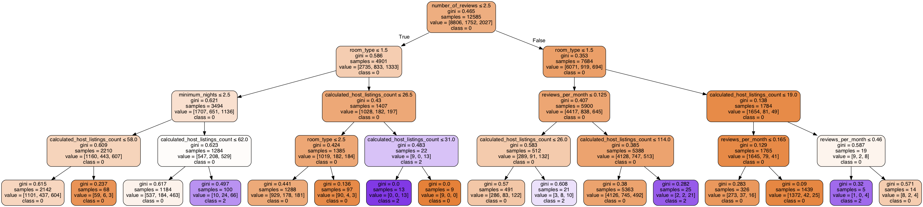
Decision Tree
- Example: in case, 'number_of_reviews' <= 2.5, 'room_type' <= 1.5, 'minimum_nights' <= 2.5, 'calculated_host_listings_count’ > 62.0. These customers will be classified into the group of customers who can rent lodging at a high price (class = 2).

Slide 20
Conclusion
- Using the ordinary least squares (OLS) regression method, the constructed model will enable the prediction of lodging market values based on various characteristics, thus enabling buyers and sellers can give a preliminary judgment.
- With the decision tree technique, rental companies can apply it to the customer classification process while also relying on the factors in the decision tree to help clients choose the right lodging.
- Even though Covid-19 is happening, it seems not to affect the Airbnb market in Milan much. The price of Airbnb market seems to stay the same from 2019 to 2020. This proves that the Covid-19 is not a factor affecting the price of rental lodging.

