Slide 1
Dating Phylogenetic Trees
What are the units of branch lengths from a statistical phylogenetics analysis?
Distance = Expected # of substititions per site
Time x Rate = Distance

Slide 2
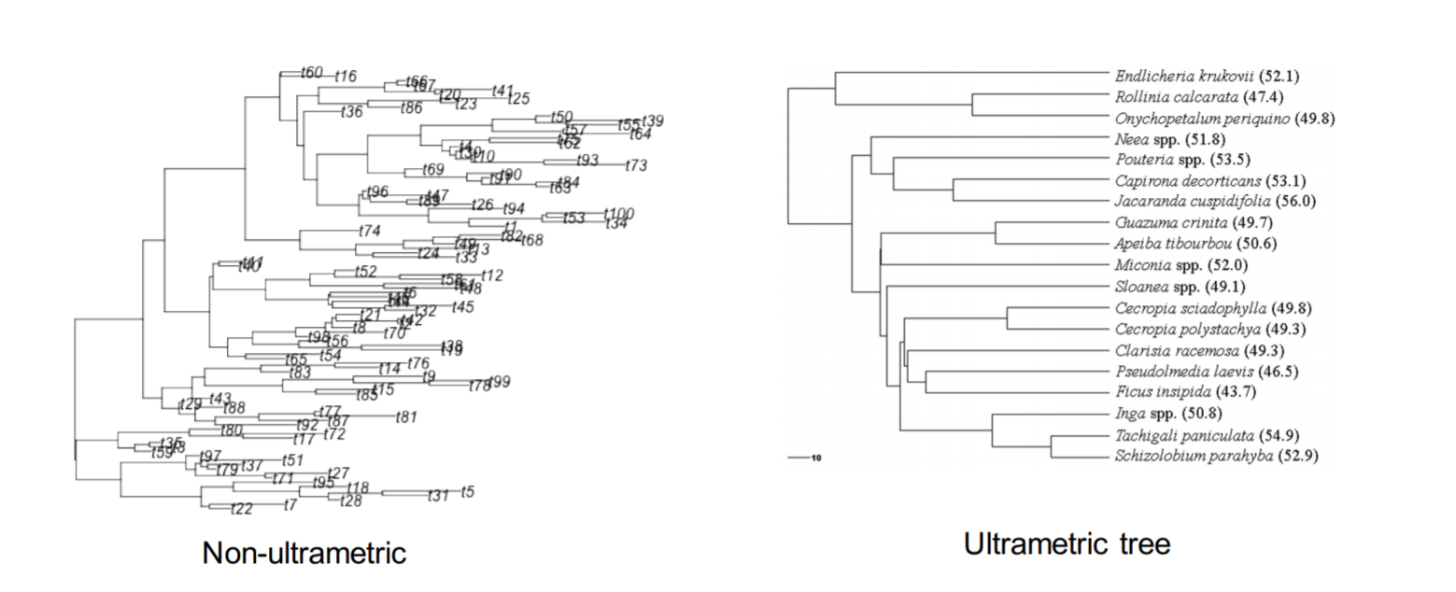
Why do we want an ultrametric tree?

Slide 3
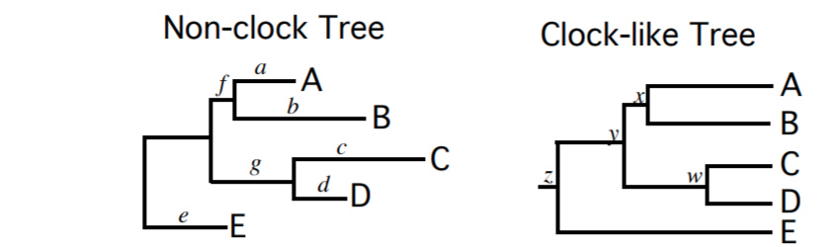
How do you get rate?
One option: Assume a universal or strict “molecular clock”
Why do real lineages often not evolve in a clock-like manner?

Slide 4
How we go from non-ultrametric tree to a chronogram in real units of time (e.g. millions of years)
Need to specify:
How the rates vary across branches
(clock model)
How branch lengths are distributed across the tree (Timetree models)
Fossil calibrations (or biogeographic, ancient DNA/sampled ancestors, etc)

Slide 5
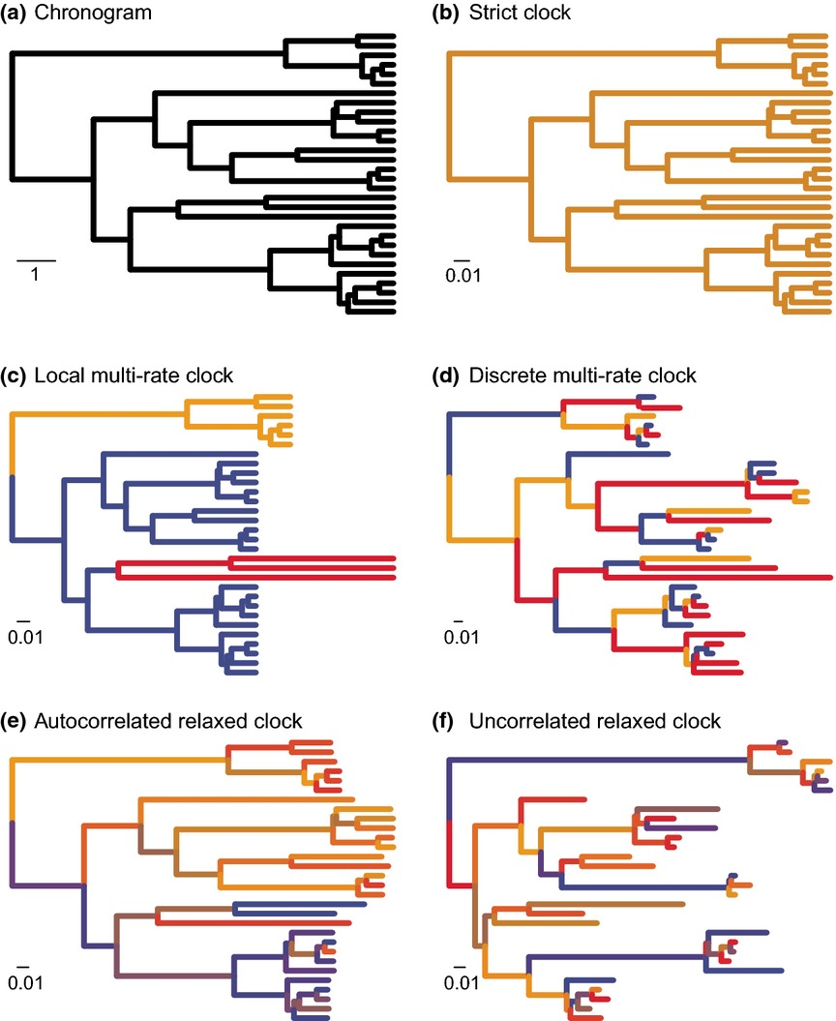
Clock Models
How do rates vary across the tree?
Ho & Duchene, 2014;
Molecular Ecology

Slide 6
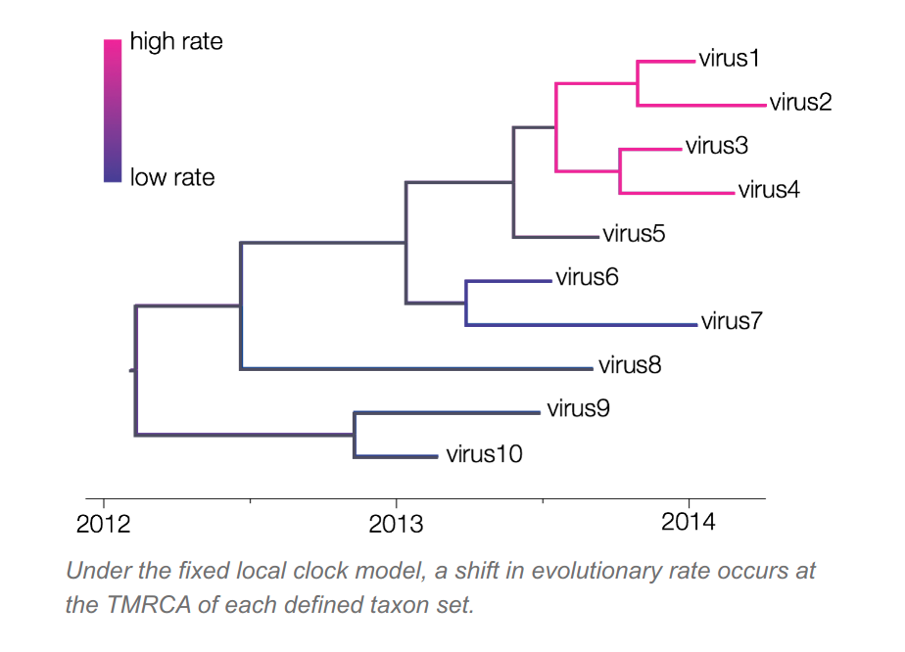
Clock Models
Local clocks
Fixed: User supplied clades
Random: Algorithm finds small number of clades

Slide 7
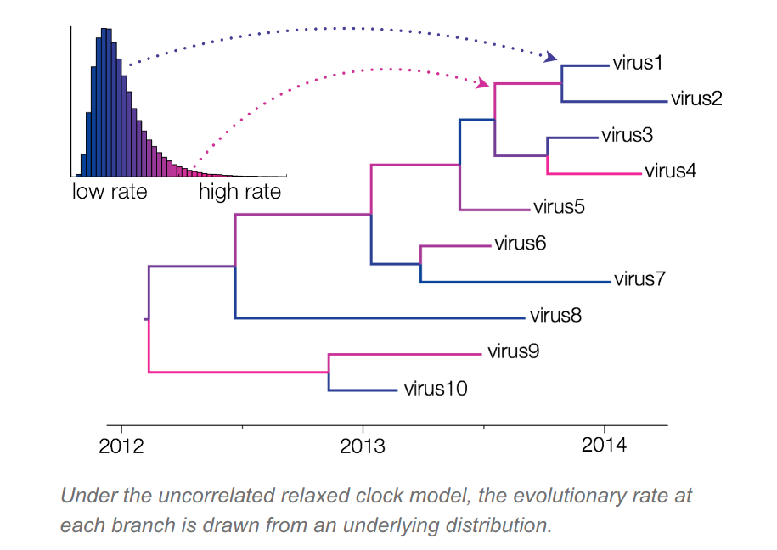
uncorrelated relaxed clock (often lognormal distribution, kind of like gamma rates, but across branches, not sites)

Slide 8
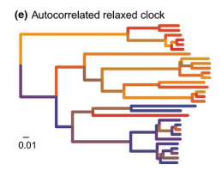
autocorrelated relaxed clocks
Rates have “memory” from
previous branch
Non-parametric “smoothing” approaches assume autocorrelated rates, and try to minimize the change across branches Sanderson (1997. Mol. Biol. Evol., 14:1218); r8s, treePL, chronoPL. Fast and efficient for large trees. Assumes branch lengths are estimated without error. Quick and dirty approach.

Slide 9
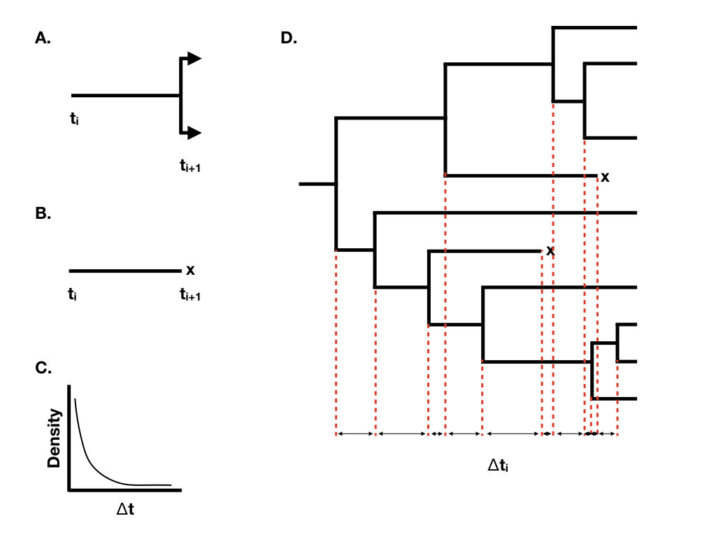
Timetree models
Birth-death model
speciation rate, λ extinction rate, μ
Diversification rate: λ - μ
Turnover: λ + μ
Yule/pure-birth model if μ = 0
Image from Harmon textbook
(Will cover this a bunch more
studying diversification)

Slide 10

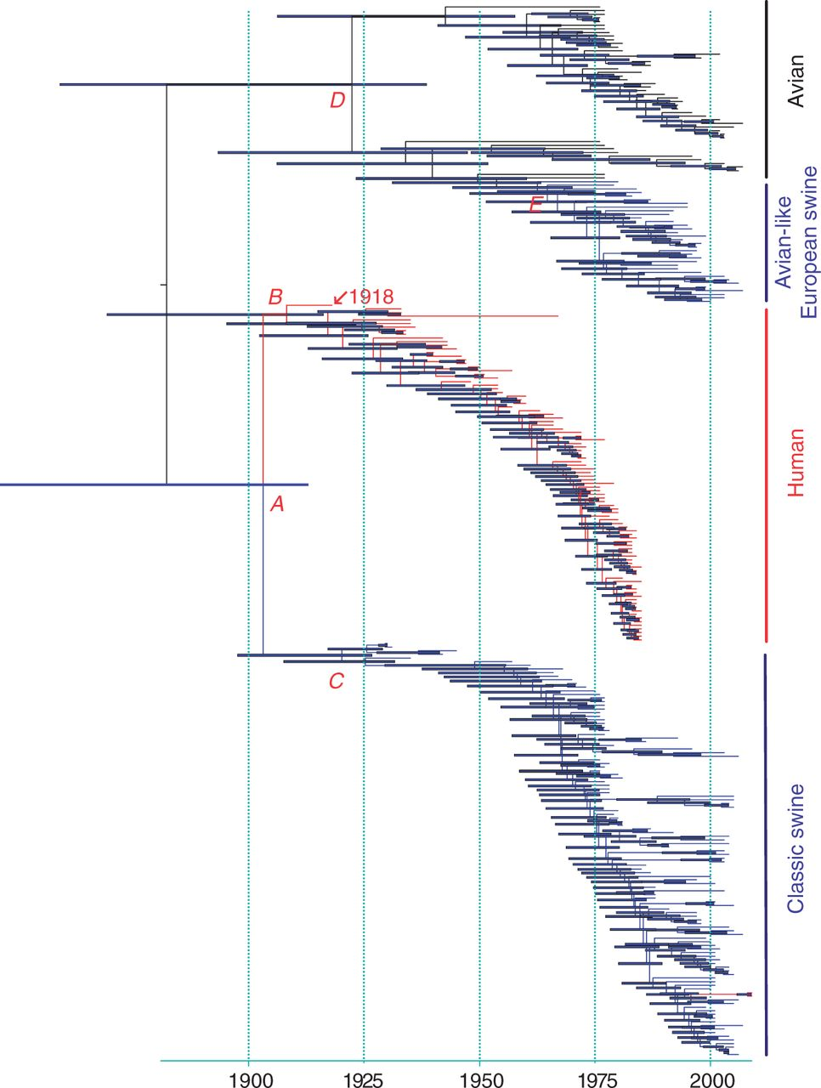
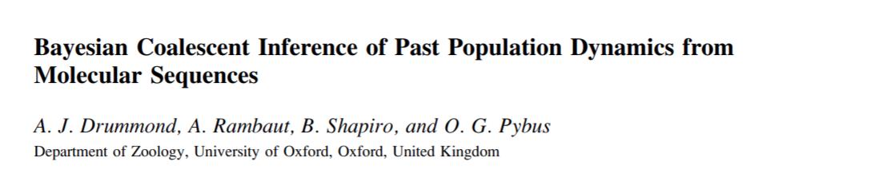
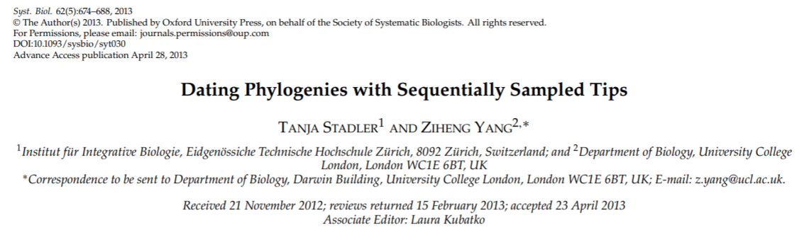
Phylodynamics
Other timetree models: Coalescent priors
Often used for viral dynamics Include “population size” as a parameter and allow inference on past demography
Tanja Stadler

Slide 11
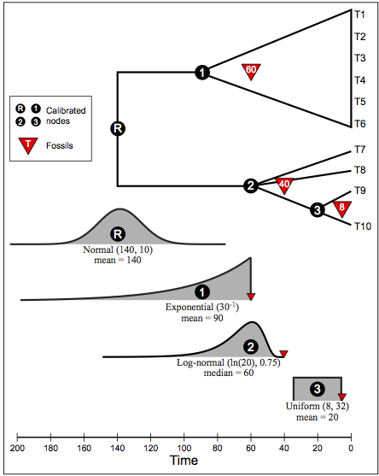
Calibrating nodes
Incorporates uncertainty
Drawback...Only the oldest fossil in a crown group is used to set the prior
Figure from Dennis Lavrov,
https://sites.google.com/site/eeob563/computer-labs/lab-7

Slide 12
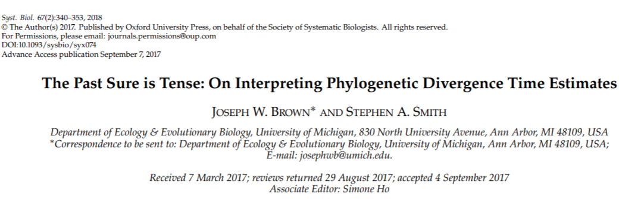
Another drawback...
Setting complicated, interacting priors
Sometimes the prior you think you're setting isn't what you're actually setting...

Slide 13
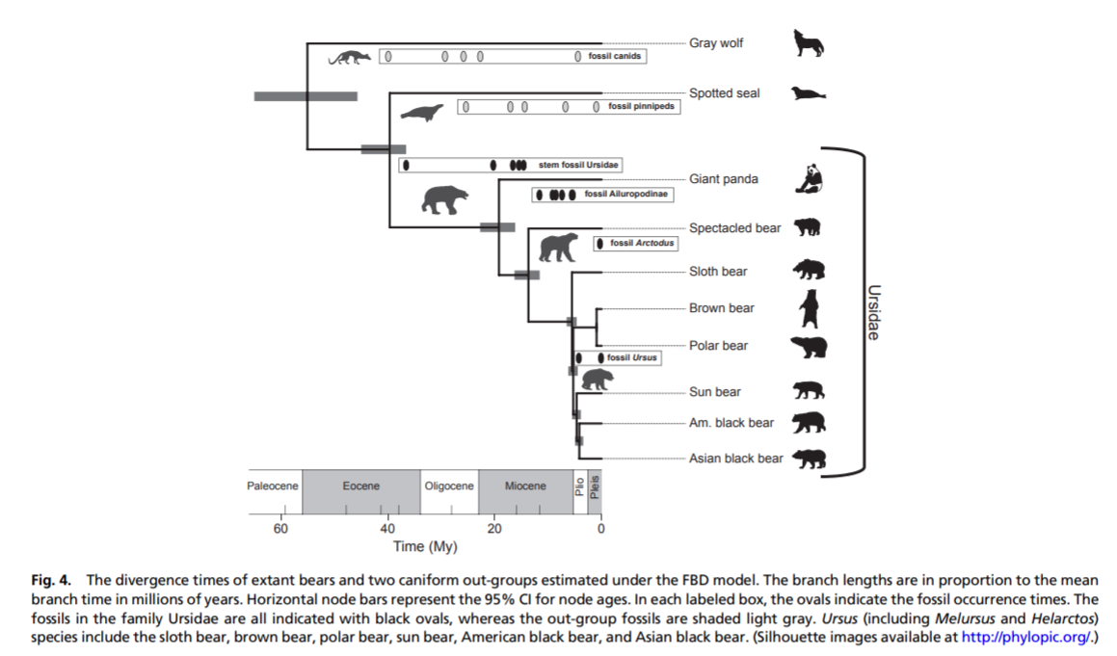
Tip-Dating

Slide 14
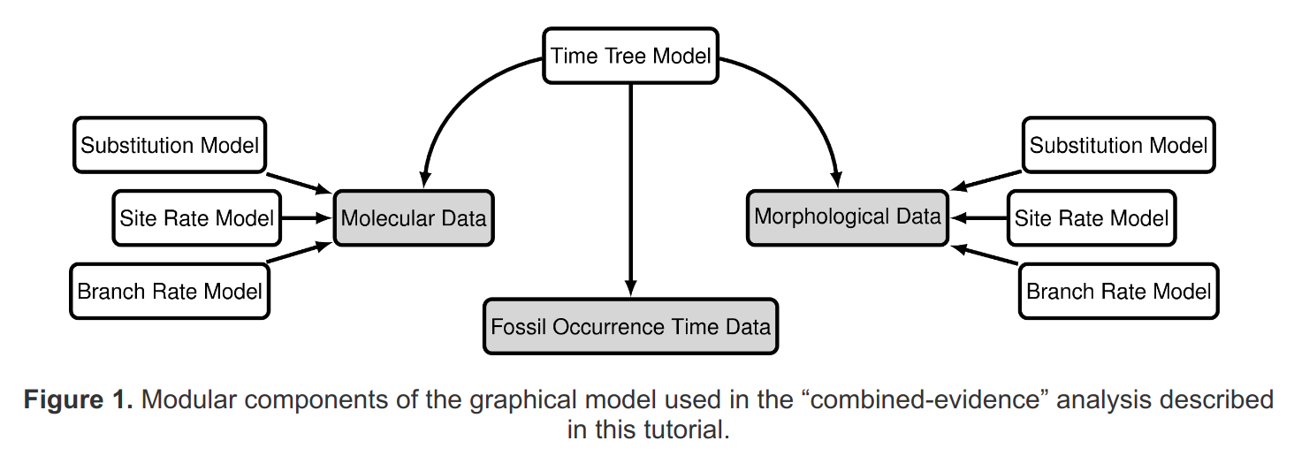
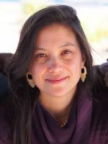
Fossilized Birth-Death Process & Total evidence analyses
https://revbayes.github.io/tutorials/fbd/
Tracy Heath Iowa State U.

Slide 15
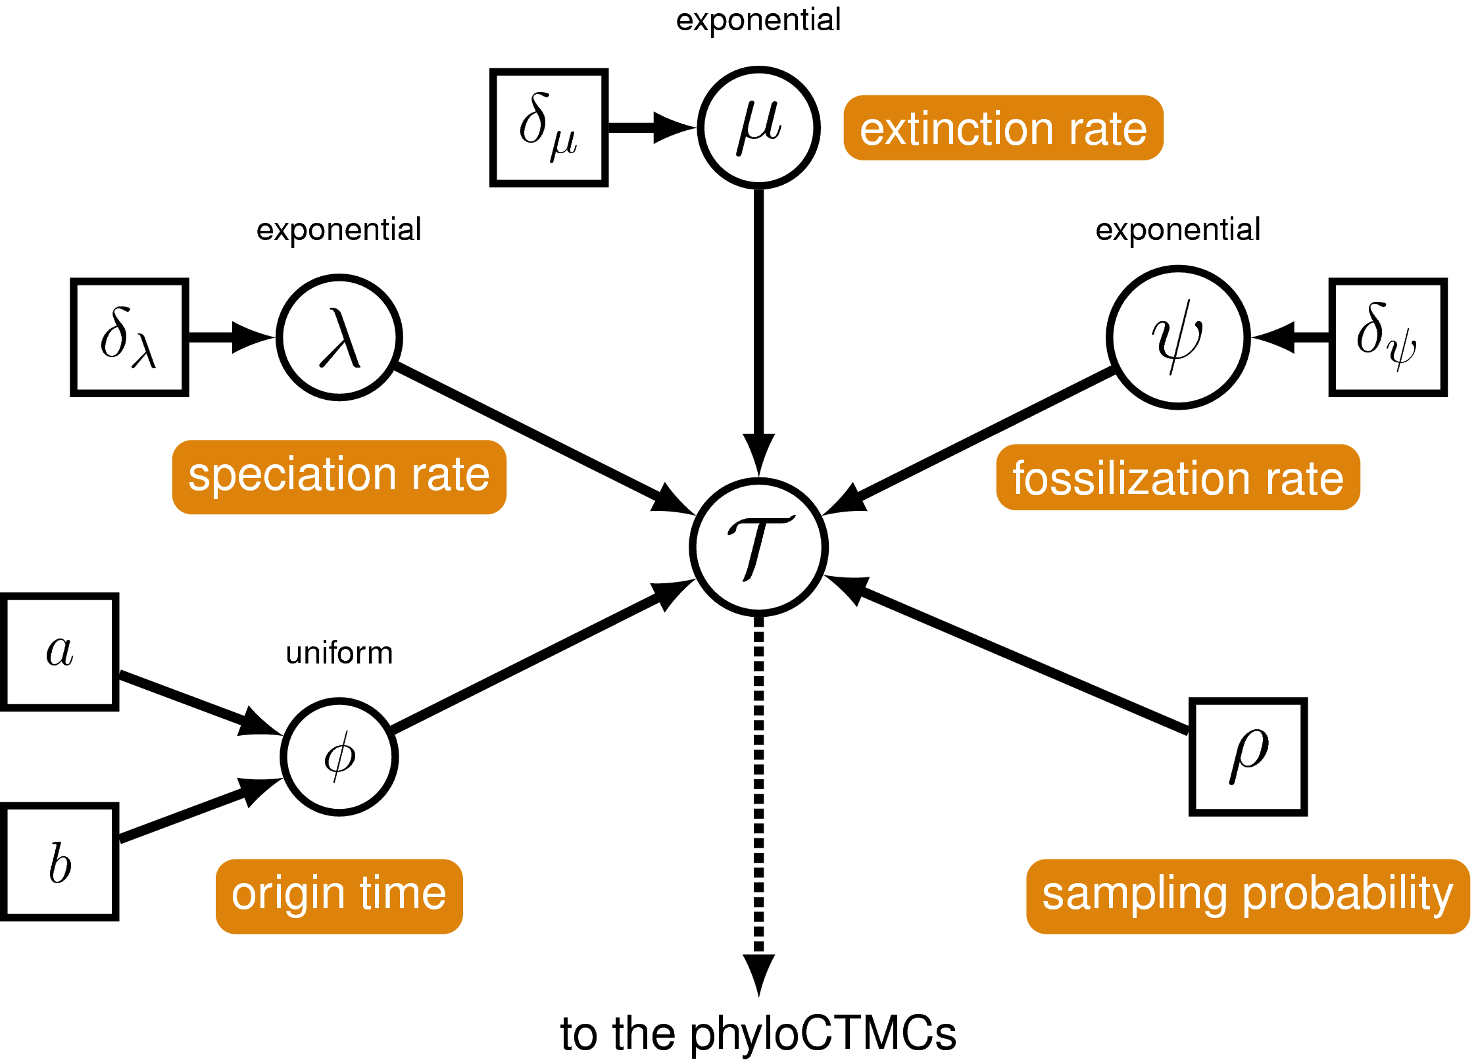
Timetree model: FBDP

Slide 16
Sampling ancestors
We usually assume we can't directly sample ancestors
But what does this depend on?
What if we sample closer to the present? What if we sample

Slide 17
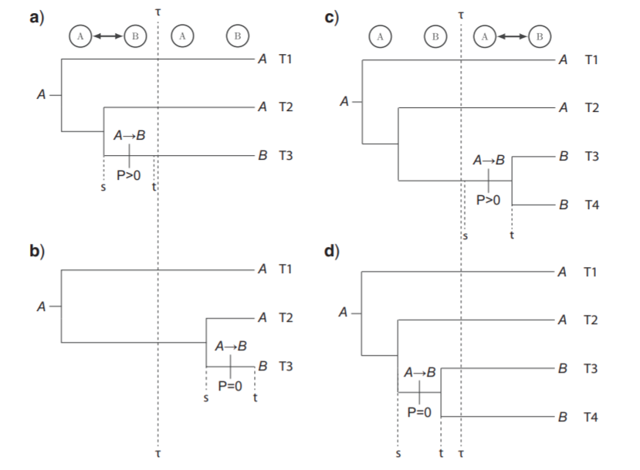
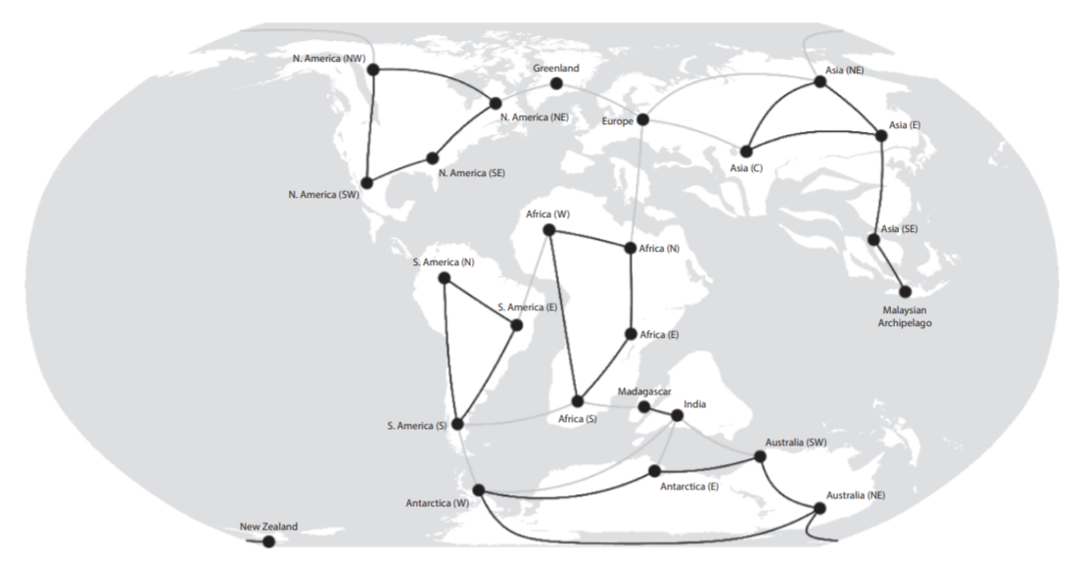
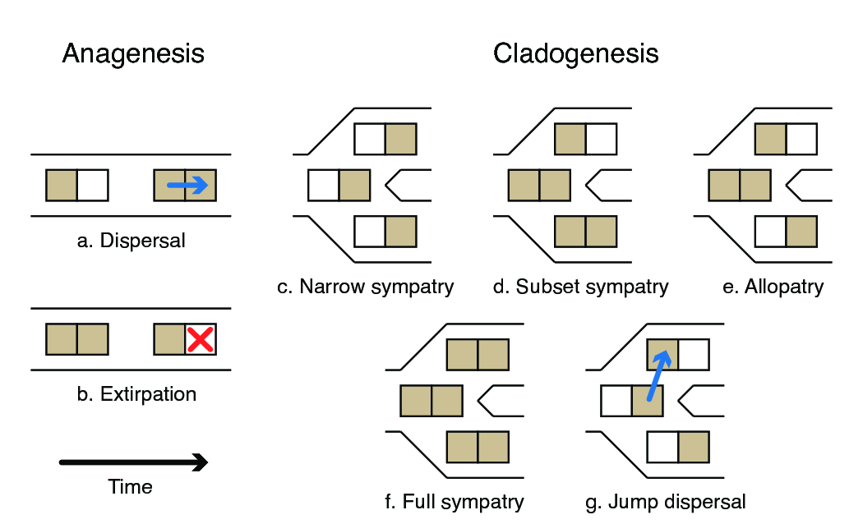
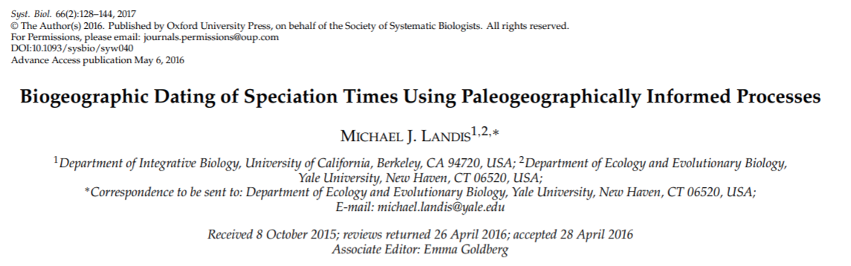
Dating with biogeography
DEC model
Dispersal + Extinction + Cladogenesis
(Ree & Smith 2008)
(This is the model I
showed on the exam)

Slide 18
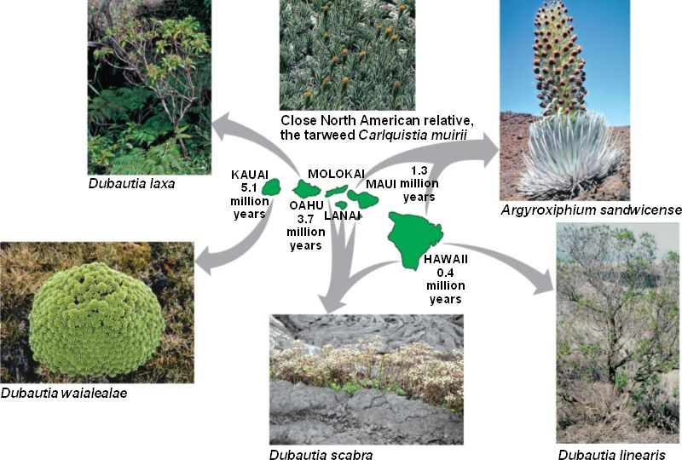
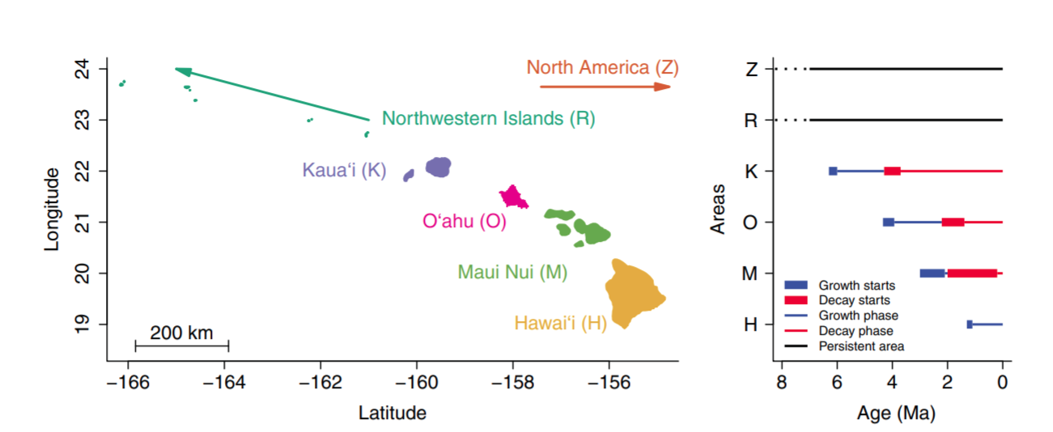
Hawaiian Silverswords (Landis, et al. 2018)

Slide 19
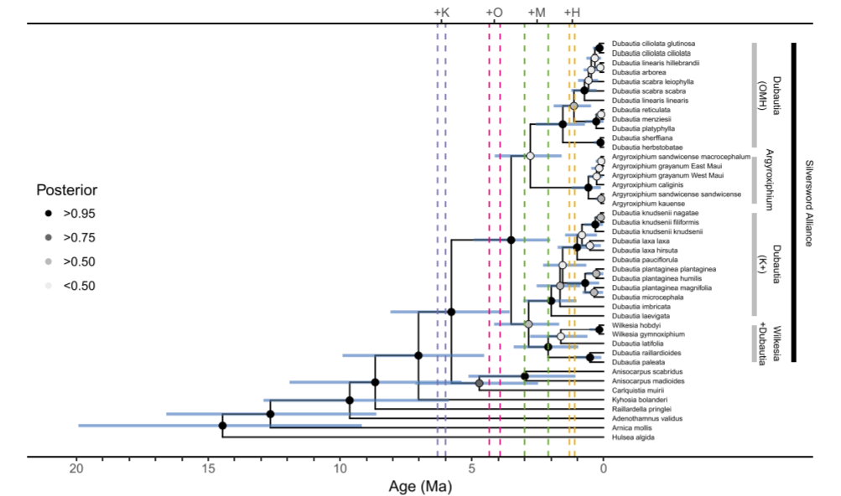
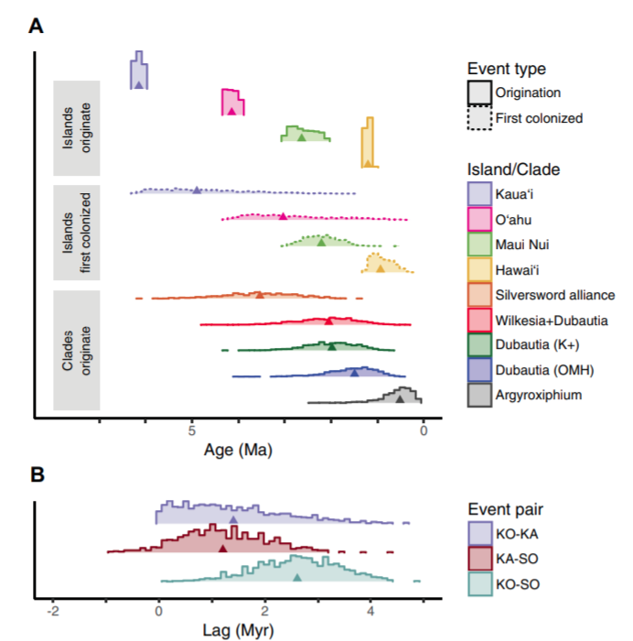
Hawaiian Silverswords (Landis, et al. 2018)

Slide 20
Summary
In order to convert phylogenies to timetrees, we need additional data and/or assumptions (non-identifiability of rate/time).
Clock models model heterogeneity in rate across branches, timetree models make assumptions about how the tree is shaped/formed
Calibrations can be placed as constraints or priors at nodes, or in tip-dating analyses
Total-evidence/integrated analyses are extremely promising for building our knowledge of evolutionary history

