Slide 1
Diversification & SSE models

Slide 2
A word about Ancestral State Reconstruction...

Slide 3
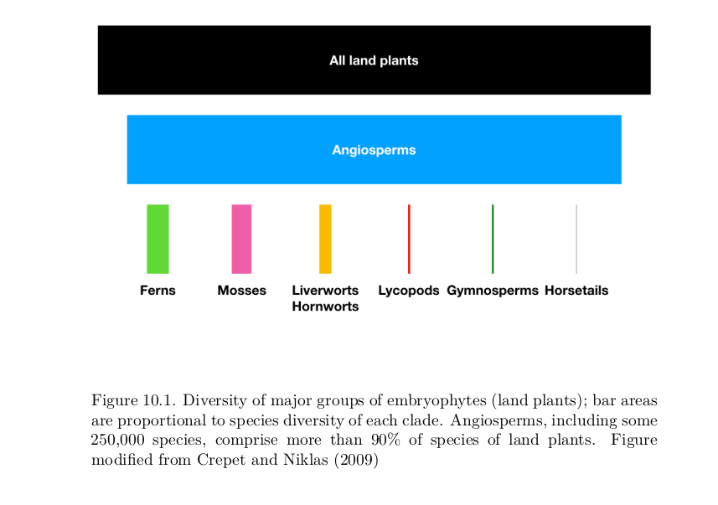
Why care about diversification?
(Harmon, Phylogenetic comparative methods)

Slide 4
Birth-Death model
Poisson process (like CTMC models) - but events = Speciation/Extinction rather than substitution

Slide 5
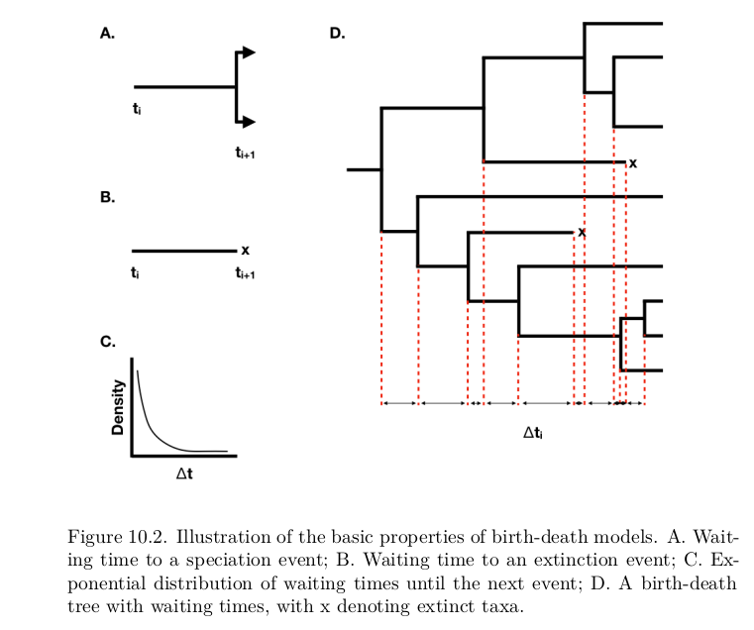
(Harmon, Phylogenetic comparative methods)

Slide 6
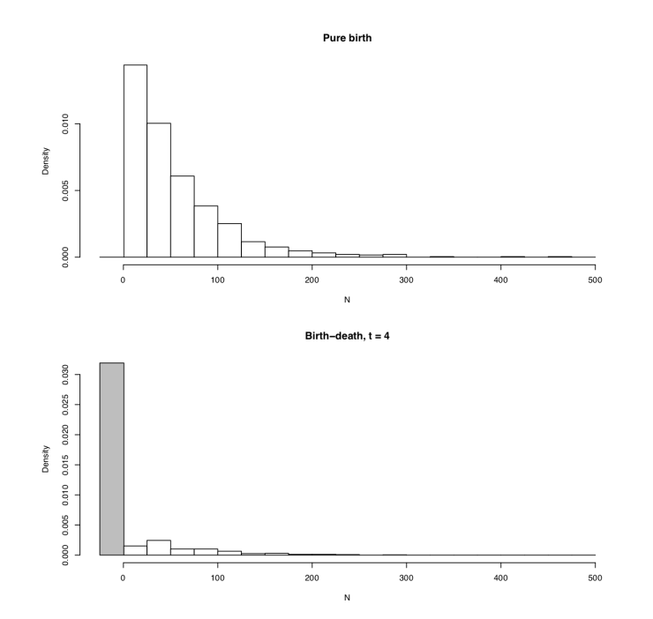
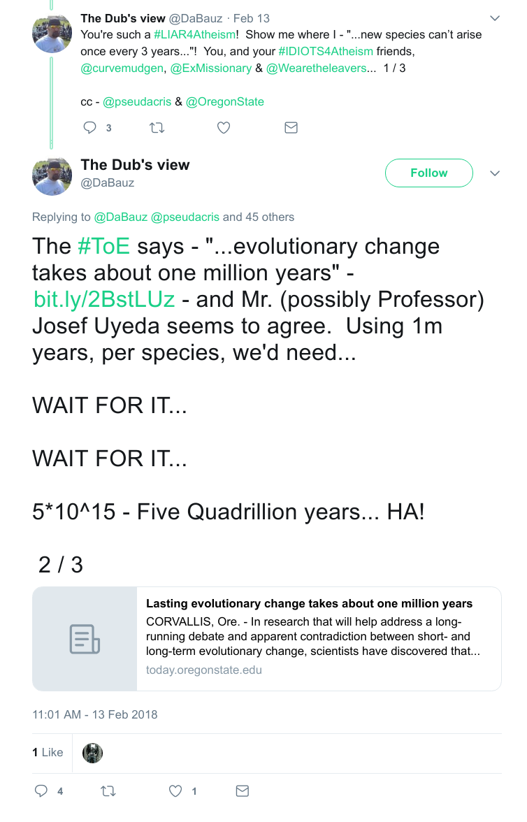
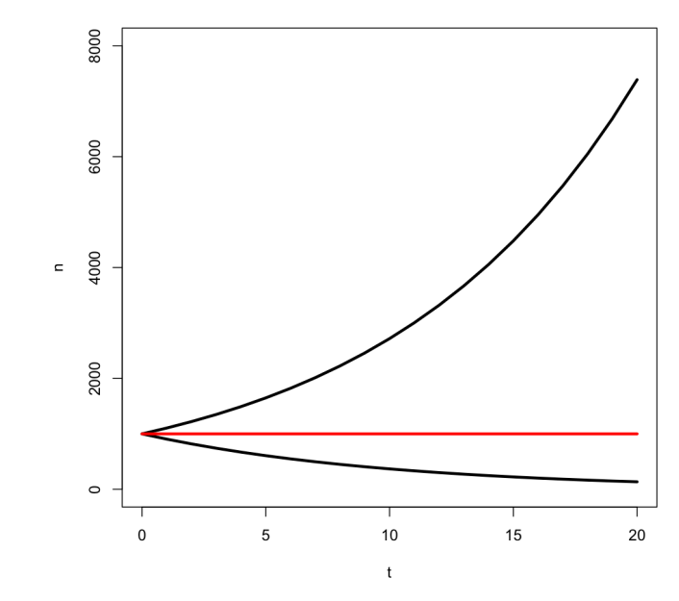


Slide 7
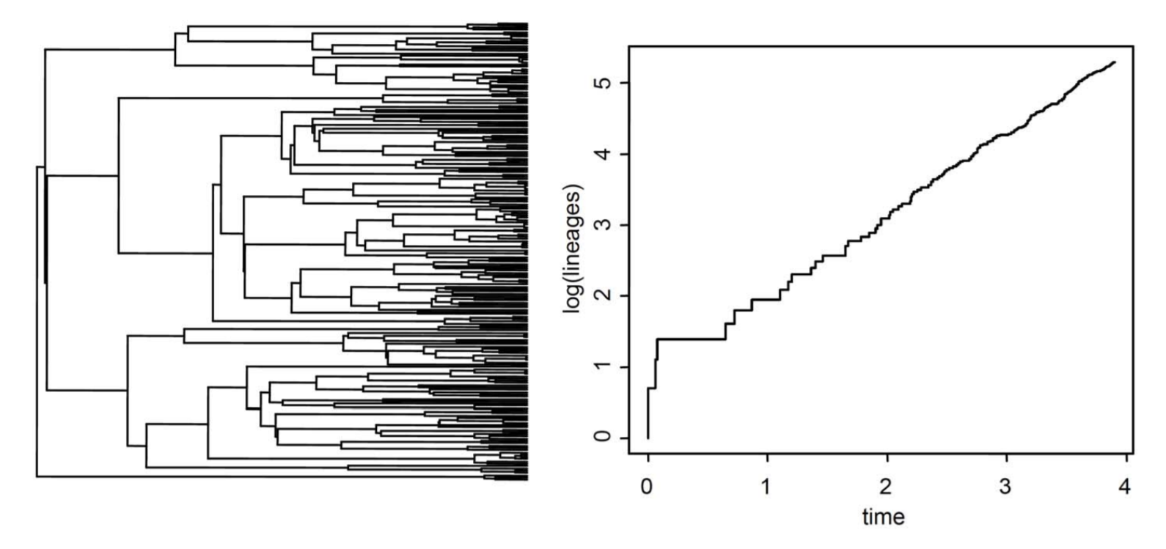
Diversification vs. Turnover
λ =Speciation rate
μ = Extinction rate
λ - μ = Diversification rate
μ/λ = Turnover rate
Yule process/Pure Birth model -> μ = 0
Under pure birth,
lineages accrue
log-linearly with time

Slide 8
A few notes...
Speciation and extinction correlated in nature, and in estimation
Estimating diversification and turnover often easier
Can we even estimate extinction from extant-only data?

Slide 9
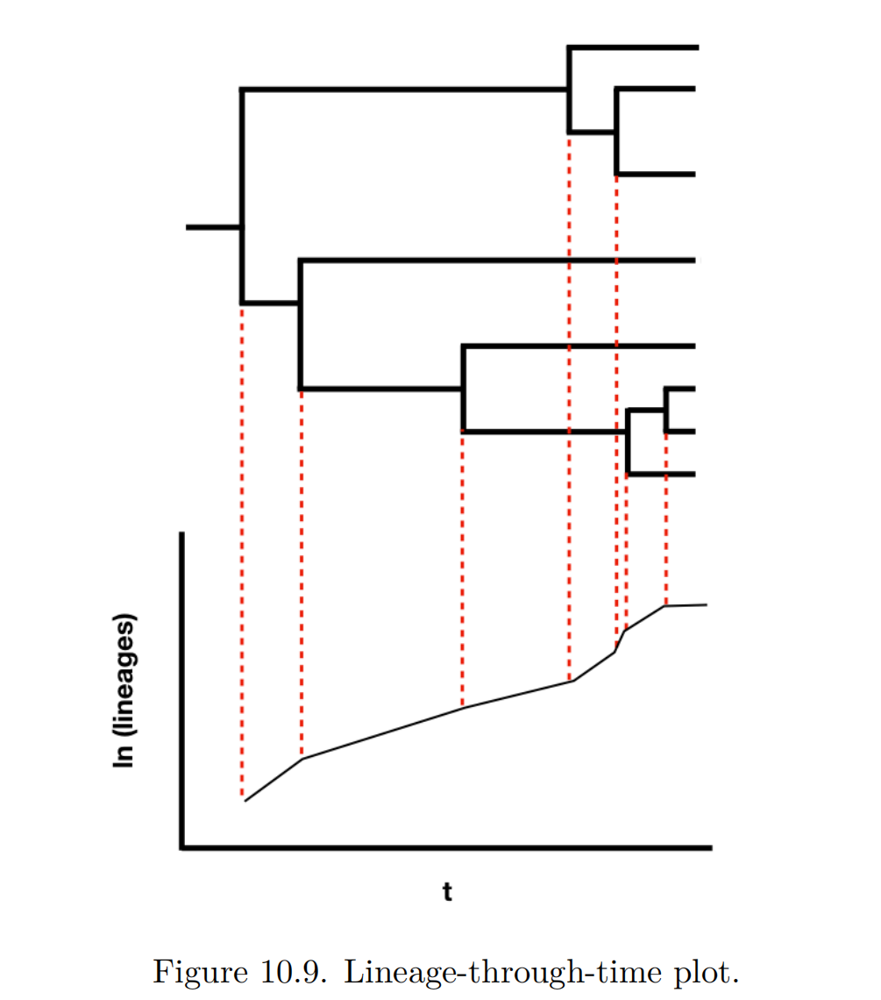
Lineage through time plots

Slide 10
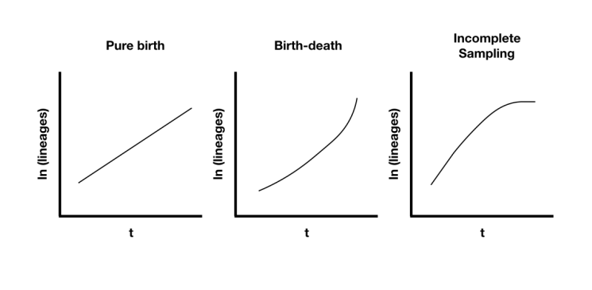
Lineage through time plots

Slide 11
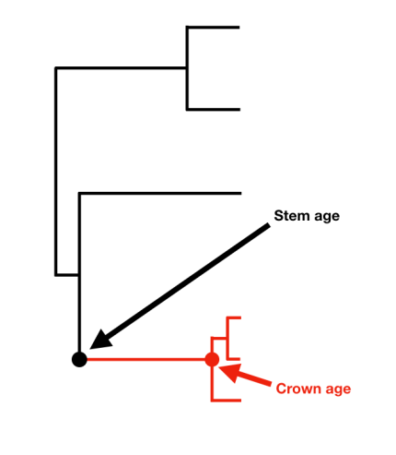


Estimating diversification
Net diversification methods using clade age & diversity (can be used on unresolved trees)
Magallon & Sanderson, 2001

Slide 12
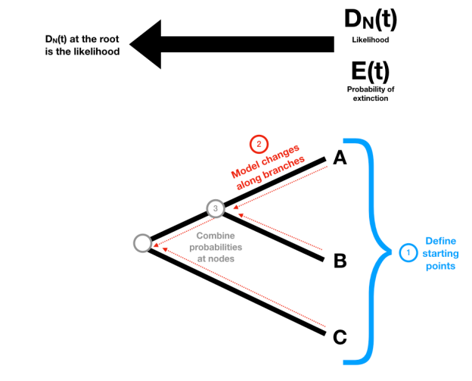
Estimating diversification
Using the distribution of branch lengths/waiting times (requires whole tree or partial tree and assumptions about sampling)

Slide 13
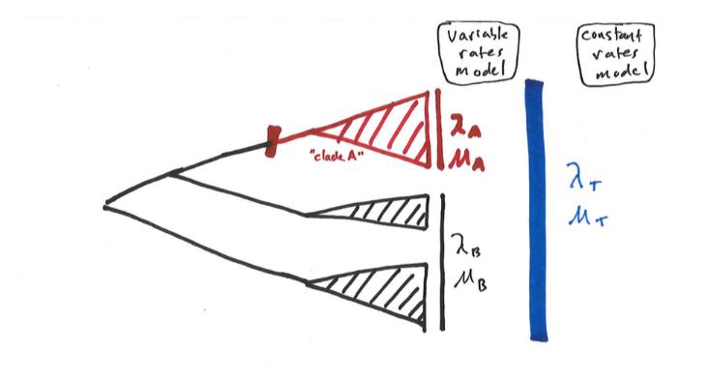
Modeling heterogeneity in diversification
Hypothesis testing

Slide 14
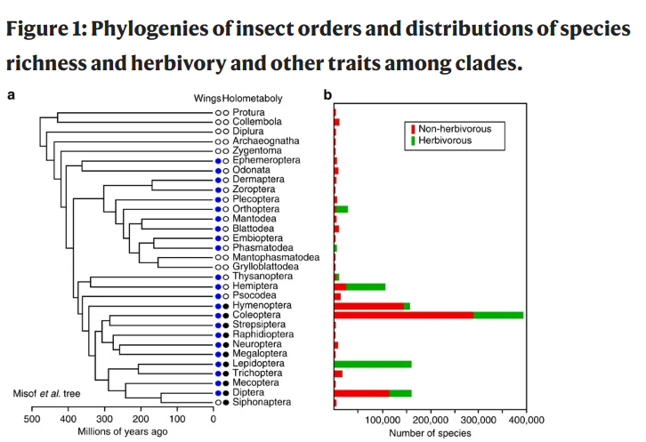
Sampling
Usually we don't have random sampling of taxa from a phylogeny
Supply each tip with # of taxa it represents
Or
Assume all sampling is random, & provide sampling fraction

Slide 15
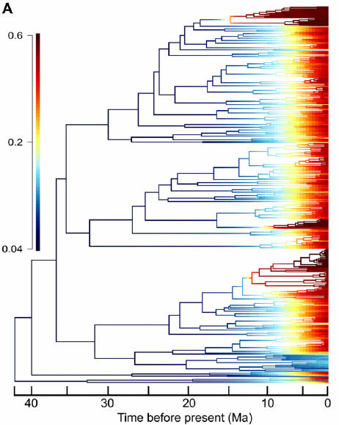
Changing diversification over time
Does diversification increase or decrease toward the present?
Biases...
“Pull of the present” “Push of the past”
Protracted speciation

Slide 16
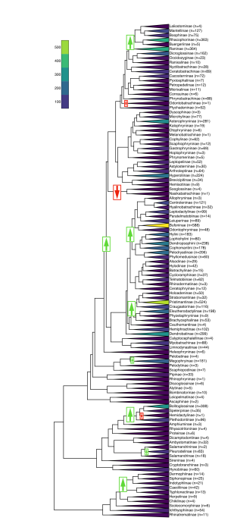
Finding evolutionary shifts
in diversification
Bayesian - BAMM (But see controversies)
Likelihood (Stepwise AIC) - MEDUSA (but see problems with stepwise AIC)

Slide 17
Easy to do with a phylogeny, but controversies abound

Slide 18
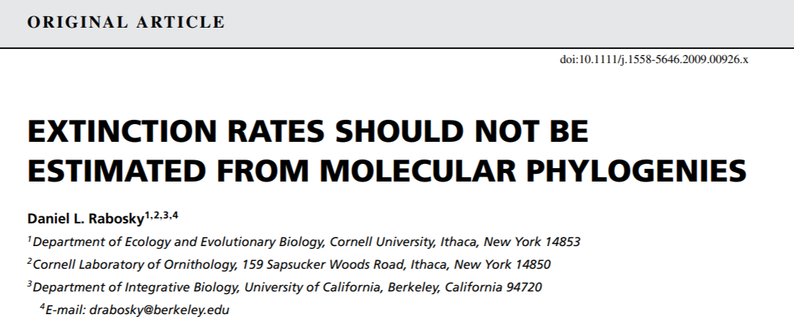

Can we ACTUALLY estimate extinction?
Frequently estimated to
be 0, diversification rates
often viewed as more reliable,
but....

Slide 19
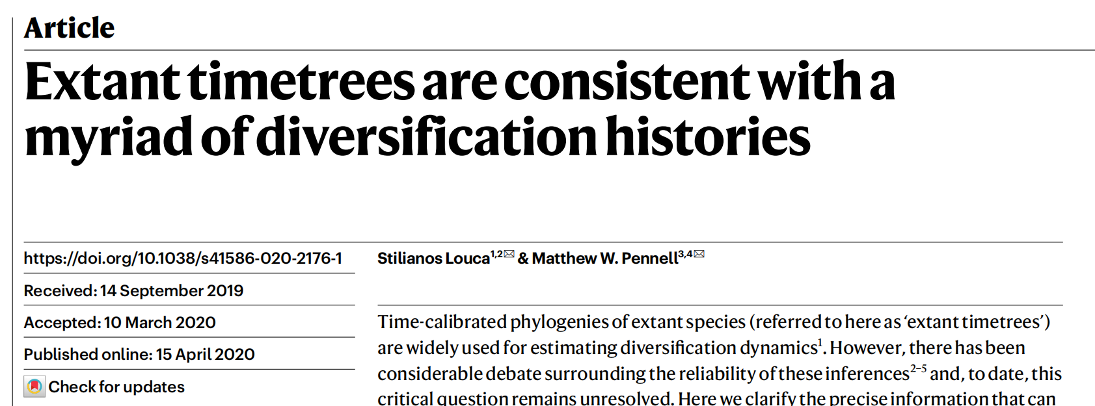
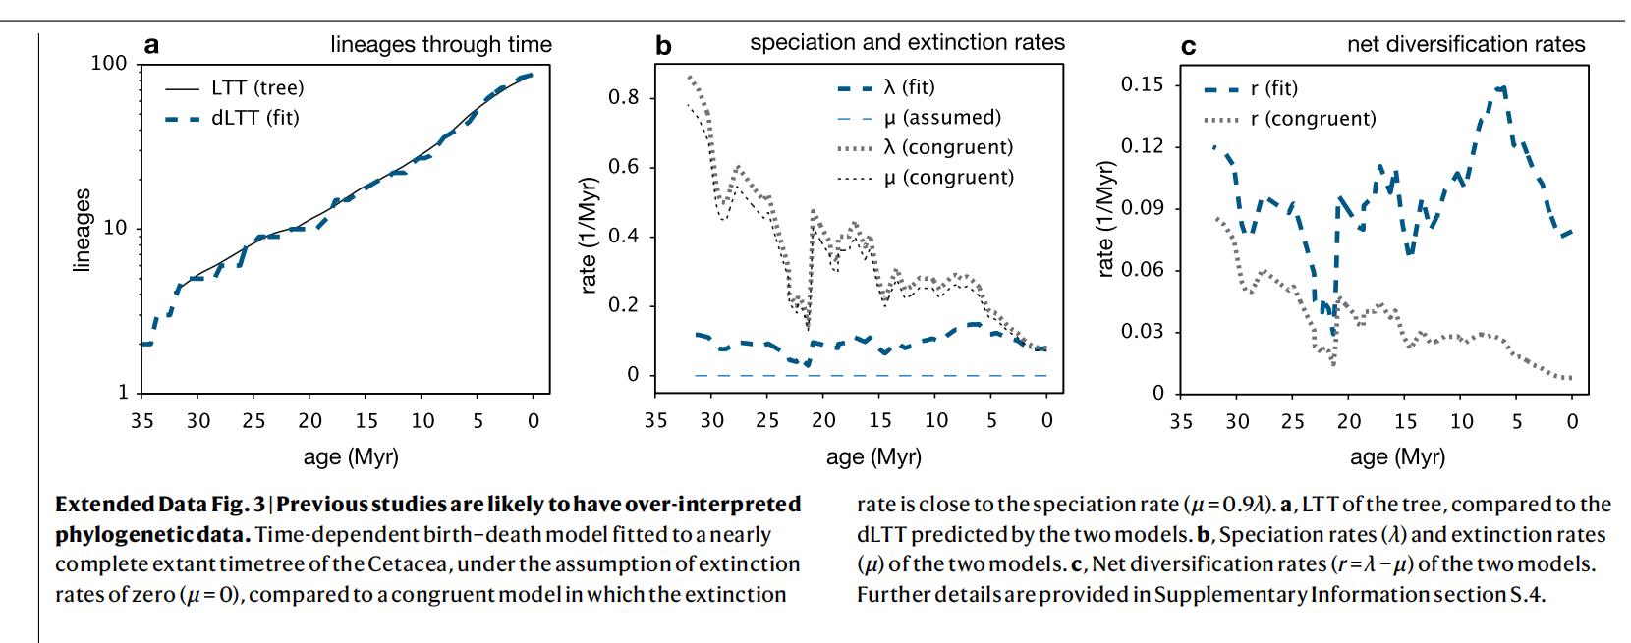

Slide 20
What's the deal with the BAMM fights?
BAMM's likelihood is wrong - model tries to evaluate diversification shifts as a Poisson Point Process
Such a process however, produces shifts on branches that then increase in extinction rate; biasing the sample of what is observed
Accounting for those “unobserved shifts” is not done correctly, and we don't have a method that does it correctly - hard problem.
But....results probably correlated with the truth/good heuristic

Slide 21
Other active areas of research:
Incorporating fossils & sampling
Diversity-dependent diversification
Time-varying diversification
Protracted Speciation
Neutral theory (Hubbell) from ecology
Trait-dependent diversification

Slide 22
Trait-dependent diversification
One approach: Estimate net div in a bunch of clades, estimate trait (prop/freq) in same clades, see if correlated (w/PGLS)

Slide 23
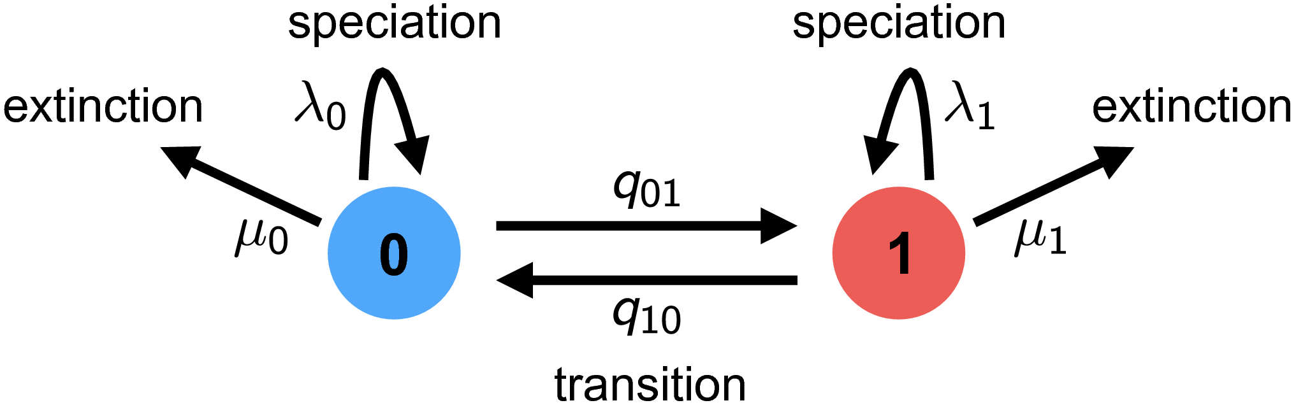
Trait-dependent Diversification
Species Selection (sometimes species sorting)
-- Controversial?!? Not anymore!

Slide 24
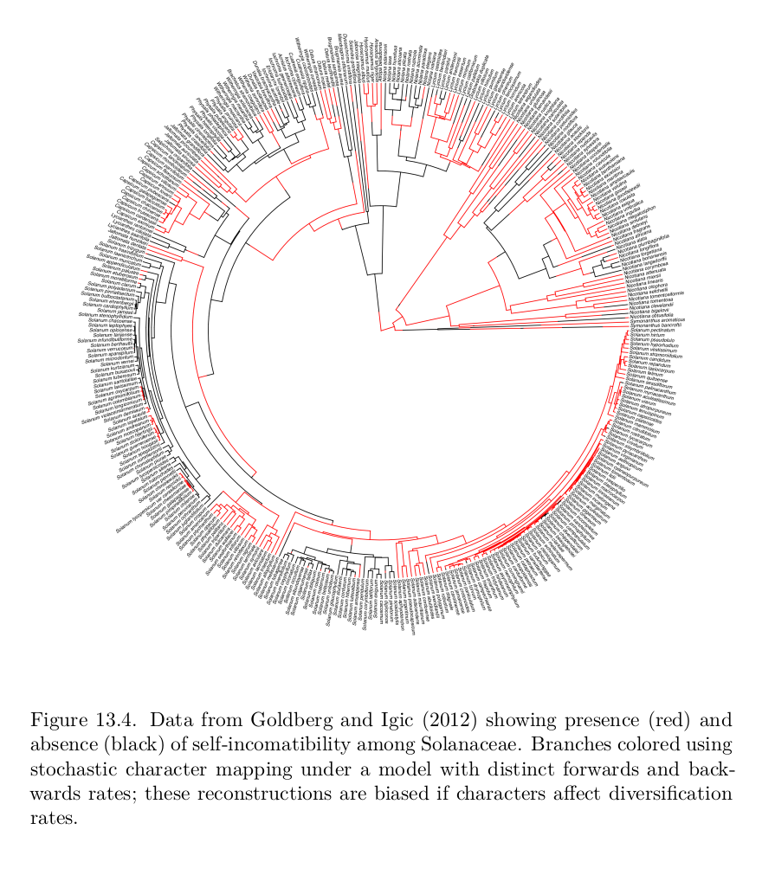
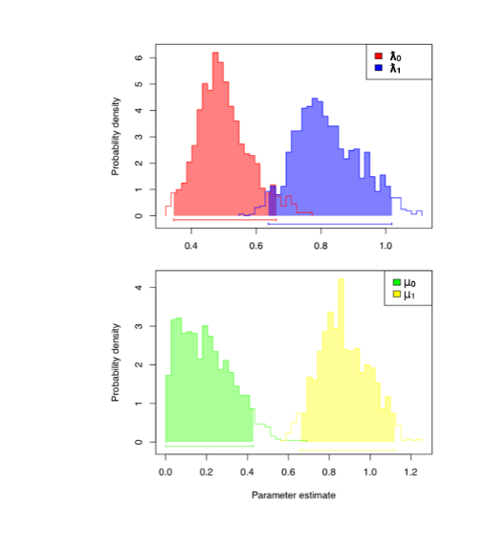
Why important?
Ancestral state reconstructions biased with trait-dependent diversification! (Maddison 2007)

Slide 25
Example:
Self-incompatibility in plants: Prevents selfing
Equal distribution but...
Selfing results in higher speciation rates AND higher extinction rates
Ancestor more likely SI than SC

Slide 26
The SSE family of models
Trait models:
BiSSE: Binary State-dependent Speciation and Extinction (extensions for incompletely resolved trees)
MuSSE: Multiple SSE
QuaSSE: Quantitative SSE (but slow)
Models where something special happens at nodes:
GeoSSE: Geographic SSE (DEC + SSE)
BiSSE-ness/ClaSSE: Cladogenetic SSE
Hidden-state models that account for background heterogeneity:
HiSSE: Hidden-State SSE (Solution to problem pointed out by Rabosky and Goldberg)
GeoHiSSE: Geographic Hidden-State SSE

Slide 27
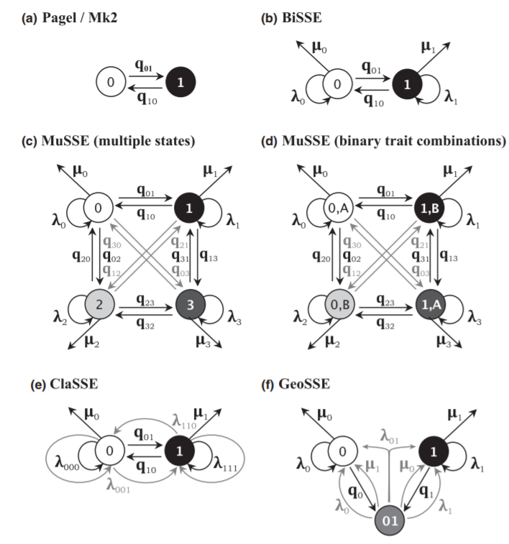
Ng & Smith 2014, Journal of Evolutionary Biology

Slide 28
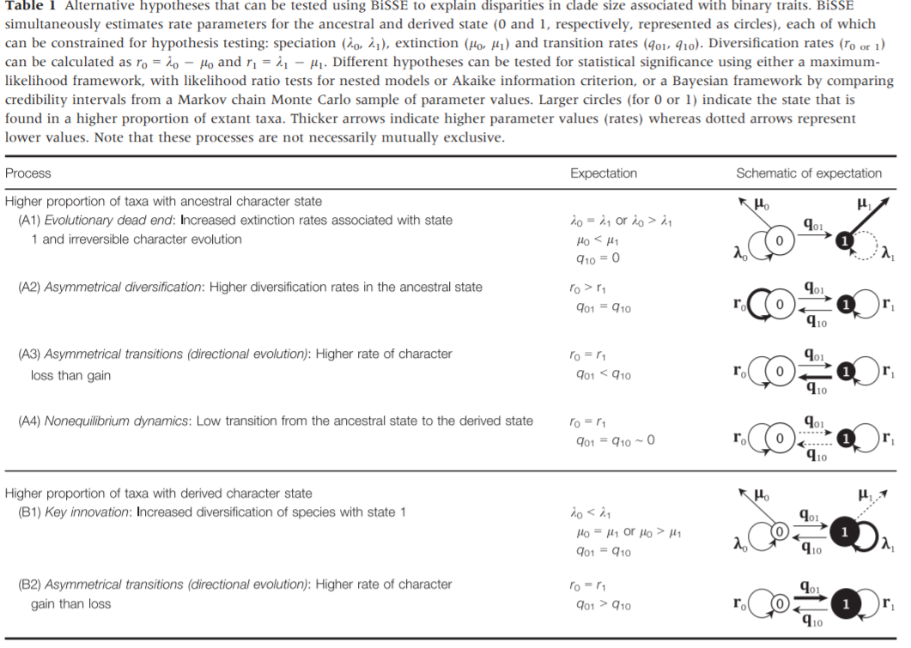
Ng & Smith 2014, Journal of Evolutionary Biology

Slide 29
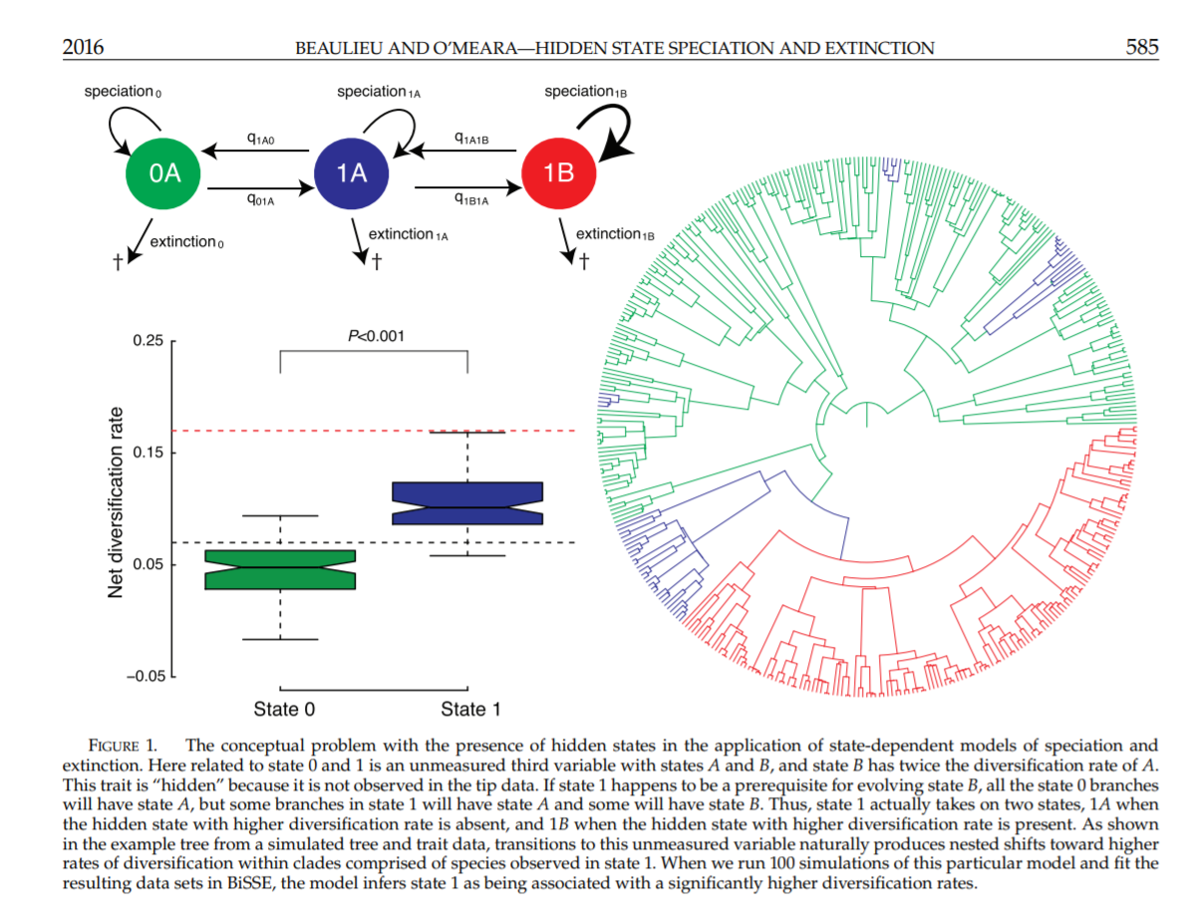

Slide 30

Next time: Diversitree lab

