Slide 1
The Comparative Method

Slide 2
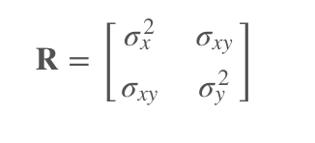
Multivariate Brownian Motion
Univariate:
root = μ
step variance = σ²
Multivariate (N traits):
root = c(μ₁, ..., μ_{N})
step variance =

Slide 3
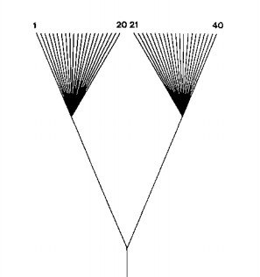
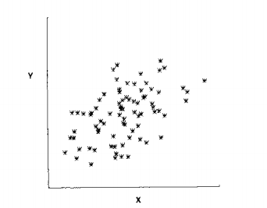
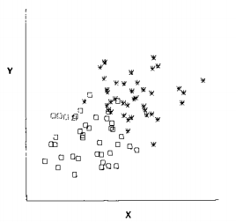
Felsenstein 1985

Slide 4
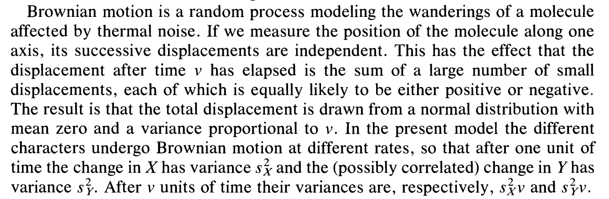

Slide 5
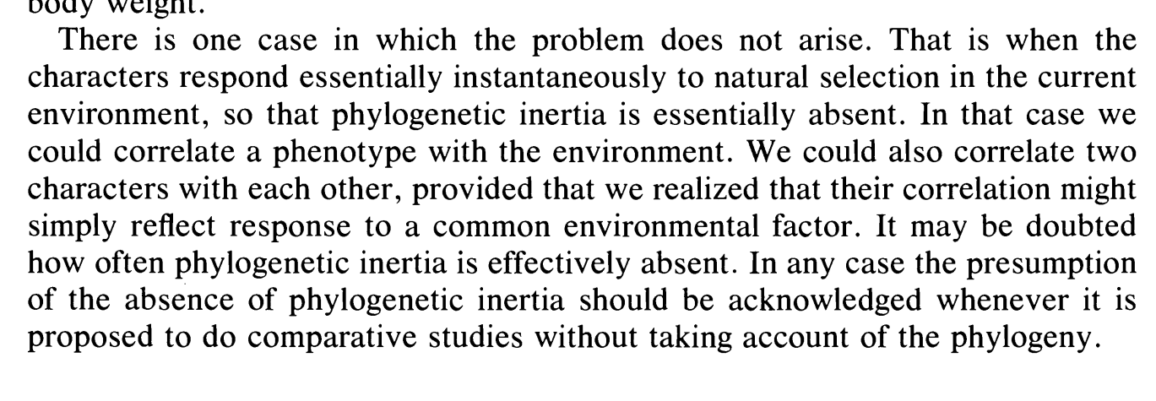
What is meant by this passage? Why does Felsenstein make this argument?

Slide 6
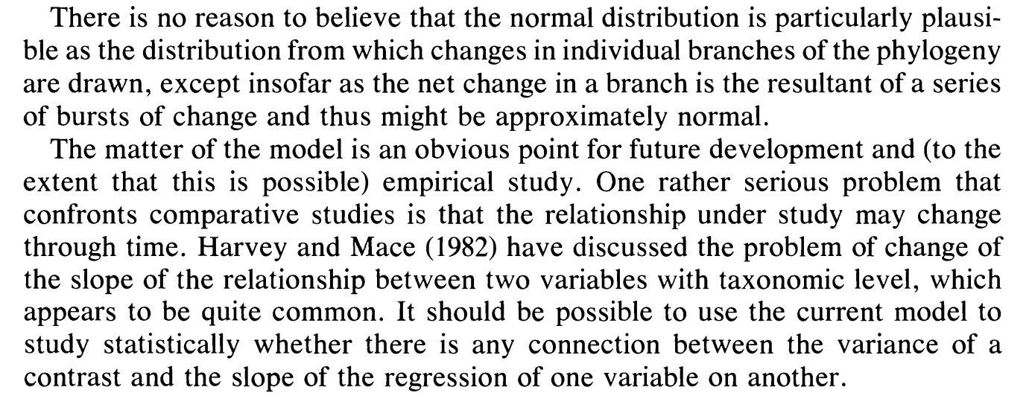

Slide 7
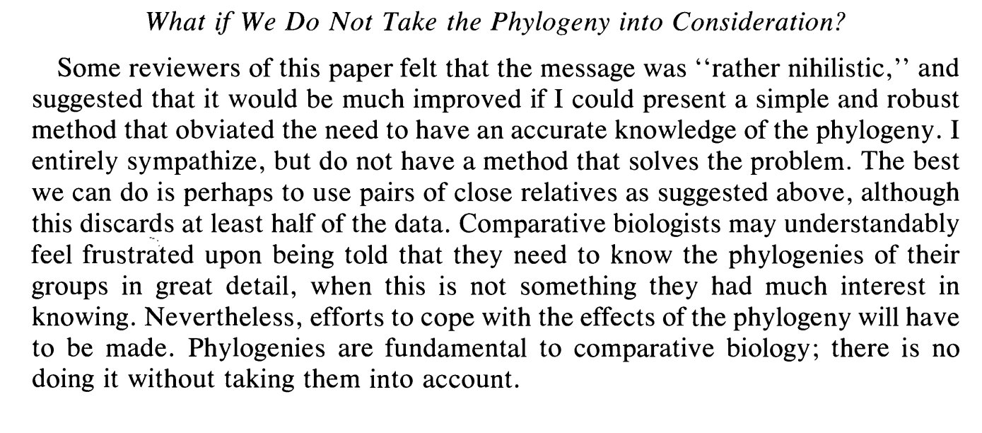

Slide 8
Phylogenetically Independent Contrasts Regression
N-1 contrasts for N tips
Regress Y ~ X (or X ~ Y) with intercept fit through the origin
Assumes multivariate Brownian Motion of both X and Y
Can incorporate measurement error in both X and Y (Felsenstein 2008)

Slide 9
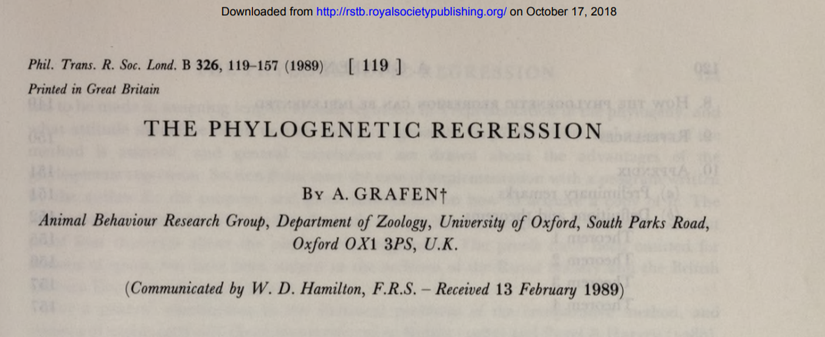
Phylogenetic Generalized Least Squares Regression

Slide 10
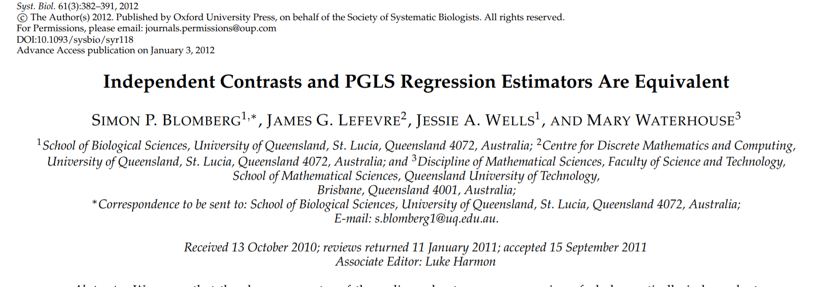
Turns out...

Slide 11
Y ~ X
E₀
E₁
E₂
E₃
E₄
E₅
E₆
Y₅
Y₆
Y₇
Y₈
X₃
X₄
X₅
X₆

Slide 12
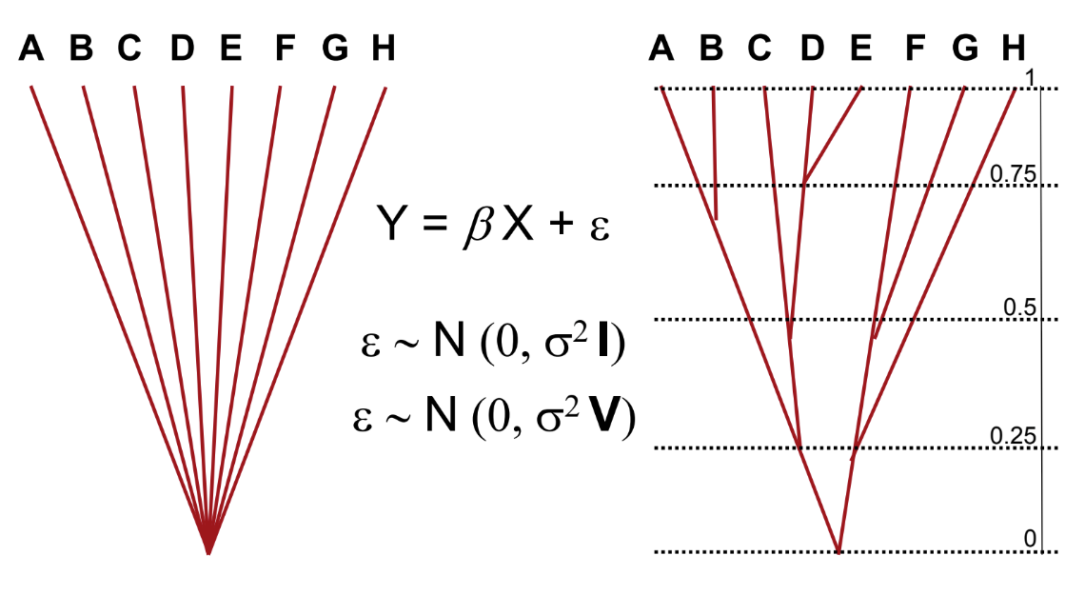
Just like before...multivariate Normal distribution
To define a mvNormal distribution, just need a mean (vector) and a variance (matrix).

Slide 13
Extensions of PGLS
Tree transformations
λ - “non phylogenetic slop” (heritability)
= 1 BM
= 0 No tree structure
κ - Speciatiational
= 1 BM
= 0 Only speciational
δ - Node heights raised/lowered to power of delta
= 1 BM
> 1 Accelerating
<1 Decelerating
Ornstein-Uhlenbeck - We will cover a lot more later!

Slide 14
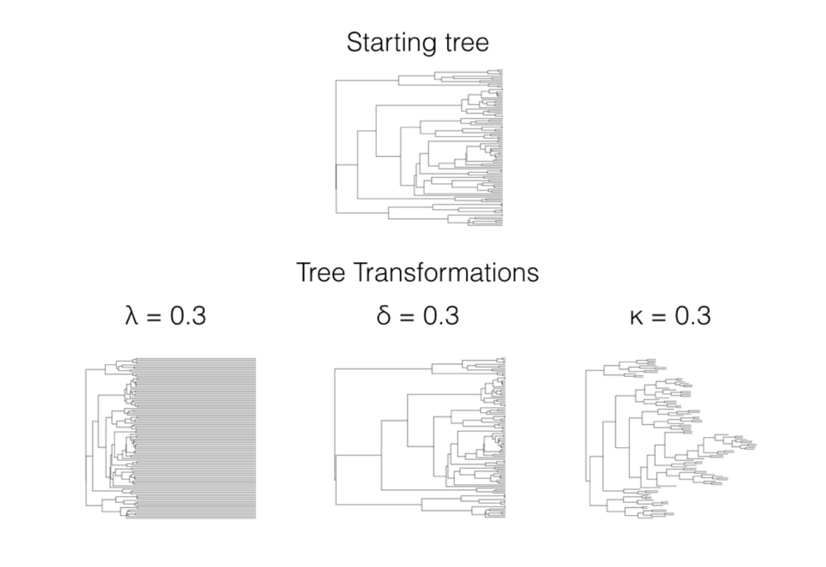
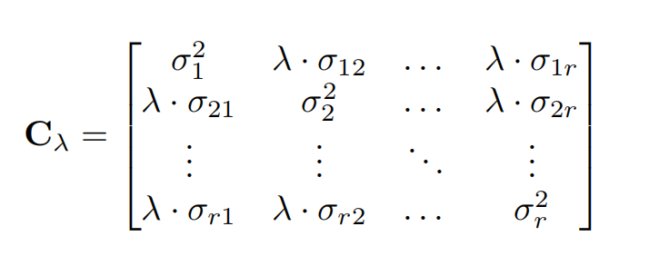
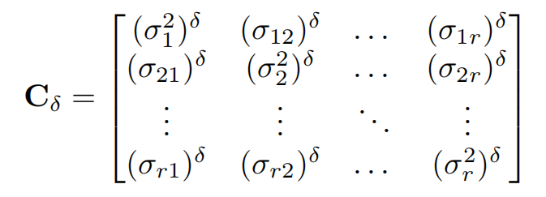
Tree transformations

Slide 15

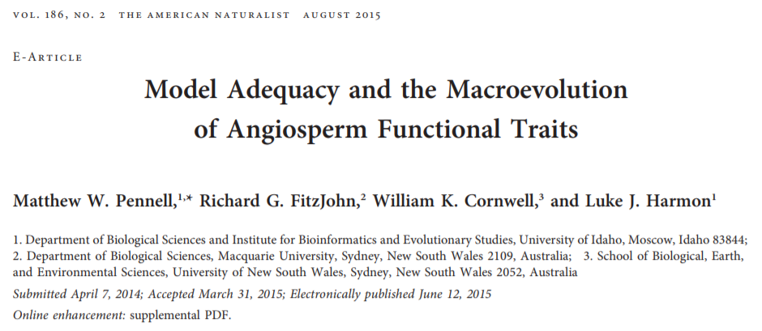
Model adequacy

Slide 16
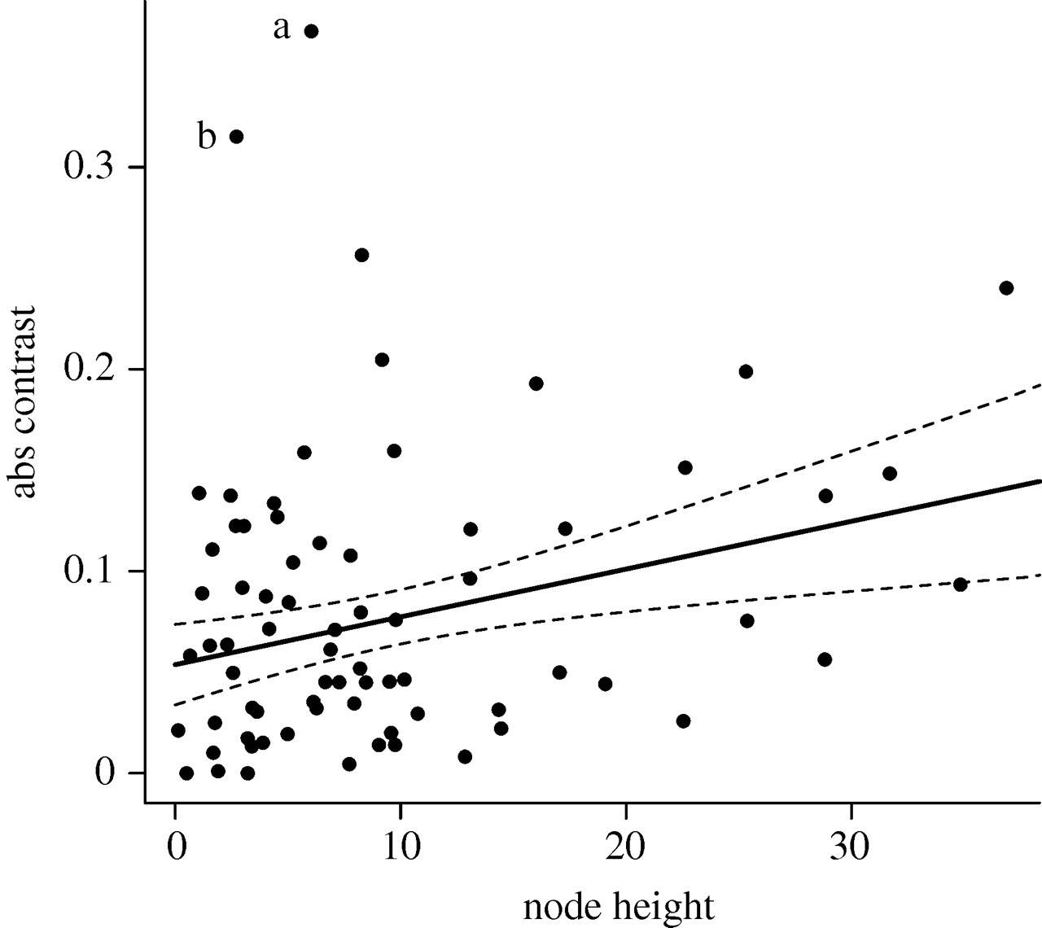
Node-Height test
Slope = 0: BM prediction
Positive - OU-like
Negative - Early burst like
Outliers - Not BM!

Slide 17
What will be the effects if:
You don't have a fully resolved tree?
You have a tree with error?
You have Y values with error?
You have X values with error?

Slide 18
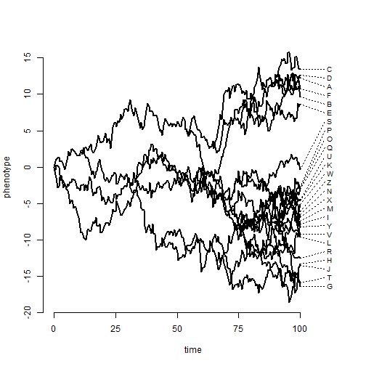
Give me your best estimate of the evolutionary rate (back of the napkin calculation)

