Slide 1
Diversification & SSE models

Slide 2
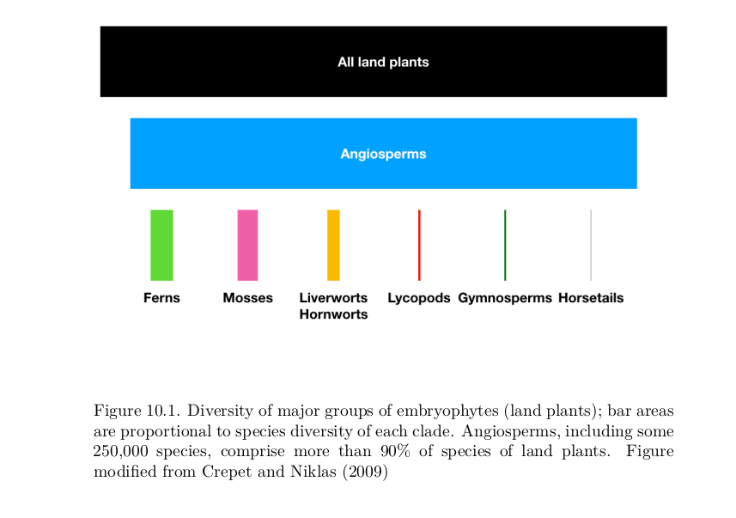
Why care about diversification?
(Harmon, Phylogenetic comparative methods)

Slide 3
Birth-Death model
Poisson process (like CTMC models) - but events = Speciation/Extinction rather than substitution

Slide 4
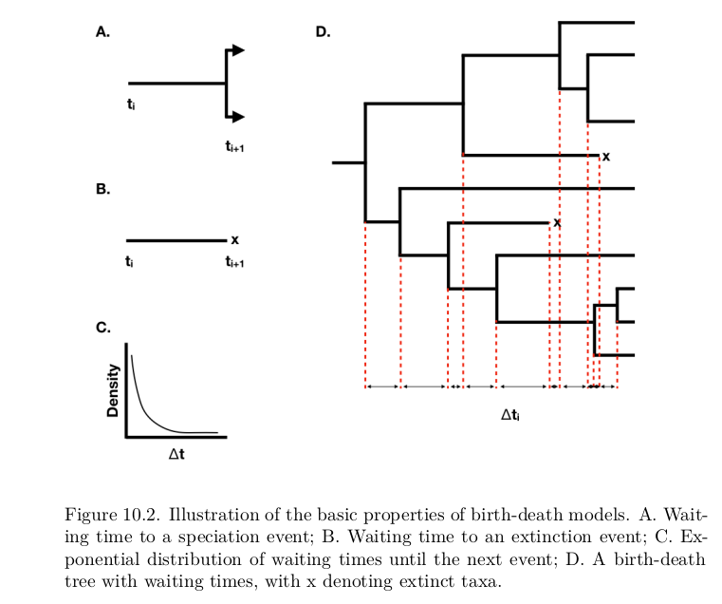
(Harmon, Phylogenetic comparative methods)

Slide 5
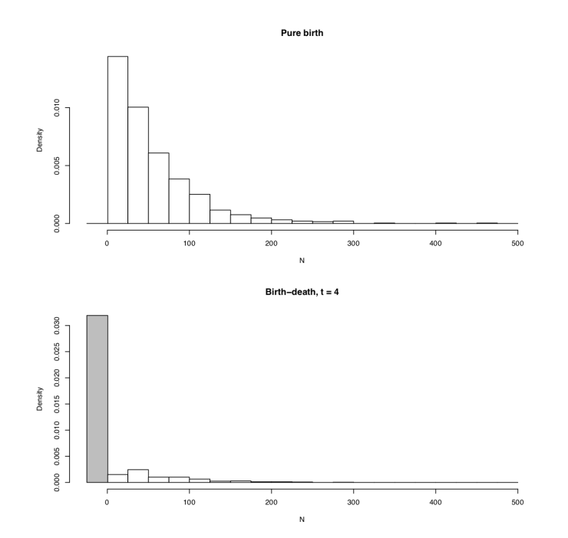
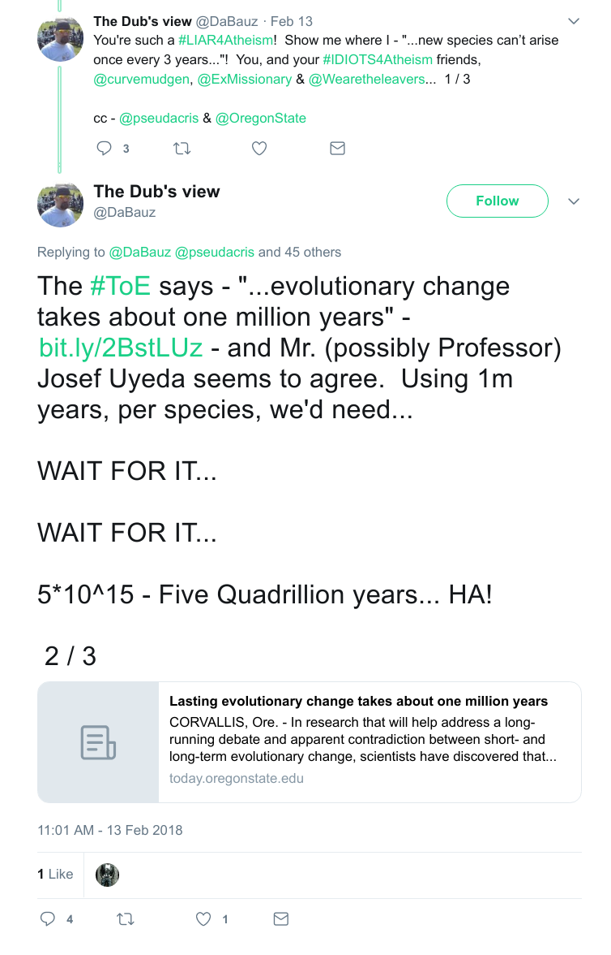
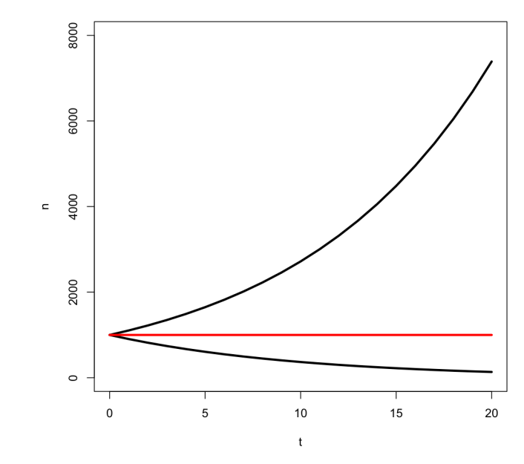


Slide 6
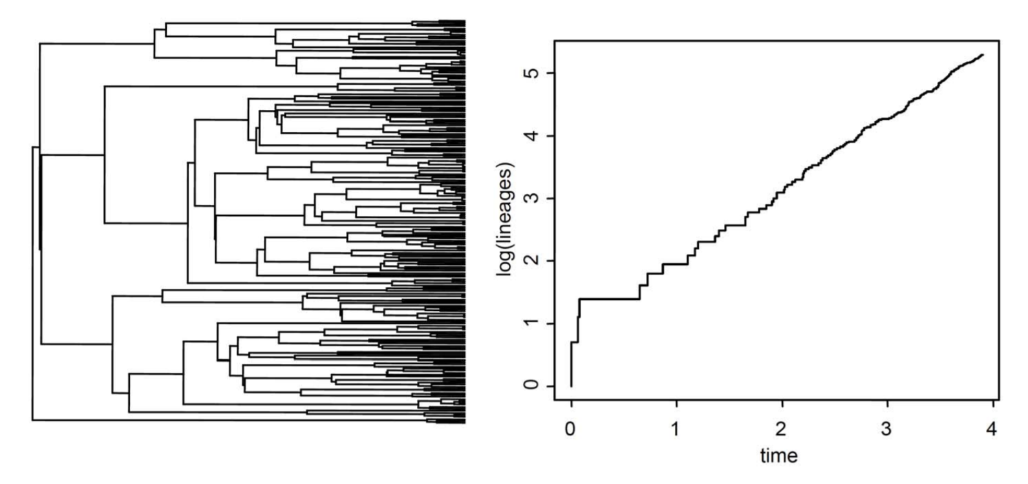
Diversification vs. Turnover
λ =Speciation rate
μ = Extinction rate
λ - μ = Diversification rate
μ/λ = Turnover rate
Yule process/Pure Birth model -> μ = 0
Under pure birth,
lineages accrue
log-linearly with time

Slide 7
A few notes...
Speciation and extinction correlated in nature, and in estimation
Estimating diversification and turnover often easier
Can we even estimate extinction from extant-only data?

Slide 8
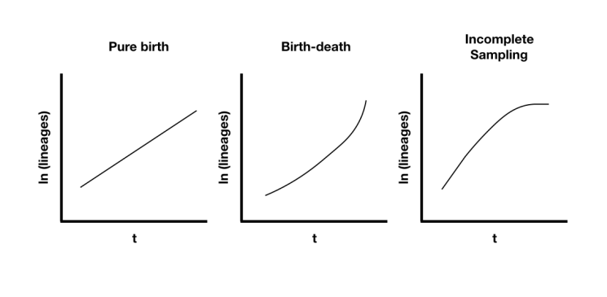
Lineage through time plots

Slide 9
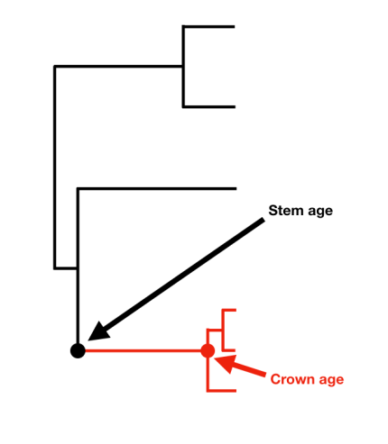


Estimating diversification
Net diversification methods using clade age & diversity (can be used on unresolved trees)
Magallon & Sanderson, 2001

Slide 10
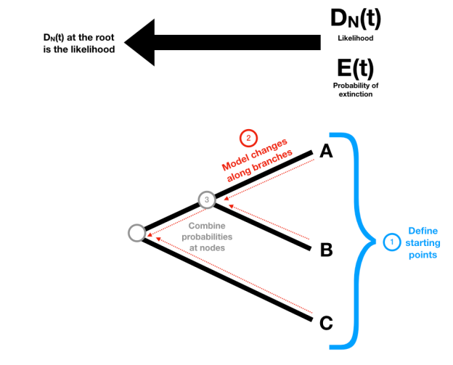
Estimating diversification
Using the distribution of branch lengths/waiting times (requires whole tree or partial tree and assumptions about sampling)

Slide 11
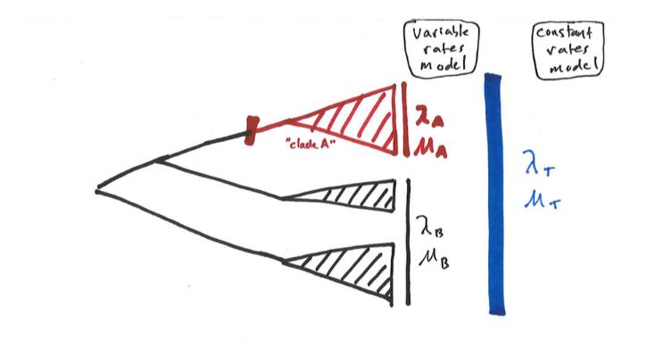
Modeling heterogeneity in diversification
Hypothesis testing

Slide 12
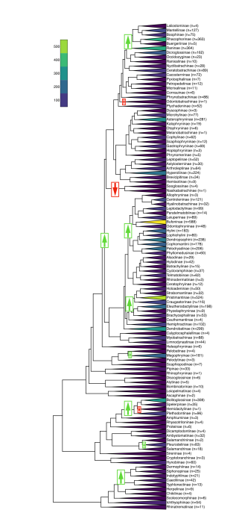
“Phylogenetic Natural History” methods
Bayesian - BAMM (But see controversies)
Likelihood (Stepwise AIC) - MEDUSA (but see problems with stepwise AIC)

Slide 13
Other active areas of research:
Incorporating fossils & sampling
Diversity-dependent diversification
Time-varying diversification
Protracted Speciation
Neutral theory (Hubbell) from ecology
Trait-dependent diversification

Slide 14
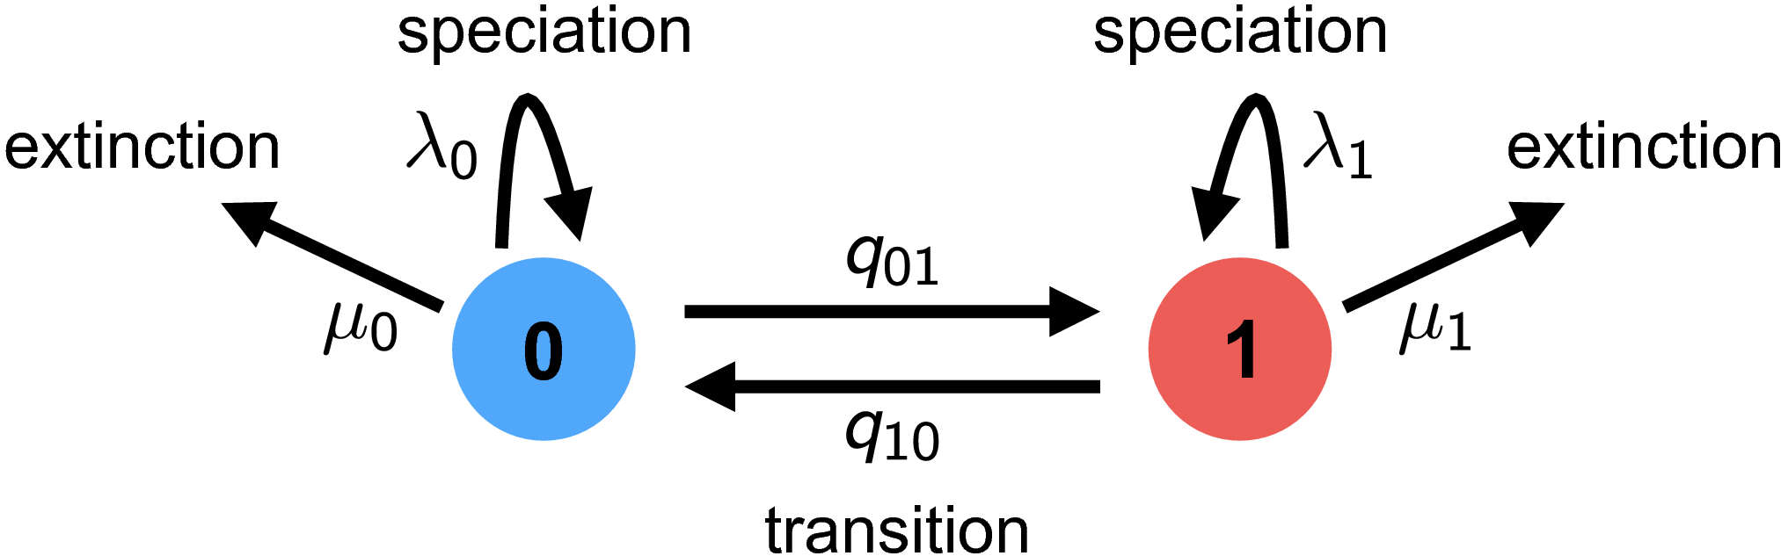
Trait-dependent Diversification
Species Selection (sometimes species sorting)

Slide 15
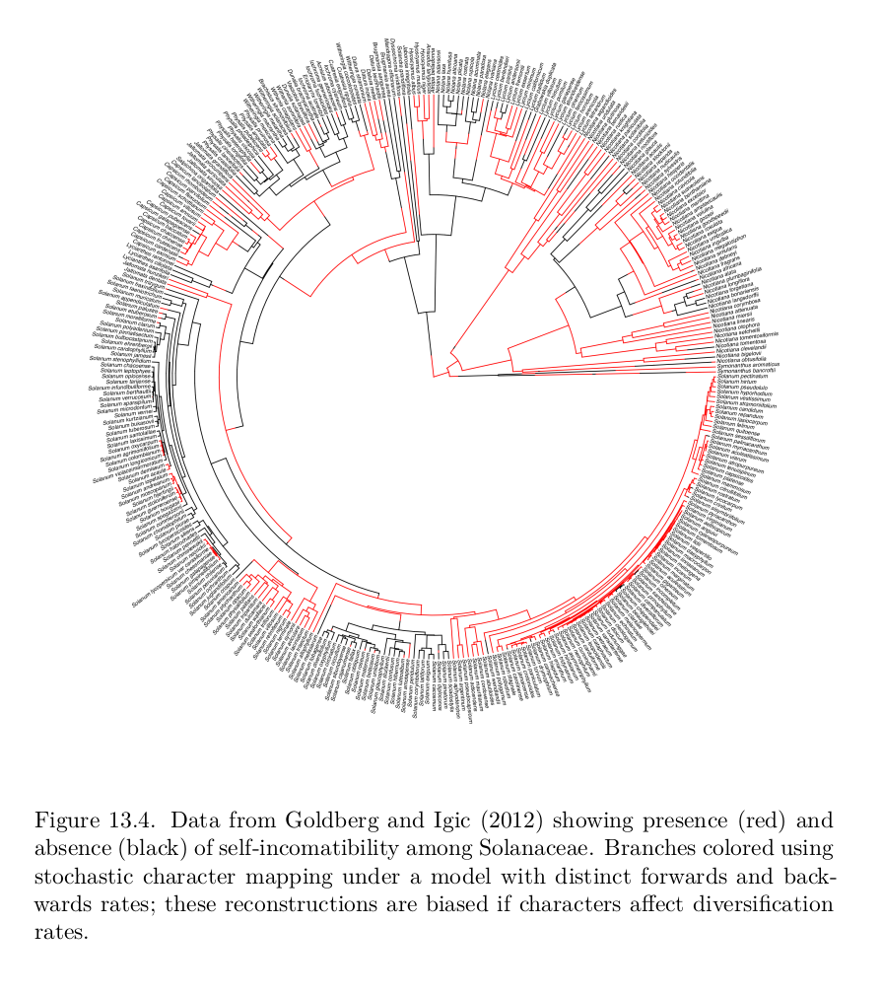
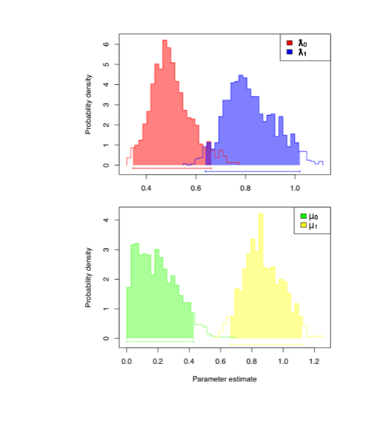
Why important?
Ancestral state reconstructions biased with trait-dependent diversification!

Slide 16
Example:
Self-incompatibility in plants: Prevents selfing
Equal distribution but...
Selfing results in higher speciation rates AND higher extinction rates
Ancestor more likely SI than SC

Slide 17
The SSE family of models
Trait models:
BiSSE: Binary State-dependent Speciation and Extinction (extensions for incompletely resolved trees)
MuSSE: Multiple SSE
QuaSSE: Quantitative SSE (but slow)
Models where something special happens at nodes:
GeoSSE: Geographic SSE (DEC + SSE)
BiSSE-ness/ClaSSE: Cladogenetic SSE
Hidden-state models that account for background heterogeneity:
HiSSE: Hidden-State SSE (Solution to problem pointed out by Rabosky and Goldberg)
GeoHiSSE: Geographic Hidden-State SSE

Slide 18
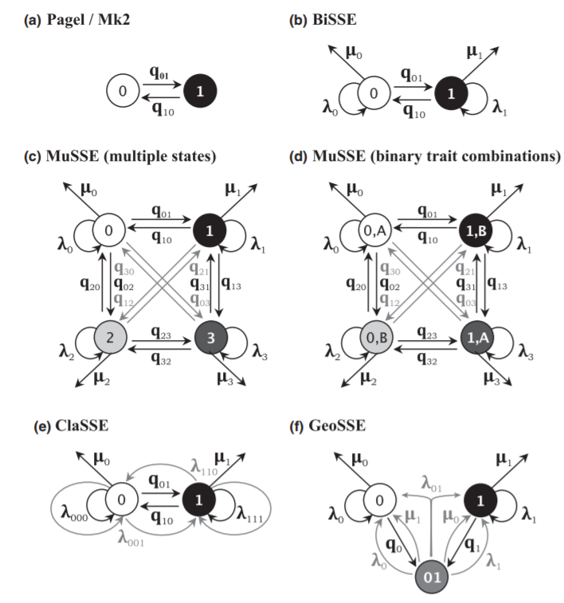
Ng & Smith 2014, Journal of Evolutionary Biology

Slide 19
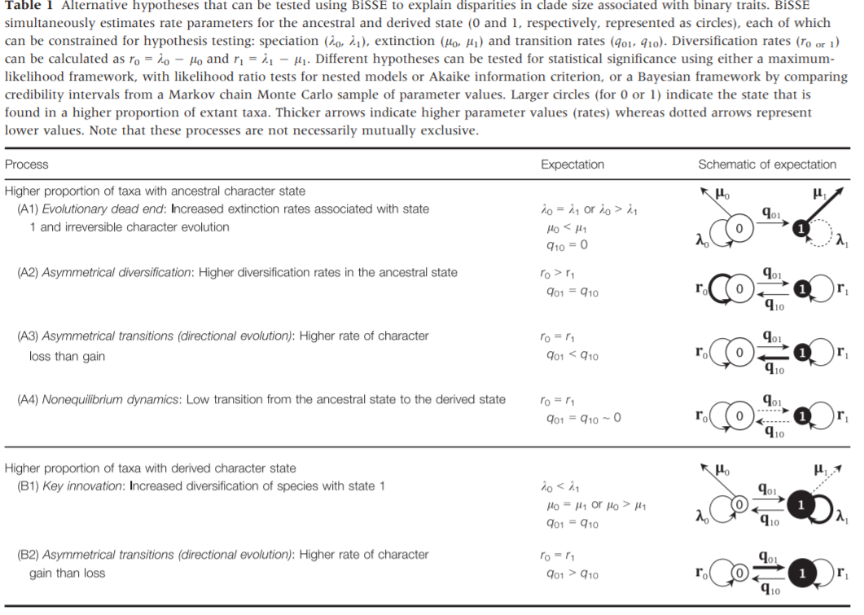
Ng & Smith 2014, Journal of Evolutionary Biology

Slide 20
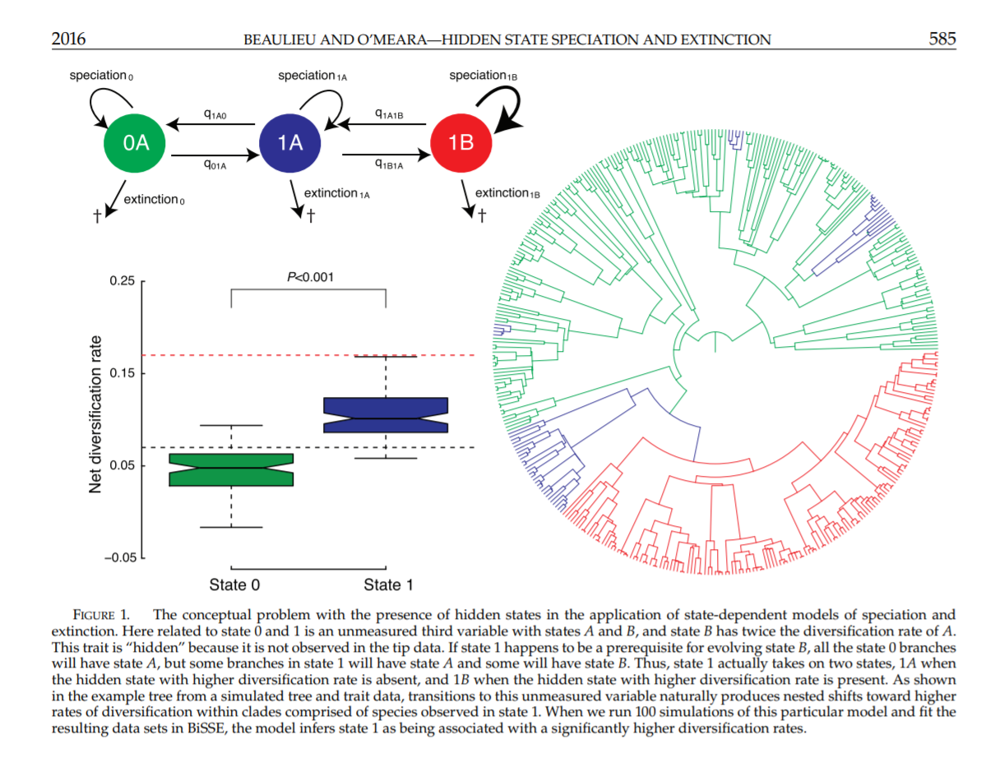

Slide 21

Next time: Diversitree lab

