Slide 1
Alignments
Another (often) hard problem!
1 ACCGAATATTAGGCTC
2 ACATAGTGGGATC
3 AAAGGCATTAGGATC
4 GAAGGCATTAGCATC
5 CACGAAGGCATTGGGCTC
1 ACCGAAT--ATTAGGCTC
2 AC---AT--AGTGGGATC
3 AA---AGGCATTAGGATC
4 GA---AGGCATTAGCATC
5 CACGAAGGCATTGGGCTC

Slide 2
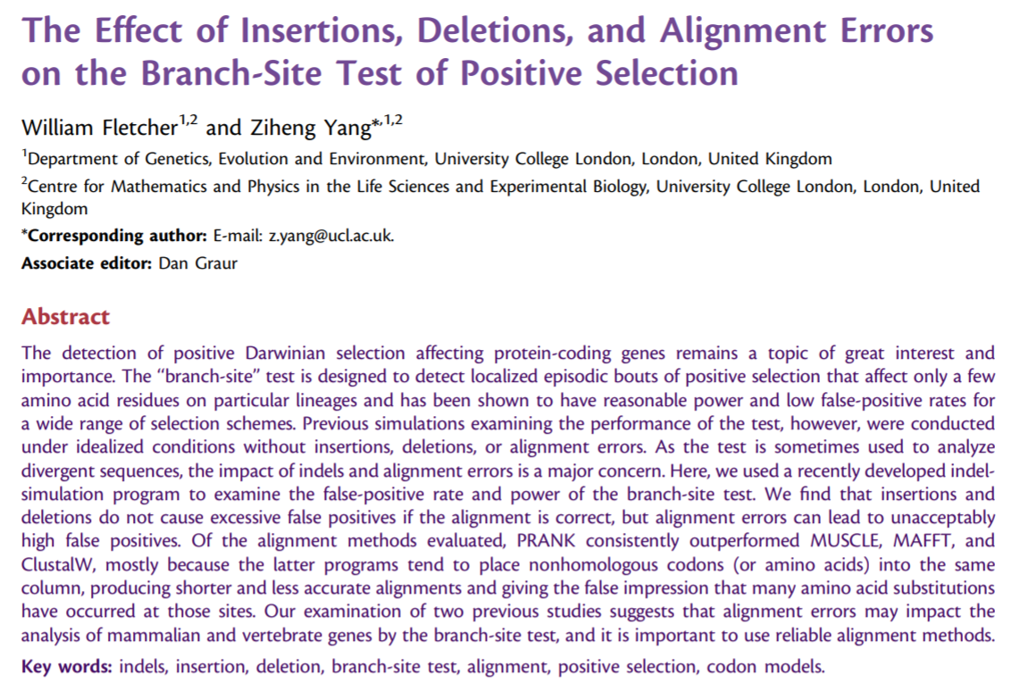
What if you get it wrong?

Slide 3
1 ACCGAAT--ATTAGGCTC
2 AC---AT--AGTGGGATC
3 AA---AGGCATTAGGATC
4 GA---AGGCATTAGCATC
5 CACGAAGGCATTGGGCTC
Knowing the tree will help you figure out the most likely alignment

Slide 4

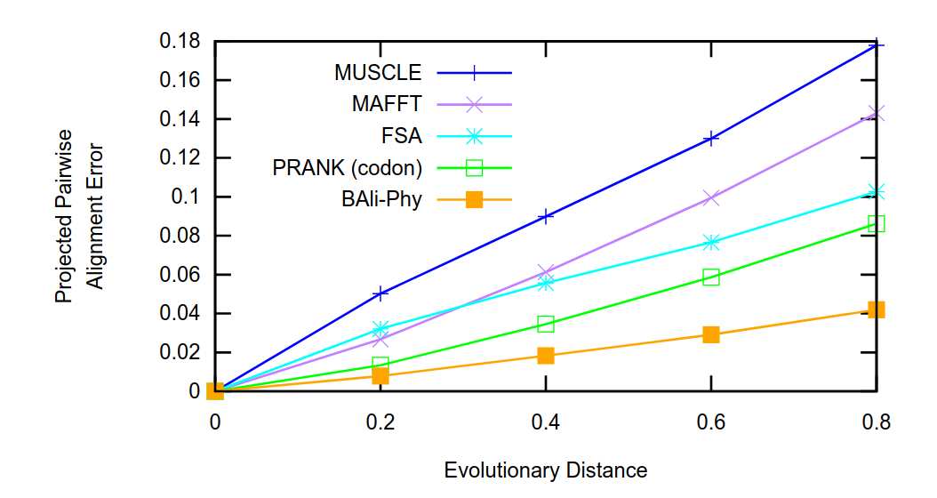
Best approach: Estimate alignment & phylogeny simultaneously
Hard problem x Hard problem = :'-(

Slide 5
Measuring support: Bootstrap, jacknife, posterior probability
Bootstrap: Sample sites in your alignment with replacement, reanalyze each time
Jacknife: Randomly delete sites in your alignment, reanalyze
Posterior probability: Falls out naturally from a Bayesian analysis, probability of a split occuring given the data

Slide 6
Model selection, Model adequacy & Hypothesis testing

Slide 7
Model selection & hypothesis testing: Of my set of models, which one is best?
Can I reject one hypothesis in favor of another?
Model adequacy: Is this model a good description of the data

Slide 8
Model selection

Slide 9
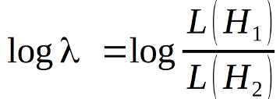
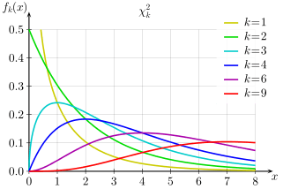
Likelihood ratio tests
Models must be nested (hierarchical)
As sample size approaches
infinity:
-2 ln λ ~ Chi-Square(p₂ - p₁)

Slide 10
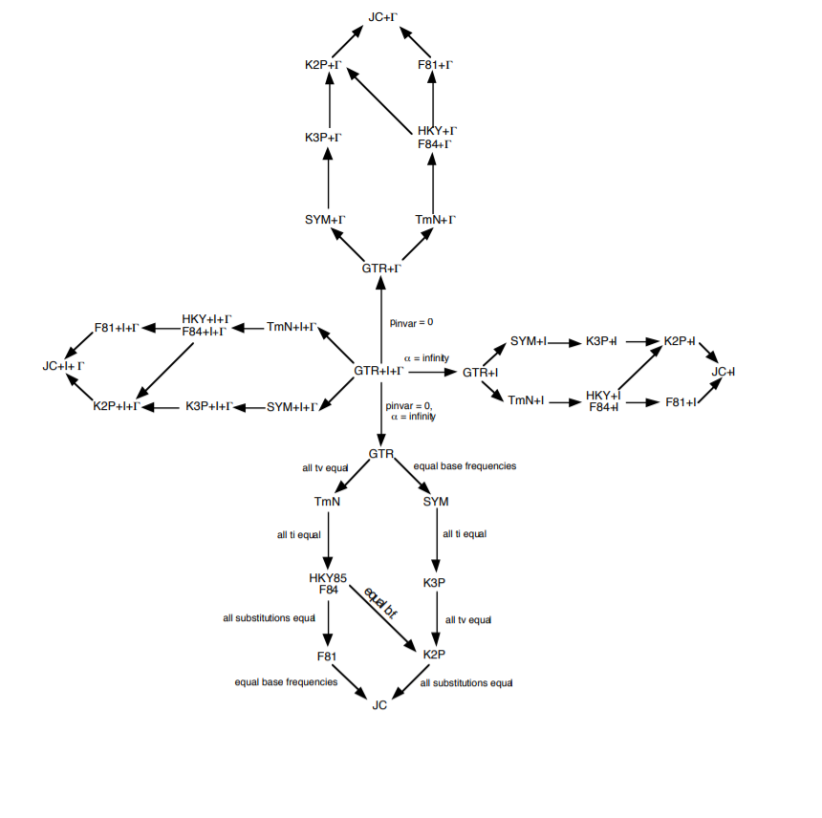

Slide 11


Information theory
Akaike Information Criterion (Approximates Kullback-Leibler Divergence asymptotic result, small sample size correction available.)
Bayesian Information Criterion
Relative fit for a given dataset
Others: Deviance Information Criterion, Focused Information Criterion etc.

Slide 12
Information theory
Minimize loss of information by maximizing relative goodness of fit while penalizing model complexity
BIC penalizes more heavily, AIC will usually find more heavily parameterized models

Slide 13
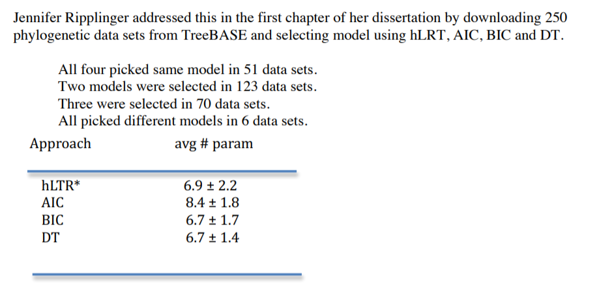

Slide 14
What is sample size in phylogenetic datasets?

Slide 15
ML hypothesis testing
Hypothesis: Are archaea monophyletic?
H1: No constraints on topology H2: Constrain archaea to be monophyletic Compare with a model selection (AIC, BIC, hLRT)
Reward ↑ likelihood, penalize ↑ # of parameters

Slide 16
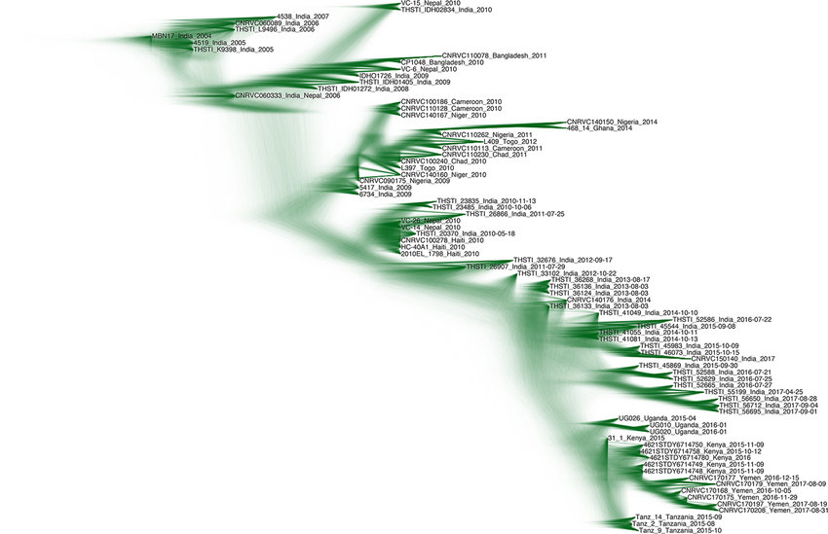
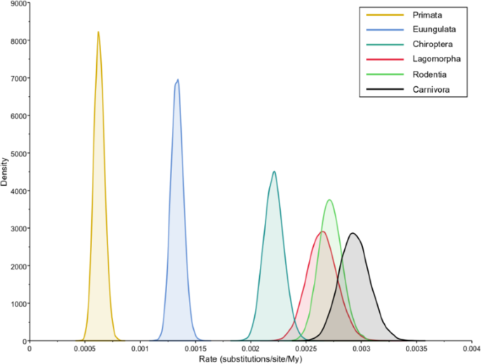
Bayesian hypothesis testing
Often stupidly easy! Just check your posterior distribution.
Posterior probability is the hypothesis test.

Slide 17
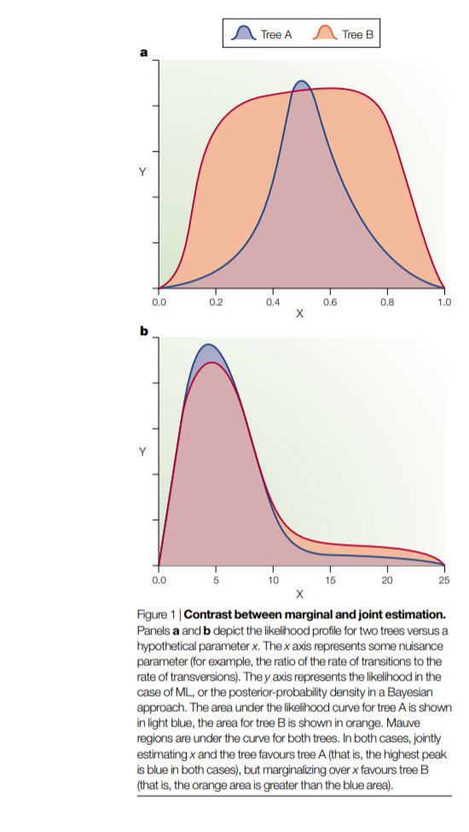
Marginal vs. joint estimation
Example: Ancestral state reconstruction
Joint reconstruction: Set of internal nodes that together have the single highest likelihood.
Marginal reconstruction: For a focal node, marginalize over all possible reconstructions and find the mostly likely state of each node individually.
-> Nuisance parameters
Holder & Lewis 2003

Slide 18
Frequentist model selection: Which model has the highest likelihood for one possible scenario that the model allows.
Bayesian model selection: Which model has the highest marginal likelihood over all possible worlds the model allows -> prior sensitive because prior determines what worlds are allowed!

Slide 19
Bayesian Model Selection
A job needs done, and I want to know what tools are needed to do it as efficiently as possible
Model 1: I give Joel a hammer
Model 2: I give Frank a screwdriver
Model 3: I give Ignacio an entire toolshed
Who will find a better tool for the job?

Slide 20
Bayesian Model Selection
A job needs done, and I want to know what tools are needed to do it as efficiently as possible
Model 1: I give Joel a hammer
Model 2: I give Frank a screwdriver
Model 3: I give Ignacio an entire toolshed
Who will finish the job first?

Slide 21
Because the questions are different, we aren't as concerned about overfitting in Bayesian models, because we are marginalizing over parameters, rather than searching them for the best possible combination

Slide 22
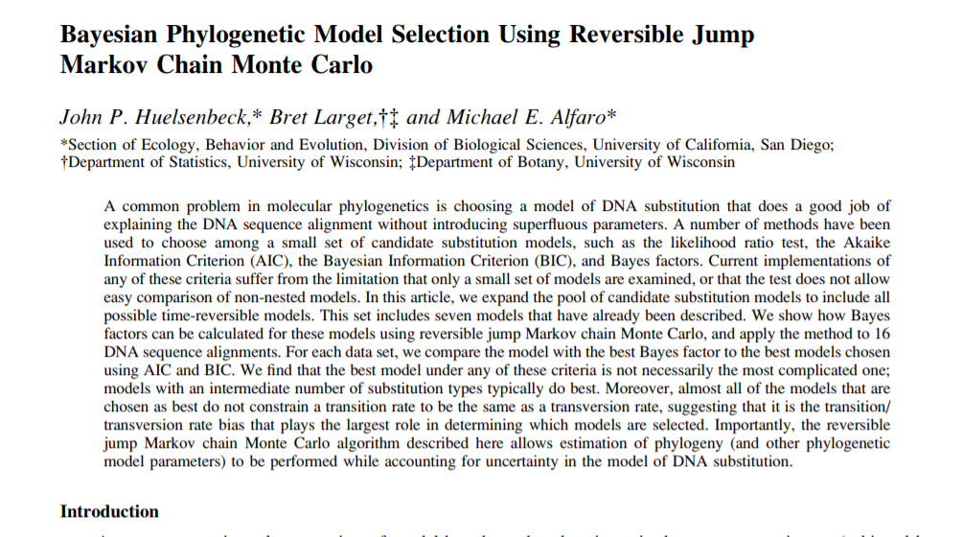
Reversible-Jump MCMC

Slide 23
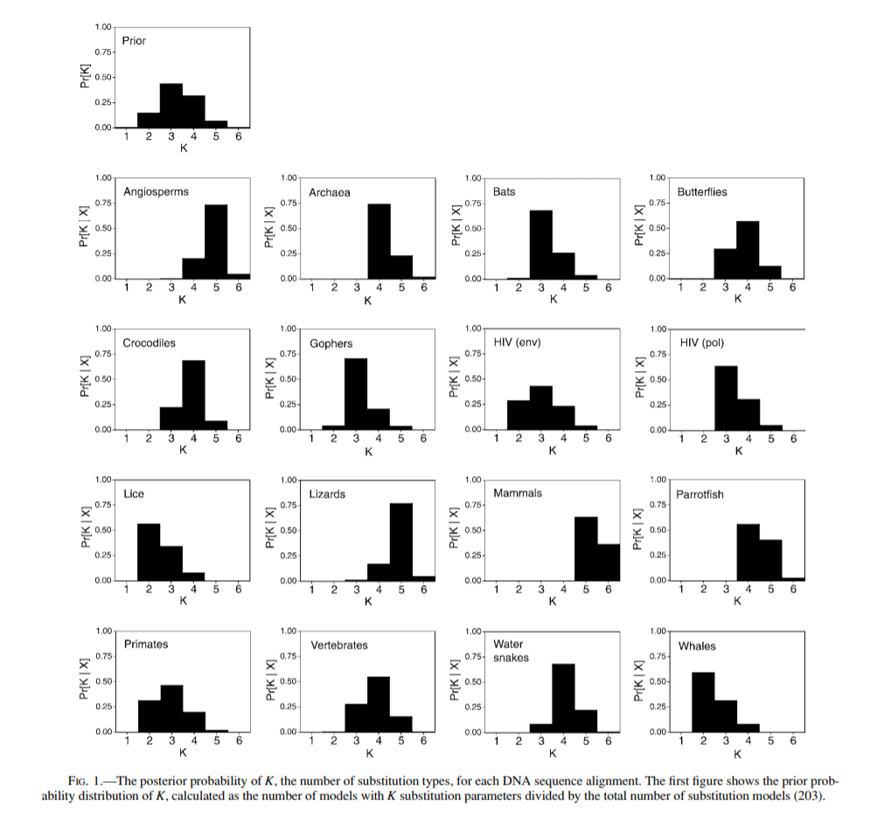

Slide 24
Model Adequacy

Slide 25
Relative vs. absolute goodness of fit
Best model may still be bad!
We want a model that adequately describes the data generating process.
Frequentist solution: Parametric bootstrap
Bayesian solution: Posterior predictive simulation

Slide 26
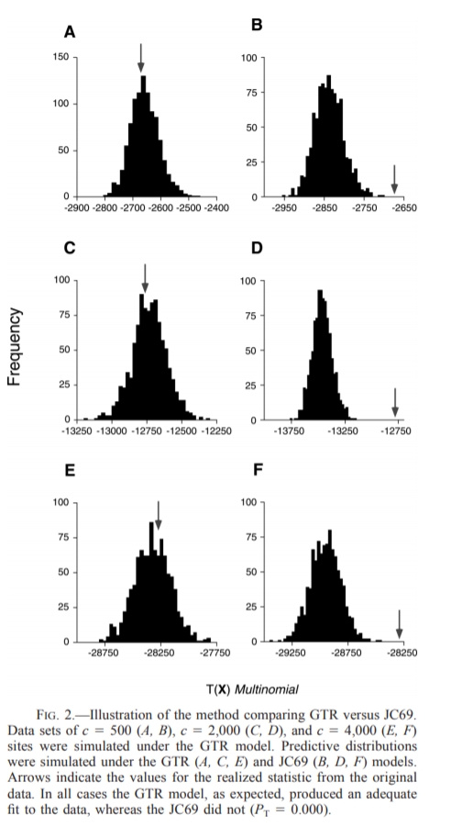
Basic idea:
Estimate parameters (either ML estimate or posterior distribution)
Simulate data using parameters
Calculate a test statistic seeing if the model predicts “similar” datasets to your original
Compare to summary statistic measured on empirical data

Slide 27
What test statistic should be used?
good question...

Slide 28
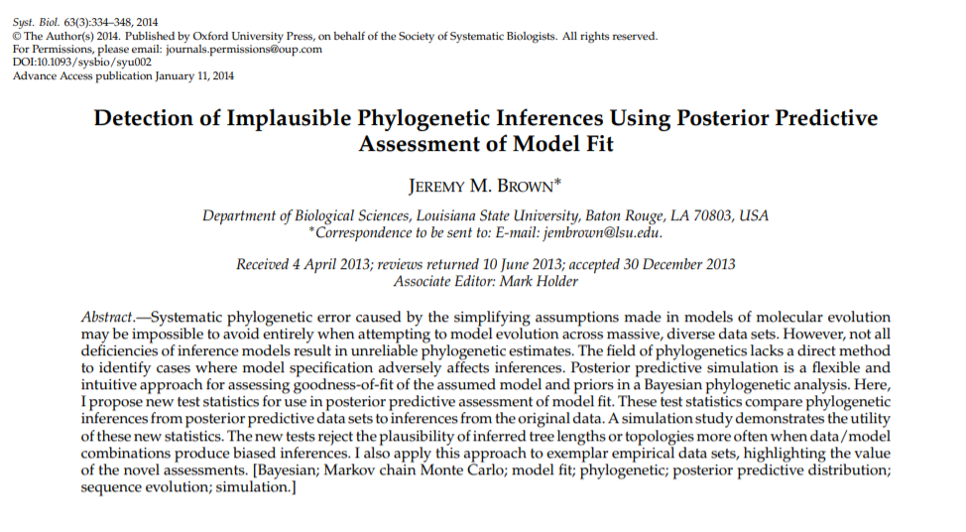

Slide 29
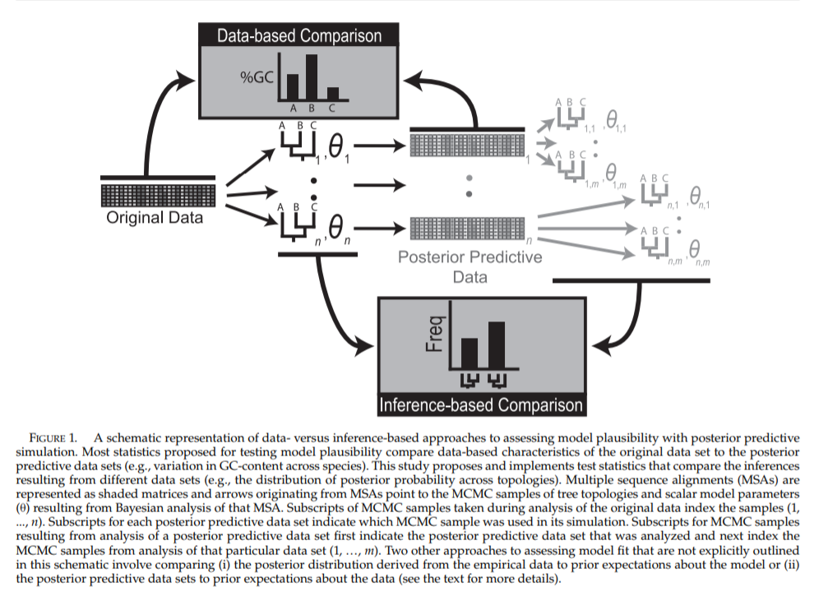

Slide 30
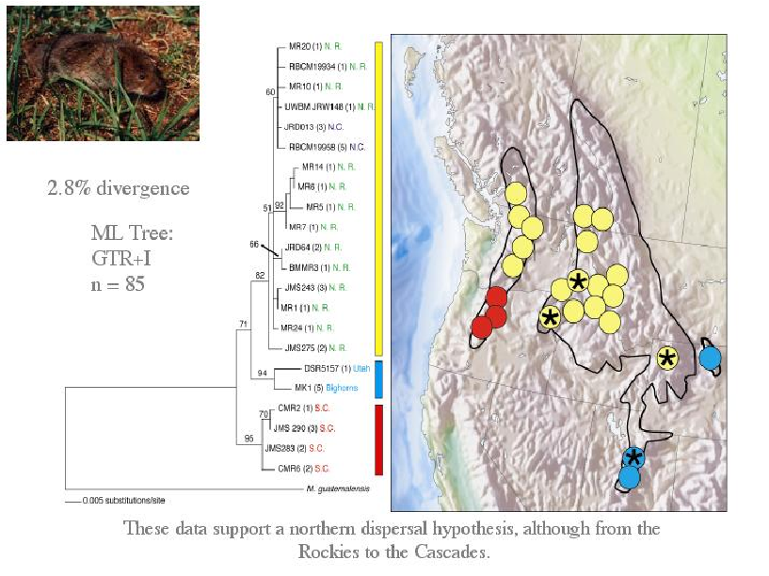
Example:

Slide 31
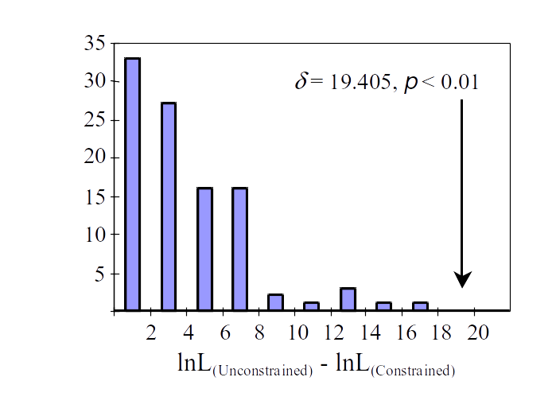
Run parametric bootstrap

Slide 32
Summary
Model selection using relative goodness of fit (hLRT, AIC, BIC, DT) common, useful
Often, we want absolute goodness of fit, which can be evaluated with simulations (e.g. parametric bootstrap, posterior predictive simulation), cross-validation etc.
Bayesian vs. Likelihood approaches can be very similar, but ask different questions, leading to differences in response to model complexity.
All models are wrong, targeting our inferences with hypothesis testing is useful.

