Slide 1
The ‘why’ and ‘how’ of using spike-ins for sequencing analysis
Liz Ing-Simmons
2016-02-16

Slide 2
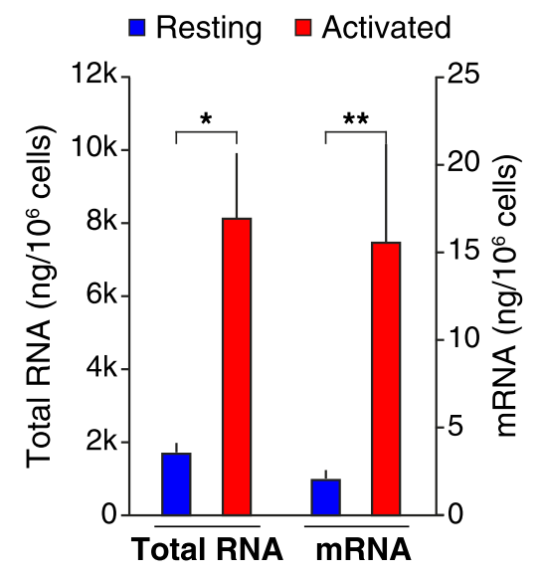
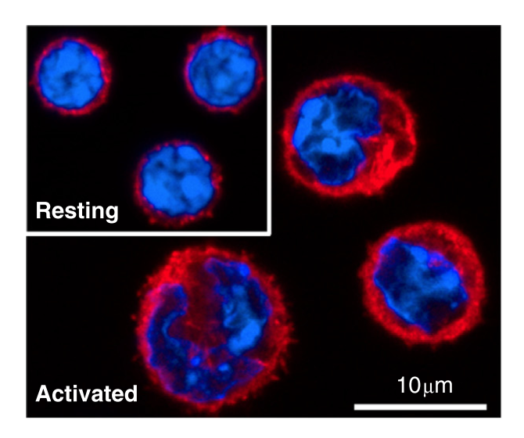
The problem
Activated B cells increase in size
Larger → more RNA!
(Kouzine et al, Cell, 2013)
Notes:
The problem: this shows resting and activated B cells – nucleus is blue, cytoplasm red
resting B cells don’t have much transcription – activated by signals, transcribe and divide
lots more RNA – pretty much every transcript increases

Slide 3
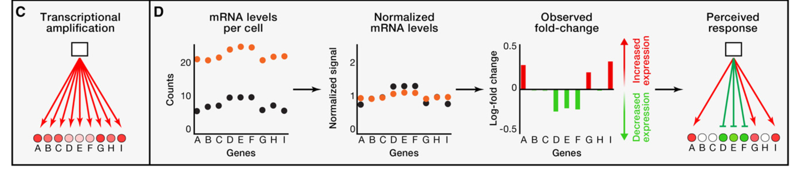
The problem
Another example:
Myc can amplify global gene expression
Differential expression analysis assumes that most genes don’t change expression
Inaccurate results if this assumption isn’t true
(Loven et al, Cell, 2012)
Notes:
Another example of this kind of global amplification is the effects of Myc – e.g. in cancer cells, thought t globally amplify transcription
so if you have RNAseq data from cells with and without myc overexpression, or before and after B cell activation
and you use typical normalisation methods
you’ll get something like this – only the relative changes in abundance of transcripts
this might be all you want, and that’s okay – but if you want to detect the global amplification, you need to do something else

Slide 4
A solution: normalise to the number of cells
Usually use equal amounts of mRNA for sequencing
Not always the same number of cells
Add something in a fixed ratio to the number of cells
Can also help to normalise for technical variation in library prep / sequencing
Notes:
One solution is to normalise your RNAseq to the number of input cells
usually, experiments use equal amounts of RNA from each sample for sequencing – but this may be diff numbers of cells
so add something, in a known fixed ratio to the number of cells (need to count the cells)
if you add it early in the process it can help account for variation in library prep – if one has lower reverse transcription efficiency, e.g.

Slide 5
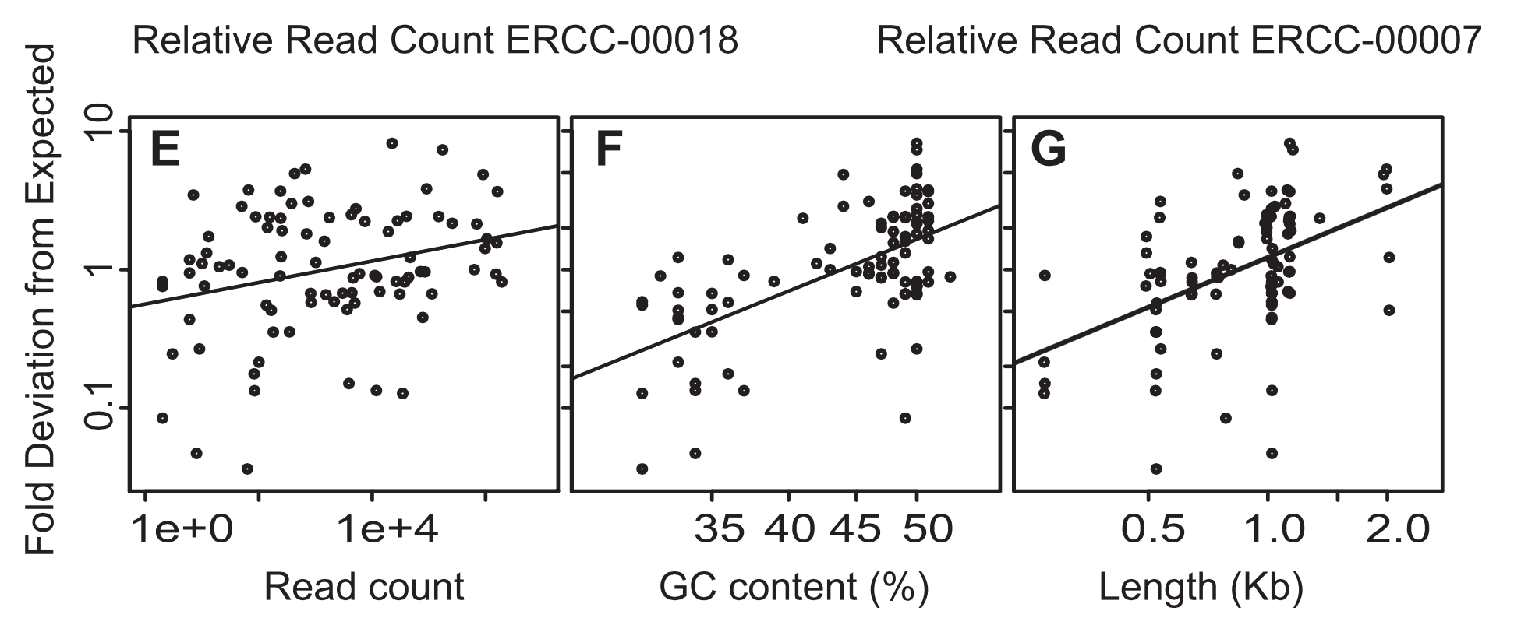
Spike-ins for RNA-seq
External RNA Controls Consortium (ERCC) produces a set of 92 standard RNAs
Mix 1 and Mix 2 with varying concentration
true positive differential expression controls
(Jiang et al, Genome Research, 2011)
Notes:
What people usually use for RNAseq experiments is a set of 92 RNAs from the ERCC
they have a range of GC content, length, and a range of different concentrations within the mix – some only one copy per cell, some thousands
you can also get two mixes with the same RNAs in diff concentrations, use for comparison experiments – gives known changes of expression in known ratios

Slide 6
A simple example analysis
Raw reads
B cell activation (Kouzine et al, 2012)
mm9
spike-in
sequences
Calculate copy number per cell
Count reads
Thanks due to Wolfgang Resch for providing the spike-in analysis code used in Kouzine et al.
Notes:
I’m going to show a really simple overview of an analysis I was asked to do on the data from this paper, from before and after B cell activation
We were interested in finding out how a particular gene changed in terms of copy number per cell
align → count reads per ‘transcript’
calculate copy number per cell according to what was added to experiment
plot – something like this. for activated, in red, same copy number gives lower RPKM – because more other RNA
once you have this info, can use to calculate copy numbers per cell for mouse transcripts

Slide 7
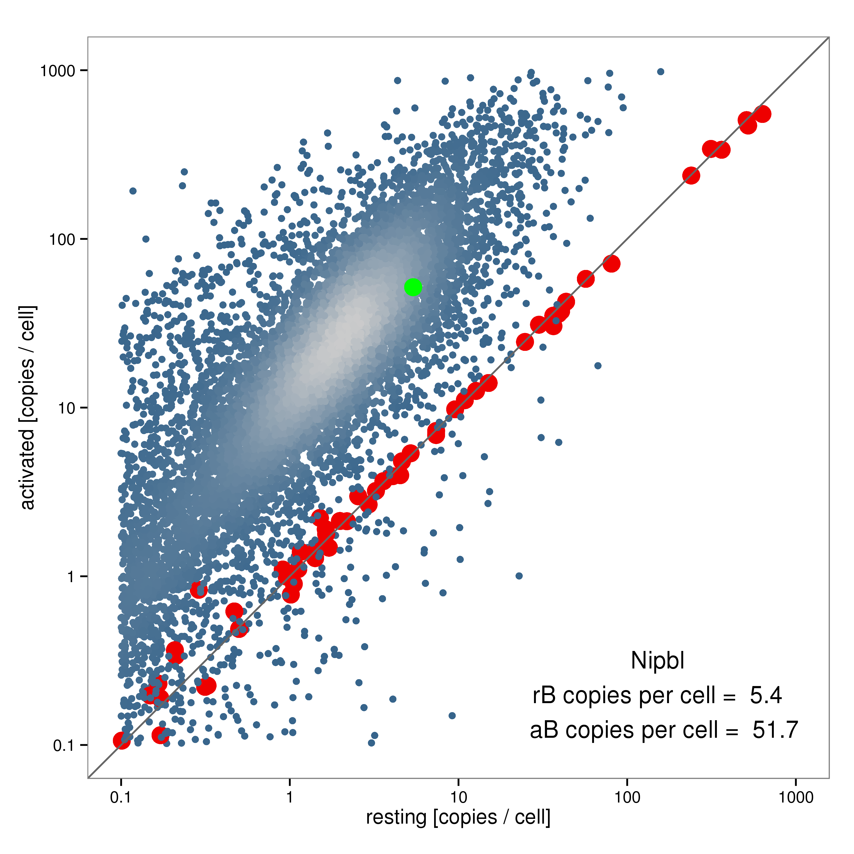
A simple example analysis
Spike read count
Spike copy number
per cell
Linear model
lm(log10(known copy number) ~
log10(RPKM) + cell,
data = counts)
mm9
genes
Gene copy number per cell
Compare samples
Thanks due to Wolfgang Resch for providing the spike-in analysis code used in Kouzine et al.
Notes:
once you have this info, can use to calculate copy numbers per cell for mouse transcripts
using a linear model
in this case just lm() in R – model accounting for cell type – just standard lm, more sophisticated fitting is possible
apply to transcripts data
plot
my gene of interest is green – pretty similar to the bulk of the genes

Slide 8
Notes to consider
Variable detection at low concentrations is normal
Make sure you treat spikes and transcripts in the same way (e.g. low expression removal)
Replicates are (as always) important!

Slide 9
Caveats
Assumption: biological and technical effects should affect the spike-ins in the same way as they do the genes
Example:
variable mRNA proportion between treatment/control leads to variation in spike fraction (Munro et al, Nature Communications, 2014)
See also Risso et al, Nature Biotech, 2014
suggest using a set of stable genes to remove unwanted variation (RUV)
Notes:
Extension: GC content effects?
RUV – can use more genes than the 92, more reliable model

Slide 10
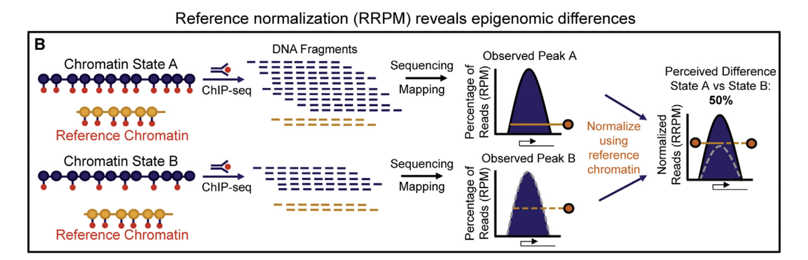
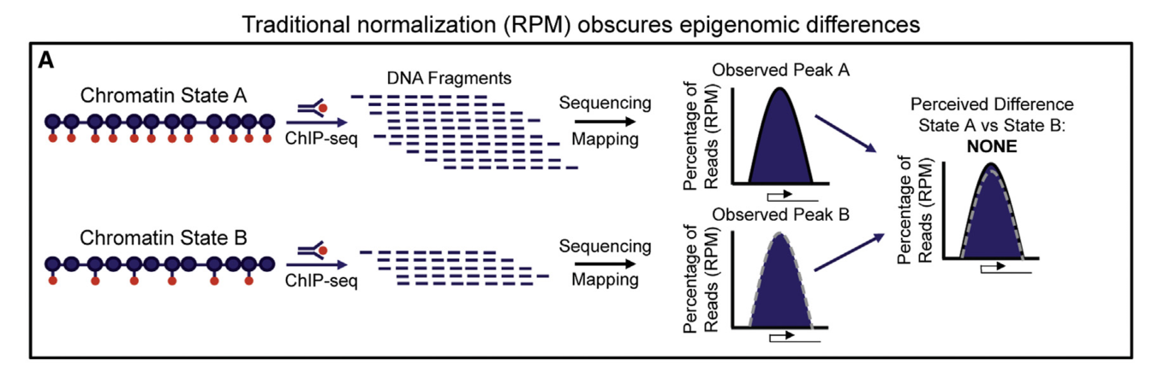
Other applications of spike-ins
ChIP-seq
Global changes can be caused by e.g. histone methyltransferase knockout / inhibition
Add foreign chromatin recognised by same antibody
(Orlando et al, Cell Rep., 2014)
Notes:
global changes can be caused by drug treatment or knockout of a modifier
if normalise to total reads will miss changes in height only
if normalise to reference can see changes
note that need chromatin recognised by same antibody, but DNA not too similar – human/mouse, human/Drosophila
add early to account for IP efficiency, etc (but need to sonicate first…)

Slide 11
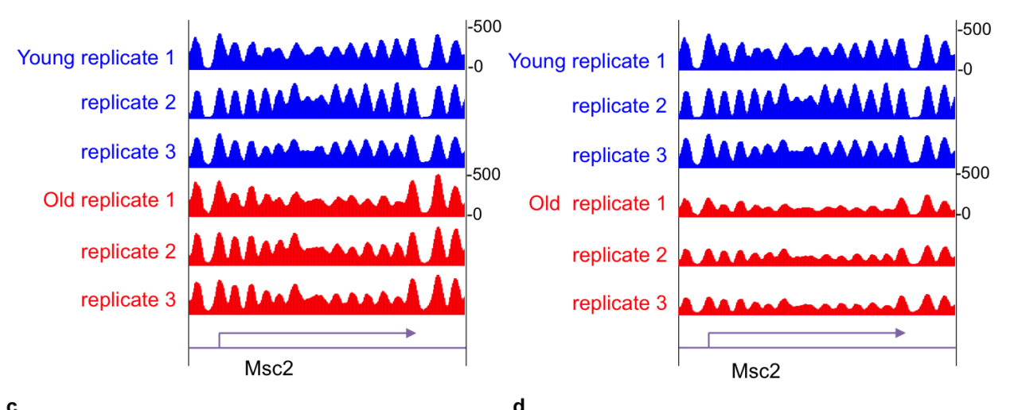
Other applications of spike-ins
MNase-seq
Yeast aging leads to global loss of histones
Not detectable without spike-in normalisation
Controls: amplified bacterial DNA sequences of comparable length
(Chen et al, MCB, 2015)
Notes:
can also be used for Mnase
one lab found that yeast had lower levels of histones when aged
but Mnase-seq showed no differences, until they used a spike in to normalise

Slide 12
Summary
Spike-ins can correct for global changes in transcriptome / epigenome
92 ERCC RNA standards for RNA-seq
two mixes for differential expression
Different species chromatin for ChIP-seq
Assumption: spike in and endogenous sequence are similarly affected by technical / biological variation

